Slide 1
Understanding Opportunities for Learning Mathematics
Anne Watson
Fields MathsEd Forum
March 25th 2023

Slide 2
Design (1962)
How could a set of examples, and the associated pedagogy, and the classroom climate, be constructed so that ‘discovery’ can be exciting, validated, meaningful and maybe even central to a lesson? (2000)

Slide 3
Polya: How to solve it
Mason, J., Burton, L., & Stacey, K. (1985).Thinking Mathematically. Addison-Wesley.
Sierpinska (1994) Understanding in Mathematics
Dyrszlag, Z. (1984) Sposoby Kontroli rozumienia pojec matematycznych. Oswiata i Wychowanie, 9(B)
What am I doing when the book says ‘mulling’?
Wow! This is how I am thinking when ‘mulling’

Slide 4
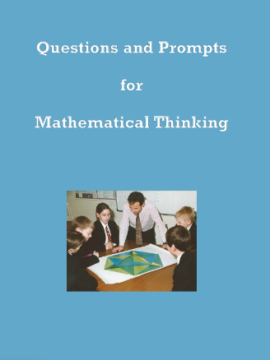
Watson & Mason, 1998

Slide 5
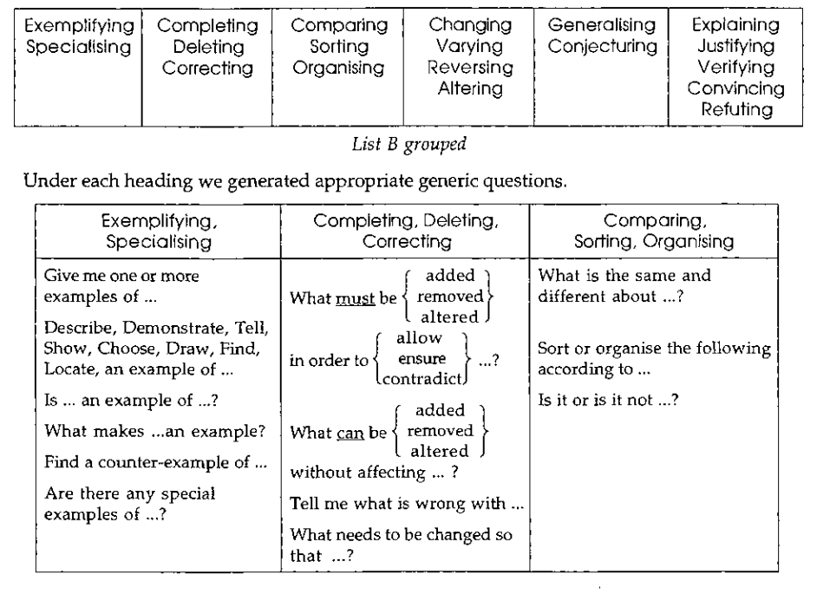

Slide 6
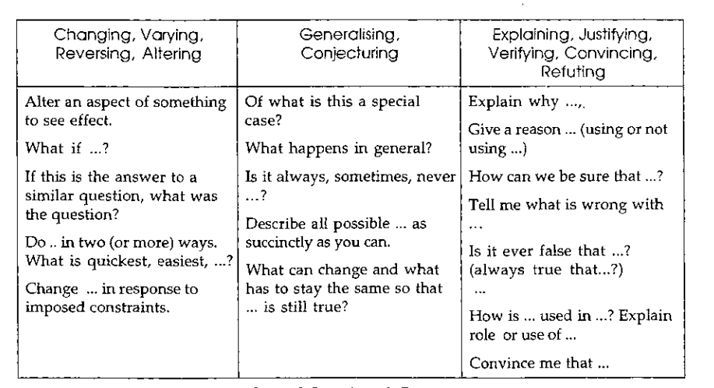

Slide 7
How could a set of examples, and the associated pedagogy, and the classroom climate, be constructed so that ‘discovery’ can be exciting, validated, meaningful and maybe even central to a lesson? (2000)
Notes:
My research – looking for evidence of how teachers recognised the mathematical nature of what learners said, wrote or did
standard mathematics test questions are limited, and limit mathematical awareness
social interactions are likely to be biased in various ways
When and where and how can conceptual realisations be an integral aspect of lessons?
My research insights from classroom observation of teachers - what is available for me to see, hear, read, do, say and learn in this lesson?

Slide 8
What is available for me to see, hear, read, do, say and learn in this lesson?

Slide 9
Exemplification
Teacher led
Learner generated
Notes:
Such moments and lessons are always engineered by juxtaposing examples in sequence, by contrast or in relationships – whether they were planned or generated by teachers or task/lesson designers or by learners who are exploring and investigating

Slide 10
Variatio est mater studiorum (2000) Marton & Trigwell
What varies? What stays the same? How do these elements relate?

Slide 11
The new car syndrome
Yizhu Liu (ICME 2004) Compare –2.5 and |–2.5|
Tuckey (1904): Multiply each of the terms in the top row by each of the terms in the bottom row in pairs:
x – 1 x + 1 x + 2 x + 3
x – 1 x + 1 x + 2 x + 3

Slide 12
Tuckey (1904)

Slide 13
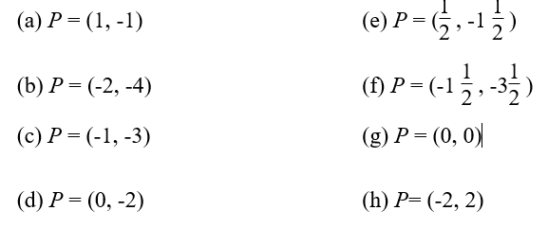
For this exercise A = (-2,-1). Mark A on a coordinate grid. For each point P in (a) to (h) below calculate Dt(P, A) and mark P on the grid:

Slide 14
Overheard
“When I am told a generality I make some examples;
when I am shown an example I construct a generality”

Slide 15
Examples for, of or in
elements of objects
classes of objects
techniques
physical objects
symbolic objects
questions
calculations
representations
properties
manifestations

Slide 16
The power of a word
‘Variation’ and ‘examples’
Tools to make sense of mathematical understanding
naming what they do anyway
a vocabulary for designing tasks
a tool for exploring or expressing the scope of learners’ knowledge
Notes:
Education is an effortful human activity that generates its own knowledge.
Publication in professional media is part of the academic work of education
Fertilisation from professional wisdom
Explicit use of ‘variation’ and ‘examples’ resonates with teachers, as it did for me
a new tool that made sense within their own mathematical understanding
it names what they do anyway
it gives a vocabulary for designing tasks
a tool for exploring or expressing the scope of learners’ knowledge

Slide 17
Arthur said: I see functions as input-output machines, which receive some input and give an appropriate output.
Ruth said: I see function as a mapping of each element of one set to exactly one element of a second set.
Ian said: Functions for me represent relations between variables.
Naomi said: A function shows how one variable changes in relation to another variable.
Liz said: I see functions as expressions to calculate y-values from given x-values.
Notes:
it is important for me to be passionately engaged in the mathematics which is being done around me, and I have a predilection for mathematical ideas, structures and abstractions that are experienced through examples and actions by deductive and inductive reasoning. For me, this is what mathematics is and in school these come to us through symbol systems, physical objects and dynamic representations.
The prompts offered by Dyrszlag seemed to be completely situated in such a view.
Variation theory gave me a language to communicate with teachers about how attention can be drawn to the critical components of an idea.
Closely related to the pedagogic use of variation is the construction of example spaces, so that learners have a range of examples of a mathematical idea from which to draw their generalisations (and reject non-examples).
Working with teachers about variation and exempification has been like walking into a vast public space where my implicit engagement with mathematics became explicit and was broadcast. Looking back at earlier research showed me that I had always seen mathematics this way, so ‘the role of mathematics in my research’ had always been this, but I had not always recognised it.

Slide 18
References
Ayalon, M., Watson, A., & Lerman, S. (2017). Students’ conceptualisations of function revealed through definitions and examples. Research in Mathematics Education, 19(1), 1-19.
Cuoco, A., Goldenberg, E. P., & Mark, J. (1996). Habits of mind: An organizing principle for mathematics curricula. The Journal of Mathematical Behavior, 15(4), 375-402.
Dyrszlag, Z. (1984) Sposoby Kontroli rozumienia pojec matematycznych. Oswiata i Wychowanie, 9(B)
Krause, E. (1986). Taxicab geometry: An adventure in non-euclidean geometry (reprinted from 1975). NY: Dover
Lipka, J. (1994). Culturally negotiated schooling: Toward a Yup'ik mathematics. Journal of American Indian Education, 14-30.
Liu, Y. (2004). The design of exercises in mathematics textbooks. Regular lecture at the 10th International Congress of Mathematics Education, Copenhagen, July 2004
Polya, G. How to Solve it.
Mason, J., with Burton, L., & Stacey, K. (1982). Thinking mathematically. London: Addison Wesley
Marton, F. & Trigwell, K. (2000) Variatio est mater studiorum.Higher Education Research & Development 19 (3), 381-395
Sierpinska (1994) Understanding in Mathematics. London: Falmer.
Tuckey, C. (1904). Examples in algebra. London: Bell.
Watson, A. (2021). Care in Mathematics Education: Alternative Educational Spaces and Practices. London: Palgrave Macmillan
Watson, A., & Mason, J. (1998). Questions and prompts for mathematical thinking. Derby, England: Association of Teachers of Mathematics
Watson, A., & Mason, J. (2005). Mathematics as a constructive activity: Learners generating examples. Mahwah, NJ: Lawrence Erlbaum Associates

Slide 19
pmtheta.com annewatson1089@gmail.com

