Slide 1






These are a Few of my
Favourite Things
Promoting Mathematical Thinking
John Mason
SFU
Vancouver
Nov. 2014
The Open University
Maths Dept
University of Oxford
Dept of Education

Slide 2
Outline
Throat clearing
A Task to Work On
Some Perplexing Problems
  In Mathematics
  In Mathematics Education

Slide 3
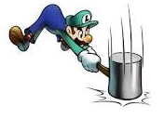
Throat Clearing
Everything said here is a conjecture …
  … to be tested in your experience
My approach is fundamentally phenomenological …
I am interested in lived experience.
Radical version: my task is to evoke awareness (noticing)
So, what you get from this session will be mostly …
  … what you notice happening inside you!
Avoid the teaching of
speculators,
whose judgements are
not confirmed
by experience.
(Leonardo Da Vinci)
Central role of attention:
… What is being attended to?
… How it is being attended to?
Awareness
as consciousness
as that which enables action

Slide 4
Rich Tasks
It’s not the task that is rich
but whether the task is used richly: rich pedagogy
  Calling upon & developing learners’ natural powers
  Encountering mathematical themes
  Bringing personal dispositions and propensities to the surface
Outer, Inner & Meta aspects of tasks
Avoid sterile debates around simple names for pedagogies
(discovery, child-centred, problem solving, reform, constructivist, …)
Focus on (Rich) Pedagogic Actions

Slide 5
Outer, Inner & Meta Aspects of Tasks
Outer Task
  What author imagines
  What teacher intends
  What students construe
  What students actually do
Inner Task
  What powers might be used or developed?
  What themes might be encountered and enriched?
  What connections might be made?
  What reasoning might be called upon?
  What sense students make of their activity
  What students are now prepared to be able to hear & see
  What students recosntruct later
Meta Task
  Personal propensities and dispositions to challenge or work on
  Working collaboratively and individually

Slide 6
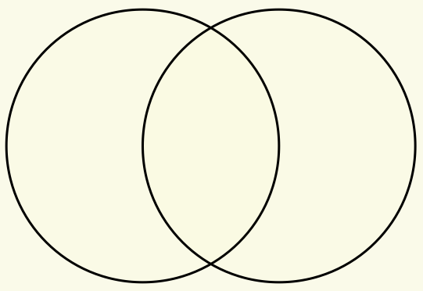
Set Ratios
In how many different ways can you put 17 objects into the two sets (the circles) so that both sets have the same number of objects?
Notes:
Now apply what we have been doing, paying attention to powers and themes.
How else could the task be presented?

Slide 7
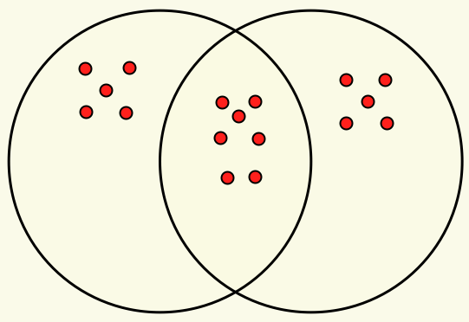
Example

Slide 8
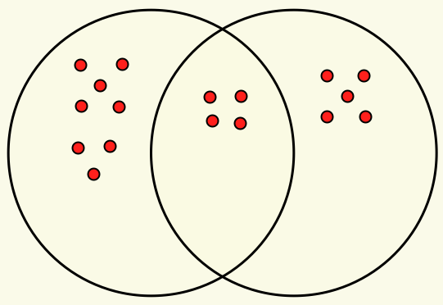
Extension
Here the sets are in the ratio of 4 : 3.
In how many ways can the 17 objects be placed so the sets are in the ratio 3 : 2?
4 : 3
What about 3 sets?

Slide 9
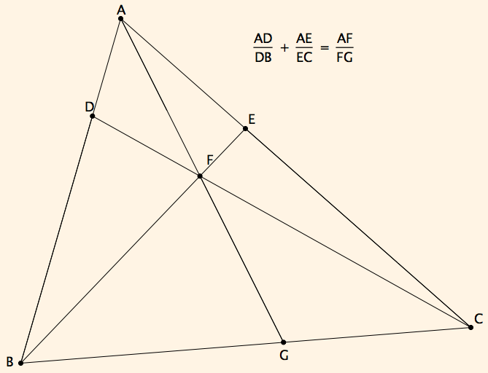
Ratio Addition

Slide 10
Reasoning
A
Movements of attention:
E
D
F
C
B
G

Slide 11
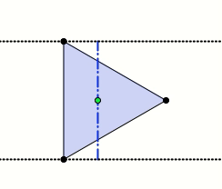
Polygon Shadows
Imagine an equilateral triangle
A light (very far away) lies in the plane of the triangle so that the triangle casts a one-dimensional shadow.
How does the length of the shadow change as the light circulates around the triangle?

Slide 12
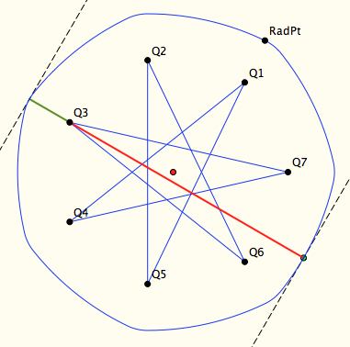
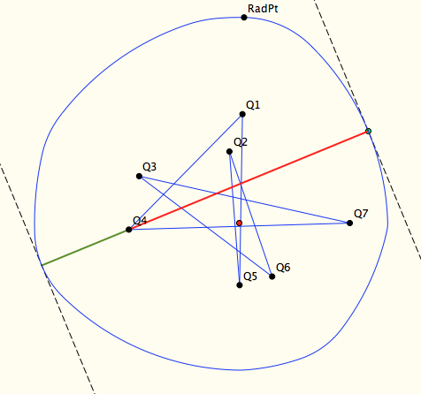
Constant Shadows

Slide 13

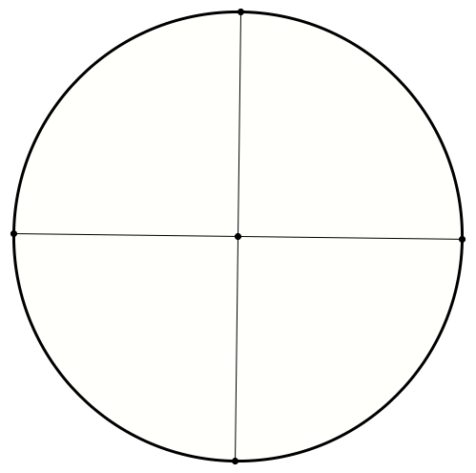

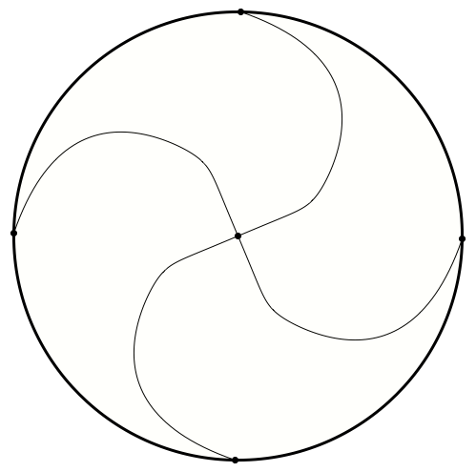
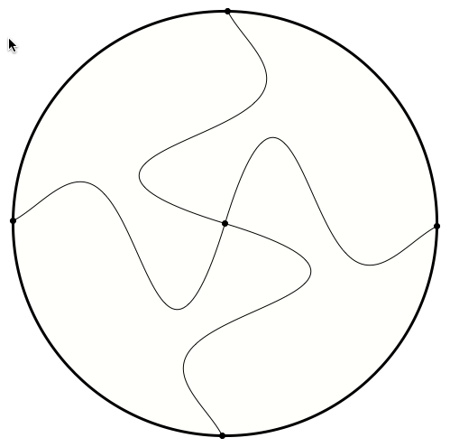
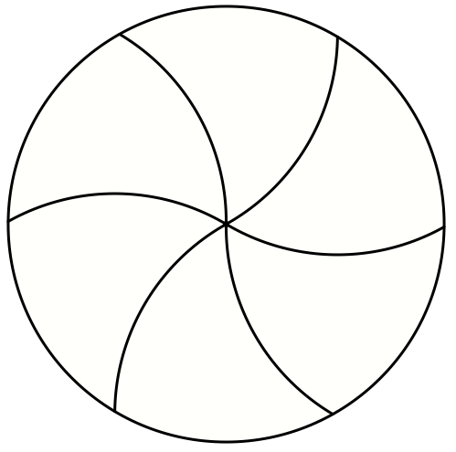
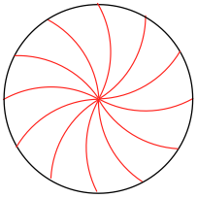
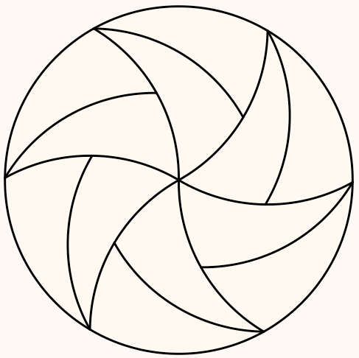
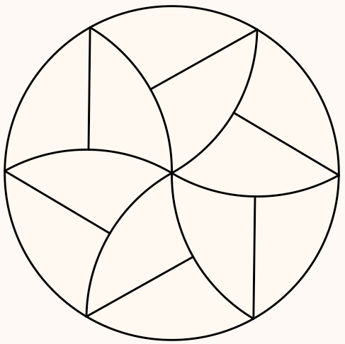
Circular Jigsaws
Notes:
What does ‘different’ mean? Evolution of complexity

Slide 14
Early Amongs
Among any odd number of integers, the sum of all but some one of them is even.
Among any 2m –1 integers, the sum of some m of them is divisible by m.

Slide 15
Amongs
Write down 9 integers in a list. I assert that
  The sum of some consecutive terms from among the ordered list is divisible by 9.
  The sum of some 6 from among them is divisible by 3, and more generally, any remainder mod 3 can be achieved by adding some 6 from among them;
  The sum of some 5 from among them is divisible by 5, and more generally, any remainder modulo 5 can be achieved by adding some 5 from among them;
  The sum of some 7 from among them is divisible by 3 as long as no 8 of them are mutually congruent, and more generally, any remainder mod 3 can be achieved by adding some 7 from among them, as long as no 8 of them are mutually congruent modulo 3;
  The sum of some 3 from among them is divisible by 7, as long as no 4 are mutually congruent modulo 7, and more generally, any remainder modulo 7 can be achieved by adding some 3 from among them, as long as no 4 of them are mutually congruent modulo 7.

Slide 16
More Amongs
Among any ordered repset of m integers, there is a consecutive sub-repset whose sum is divisible by m.
If p is prime, then among any s + p – 1 numbers there are s whose sum is divisible by p as long as no s+1 of them are mutually congruent modulo p.

Slide 17
Reacting & Responding
Anne and John together have 25 marbles; Anne has 5 more than John. How many do they each have?
You have 200 objects, 98% of which are red and the others brown.
How many of the reds must you remove so that red objects are 96% of the total?
You have some objects, R% of which are red and the others Brown.
What fraction of the reds must you remove so that red objects are r% of the total?
Dual process Theory (Kahneman et al):
  System 1 (automaticities, habits, compulsiveness)
  System 2 (rational, considered, chosen, responsible)
Bicamerality (MacGilchrist et al)
  Left brain (details, local attention; choosing & following; predictive)
  Right brain (broad overview, context, vigilance, big picture; abstraction )
Notes:
(R-r) / (100-r) x 100 / R of the reds (25/49)

Slide 18
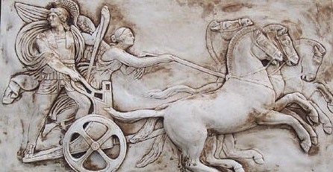
Human Psyche
Psyche
  Enaction (Body)
  Affect (Emotions)
  Cognition (Intellect)
  Attention
  Will
  Witness
Adherences, Co-ordinations, Selves, Micro Identities

Slide 19
Human Psyche
Intellect (cognition)
Imagery
Attention/Will
Emotions
(affect)
Body (enaction)
Habits
Practices

Slide 20
MGA

Slide 21

Structure of a Topic
Language Patterns
& prior Skills
Imagery/Sense-of/Awareness; Connections
Root Questions
predispositions
Different Contexts in which likely to arise;
dispositions
Standard Confusions
& Obstacles
Techniques & Incantations
Emotion
Awareness
Behaviour
Only Emotion is Harnessable
Only Awareness is Educable
Only Behaviour is Trainable
Only Attention can be Directed

Slide 22
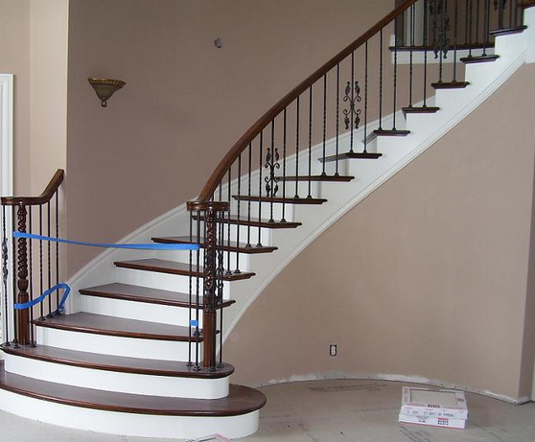
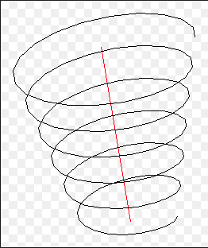
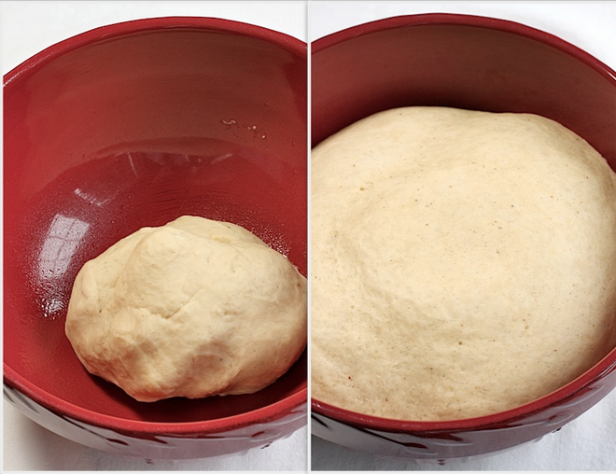
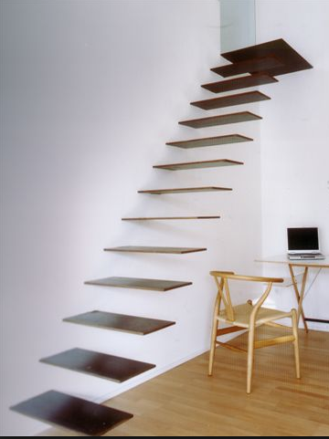

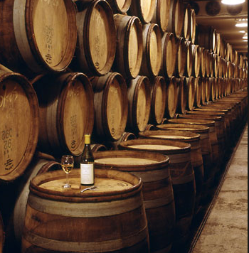
Conceptions of Learning
Staircase
Spiral
Maturation

Slide 23
Learning & Assessment
What is available to be learned?
What is discernible?
What relationships are recognisable?
What properties are perceiveable as being instantiated?
What reasoning is called upon?
What behaviour is accessible to assessment?
What is done?
What discernments, relationships and properties need to be present in order to perform?
What justifications are sought and given?
What learning is accessible to assessment?
What is discerned?
What relationships are recognised?
What properties are perceived as being instantiated?
What reasoning is displayed?

Slide 24
Reflection as Self-Explanation
What struck you during this session?
What for you were the main points (cognition)?
What were the dominant emotions evoked? (affect)?
What actions might you want to pursue further? (Awareness)
Notes:
Chi et al

Slide 25
Follow Up
John.Mason@open.ac.uk
Mcs.open.ac.uk/jhm3 go to Presentations
Questions & Prompts for Mathematical Thinking (ATM UK)
Thinking Mathematically (Pearson)
Designing & Using Mathematical Tasks (TarquinUK)
Researching Your Own Practice using the Discipline of Noticing (Routledge)

