Slide 1
Variation
Anne Watson & John Mason
South West Mathematics PD Providers Conference
Jurassic Maths Hub
Exeter
Sept 2018

Slide 2
Technical terms
Contrast/ Separation/ Fusion/ Generalisation
Dimensions of possible variation/ Ranges of permissible change
Conceptual variation/Procedural variation
One problem; multiple solutions (OPMS)
One problem; multiple changes/conditions (OPMC)
Multiple problems; one solution method (MPOS)
Perceptual variability/ Mathematical variability

Slide 3
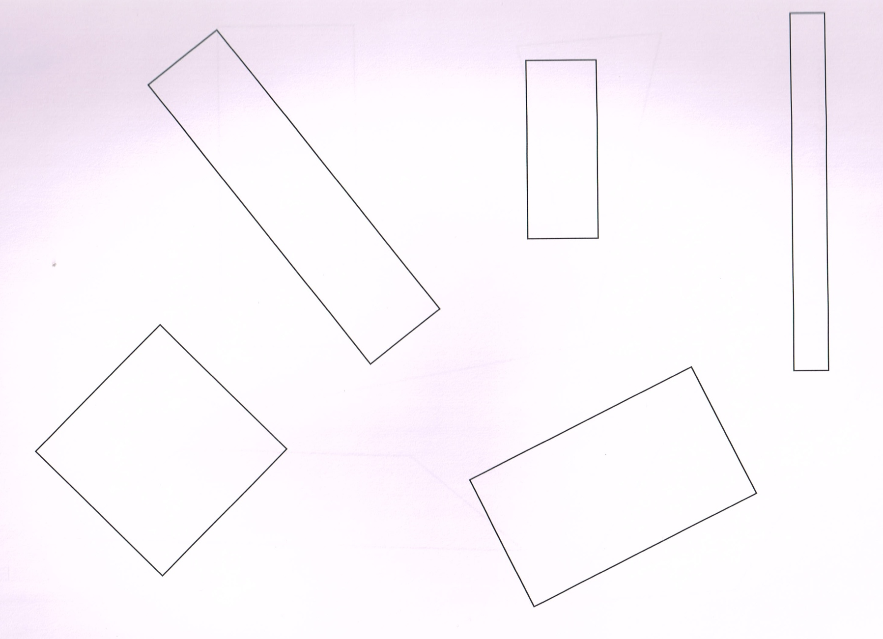
What is available to be discussed? Learnt?

Slide 4
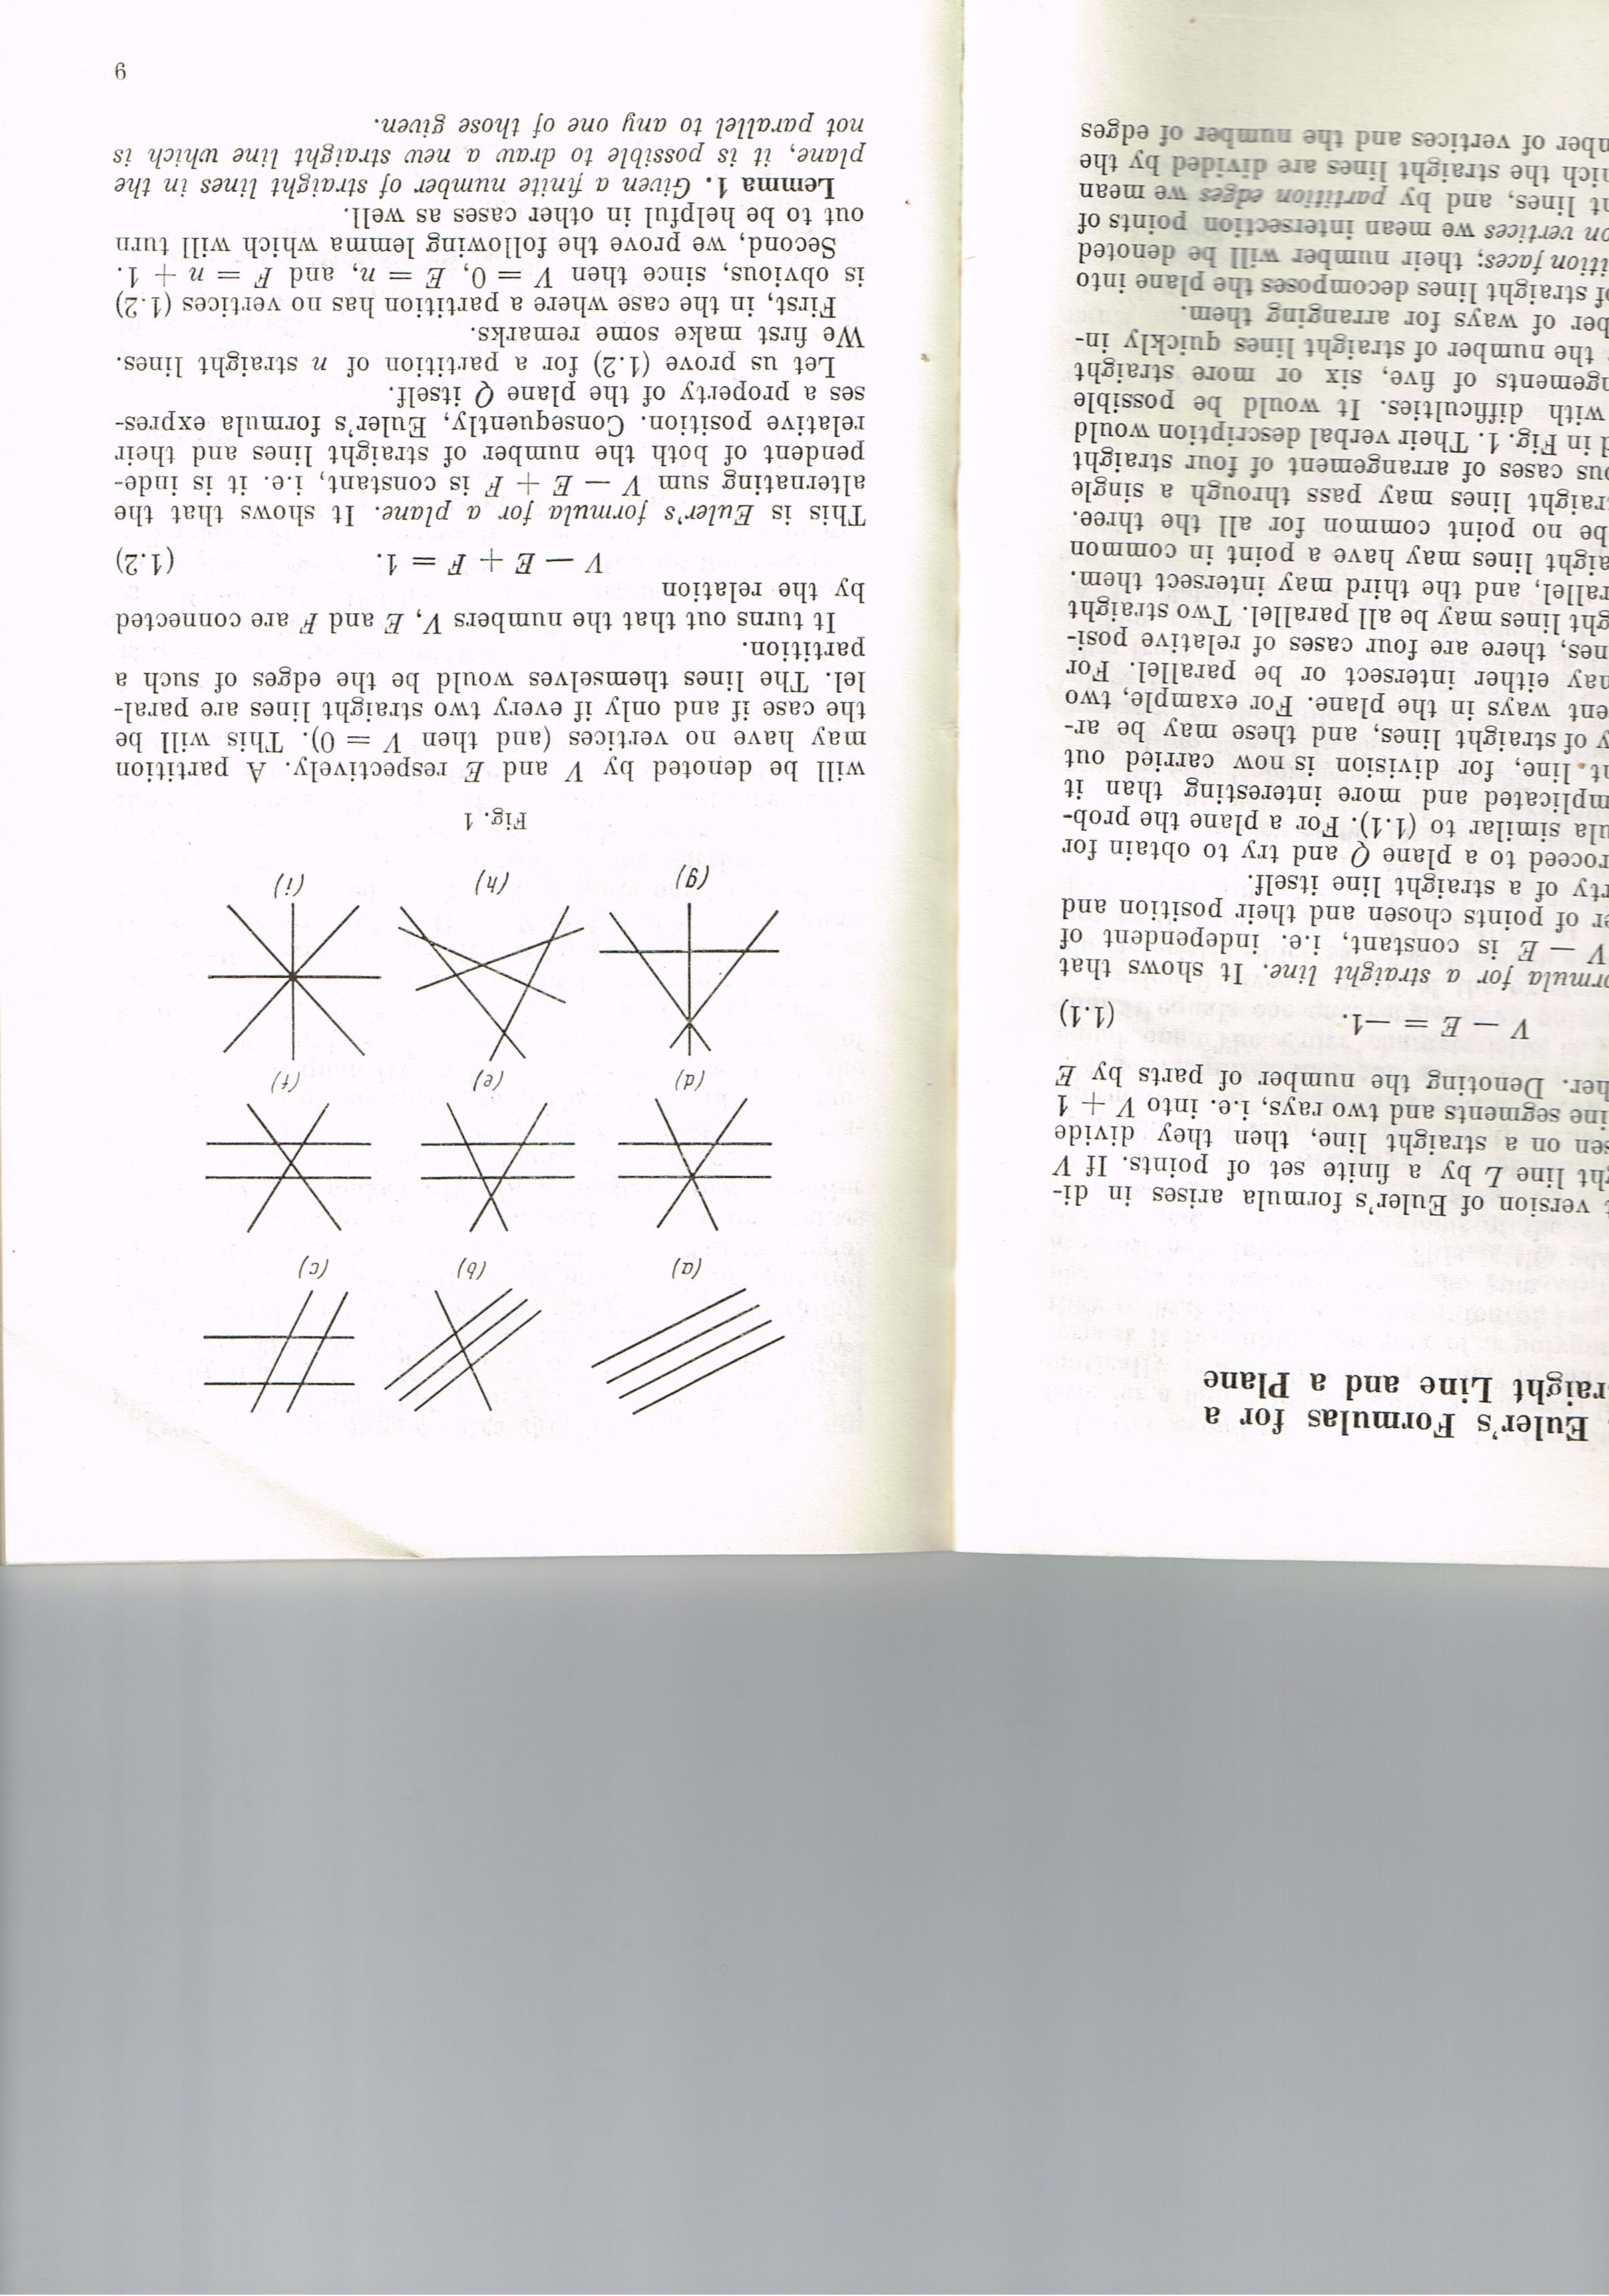
What is available to be discussed? Learnt?

Slide 5
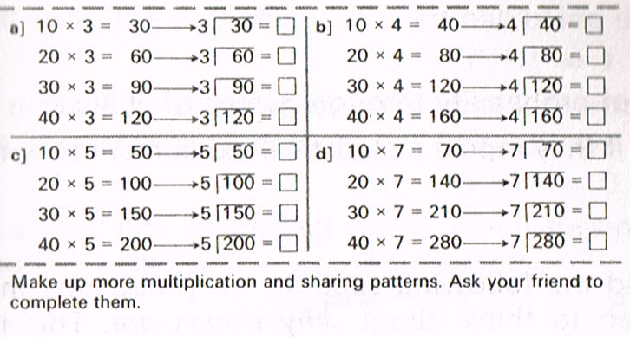
What is available to be discussed? Learnt?
Name that variation

Slide 6
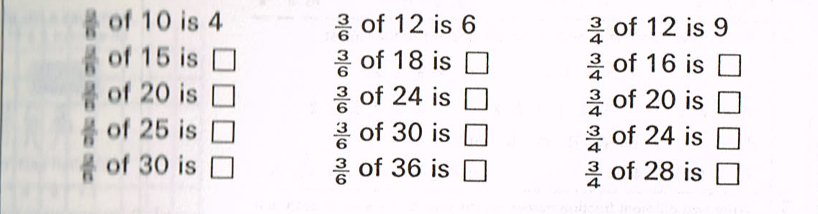
2
3
3
5
6
4
What is available to be discussed? Learnt?
Name that variation

Slide 7
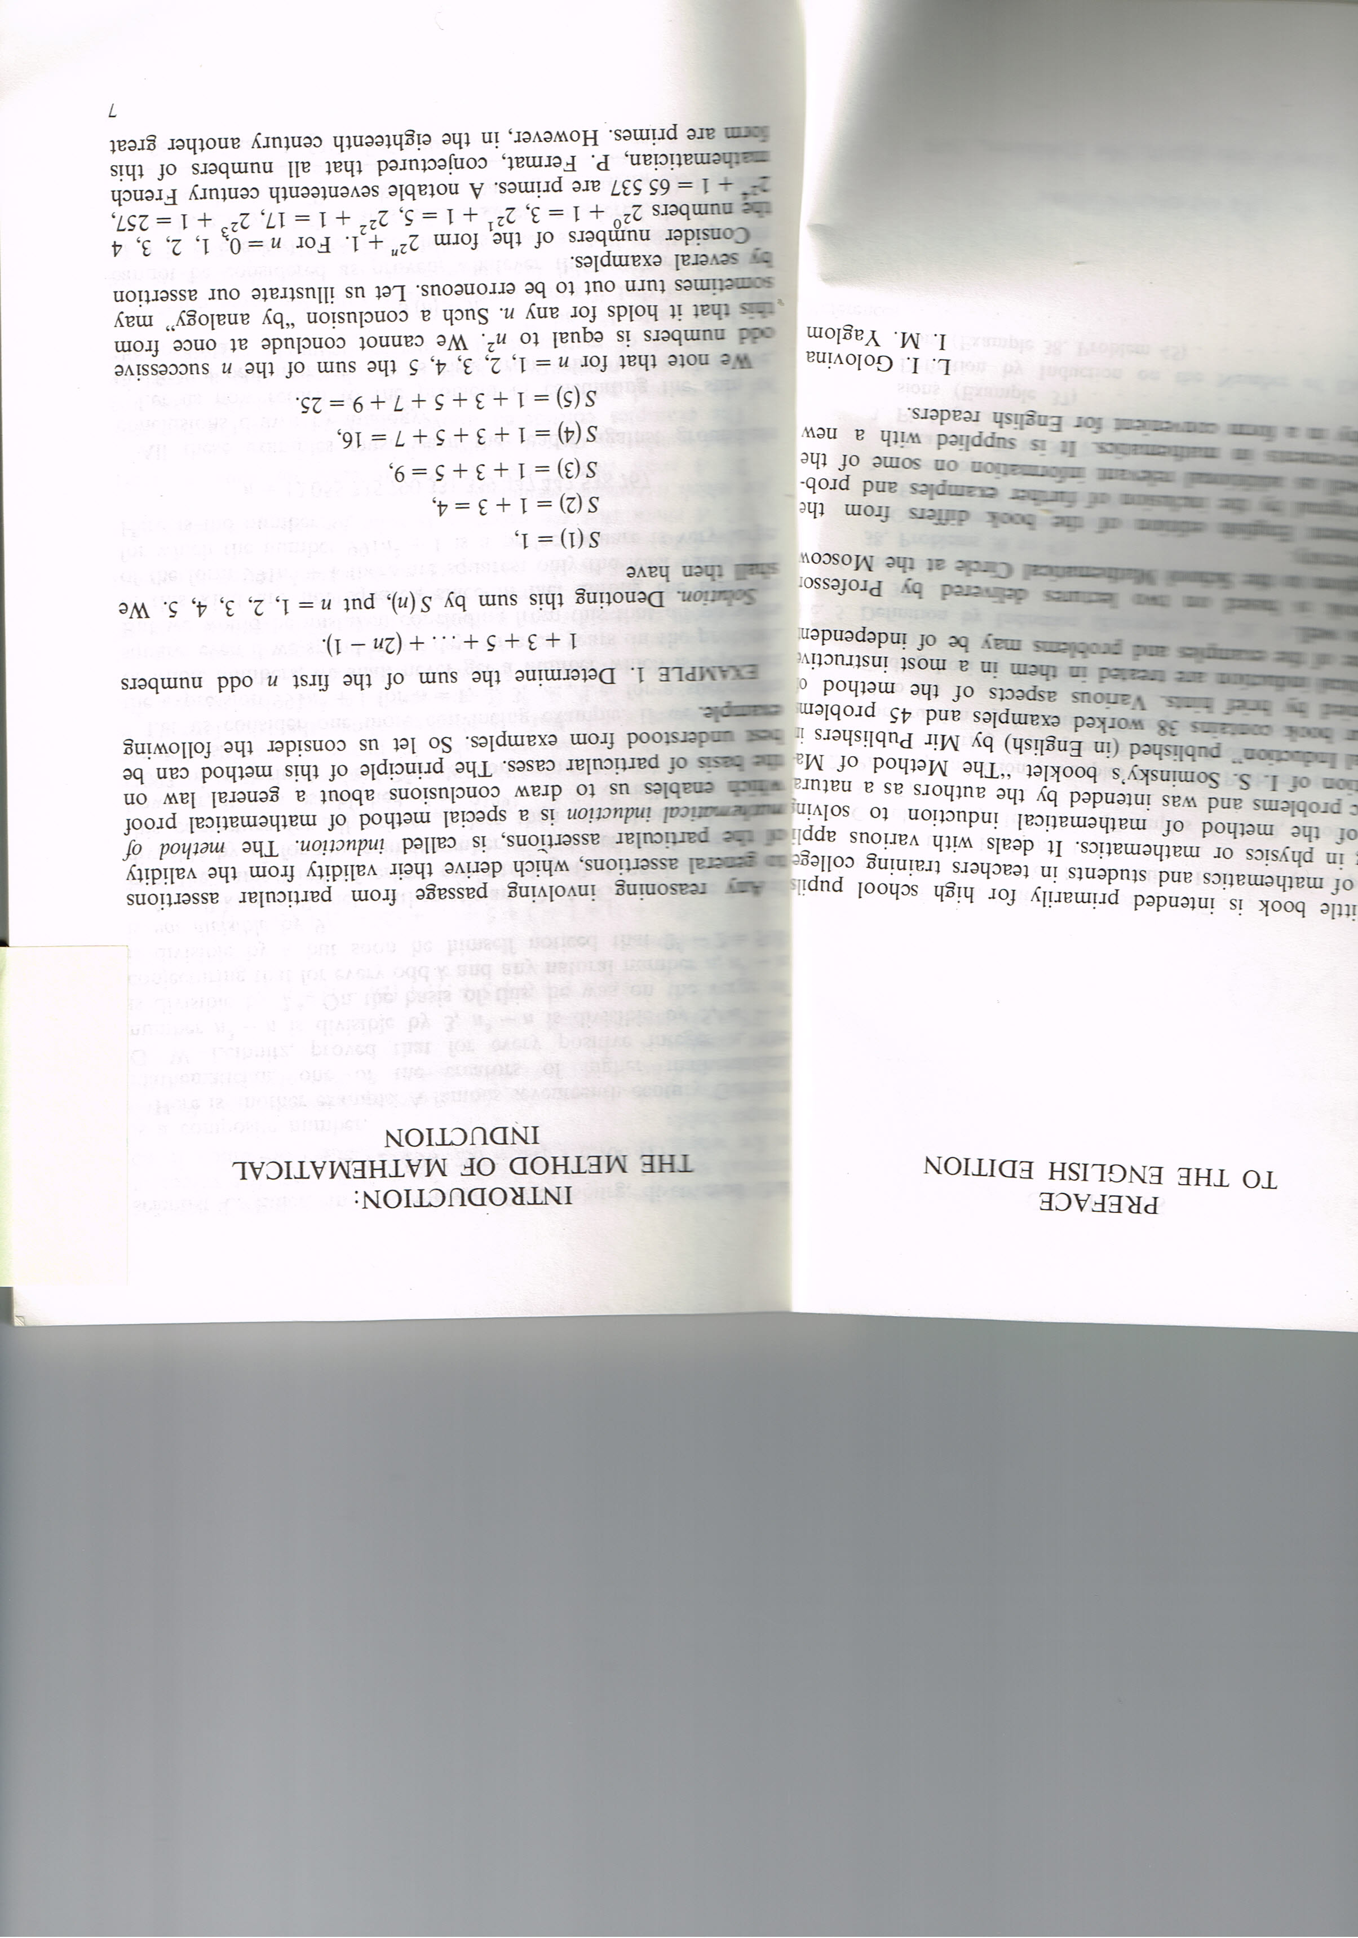
What is available to be discussed? Learnt?
Name that variation

Slide 8
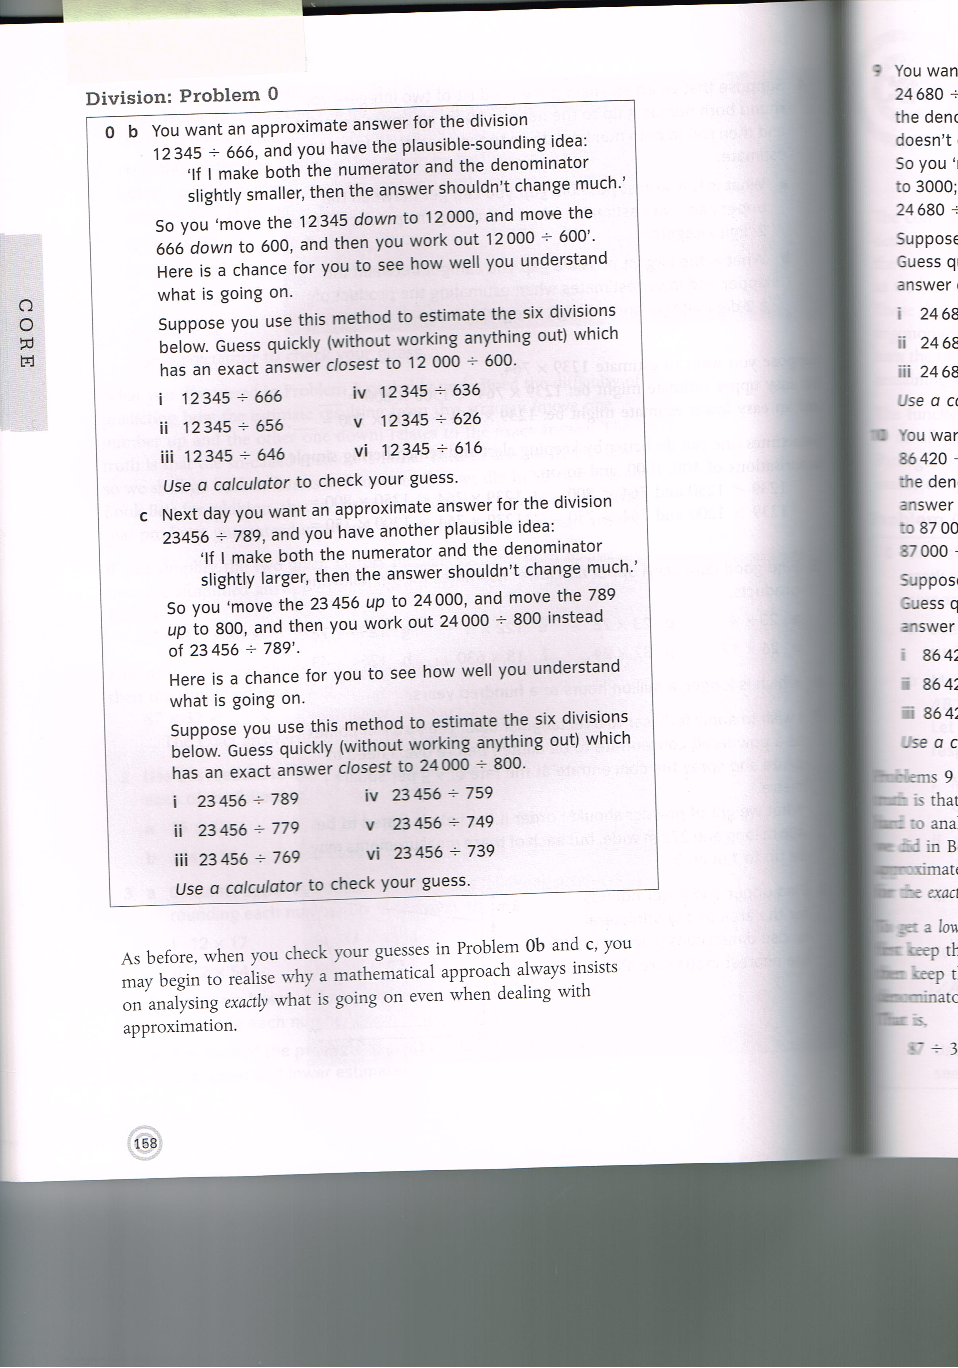
What is available to be discussed? Learnt?

Slide 9
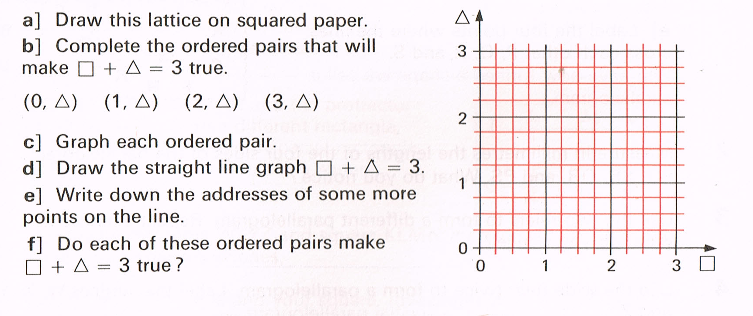
What is available to be discussed? Learnt?

Slide 10
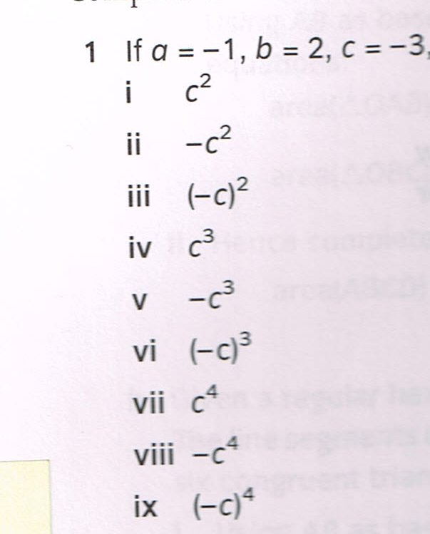
What is available to be discussed? Learnt?

Slide 11
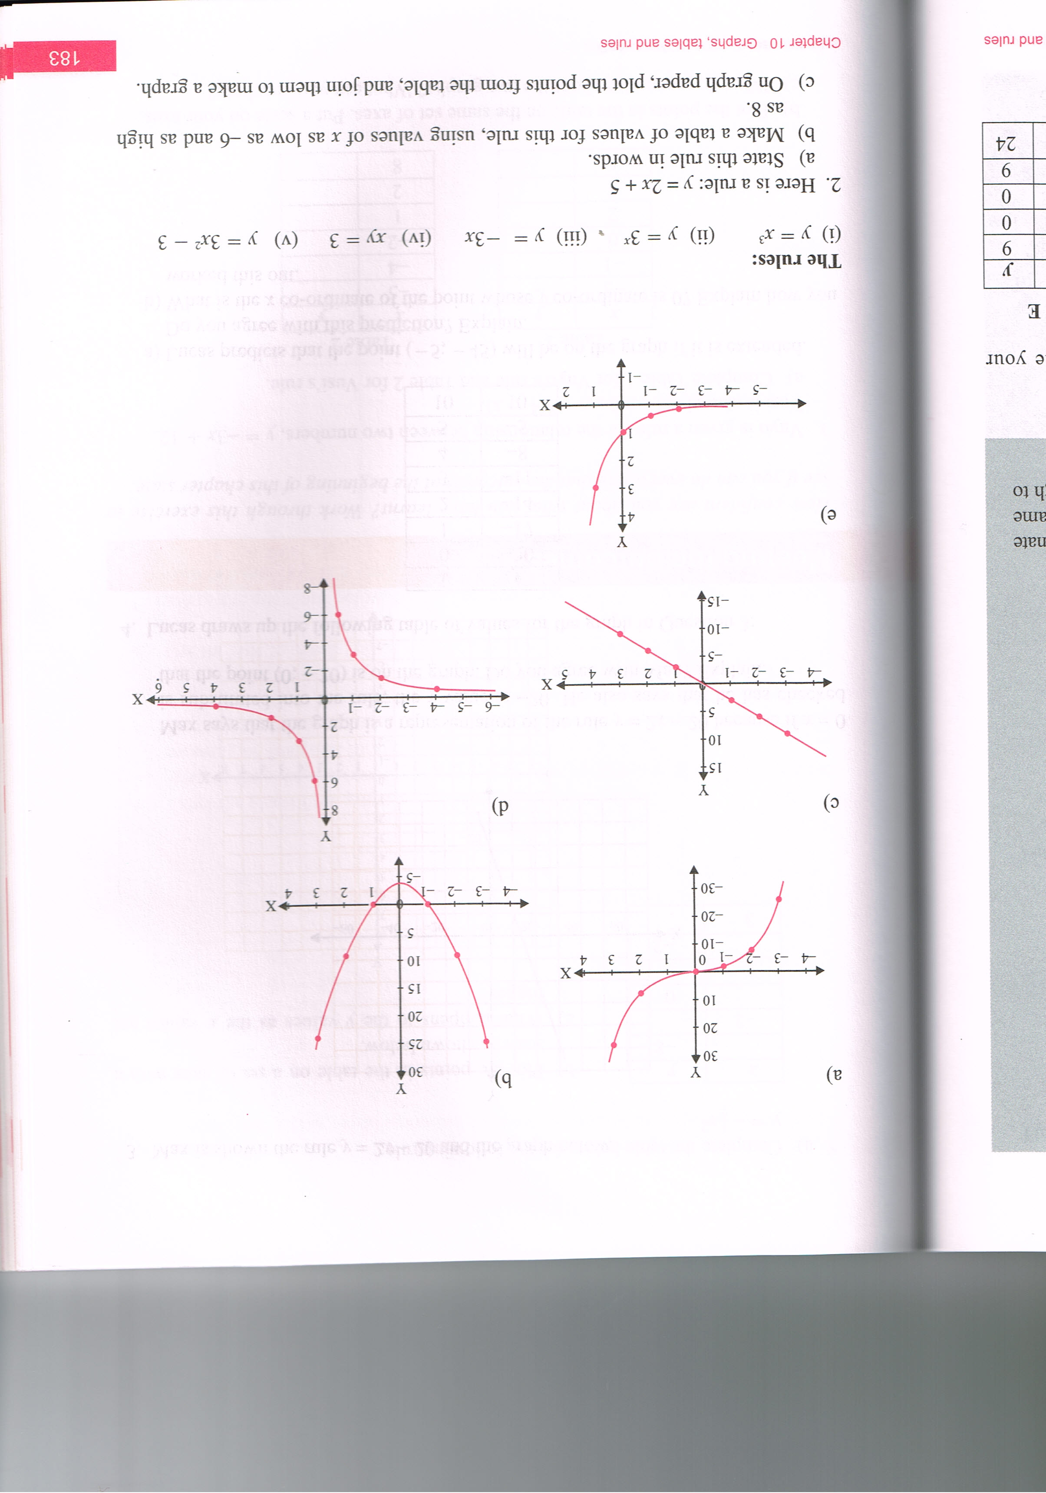
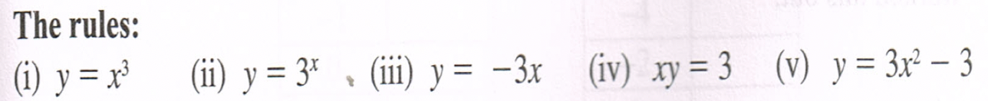
What is available to be discussed? Learnt?

Slide 12
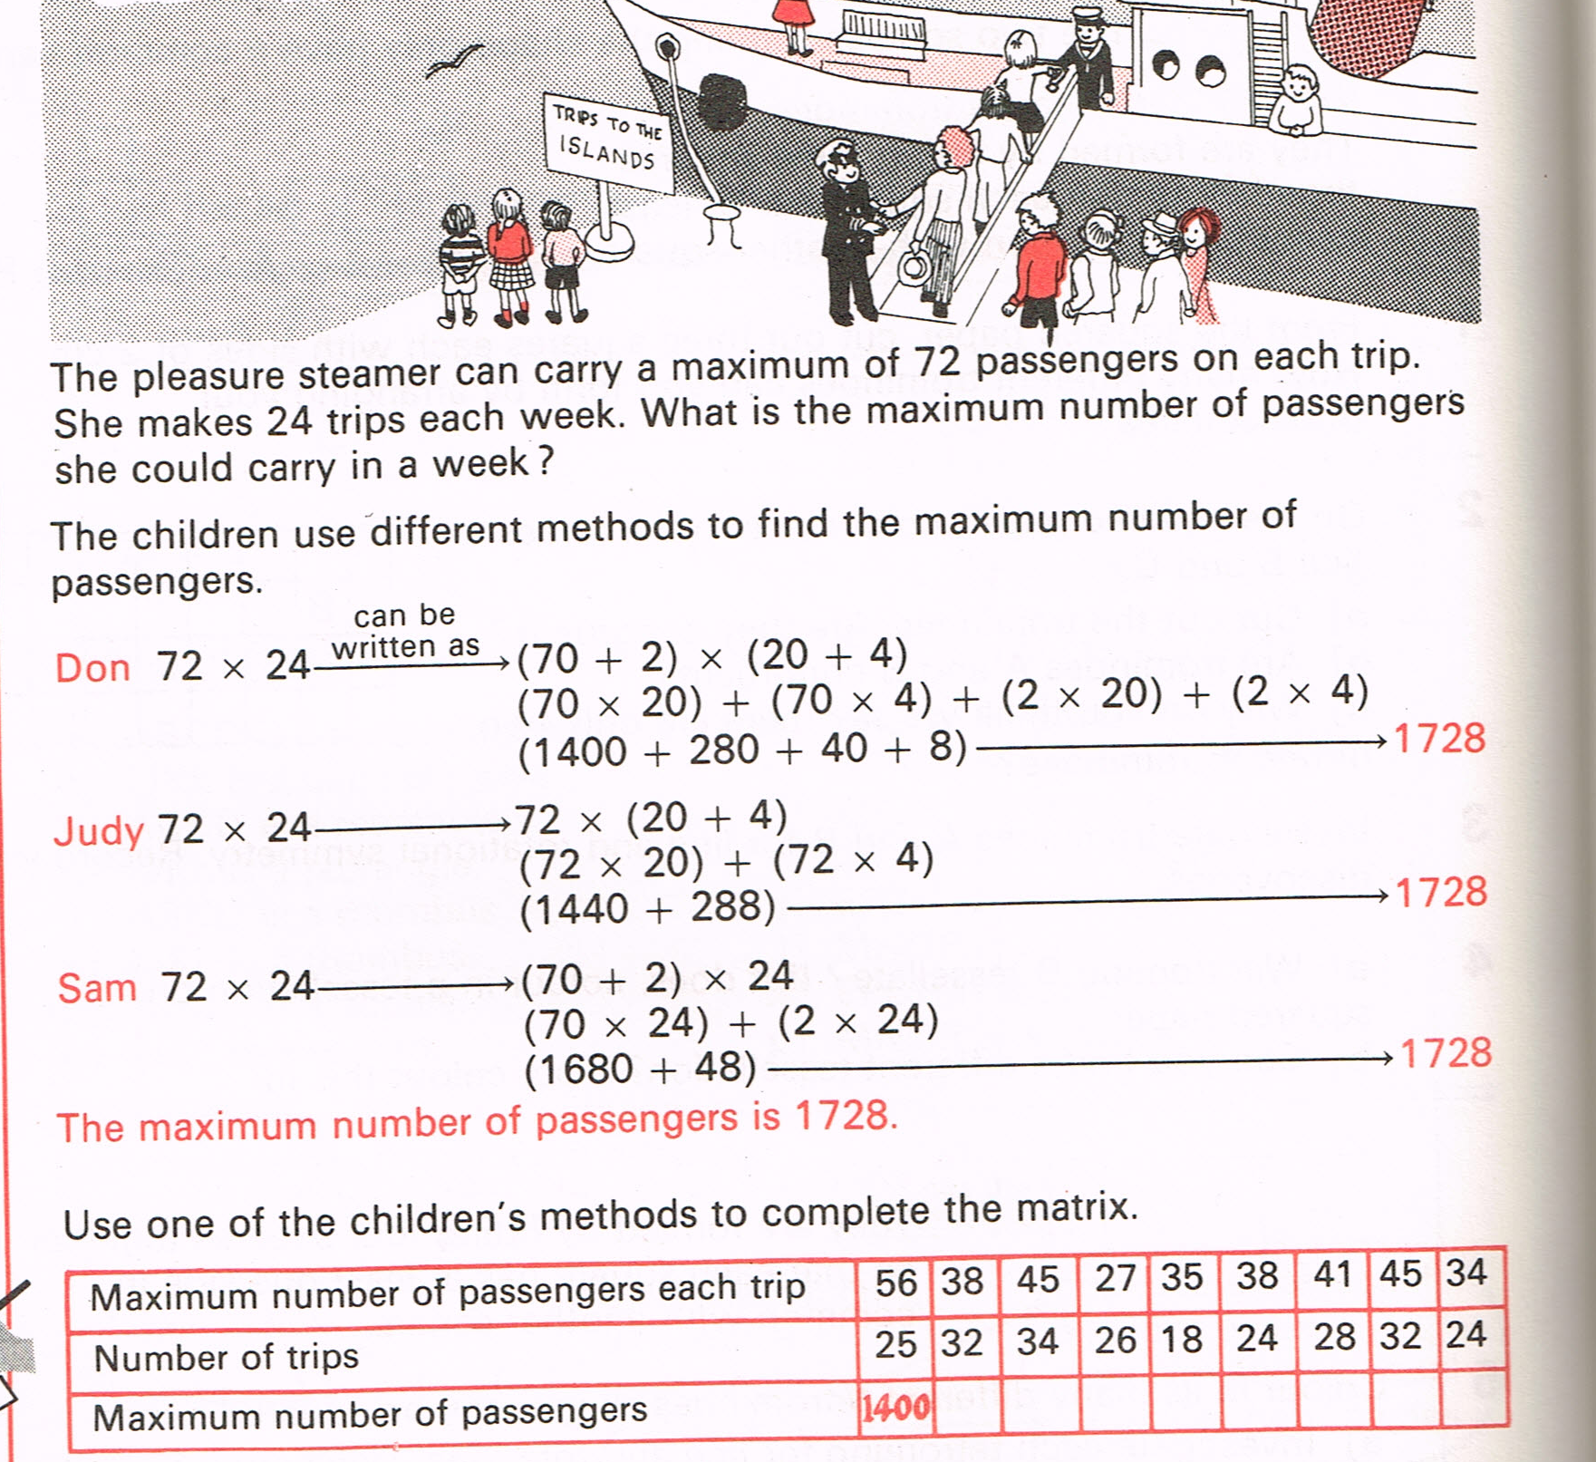
What is available to be discussed? Learnt?

Slide 13
Key questions for teaching and learning:
What’s the same; what’s different?
What changes; what stays the same?
  Over what ranges
If this changes, what else has to change?
  Over what range?
If I know this, what else do I know?
Key questions for planning:
What do I hope they will learn?
What tasks and questions connect the intended, enacted and lived ‘object of learning’, ‘key idea’, ‘critical aspect’ etc.?

Slide 14


Fractional Divisors
The fraction is said to ‘divide into’ or to be a
‘factor of’ or a ‘divisor of’ the fraction
if and only if divided by is an integer.
What is needed in order to make sense of this?
Meaning
Examples
Retreat to more familiar ground

Slide 15
Fractional Divisors
Meaning:
  What does it mean to say that one number divides into another?
Examples:
Yours or mine?
What fractions does divide into?
What fractions divide into ?
2
3
2n
3
Anything of the form
2
3
2
3n
Anything of the form
10
21
10n
21
What fractions does divide into?
What fractions divide into ?
Anything of the form
10
21
10
21n
Anything of the form
Retreat:
What numbers divide into 24? …

Slide 16
Retreat: Factors and Divisors of Integers
What are the factors of 24? (what numbers divide into 24?)
What is the largest number that is a factor of both
24 and 18?
  Highest Common Factor (Greatest Common Divisor)
What is the smallest number they both divide into?
  Lowest Common Multiple
What is the largest number that is a factor of both 2³x5²x7⁴ and 2⁴x3²x 5x7³?
  First check: What are the factors of 2³x5²x7⁴?
  Highest Common Factor (Greatest Common Divisor)
What is the smallest number they both divide into?
  Lowest Common Multiple

Slide 17
LCM & HCF of Rational Numbers
How do you find the LCM and the HCF of two rational numbers?
Does it make sense (suppose you use different fractions for the same rational)?

Slide 18
Rational Divisors
sa
sb
tc
td
If is a divisor of , does it necessarily follow
that is a divisor of ?
  This is necessary in order to carry over the idea of divisors from fractions to rationals.
a
b
c
d

Slide 19
Common Factors
What fractions are factors of both and ?
Numerator must divide into numerator;
Denominator must be divisible by denominator
Must be of form of both
and
So anything of the form
Largest is which is the HCF or GCD

Slide 20
Common Factors
What fractions have both and as factors?
Numerator must divide into numerator;
denominator must be divisible by denominator
Must be of form of both
or
and
Smallest is. which is the LCM

Slide 21
Key questions for teaching and learning:
What’s the same; what’s different?
What changes; what stays the same?
  Over what ranges
If this changes, what else has to change?
  Over what range?
If I know this, what else do I know?
Key questions for planning:
What do I hope they will learn?
What tasks and questions connect the intended, enacted and lived ‘object of learning’, ‘key idea’, ‘critical aspect’ etc.?

Slide 22
Technical terms
Contrast/ Separation/ Fusion/ Generalisation
Dimensions of possible variation/ Ranges of permissible change
Conceptual variation/Procedural variation
One problem; multiple solutions (OPMS)
One problem; multiple changes/conditions (OPMC)
Multiple problems; one solution method (MPOS)
Perceptual variability/ Mathematical variability

Slide 23
Reflection
What forms of variation did you detect?
What further variation would you require in order to develop fluency, appreciation and comprehension?
Could you do that varying for yourself?

Slide 24
Follow-Up
Variation unplugged www.pmtheta.com (AnneW)
Variation in mathematics (2018)
Association of Teachers of Mathematics (AnneW)
Anne Watson & John Mason (2006)
Variation and mathematical structure,
Mathematics Teaching, 194 (ATM).
These PPT slides PMTheta.com (joint presentations)

Slide 25
Discussion
What is more important to teachers …
… identifying and naming different forms of variation?
… developing pedagogic insight around key mathematical ideas?

