Slide 1


Effective Use of Examples in Mathematics
Loughborough
Feb 2020

Slide 2
Throat Clearing
I am not going to present statistical findings, nor am I going to report lots of observations of learners
Where I do not quote others’ research directly, my remarks are based on phenomenological study of my own lived experience, and that of learners.
I am interested in the lived experience of doing and learning mathematics.
I caution you not to believe anything I say, but to check it out in your own experience and that of the learners with whom you work
What you get from this session will be what you notice happening to you

Slide 3
Outline
Familiar Phenomena
Examples from the past
Mathematical & Pedagogical Theme
  Invariance in the midst of change
Examples, Example Spaces & Variation

Slide 4
Phenomena
Students often ignore conditions when applying theorems
Students often have a very limited notion of mathematical concepts ...
  What is it about some examples that makes them useful for students?
  What do students need to do with the examples they are given?
Students often ask for more examples ...
  But do they know what to do with the examples they have?

Slide 5
Quick Experience
For each x in R, send x to the first significant digit of x.
Is this a function?
Be honest …!
  Did you consider an example or two?
  Did you later consider .9999…?
Trying examples
Having standard examples become available
Accessible Space of Examples
Knowing to look for possible counter-examples
Asking what can be varied

Slide 6
Questions
Do you use case studies when teaching students?
Do you work through one or more examples in front of students?
  Reverse Dentistry (Fill-em & Drill-em)
  Show-Try-Test (??)
What do you expect or intend students to do with these?
Do you construct mathematical objects as examples of concepts?
  With, or in front of, students?

Slide 7
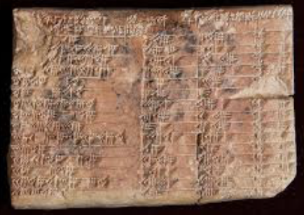
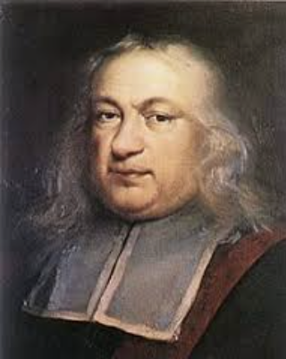
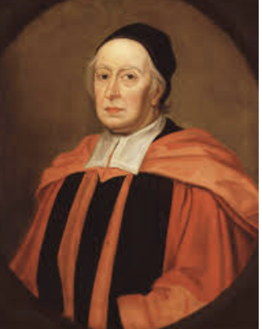
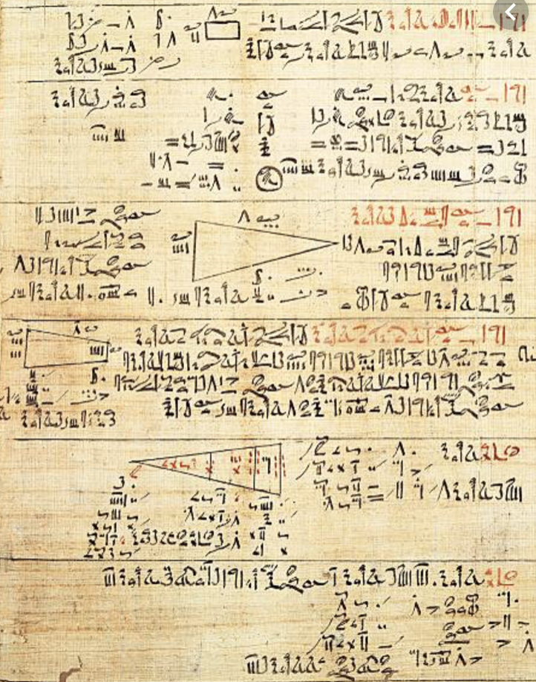
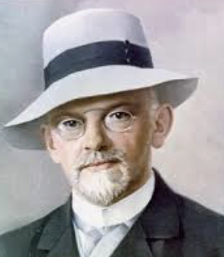
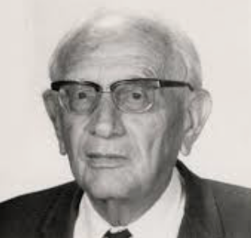
Historical Uses of examples
Babylonian Tablets & Egyptian Papyry
  “Thus is it done”; “Do it thus”
Pierre Fermat & John Wallis
  “My method of investigation”
David Hilbert
  One ‘generic’ example
George Pólya
  Specialising & Generalising

Slide 8
What do students say?
“I seek out worked examples and model answers”
“I practice and copy in order to memorise”
“I skip examples when short of time”
“I compare my own attempts with model answers”
NO mention of mathematical objects other than worked examples!
Notes:
These are Oxford ugs starting their 2nd year in mathematics

Slide 9
On worked examples
Templating: changing numbers to match
What is important about worked examples?
  knowing the criteria by which each step is chosen
  knowing things that can go wrong, conditions that need to be checked
  having an overall sense of direction
  having recourse to conceptual underpinning if something goes wrong
The issue for students is not
  Knowing that something is the case;
  Knowing how to carry out some action
  Knowing about the topic or concept
Rather, the issue is
  KNOWING TO act in the moment
  What triggers a useful action?

Slide 10
Really Simple Examples
To find 10% of something …
  You divide by 10
  So to find 20% of something you …
To differentiate x^{n} you write nx^{n-1}
  So to differentiate x^{x} you write (x-1)x^{x-1}
(x-1)² + (y+1)² = 2² has centre at
  (1, -1) and radius 2
  So (x+3)² + (y+4)² = 3² has centre at
  [4, 3] and radius 3
If f(3) = 5 then f(6) = 10
  Sin(2x) and 2sin(x); ln(3x) and 3ln(x)
  Sin(A + B) and sin(A) + sin(B)
  (a + b)² = a² + b²
What is learner Attending to?
How are they attending to it?

Slide 11
Examples of Mathematical Objects
What do you do with examples?
What would you like students to do with examples?
Unfortunately, students sometimes over-generalise, mis-generalise or fail to appreciate what is being exemplified

Slide 12
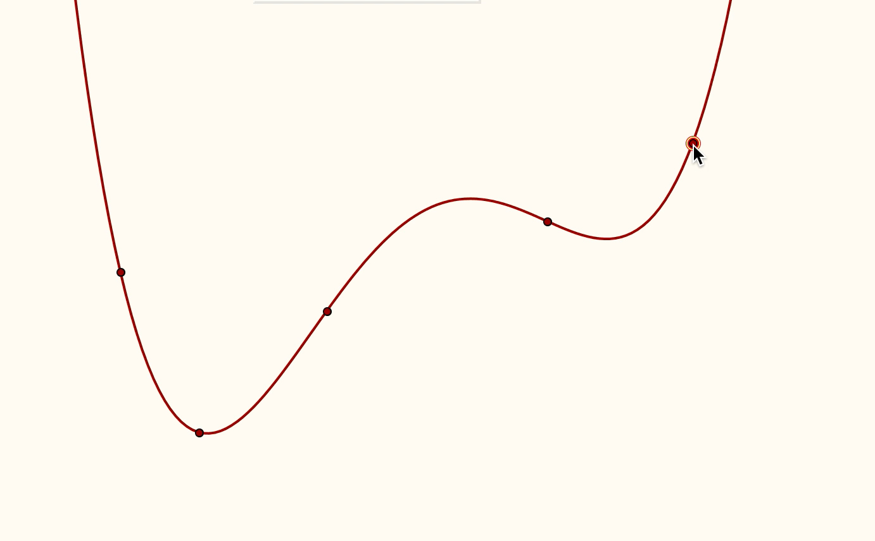
Adjusting Polynomials

Slide 13
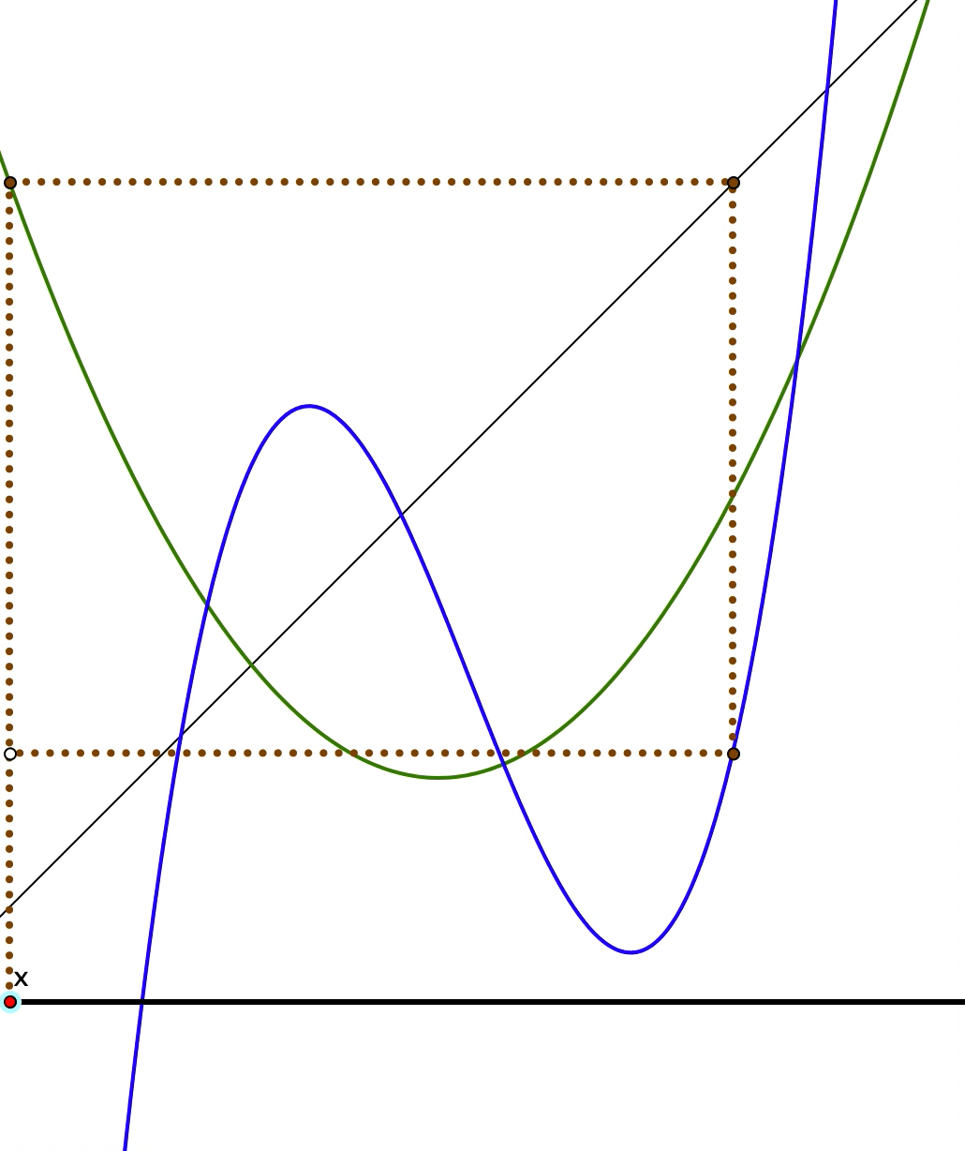
Cobwebs

Slide 14
Cobwebs Reviewed
What was being exemplified?
  Cubic specified by 4 points, Quadratic by 3 points
  Any cubic; any quadratic
  Cobweb constructions and reading graphs
  Way to imagine composite functions
  Properties of composite functions

Slide 15
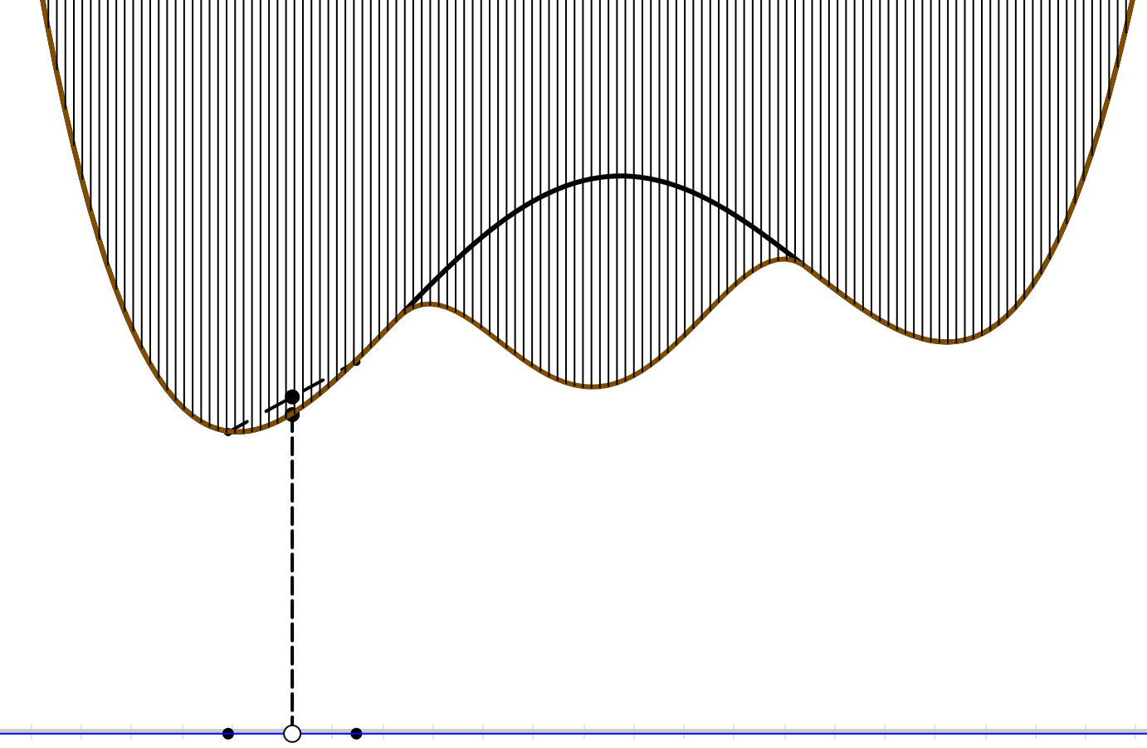
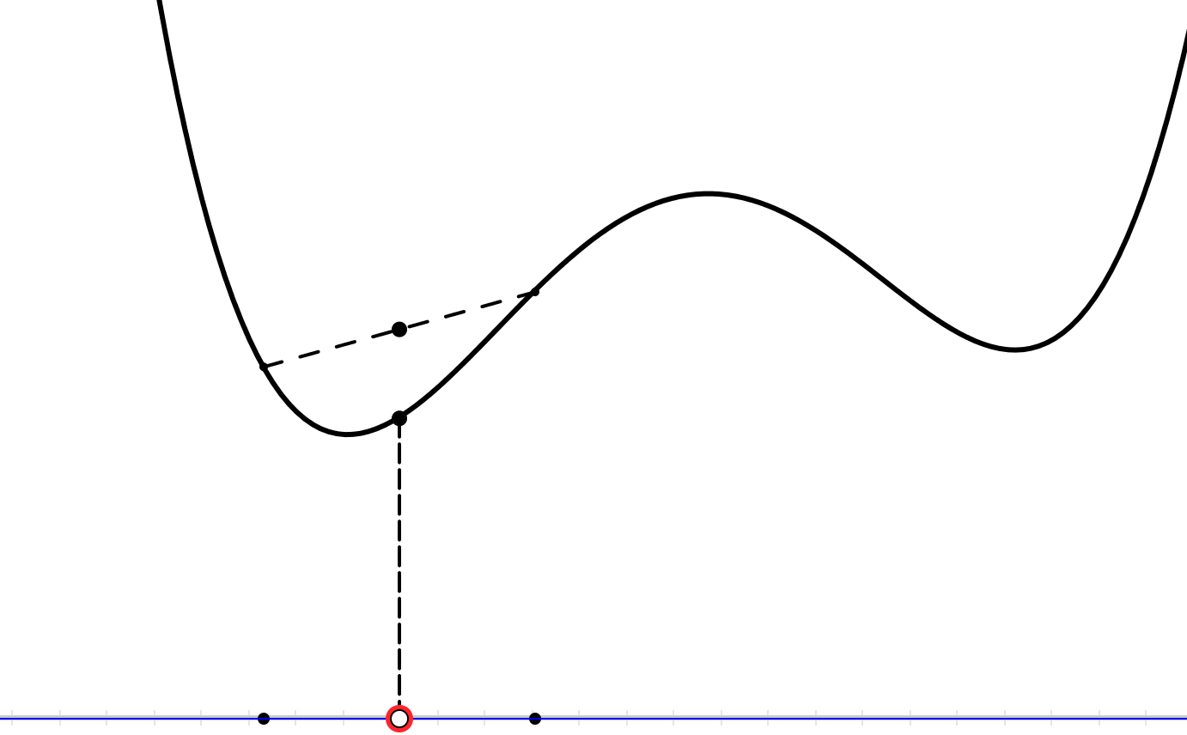
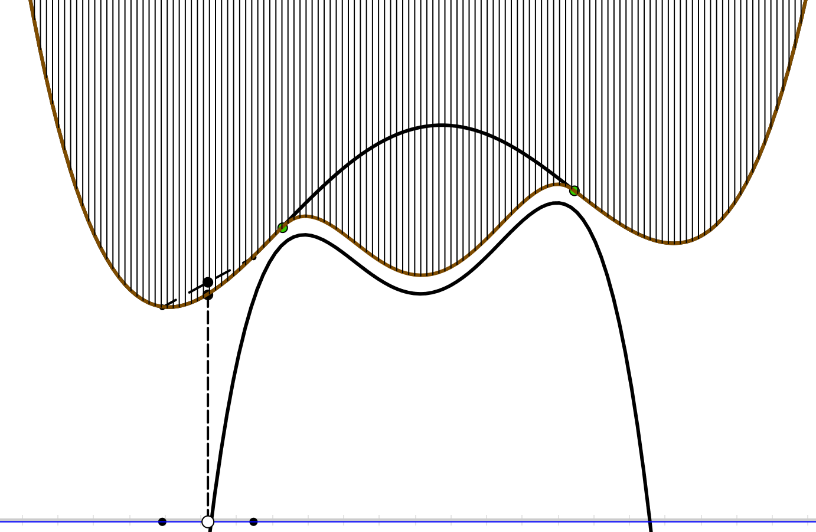
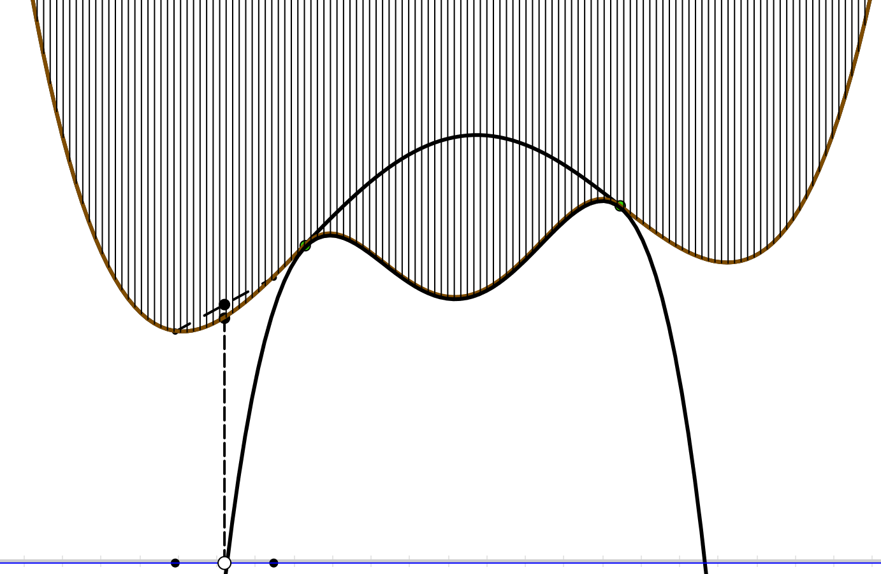
Mid-Points of Quartics

Slide 16
Quartic Mid-Points Reviewed
What was being exemplified?
  Local & Global phenomena
  Aspects of chords and how quickly they go to 0

Slide 17
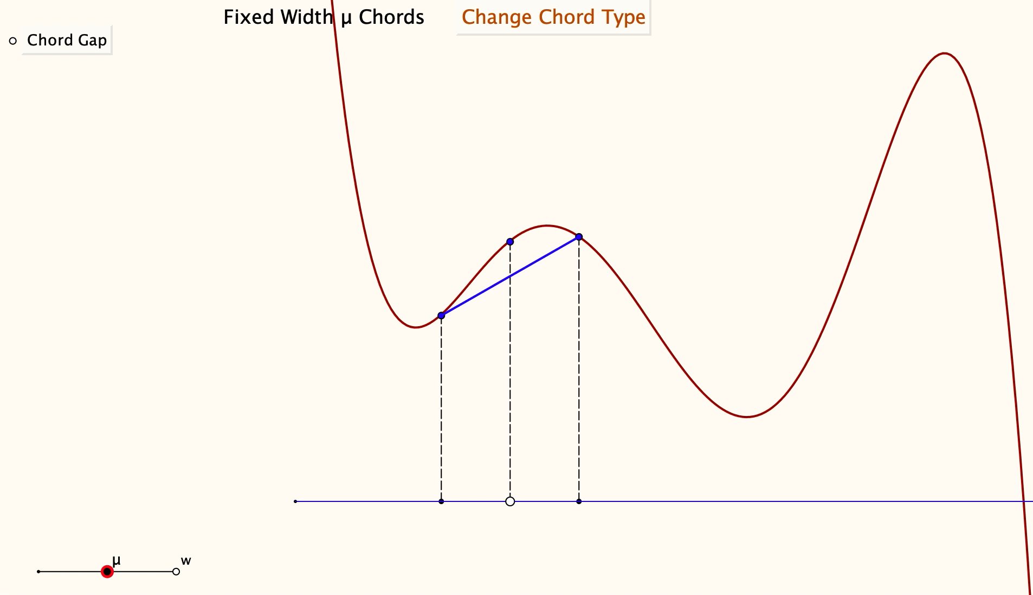
Striking a Chord

Slide 18
Striking a Chord Reviewed
What was being exemplified?
  Local & Global phenomena (fixed-end & fixed-width chords)
  Aspects of chords and how quickly they go to 0
  use of fixed-width chords for pedagogy

Slide 19
Mathematical Objects
Who produces examples?
  Lecturer?
  Students?
What are they expected to do with them?
Do they see you doing that with an example?

Slide 20
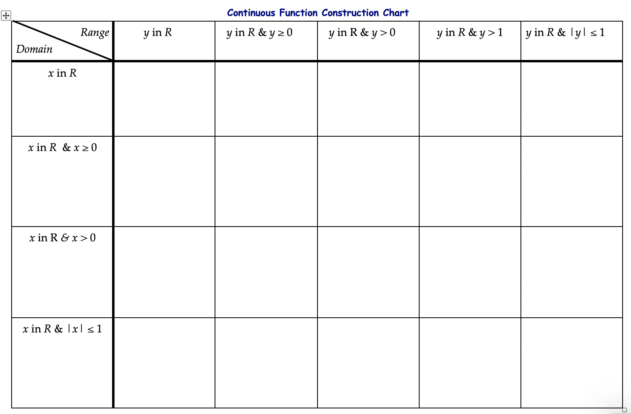
Construction Grids
?
Maximal
domain
Maximal
domain
And another
And another
Maximal
domain

Slide 21
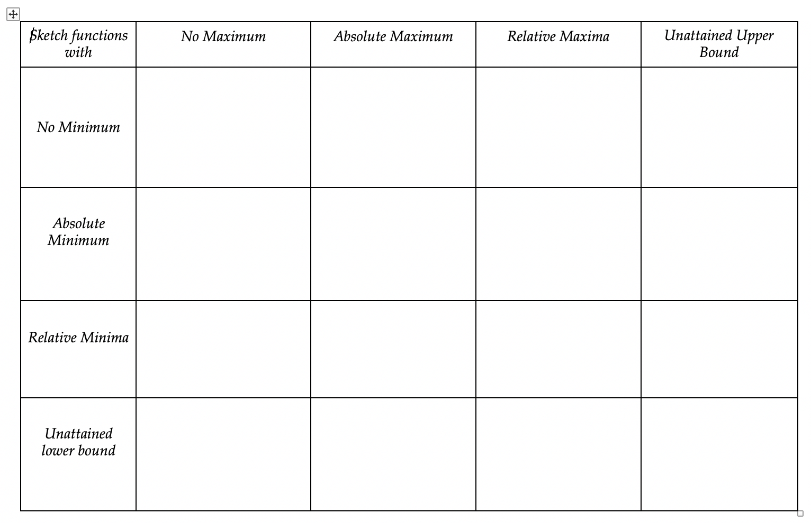
Property Chart: Extrema

Slide 22
Essence of These ‘Examples’
Stressing what can be changed
and what remains invariant:
(dimensions of possible variation)
(range of permissible change)

Slide 23
Imposing Constraints
Sketch a cubic
which does not go through the origin
and which has a local maximum
and for which the inflection slope is positive
Is there a quadratic whose root-slopes are perpendicular?
Is there a cubic whose root-slopes are alternately perpendicular?
A quartic?
  For what angles can it be done?
Notes:
Aim is to impose a constraint which is contrary to implicit assumptions made by learners in order to enrich and expand their example space: quadratic & cubic are possible; quartic is not.
In fact, for any polynomial with distinct real roots, the sum of the cotangents of the root slopes is always zero! More generally, if a line of slope m cuts a polynomial of degree d in d distinct points, the sum of the cotangents of the angles between the tangents at the cutting points and the straight line is md.

Slide 24
Example Construction
What features need to be salient?
  contrasting several examples
  What can be changed (dimensions of possible variation)
  and over what range (range of permissible change)
Learners Constructing Examples for themselves
  Sense of power over and with concept!

Slide 25

Bringing Possibilities to Attention
Construct an injective function from
[-1, 1] to R for which
  the limit as x approaches ±1 is 1,
  and f(0) = -1
Possibilities
  f(x) = x if first decimal digit of x is odd,
  else f(x) = -x
  use rationals and irrationals differently for x>0 and x<0
Is there a non-constant periodic function on R with no positive minimal period?

Slide 26
Construction Task
Write down a pair of distinct functions for which the integral of the difference over a specified interval is zero.
  and another
  and another
How did your attention shift so that you could come up with those examples?
Construct an example of a pair of distinct functions for which the integral of the difference is 0 over finitely many finite intervals; over infinitely many.
Notes:
When technical terms are used, we are triggered into accessing a space of examples. We want students to have as rich an accessible example space as possible. This means providing them with construction techniques.

Slide 27
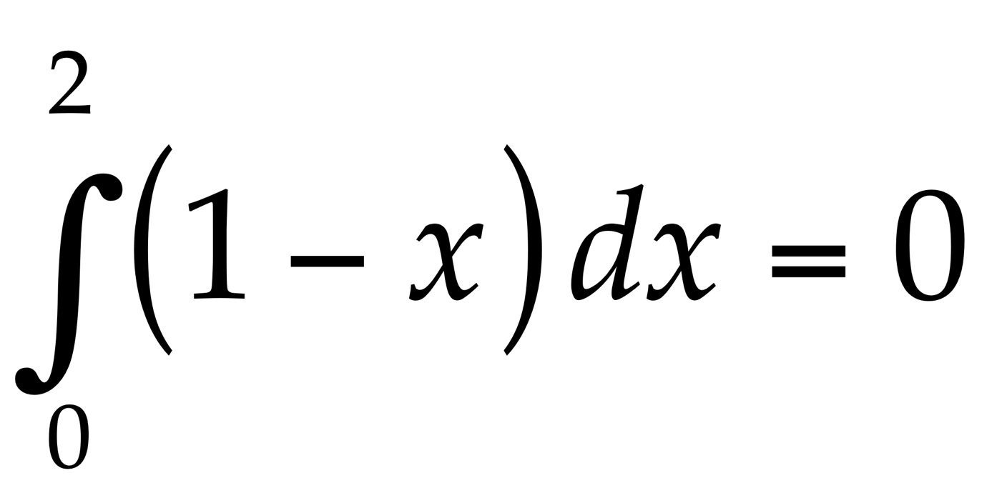
Write down another integral like this one which is also zero
  and another
  and another
  and another which is different in some way
What is the same and what is different about your examples and the original?
What features can you change and still it has integral zero?
Write down the most general integral you can, like this, which has answer zero.
Notes:
Example of reversing or undoing something which is familiar as a doing
Some learners tried preserving the difference between the limits(!) despite associating integral with area
Some immediately multiplied by a constant, but others did not
Some altered the linear function; some went to sin(x)
some revealed uncertainty between integral and area and negative area.
Have you ever found that students don’t recognise when a theorem can be applied (or else apply it when it is not applicable)?

Slide 28
Preparing the Ground
Construct a function F : [a, b] --> R
  which is continuous and differentiable on (a, b)
  for which f(a) = f(b)
  but nowhere on (a, b) is f’(x) = 0
Notes:
Setting an impossible task in order to prompt possibility and significance of a theorem

Slide 29
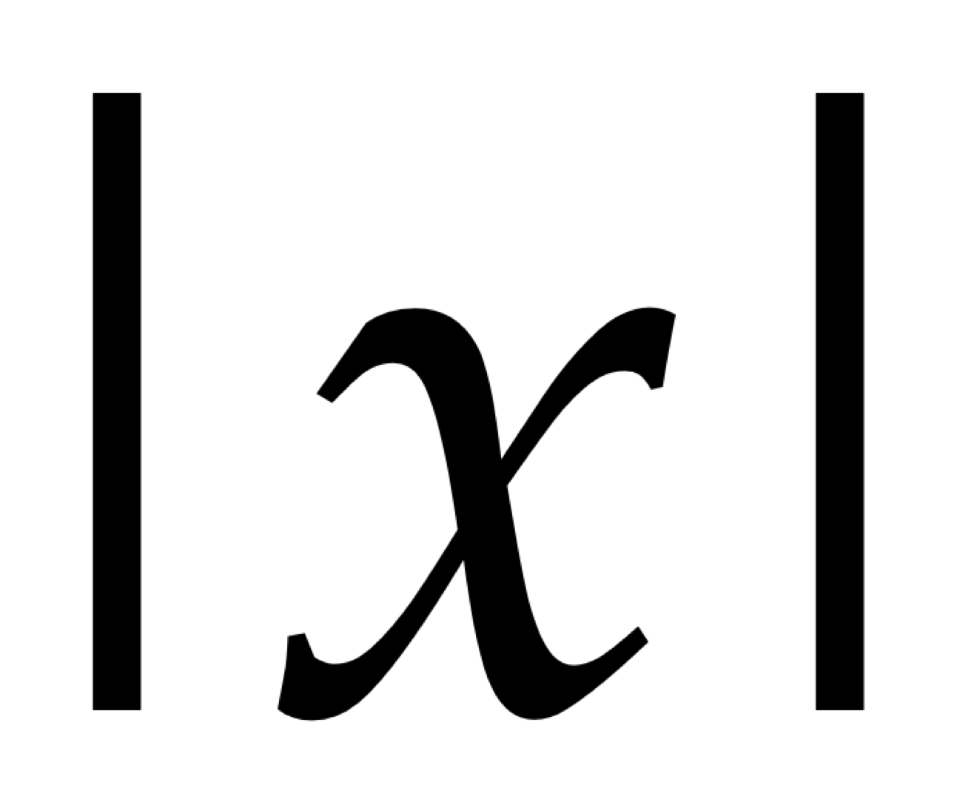
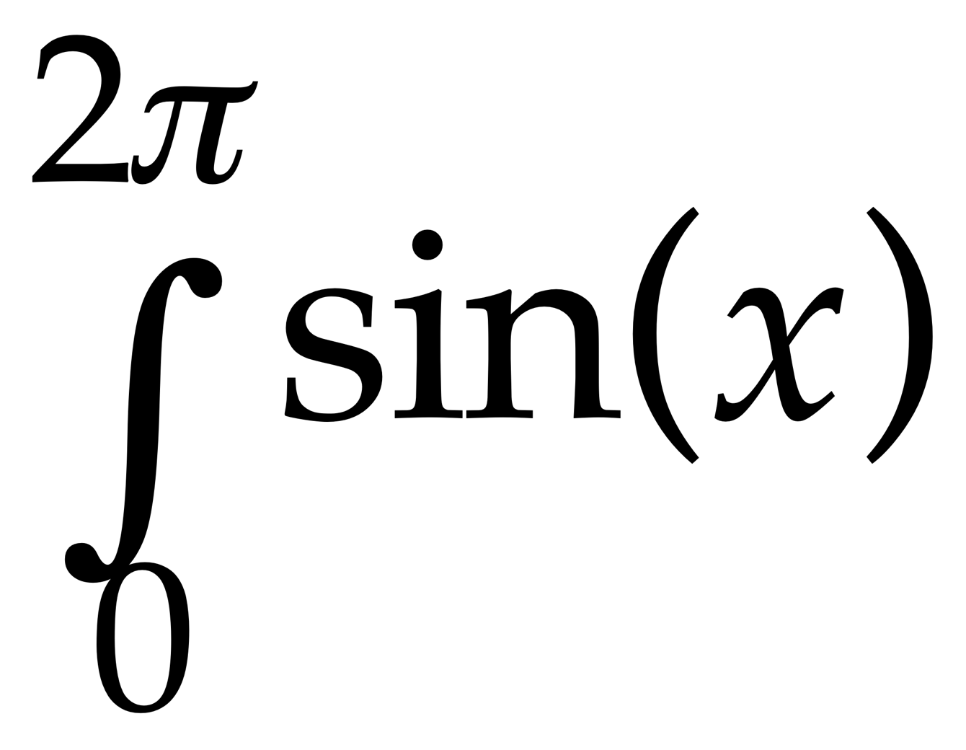
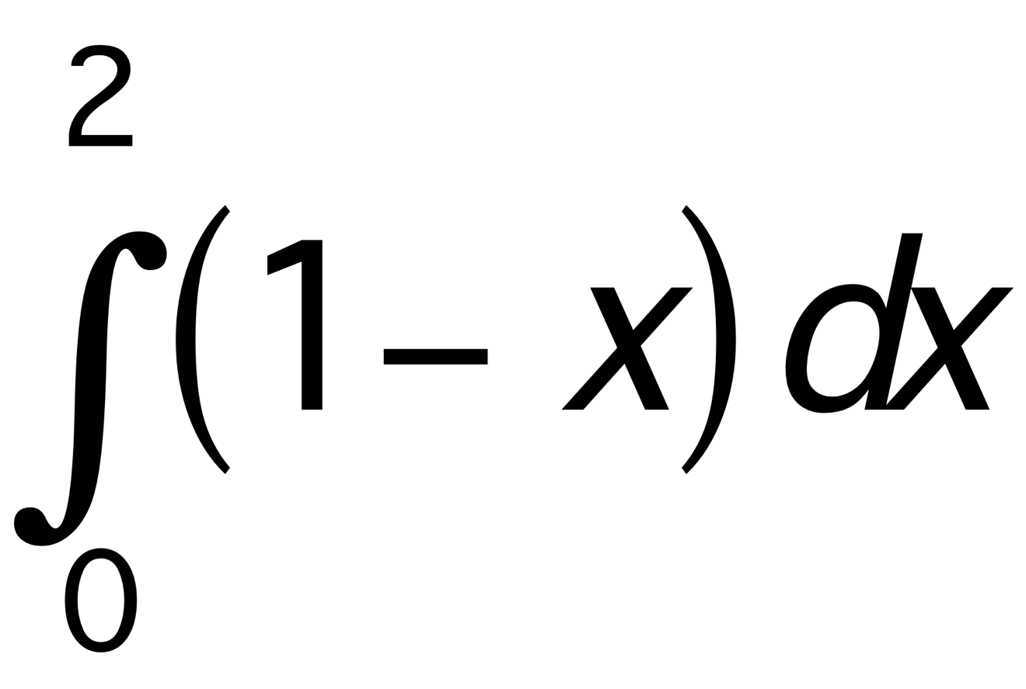
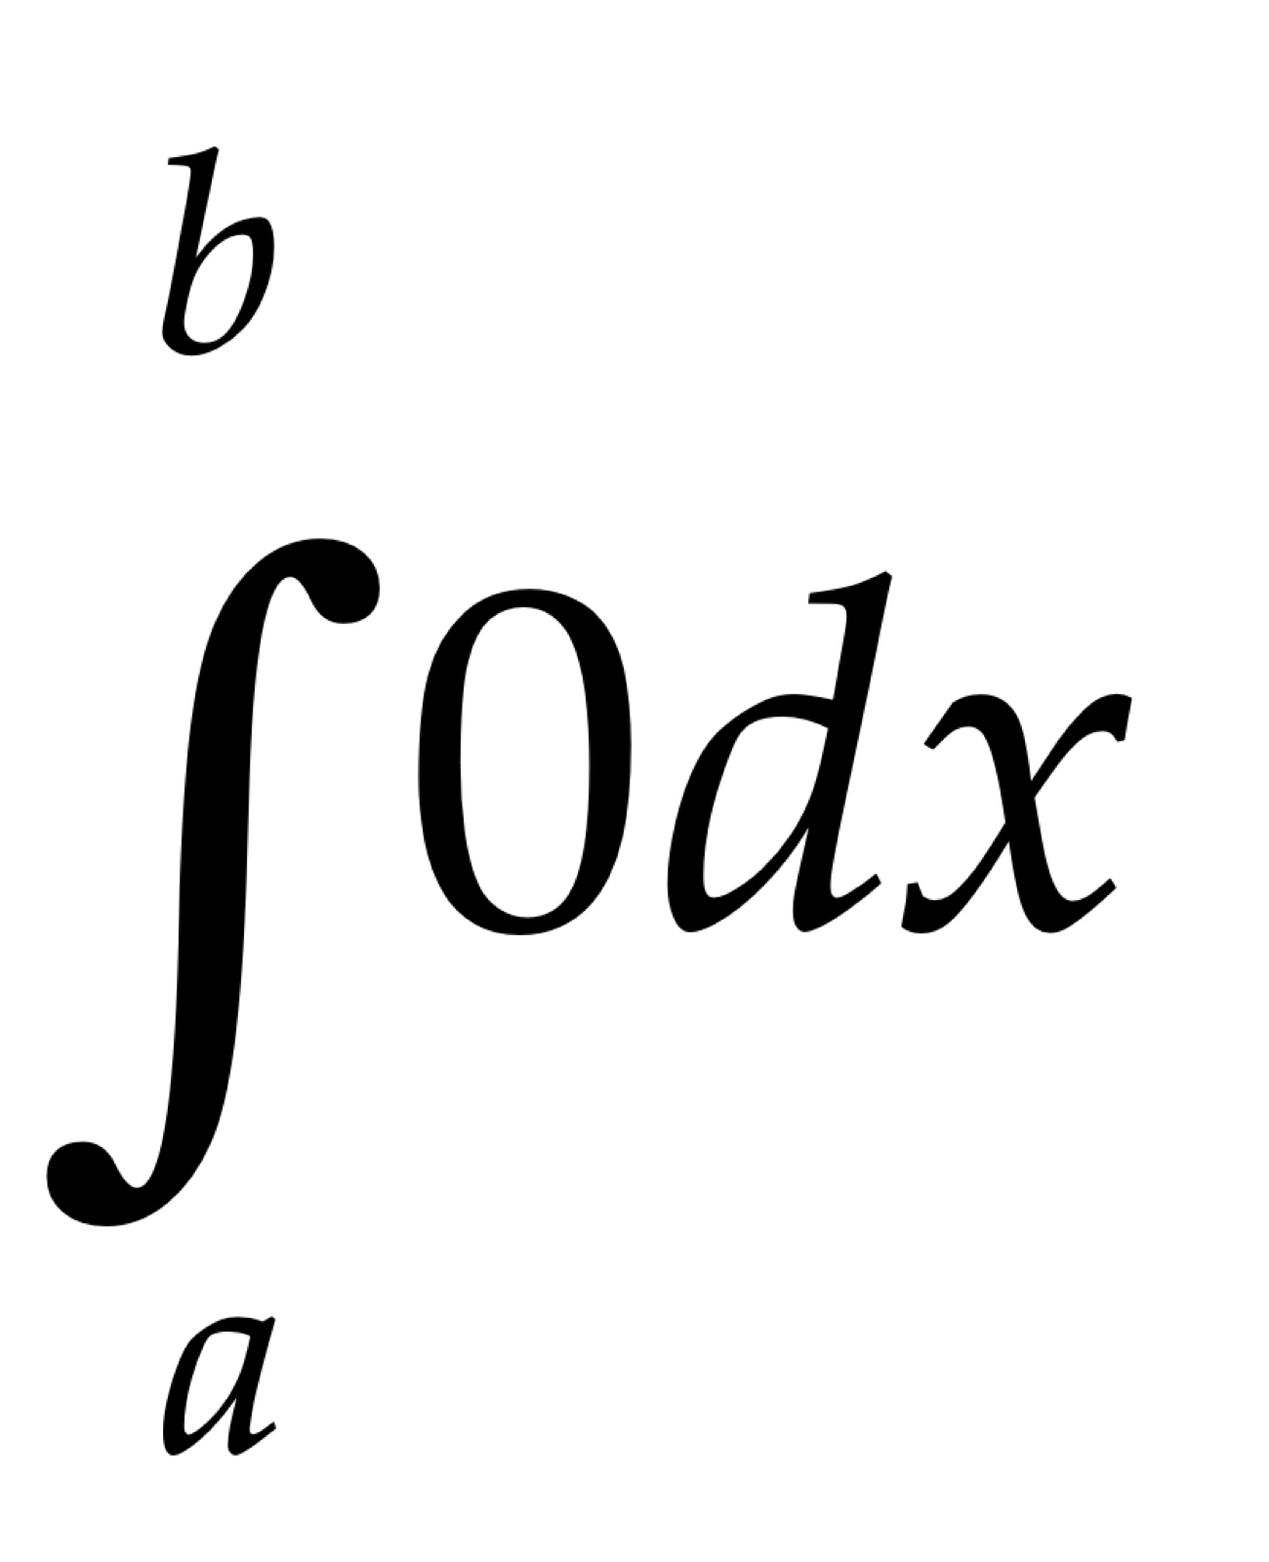
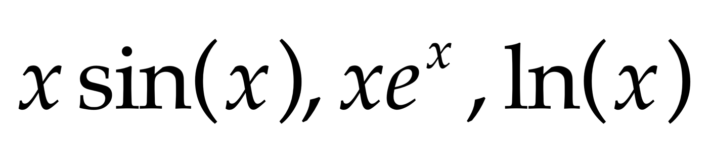
What would you use as an example of ...
A continuous function on R differentiable everywhere except at a single point?
A function whose integral on some finite subinterval of R is 0?
A function whose integral requires integration by parts?
What is informative about these?
What might learners need their attention drawn to?
What are the generic aspects?
Notes:
What are you expecting learners to see being exemplified?
What do want them to see as changeable?
What is exemplary about these?
In how many different ways can you do the first one?

Slide 30
Proposal
The first time you give an example of a mathematical object (not a worked example)
  ask students to write down on a slip of paper what they expect to do with the example
Near the end of the course, when you give (or get them to construct) an example
  ask students to write down on a slip of paper what they expect to do with the example
get them to put their initials or some other identifying mark on the papers so you can track development!

Slide 31
Conjecture
When learners construct their own examples of mathematical objects they:
  Extend and enrich their accessible example spaces
  Become more engaged with, and confident about, their studies
  Make use of their own powers mathematically
  Experience mathematics as a constructive and creative enterprise, a valuable mode of thought

Slide 32
Using |x| ...
... write down a continuous function which is differentiable everywhere on R except at two points;
  and another
  and another
  and another but at three points
What sets of points can be the set of points at which a continuous function on R is not differentiable?
Notes:
Another and another generates a desire to be more varied, more sophisticated, more general

Slide 33
Applying a Theorem as a Technique
Sketch a continuous function on the open interval (-1, 1) which is unbounded below as x approaches ±1 and which takes the value 0 at x = 0.
Sketch another one that is different in some way.
and another; and another
What is common to all of them?
Can you sketch one which does not have an upper bound on the interval?
Notes:
Students had failed to use the theorem about achieving extrema on a closed interval, to apply to this case of an open interval. So tutor asked them to construct examples.

Slide 34
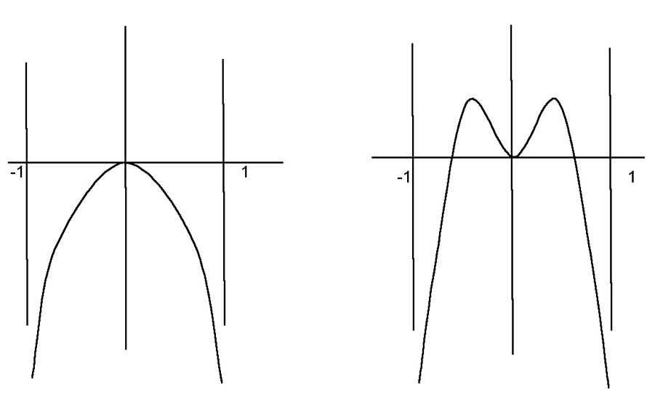
Student Constructions
Notes:
Because it is continuous was all that students offered.
Only when the tutor mentioned that because the function goes to negative infinity at both ends, there cannot be a maximum ‘close’ to an end, so you can locate a subinterval which is closed, did ‘closed & bounded’ cue appropriate steps.

Slide 35
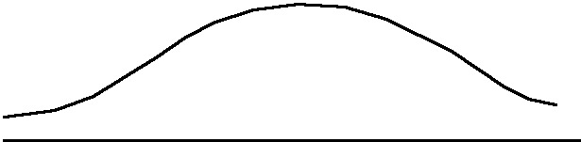
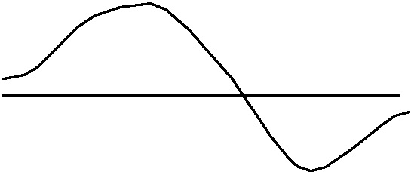
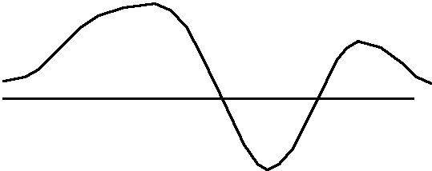
More Student Constructions
What can we change in the conditions of the task and still have the same (or similar) phenomenon, i.e. make use of the same reasoning?
Notes:
Here we want to force the function to have a relative maximum, or a relative extremum.
The tutor then asked what other conditions, for functions defined on other types of domain, would similarly guarantee a maximum, or a minimum.

Slide 36
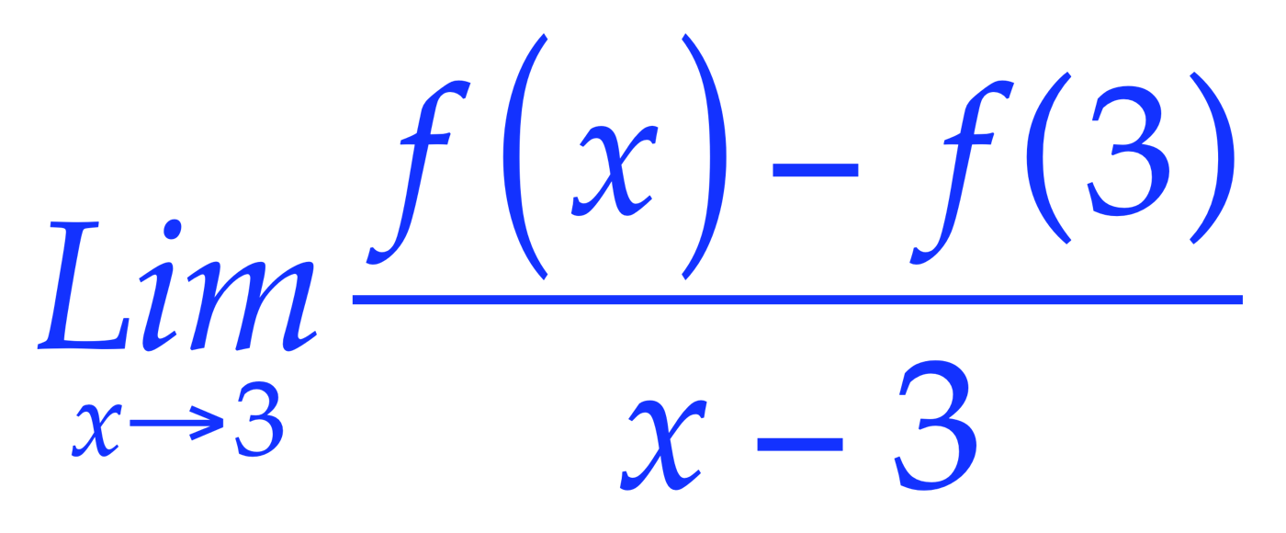
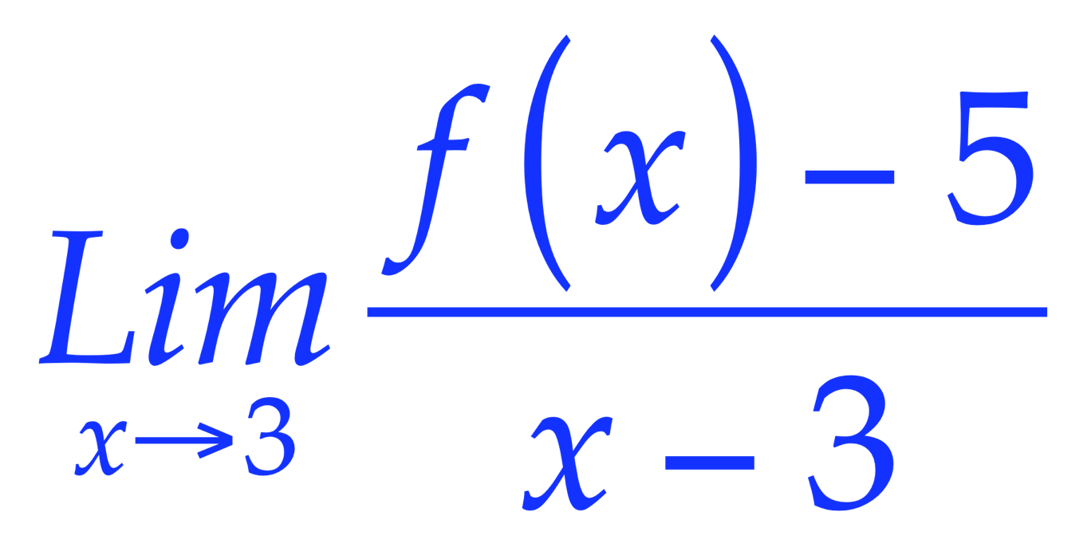
Undoing a Familiar Doing
Familiar ‘doing’:
Given f find
Unfamiliar ‘undoing’:
What can be said about f if
= 2
Notes:
f(x) = 2x+1 + h(x)(x-3)^2 for any h(x) with a limit at 3.
f’(3) = 2

Slide 37
Bury The Bone
Construct an integral which requires two integrations by parts in order to complete it
Construct a limit which requires three uses of L’Hôpital’s rule to calculate it.
Construct an object whose symmetry group is the direct product of four groups
Construct an object whose symmetry group involves wreath products of cyclic groups
Notes:
Alternatives:
construct an object which makes it difficult to see that it is ...
an integration by parts; a use of L’Hopital; that its symmetry group is a direct product; ...

Slide 38
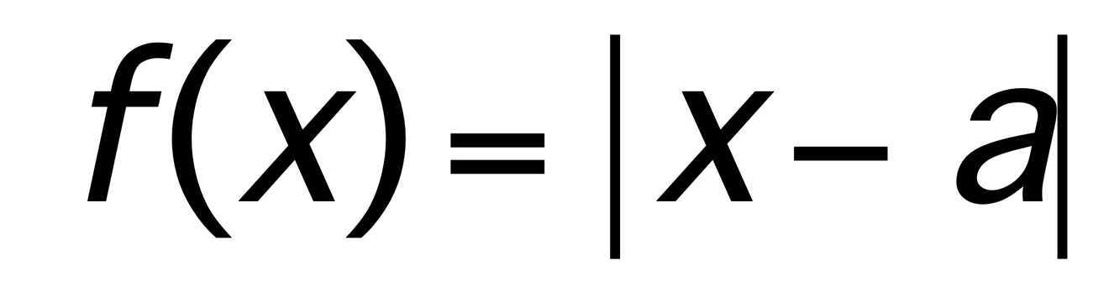
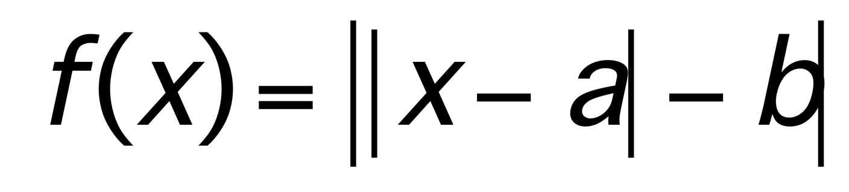
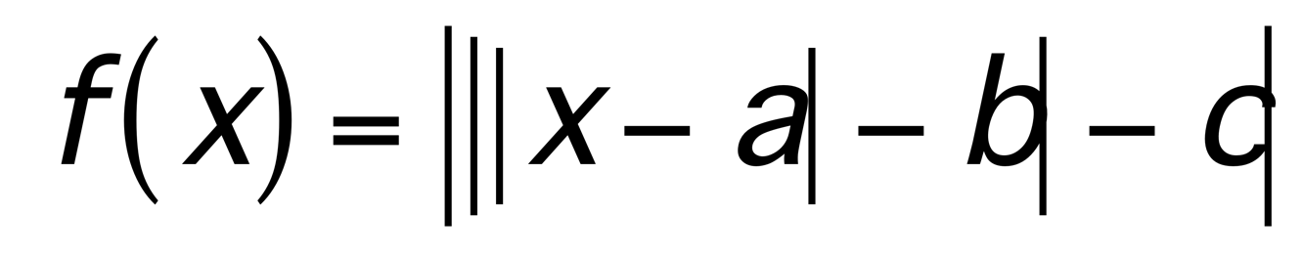
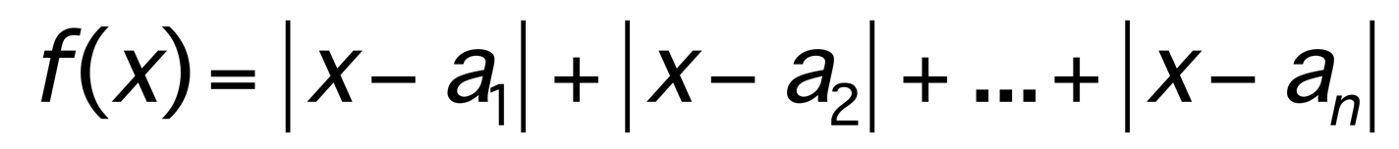
|x|
Of what is |x| an example?
What is the same and what different about
graphs of functions of the form
…
or
Characterise these graphs in some way

Slide 39
The Exemplification Paradox
In order to appreciate a generality, it helps to have examples;
In order to appreciate something as an example, it is necessary to know the generality being exemplified;
so,
I need to know what is exemplary about something in order to see it as an example of something!
What can change and
what must stay the same,
in order to preserve examplehood?
Dimensions of possible variation
Ranges of permissible change
Notes:
Need to break into this ‘shell’
Using the previous ‘examples’, we can explore some pedagogic tactics

Slide 40
Presenting Examples
‘give’ or ‘work through’ examples
use a sorting task
get students to construct some objects for themselves
(another & another)
tinker publicly, even interactively,
with simple examples,
in order to indicate other possibilities

Slide 41
Probing Awareness
Asking learners what aspects of an example can be changed, and in what way.
  learners may have only some possibilities come to mind
  especially if they are unfamiliar with such a probe
Asking learners to construct examples
  another & another; adding constraints
Asking learners what concepts/theorems an object exemplifies
Property Charts

Slide 42
What Makes an Example ‘Exemplary’?
Awareness of
‘invariance in the midst of change’
What can change and still the technique can be used or the theorem applied?
Particular seen as a representative of a space of examples.

Slide 43
Useful Constructs
Accessible Example Space
(objects + constructions)
Dimensions of Possible Variation
  Aspects that can change
Range of Permissible Change
  The range over which they can change
Conjecture:
  If lecturer’s perceived DofPV ≠ learner’s perceived DofPV
  then there is likely to be confusion
  If the perceived RofPCh are different, learners’ experience is at best impoverished
Notes:
Link to Chris Sangwin’s Question Space

Slide 44
Pedagogic Strategies
  Another & Another
  Bury the Bone
  Sequential constraints designed to contradict simple examples
  Doing & Undoing
  Request the impossible as prelim to proof
These are useful as study techniques as well!
Notes:
I have offered you one or two examples of each tactic ... is that sufficient to be exemplary? Is your example-space corresponding to each richer than one example in one mathematical domain?

Slide 45
To Investigate Further
Ask your students what they do with examples (and worked examples, if any)
Compare responses between first and later years
When displaying an example, pay attention to
  What you are attending to so they can too
  how you indicate the DofPV & the RofPCh.
Consider what you could do to support them in making use of examples in their studying

Slide 46
Follow-Up:
PMTheta.com
john.mason @ open.ac.uk
Mathematics Teaching Practice: a guide for university and college lecturers, Horwood Publishing, Chichester, 2002.
Mathematics as a Constructive Activity: learners constructing examples. Erlbaum 2005
Using Counter-Examples in Calculus ICP 2009
Researching Your Own Experience: the Discipline of Noticing RoutledgeFalmer 2002

