Slide 1
Elastic Multiplication
(scaling new heights?)
(appreciating the scale of scaling?)
John Mason
Lampton School
Hounslow
Mar 7 2018

Slide 2
Assumption
We work together in a conjecturing atmosphere
  When we are unsure, we try to articulate to others;
  When we are sure, we listen carefully to others;
  We treat everything that is said as a conjecture, to be tested in our own experience.

Slide 3
Plan
We work together on a sequence of tasks.
We try to trap our thinking, our emotions, and what we actually do as we go.
We make connections with our past experience and make plans for the future.
We consider the claims that
  Multiplication IS NOT repeated addition
  Repeated addition is a form of multiplication
  Multiplication (in school) is scaling
  Multiplication is actually composition

Slide 4
Elastics & Scaling
Imagine an elastic stretched between your two hands.
Imagine stretching it, and letting it shrink.
Now imagine that the middle of the elastic has been marked.
  Where is the mark to be found as you stretch and shrink the elastic?
Now imagine that a point one-third of the way along has been marked as well.
  Where is that mark to be found as you stretch and shrink the elastic?
You now have a way of
measuring fractions of things!
Note the invariance of the relative position in the midst of change: stretching and shrinking
You can enact a fraction
as an action
Notes:
Note the doing and undoing: scaling by a factor of 3 (stretching by 2) and scaling by ½ (shrinking by ½).
Note the invariance of the relative positions of ½ as the original object changes size.

Slide 5
Imagining the Situation
What questions occur to you about this situation?
How might the situation be exploited mathematically?
Make a line segment on a piece of paper which is a little bit longer than your elastic when not stretched.
  Keep one end of the elastic at one end of your segment.
  Stretch the elastic so the other end is at the other end of your segment
If you scale by a factor of 2 using the elastic,
where does the 1/3 point on the elastic get to on the line segment?
If you stretch the elastic so that its 1/3 point aligns with the 1/2 way point on the segment, what was the scale factor?

Slide 6
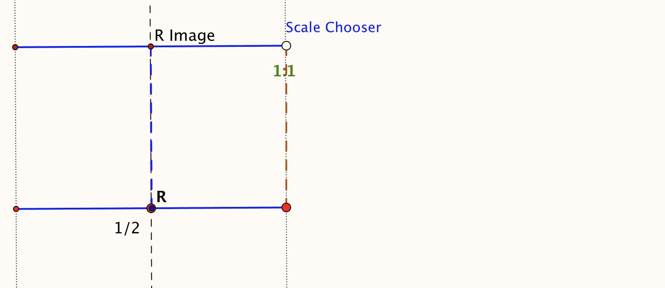
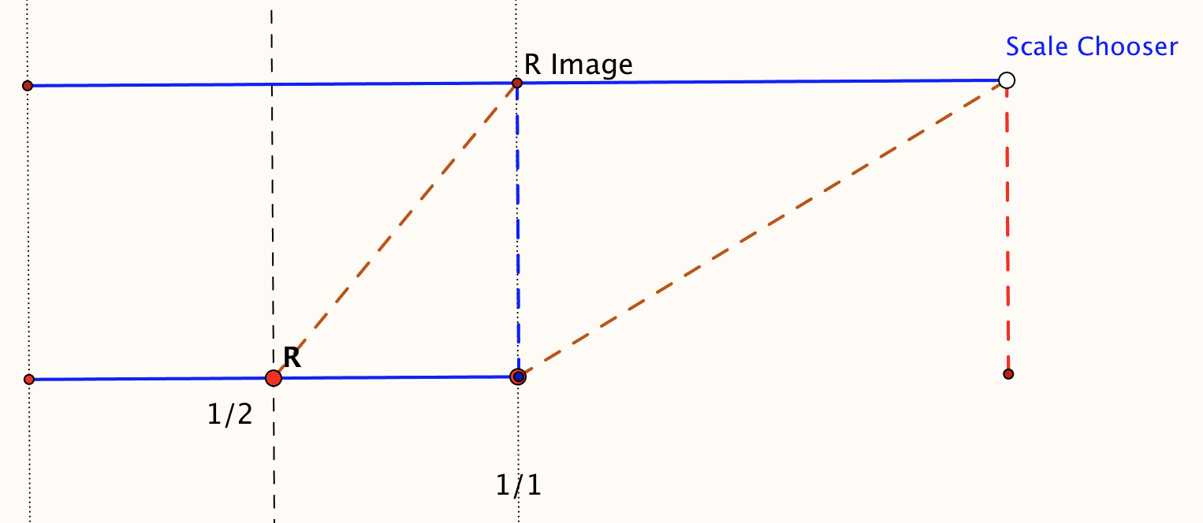
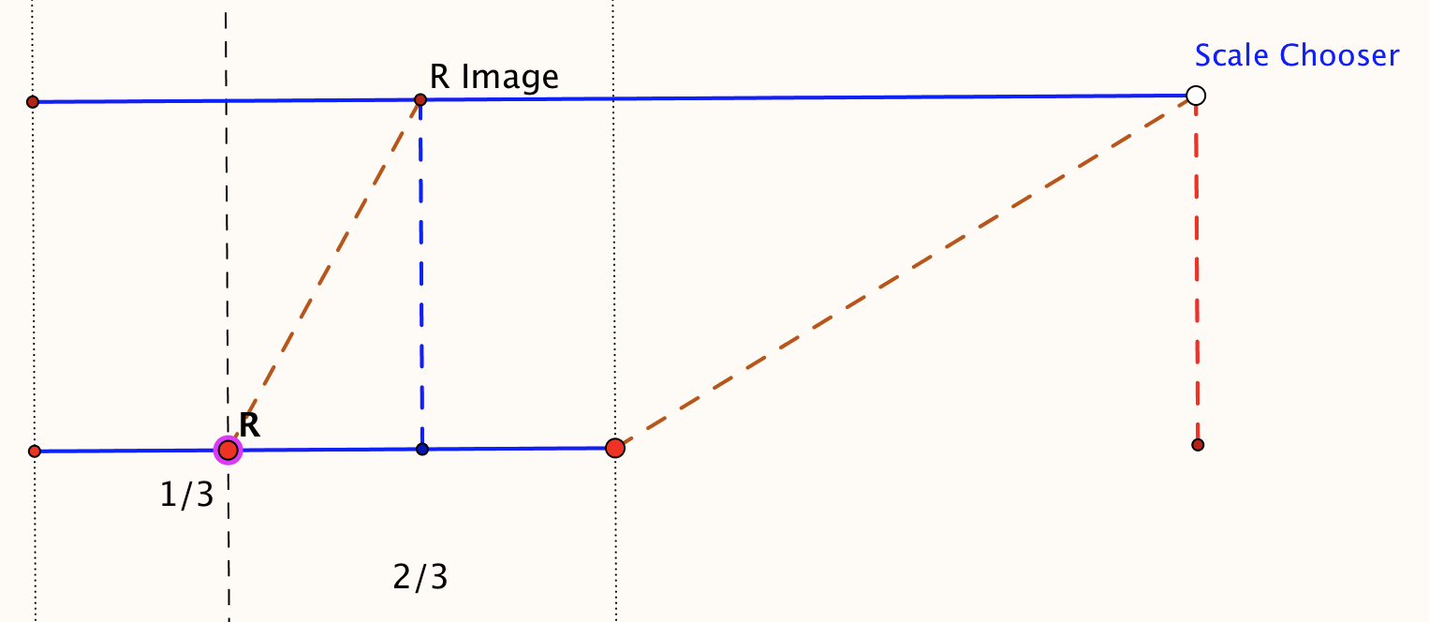
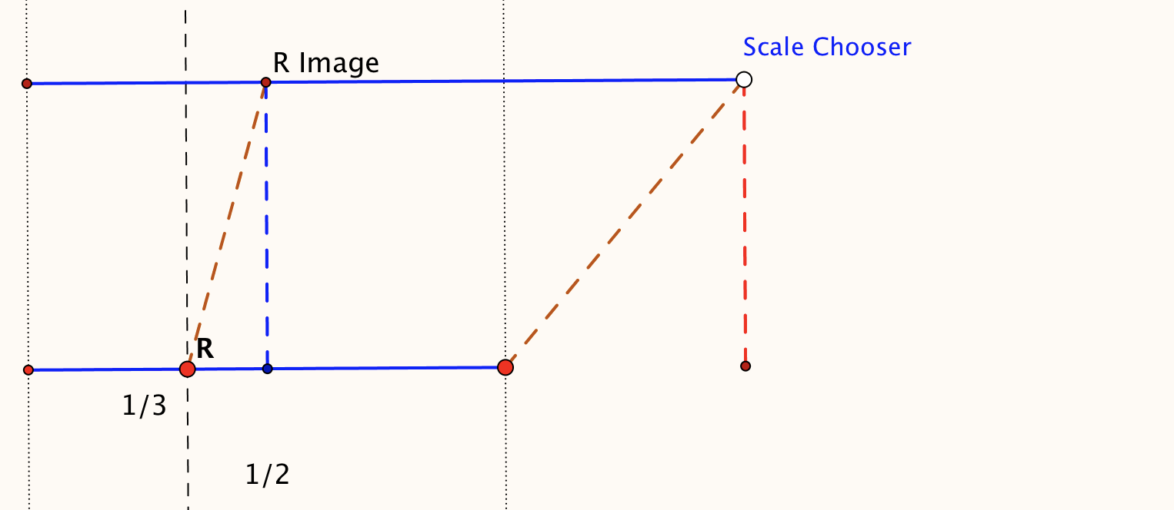
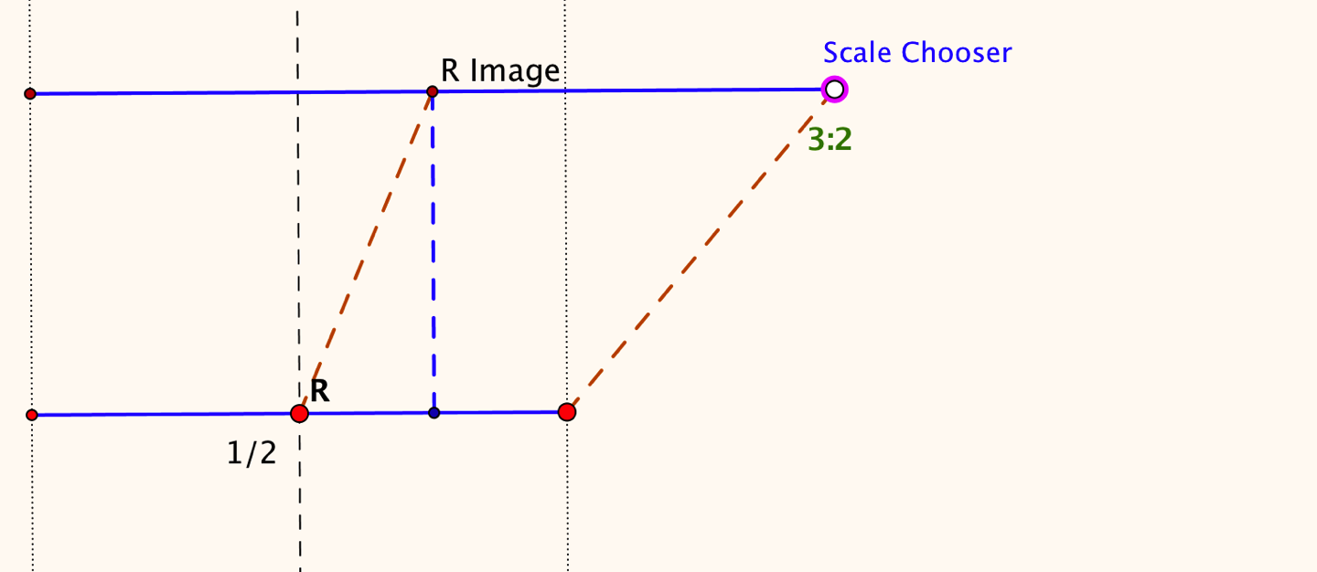
Depicting Elastic Stretching
How might you depict both the original elastic and when it is stretched?

Slide 7
Scaling on a Number Line
Imagine a number line, painted on a table.
Imagine an elastic copy of that number line on top of it.
Imagine the elastic is stretched by a factor of 2 keeping 0 fixed.
  Where does 4 end up on the painted line?
  Where does -3 end up?
  Someone is thinking of a point on the line; where does it end up?
  What can we change and still think the same way?
Return the elastic line to match the original painted line.

Slide 8
More Scaling on a Number Line
Imagine a number line, painted on a table.
Return the elastic line so as to match the original painted line.
Imagine the number line is stretched by a factor of 2 but this time it is the point 1 that is kept fixed.
Where does 4 end up on the painted line?
Where does -3 end up?
Someone is thinking of a point on the line; where does it end up?
What can we change and still think the same way?
1 + 2(4 - 1)
1 + 2(-3 - 1)
Is the point to be scaled
+
σ
( – )
Is the fixed point

Slide 9
Even More Scaling on a Number Line
-8
-7
-6
-5
-4
-3
-2
-1
0
1
2
3
4
5
6
7
8
9
Imagine the number line is stretched by a factor of 2 keeping 1 fixed.
Now imagine the number line is further stretched by a factor of 3 but this time it is the original point 5 that is kept fixed.
  Where does the original 4 end up on the painted line?
  Where does the original -3 end up?
  Someone is thinking of a point on the original line;
  where does it end up?
5 +
3([
1 + 2(4 – 1)
] – 5)
F₂ + s₂([F₁ + s₁(x – F₁)] – F₂)

Slide 10
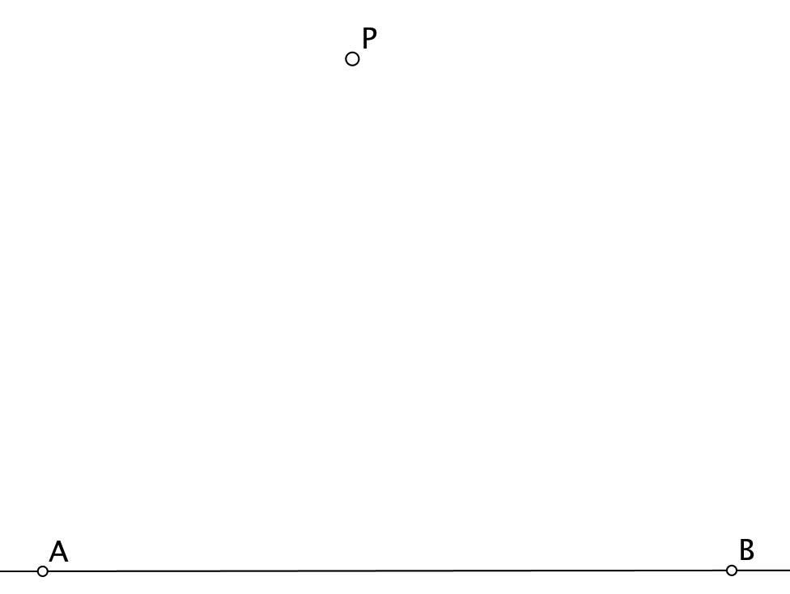
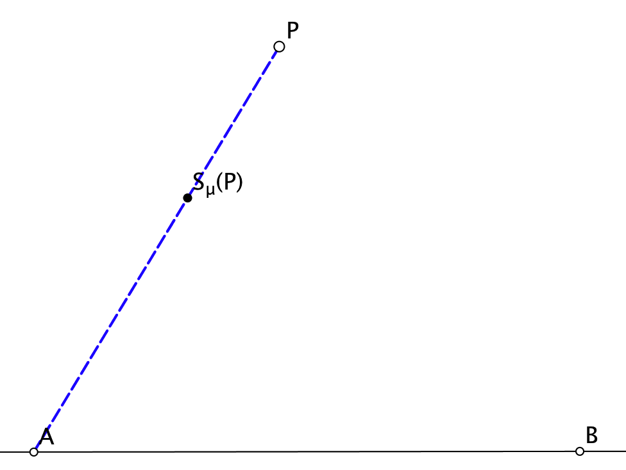
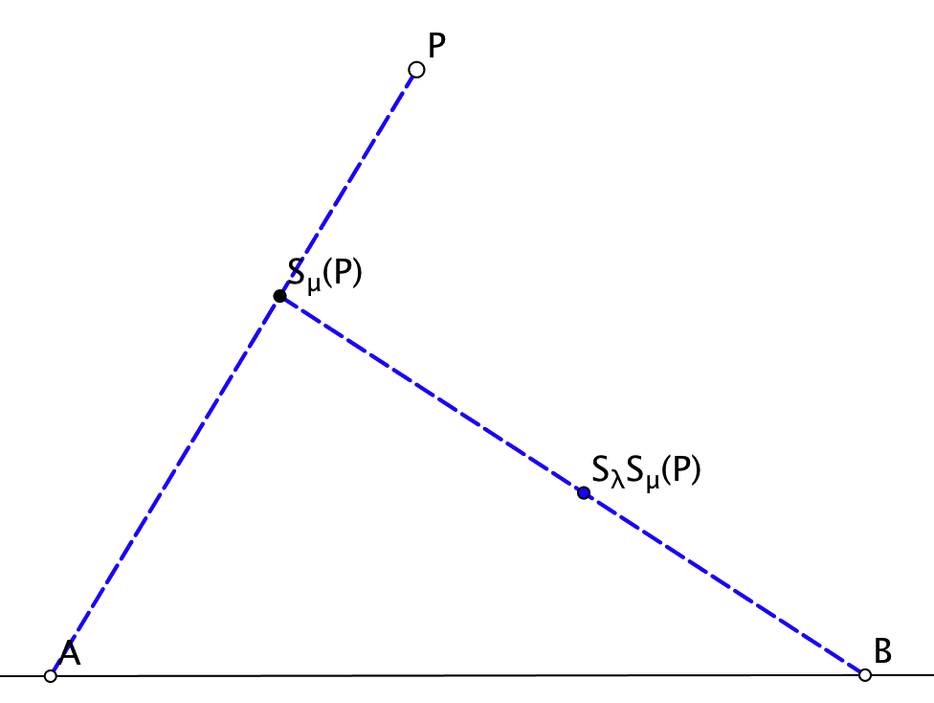
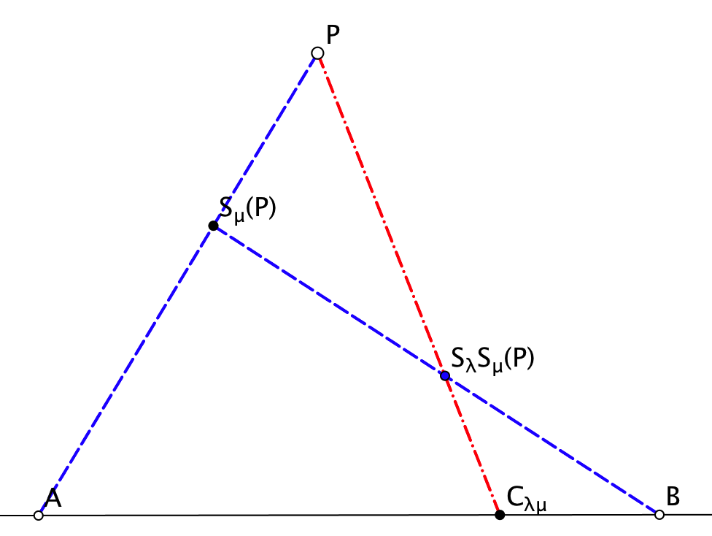
Compound Scaling (2d)
What is the effect of scaling by one factor and then scaling again by another factor, using the same centres?
What if the centres are different?

Slide 11
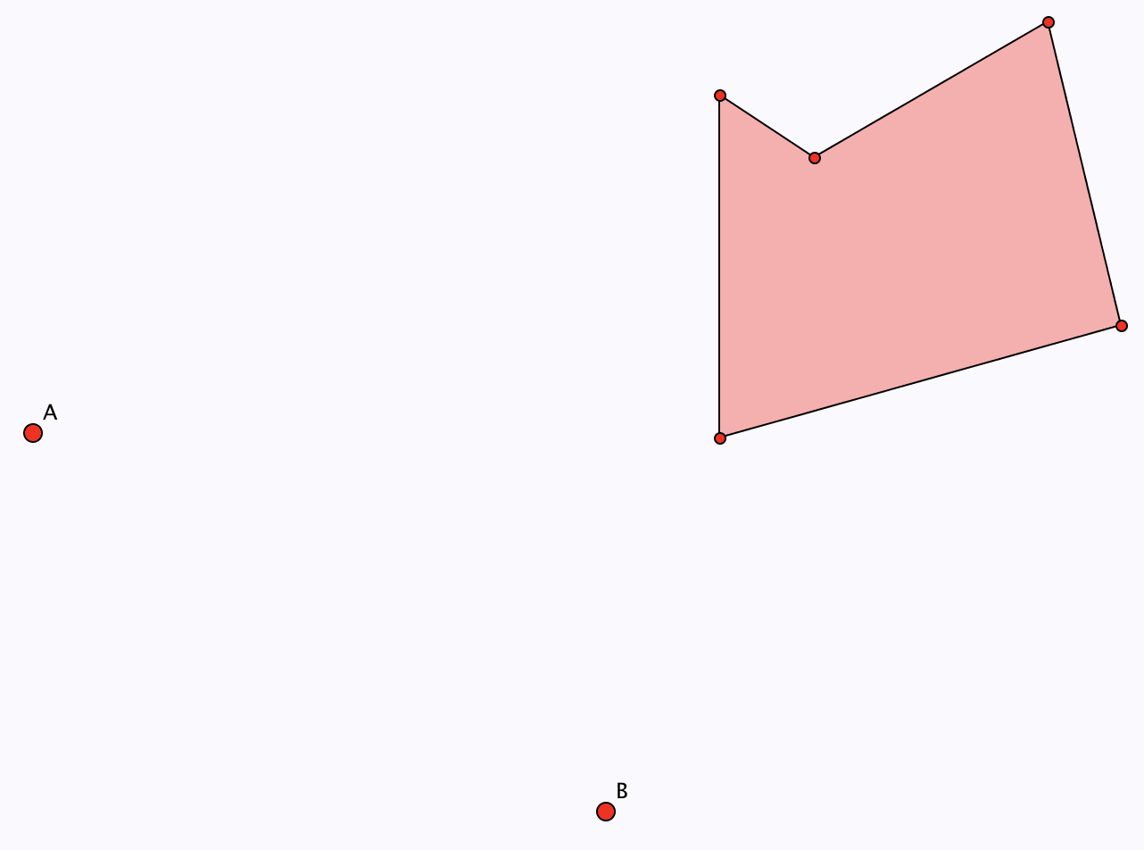
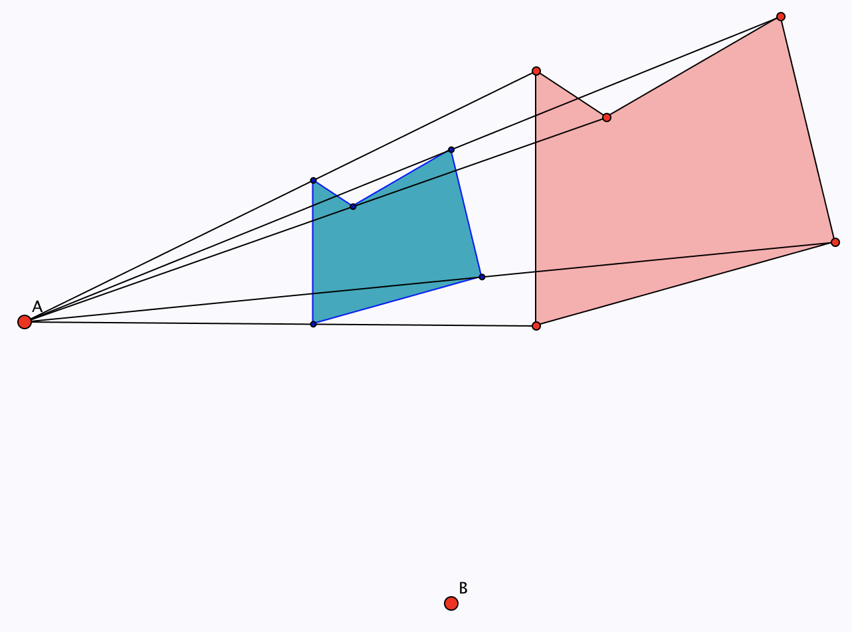
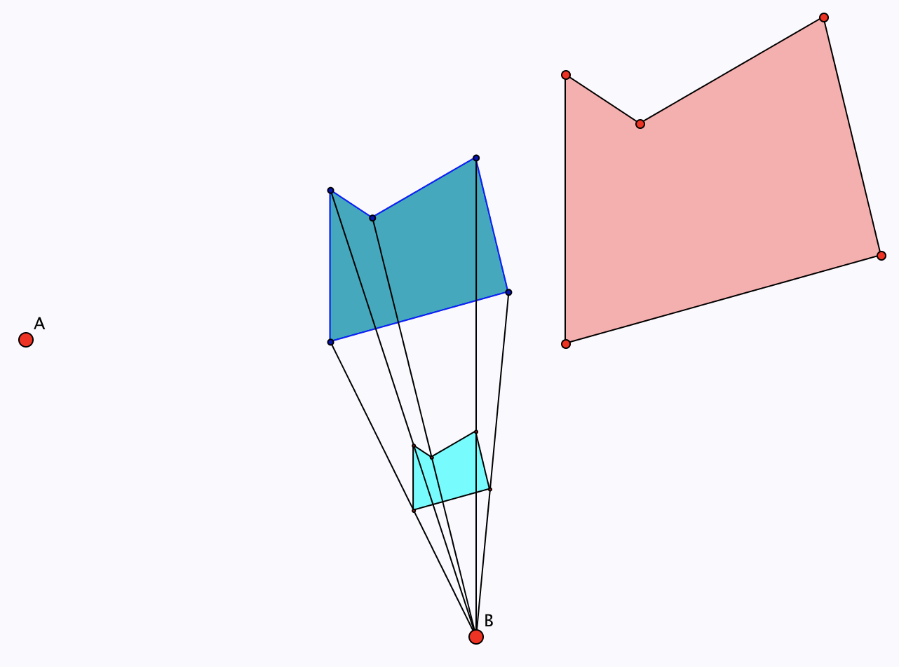
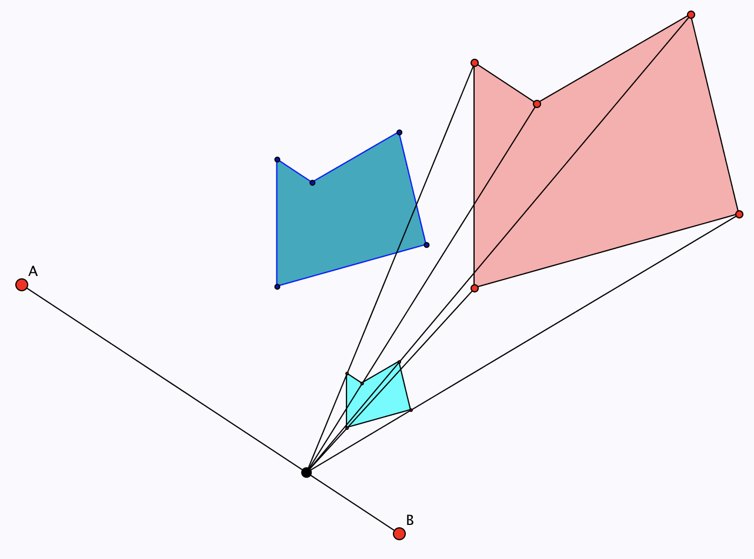
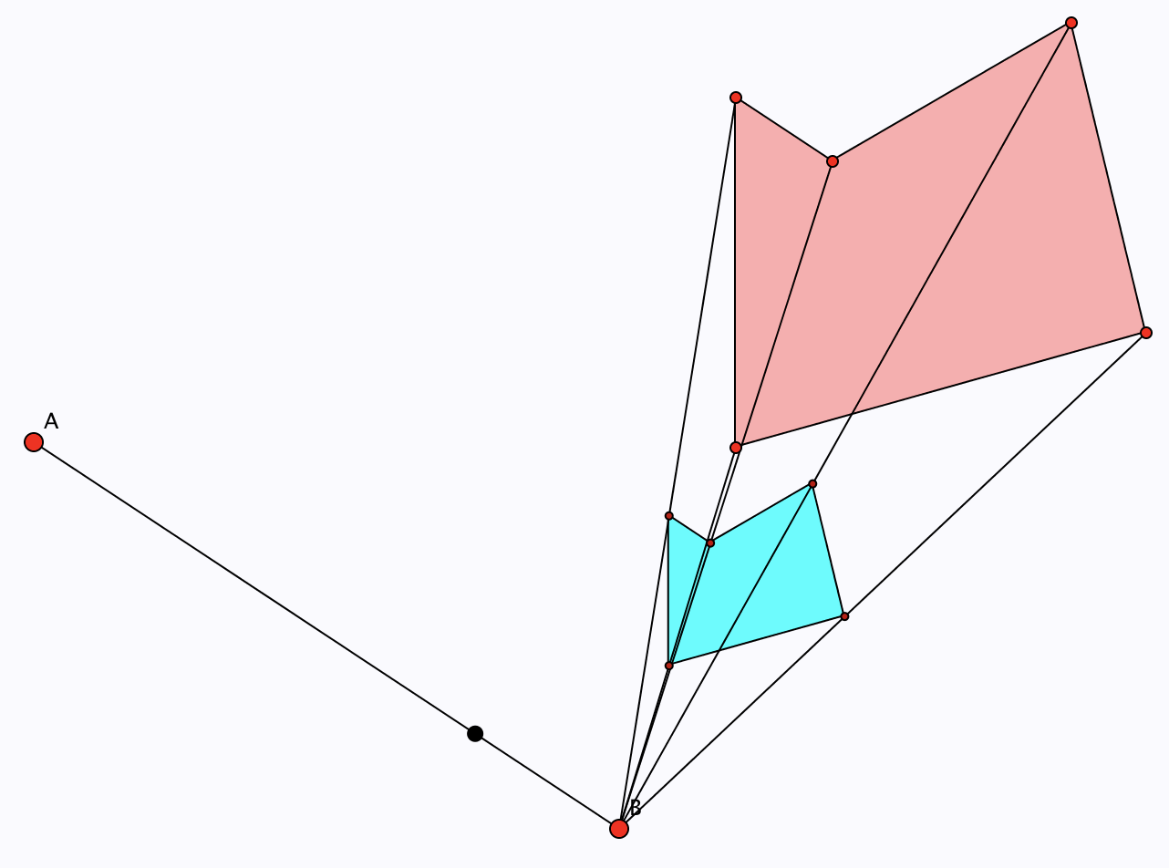
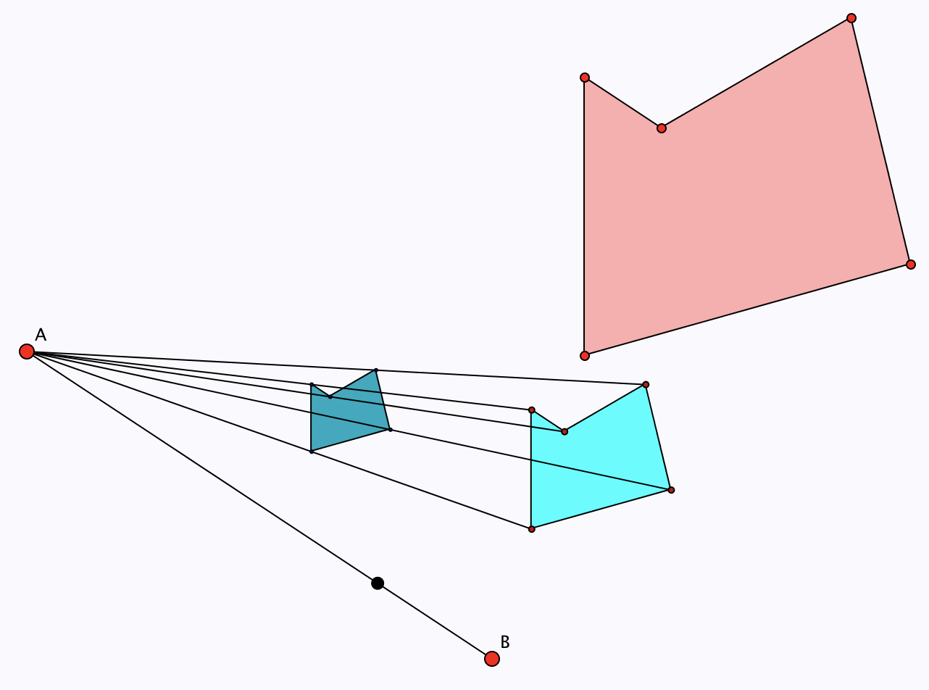
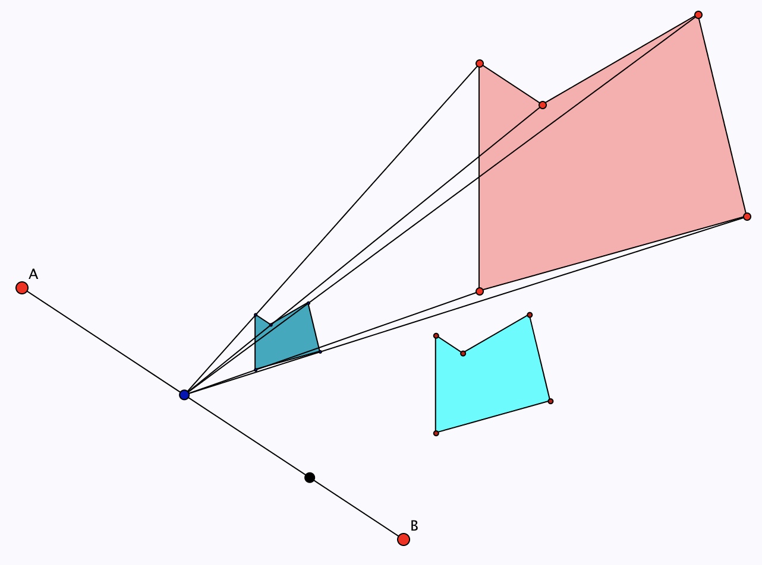
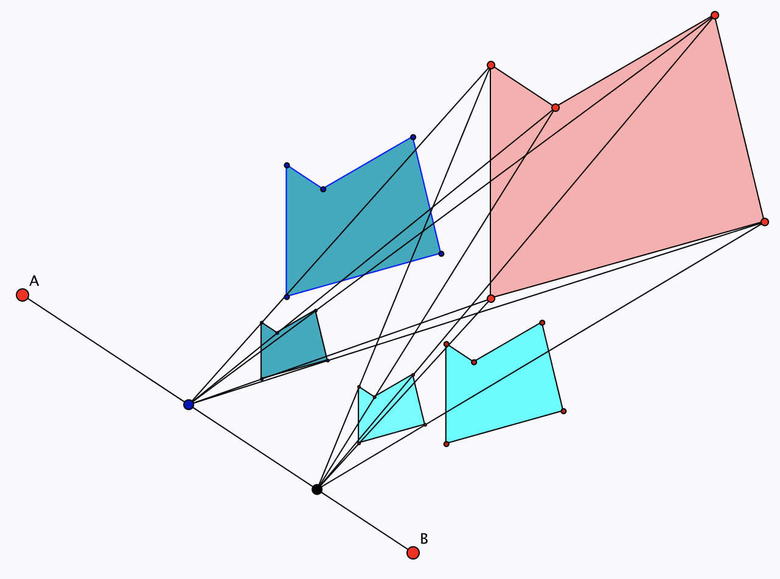
Compound Scaling (2d): Polygons

Slide 12
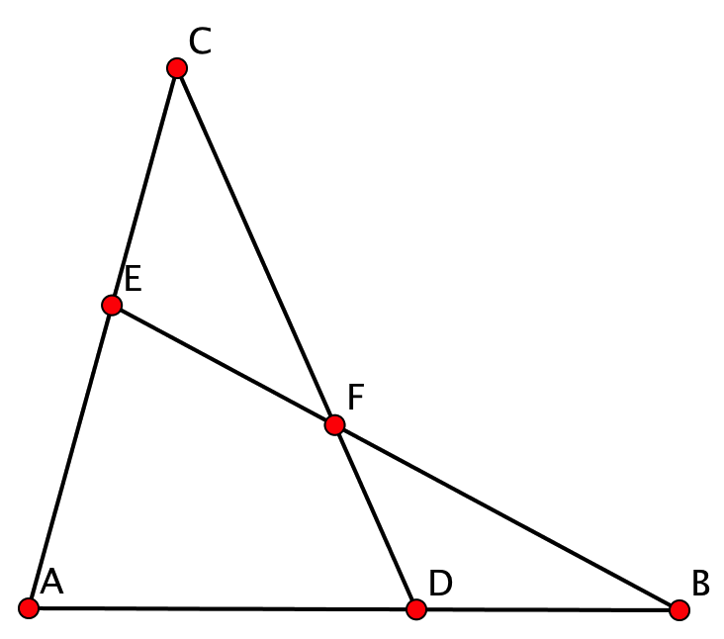
The Scaling Configuration
P | 1st Centre | 2nd Centre | Combined Centre | Image of P
C | A | B | D | F
B | A | C | E | F
A | B | C | E | F
F | D | E | B | A
E | F | D | C | A
…
There are 48 different ways of ‘seeing’ the diagram!

Slide 13
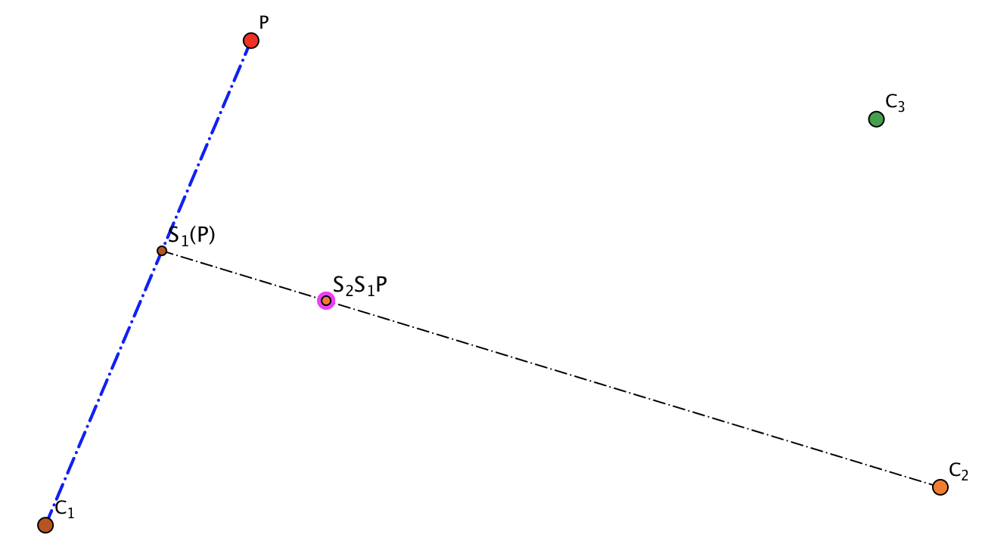
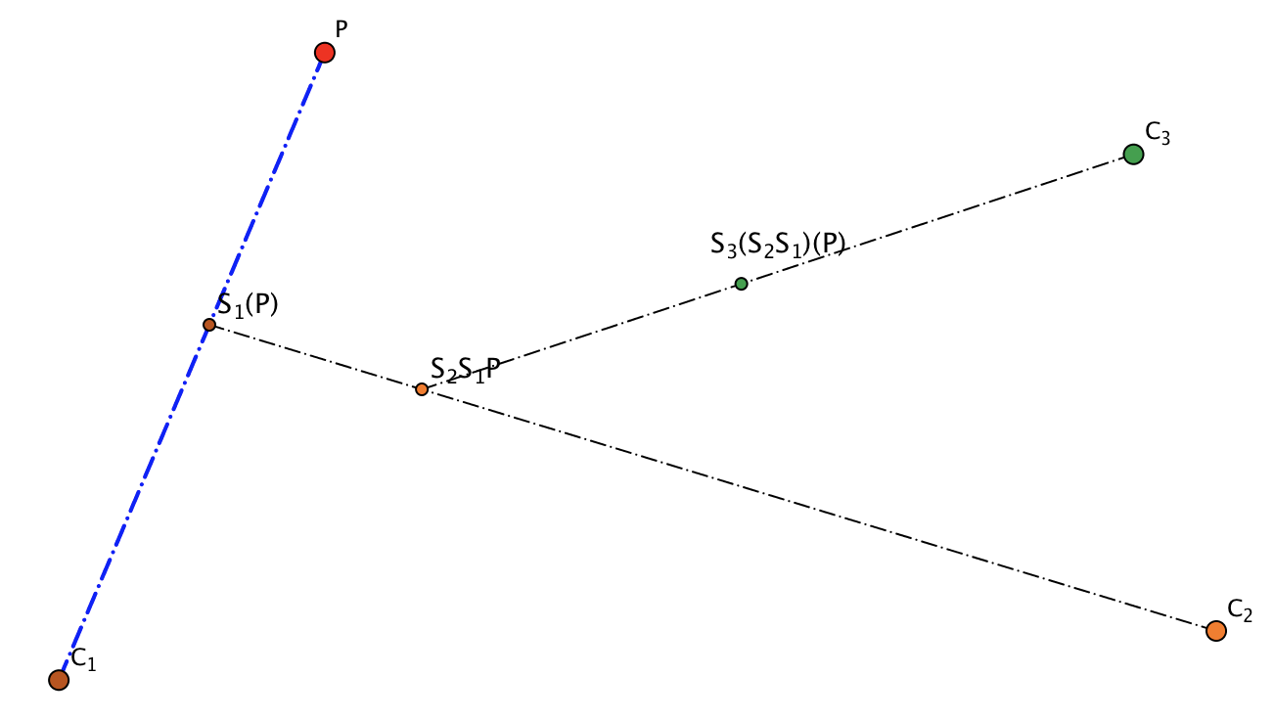
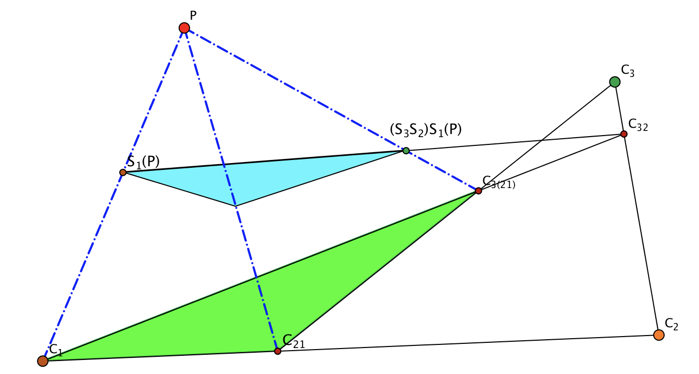
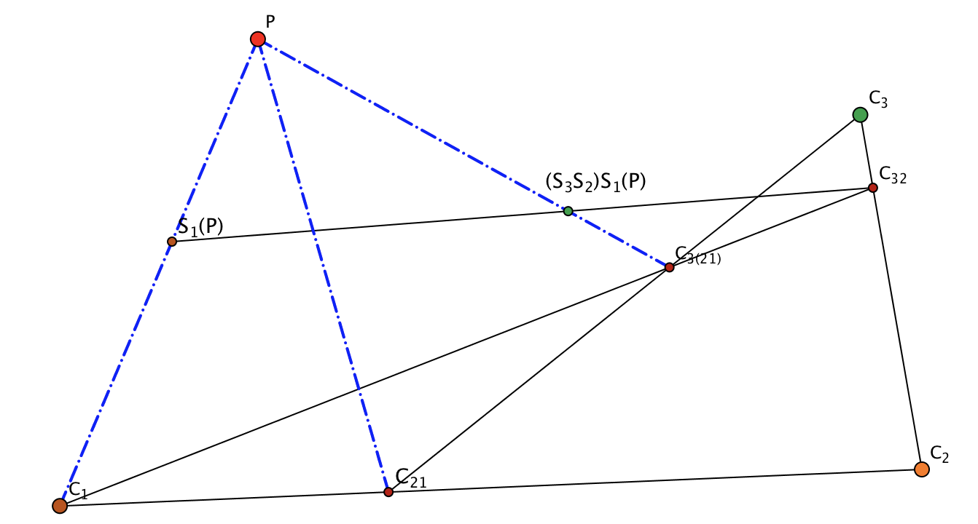
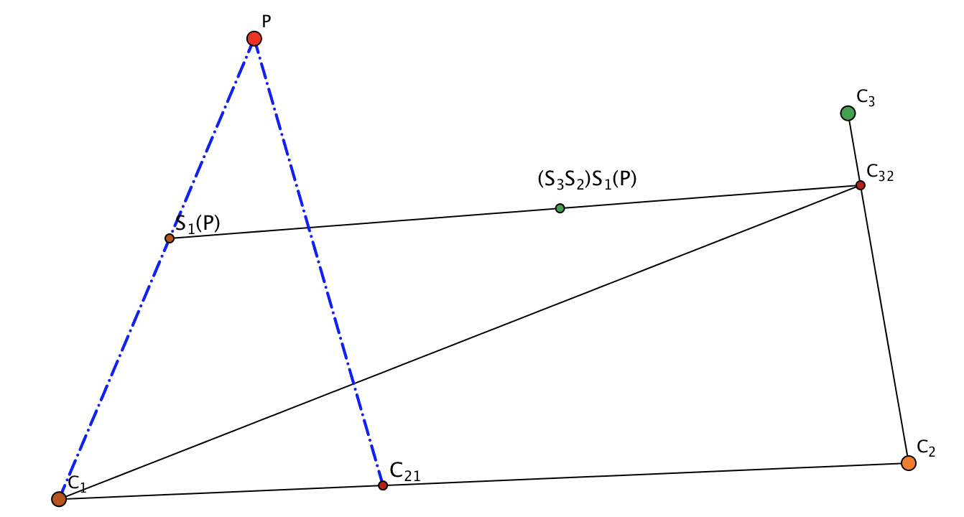
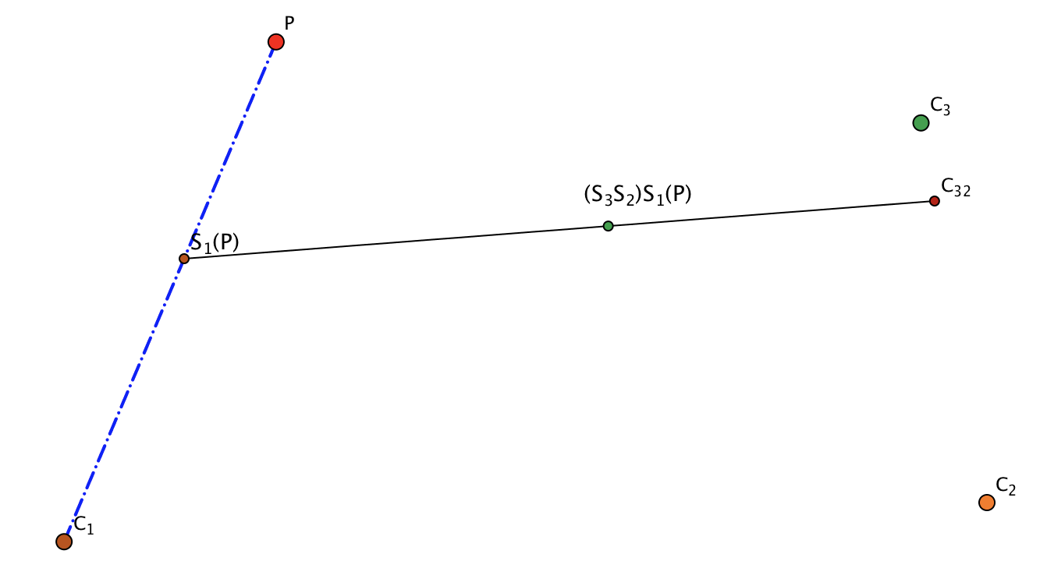
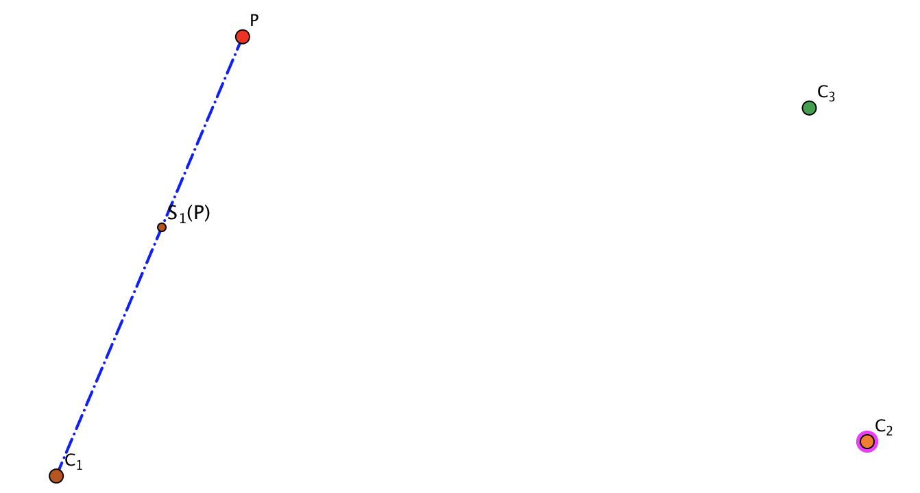
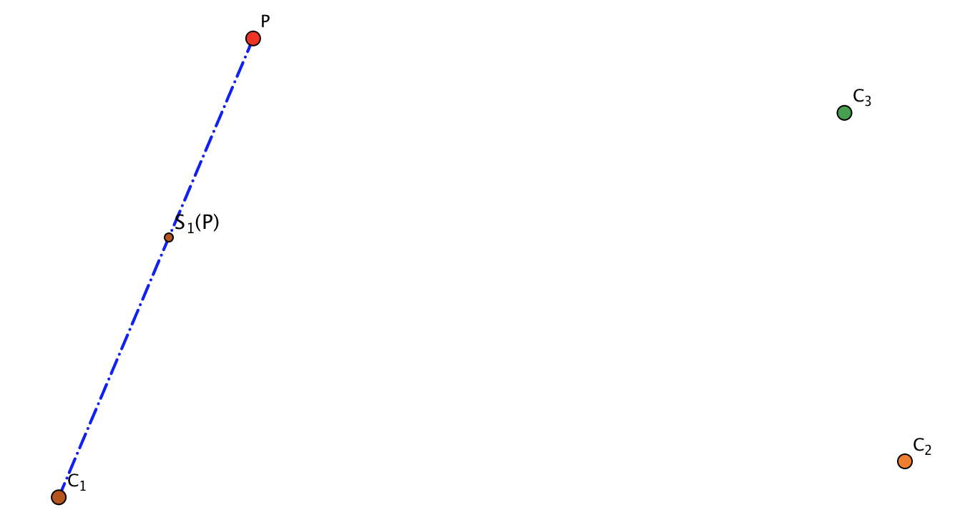
Three Scalings (associativity)
Depict the situation of three scalings looked at associatively.
Start again associating differently

Slide 14
Reflection
What mathematical actions did you experience?
What emotions came near the surface?
What mathematical powers and themes were you aware of?
Powers
Imagining & Expressing
Specialising & Generalising
Conjecturing & Convincing
Organising & Classifying
Themes
Doing & Undoing
Invariance in the midst of change
Freedom & Constraint

Slide 15
Some Observations
Use of mental imagery
Use of Variation
Inviting imagining the situation before setting a word problem.
Inviting depiction before presenting a diagram
Moving from doing to depicting to denoting
(concrete–pictorial–symbolic)
Pace when using animations
Role of attention in
  Holding Wholes
  Discerning details
  Recognising Relationships
  Perceiving Properties as being instantiated
  Reasoning on the basis of agreed properties

Slide 16
To Follow Up
PMTheta.com
  JHM Presentations
John.Mason@open.ac.uk

