Slide 1
Variation/Invariance: pupils’ experience
The Open University
Maths Dept
Promoting Mathematical Thinking
University of Oxford
Dept of Education
Anne Watson and John Mason
Every Child Counts
Edge Hill, Birmingham, March 2018

Slide 2
Ways of Working
We work through lived experience, ours and yours
We offer tasks for you, working with colleagues
Focus on what is available for you/learners to see, hear, read and do

Slide 3
Task 1: Taxi cab geometry
Taxi-cab distance Dist(P, A) is the shortest distance from P to A on a two-dimensional coordinate grid, using horizontal and vertical movement only. We call it the taxicab distance.
For this exercise A = (-2,-1). Mark A on a coordinate grid.
For each point P in (a) to (h) below calculate Dist(P, A) and mark P on the grid:
P = (1, -1)
(b) P = (-2, -4)
(c) P = (-1, -3)
(d) P = (0, -2)
(e) P =
(f) P =
(g) P = (0, 0)
(h) P= (-2, 2)

Slide 4
Reflection
How was it for you?
How did the variation in the examples influence what happened for you?
Have you made progress towards ‘mastery’ of taxi-cab geometry? What did progress mean for you?
Your conjectures about the role of variation - write them down, ready to modify them later maybe
Conjecture: we are more the same than we are different
Conjecture: we ‘see’ and act differently because of past experience, prior knowledge, social assumptions, …
What preparation might have helped you? (what did you have to ask, watch, etc. before you could get started?)

Slide 5
Task 2: Adding Fractions
Ready to practise?

Slide 6
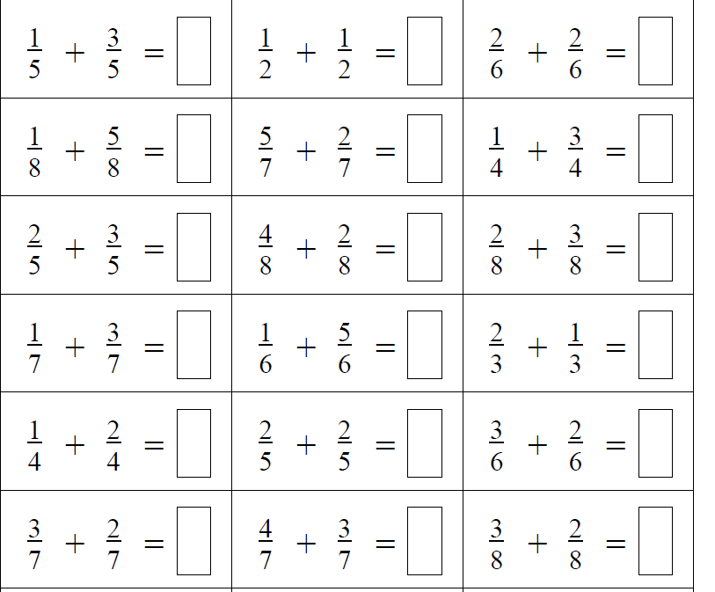

Slide 7
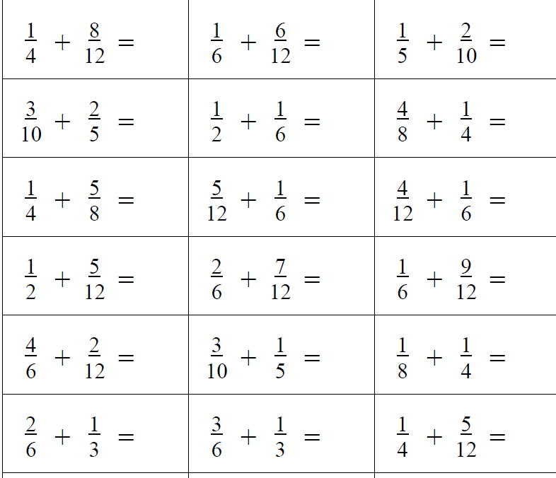

Slide 8
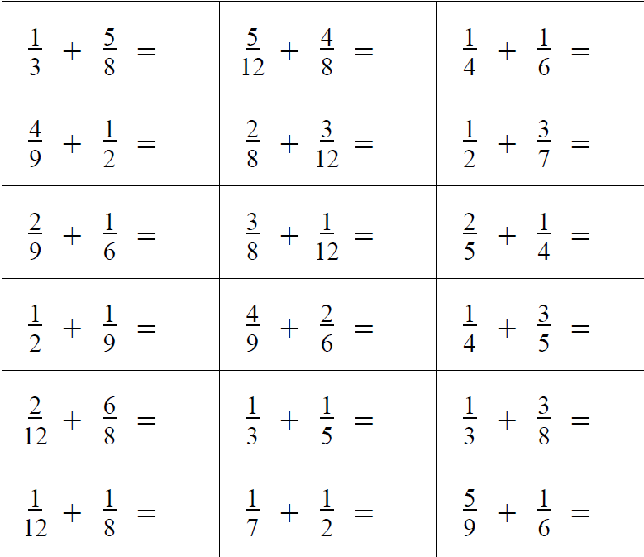

Slide 9
Once a pattern-action is noticed, it keeps being activated!
Were any of these more interesting than any others?
Were you thinking about the meaning – the fractions?

Slide 10
What for learners might link
with the previous slide?

Slide 12
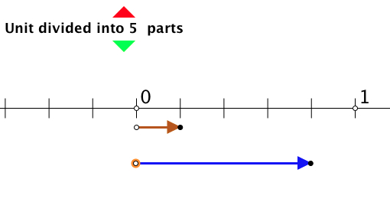
Number Line Fractions
Notes:
Fractions applet offers model for sums to 1 of fractions with the same denominator, i.e. you can position one fraction and predict where the second will take you.
Vary the denominator, also do sums to < 1, and then do sums to > 1 so as to model the meaning of mixed fractions.
Extend to different denominators where one is a multiple of the other.
Loss of fluency; increase in meaningfulness

Slide 13
Reflection
What has stood out for you so far?

Slide 14
Variation Features
critical aspects
key points
difficult points
hinges, pivotal points, ….

Slide 15
Design of the question sequence for number-line fractions applet
Content
Same denominator
Coordinating different denominators
Sums to 1
Going beyond 1
Tenths
Comparing to decimal notation etc.
Pedagogy
Diagram maintaining link with meaning
Teacher choice of examples
Why tenths?
Order (e.g when to do sums to 1 and why)
Learner generated examples

Slide 16
Task Considerations
Intended / enacted / lived object of learning
Author intentions
Teacher intentions
Learner experience
Didactic Transposition
Task
Author intentions
Teacher intentions
As presented
As interpreted by learners
What learners actually attempt
What learners actually do
What learners experience and internalise
Expert awareness is transformed into Instruction in behaviour

Slide 17
13
13 + 0 = 13
12 + 1 = 13
11 + 2 = 13
10 + 3 = 13
9 + 4 = 13
8 + 5 = 13
7 + 6 = 13
6 + 7 = 13
5 + 8 = 13
4 + 9 = 13
3 + 10 = 13
2 + 11 = 13
1 + 12 = 13
0 + 13 = 13
-1 + 14 = 13
-2 + 15 = 13
-3 + 16 = 13
…
What is available to be learned?
…
16 + -3 = 13
15 + -2 = 13
14 + -1 = 13
Notes:
Analysis of variation
What is available to be perceived/understood?
What is available to question and extend?
What else is available to vary next? (total; beyond 0 + 13; not whole numbers; representation st.line; more than two numbers …)
13 as placeholder for the same considerations with other numbers – generalisation
What do these different possibilities offer learners?
Partitions of 13; number bonds to 20; subskill for subtraction decomposition method
Extending number into negatives, fractions etc. continuity
Two-dimensional representation of number relations and working backwards from point on the line to a particular case: reasoning ‘for all ….’
Practice in adding

Slide 18
“Story of 13”
13 =
13 =
13 =
13 =
6 + 7
What is available to be learned?
3 + 4 + 6
Four operations;
Using 1, 2, 3, 4, 5
1 + 2 + 4 + 6
(4 ÷ 1) + (5 – 2) x 3
What other numbers can be made using four operations and consecutive numbers?
Notes:
Story of 13; what other ways can we make 13, given as many numbers and operations as I choose?
Creativity
Sharing of different methods
When is dividing a problem
Easier if they know number bonds and multiplication facts: do they learn these by doing this task? or do they frequently have to slow down to do a calculation? or do they use calculators? Do they reflect on work done: What can I do now that I could not do before?
Is 13 a placeholder for generalities?? Sometimes but not in all constructions

Slide 19
13
Story of 13, constrained
What is available to be learned?
What next and why?

Slide 20
Story of 13 constrained
Same?
Possibly different?
Required to be different?
number
= 13
At each stage of filling it in, how much freedom do you have?
What are the constraints?
operation
Same?
Possibly different?
Notes:
Three shapes (why not all the same? – connect forward with algebra)
Make 13
Do you spend your time reasoning, ‘if … then ….’ or counting?
Is 13 a placeholder for generalities.

Slide 21
Design of a question sequence
Construct an object subject to constraints
and another
and another
what new things are available to be seen, read, heard, done?
Alter constraints what new things are available to be seen, read, heard, done?
Variation or variety?

Slide 22
Implications for quality of teaching
Critical aspects; focus; difficult points; hinges
Anticipate what variation is necessary to see, hear, read, do, construct, construe …
Variation to draw attention to the critical aspects and focus, not to complexify
Representations matter (because the concept is abstract)
Fluency moves away from meaning; matching representations keeps meaning
Lived object of learning; what they see, hear, read, do; what generalisations is it possible to make from their experiences?

Slide 23
Reflection on the effects of variation on you
What struck you during this session?
What for you were the main points (cognition)?
What were the dominant emotions evoked (affect)?
What actions might you want to pursue further? (awareness)
Notes:
Chi et al

Slide 24
Follow Up
PMTheta.com
Joint Presentations (for these slides)
Applet(s)
Thinkers (ATM)
Questions & prompts for Mathematical Thinking: Primary) (ATM)
Contact us
Annewatson1089@gmail.com

