Slide 1


Roles for Examples in Teaching & Learning
Mathematics
Copenhagen
May 2021
in the time of Corona

Slide 2
Outline
Using examples when ‘doing’ mathematics
Using examples when teaching
Using examples as a learner

Slide 3
To get started ….
For what pairs of numbers can 48 be the Lowest Common Multiple?
For what triples?
Can 48 ever be the Lowest Common Multiple of a set of 9 distinct numbers?
Extension
  For how many distinct pairs of numbers {a, b} is n the Lowest Common Multiple of a and b?

Slide 4
Examples
An example is …
  a particular case of some larger class [of objects] about which and with which to generalise and reason: concepts, representations, questions, methods etc.
An (accessible) Example Space is …
  a space or collection of examples with tools for tinkering, extending etc., which comes to mind in a particular situation
(Watson & Mason 2005)

Slide 5
So far …
How have you used examples so far?
How have we used examples so far?
Please use the chat!

Slide 6
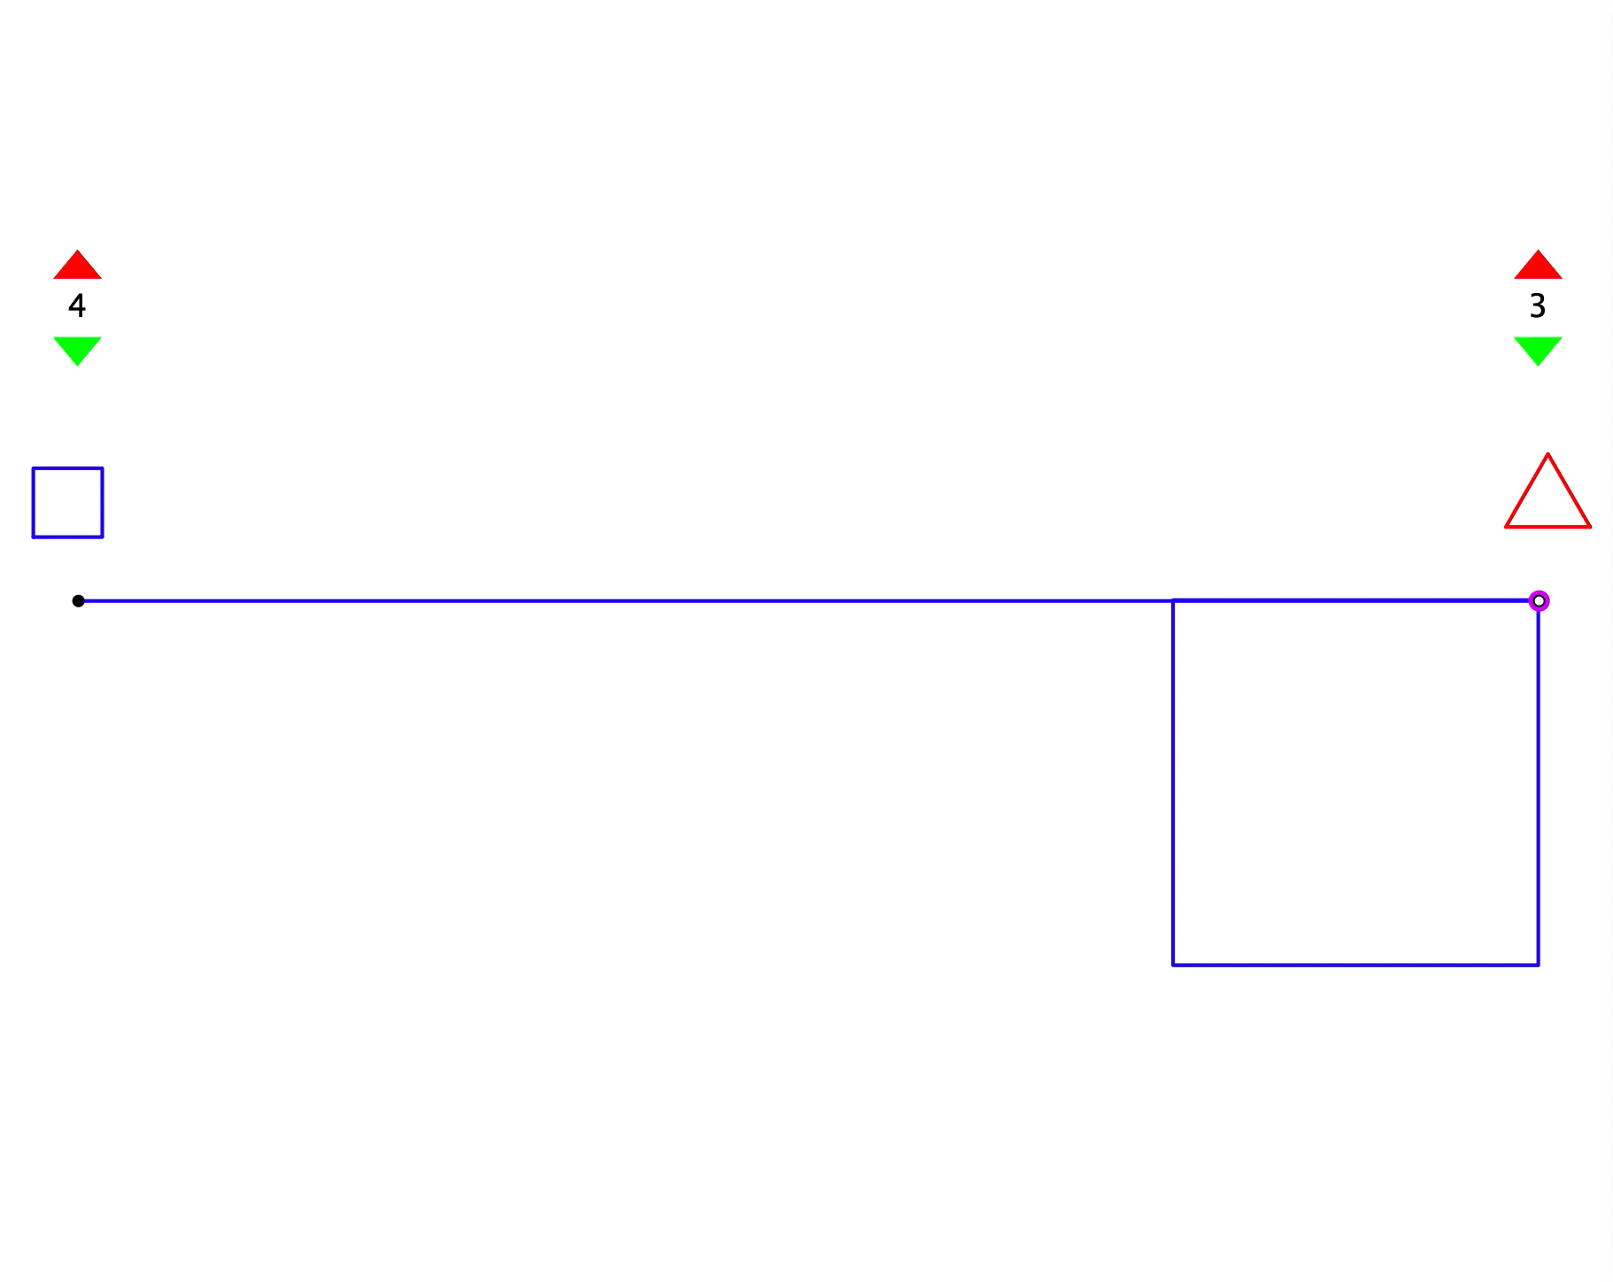
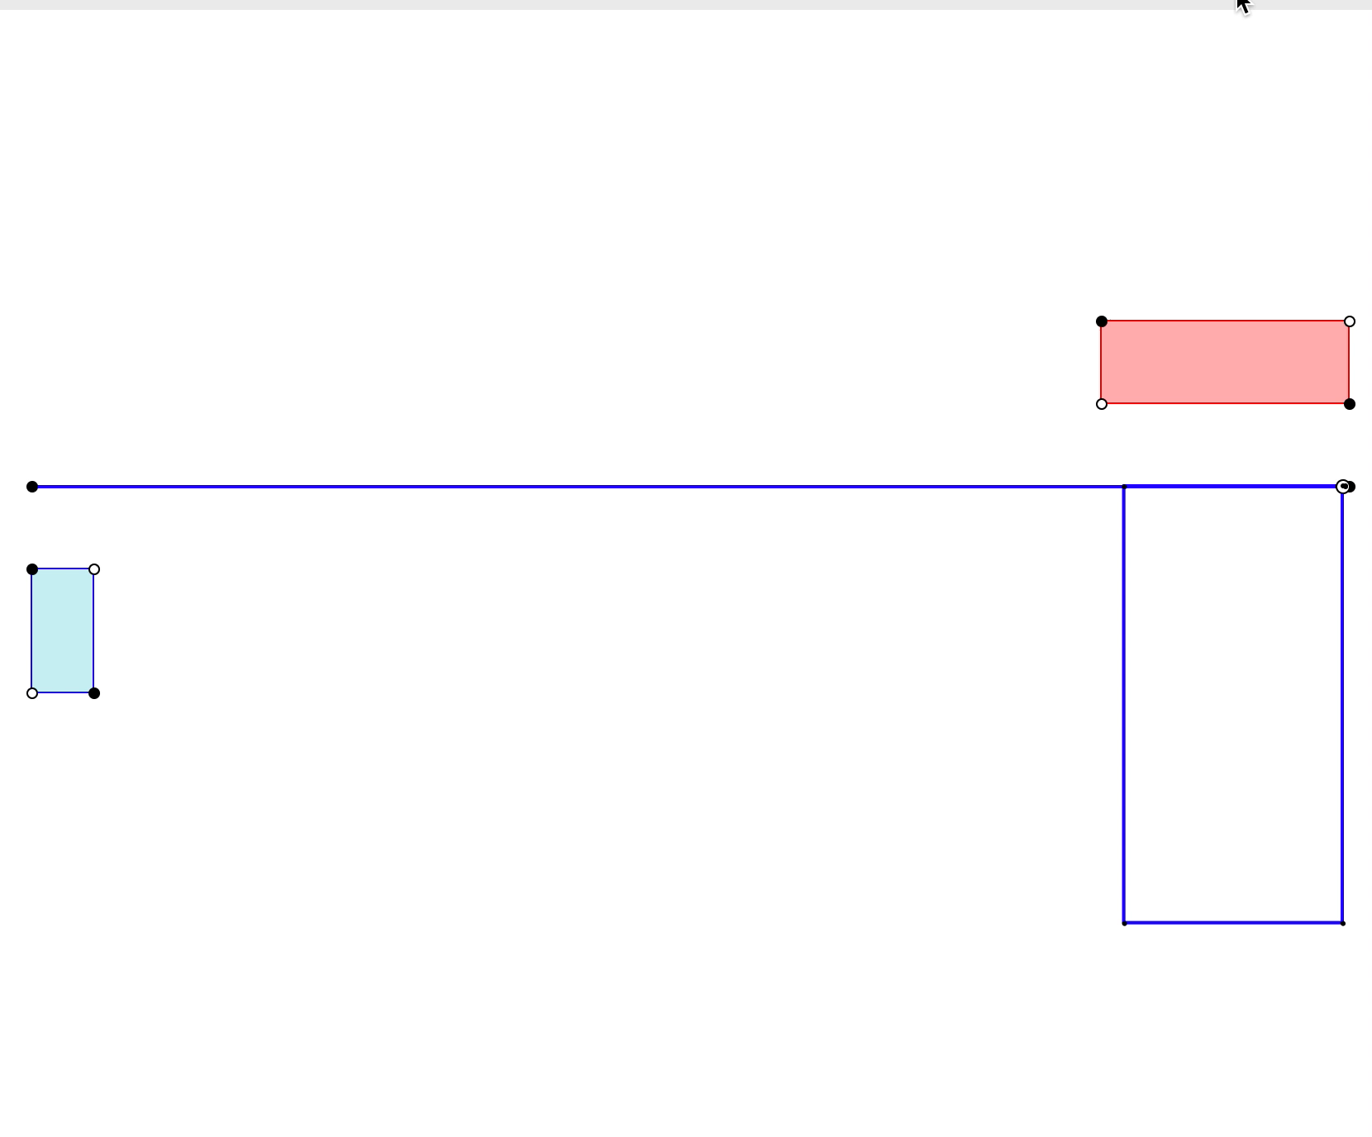
Unwrapping Perimeters
Choices (teacher)
Where will the two rectangles have the same perimeter?
Where will the two rectangles have the same area?
Where will the two polygons have the same perimeter?
Where will the two polygons have the same area?

Slide 7
So far …
How have you used examples so far?
How have we used examples so far?
What would you like to do with the examples?
  Choices for extending
  Returning to earlier examples
Please use Chat

Slide 8
Several Uses of Examples for Understanding Vectors

Slide 9
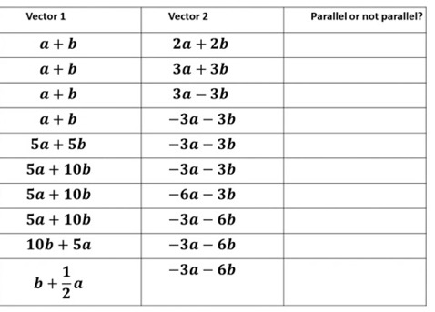
What might the author have intended students to get from ‘doing’ this task?
Examples of
Examples for
What might students understand from these examples

Slide 10
Other possibilities
More comparisons based on variation
Learner-generated examples towards classification
Guided exploration towards conjectures

Slide 11
Revised Table
Indicate with a “P” those cells which correspond to parallel vectors
Notice how many more comparisons are required
But students are still not called upon to be creative
For each of the vectors in the left-hand column,
create 3 more vectors parallel to it

Slide 12
Learner Construction of Examples
For a given vector construct 3 examples
which meet each of the following conditions:
Parallel and same length
Parallel and twice the length
Parallel and half the length
Perpendicular and half the length
Parallel, twice the length, and based at a specific point P
Perpendicular, three times the length and based at P

Slide 13
Guided exploration & conjecturing
https://undergroundmathematics.org/vector-geometry/hit-the-spot/interactive

Slide 14
How Might Teachers Use Examples?
Edwina Rissland Michener
  start-up examples motivate definitions and build a sense of what is going on
  reference examples are “standard cases” that link concepts and results, and are returned to again and again
  model examples indicate generic cases and can be copied or used to generate specific instances
  counter-examples sharpen distinctions and definitions of concepts
Attention and emphasis (Goldenberg & Mason)

Slide 15
How Might Teachers Use Examples?
Examples to develop images and language
Examples to infer relations
Elementary cases used to generate others
Extend a class: construct new cases
Indicate a possible class
Examples which express possible relations, structure and generalisations
Templates to deal with other class members
Sets of examples that span possibilities, subtypes
Worth keeping in mind:
Examples-of … something
or
Examples-for acting upon
Zara’s use of examples in Watson & Chick (2011)

Slide 16
Actions on Examples when Learning and Doing Mathematics
Analysis: analysis involves seeking plausible relations between elements of an example, from which conjectures might be generated
Generalisation: generalisation involves describing similarities among examples
Abstraction: abstraction goes further and classifies similar examples, naming the similarity as a concept or class with its properties
Building-on: examples that provide a base for extending ideas and for new ideas.
Abstraction in Context:
Recognising, Building, Constructing
in Hershkowitz, Schwarz, and Dreyfus (2001)

Slide 17
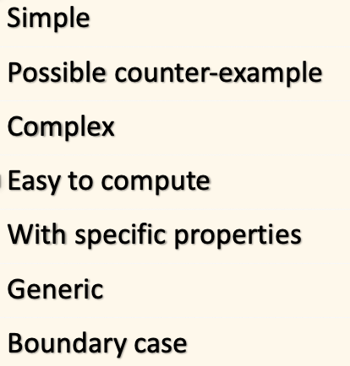
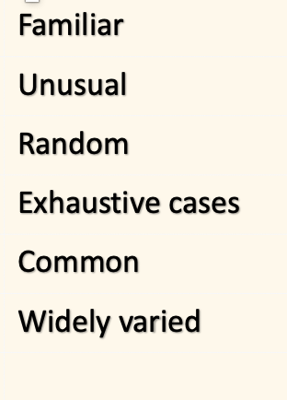
What Kind of Examples do Experts Generate when Doing Mathematics?
From Lockwood et al.

Slide 18
Why Experts Generate Examples
To get initial understanding of a situation
To seek mathematical insight
To check a conjecture/calculation
To try to break a conjecture
To get insight into how to prove something
To see possible generalisation …

Slide 19
Questions for discussion
How can we as teachers build connections between:
(i) how we use examples in our teaching and what we expect learners to do with those examples?
(ii) how we use examples in our own mathematical activity, and how we use examples in our teaching?

Slide 20
References
Goldenberg, P. & Mason, J. (2008) Shedding light on and with example spaces. Educational Studies in Mathematics,69(2),183-194
Hershkowitz, R., Schwarz, B. B., & Dreyfus, T. (2001). Abstraction in context: Epistemic actions. Journal for Research in Mathematics Education, 22, 195-222
Lockwood,E., Ellis, A. & Knuth, E. (2013) Microsoft Word - Expert Examples RUME 2013 Final Unblinded.docx (pitzer.edu).
Michener, E. (1978). Understanding mathematics. Cognitive Science, 2, 361–383.
Watson, A. & Chick, H. (2011). Qualities of examples in learning and teaching. ZDM 43 (2) p283-294. s11858-010-0301-6.pdf (springer.com)
Watson, A. & Mason, J. (2005). Mathematics as a constructive activity: Learners generating examples. Mahwah: Erlbaum.

Slide 21
Follow-Up
annewatson1089@gmail.com
john.mason@open.ac.uk
PMTheta.com

