Slide 1
Crossing Thresholds: Epistemological Obstacles & Pedagogic Interventions
Promoting Mathematical Thinking
John Mason
IMA Glasgow
June 2015
The Open University
Maths Dept
University of Oxford
Dept of Education

Slide 2
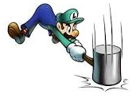
Throat Clearing
Everything said here is a conjecture …
… to be tested in your experience
My approach is fundamentally phenomenological … I am interested in lived experience.
Radical version: my task is to evoke awareness (noticing)
So, what you get from this session will be mostly …
… what you notice happening inside you!
Avoid the teaching of speculators, whose judgements are not confirmed by experience. (Leonardo Da Vinci)
Central role of attention:
… What is being attended to?
… How it is being attended to,
especially when reflecting?
Awareness
as consciousness
as that which enables action

Slide 3
Phenomena of Interest
The short term tendency by students to struggle to perform the procedures, without expending the effort (despite being more efficient in the long term) to gain the ‘high ground’ so as to appreciate and comprehend the procedures and related concepts.
The short term tendency by teachers to follow well worn pedagogical routes rather than to continue to take the time (which they may feel they do not have) to respond sensitively to students pedagogically.
The tendency of teachers to revert to their personal narrative of how they themselves learned, focussing on finding ways around what they recall finding difficult, or their students seem to find difficult.

Slide 4
Threshold Concepts
Concepts that play a central role in a topic and need to be comprehended so that their role can be appreciated (often called understanding)
Function-Formulae & Graphs
Graphs as objects and as depictions of sets of points
Limits
When are they ‘attained’ and when not?
Completed infinity and unfolding infinity
Cosets
Sets of objects as objects
Types of chords
Fixed End Point or Fixed Interval Width
More subtle

Slide 5
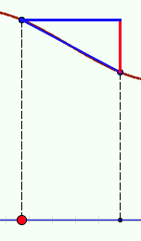
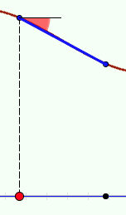
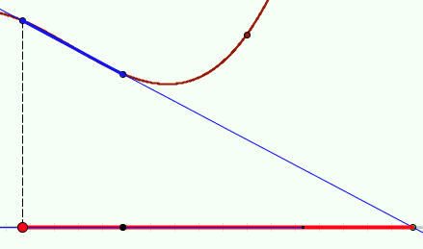
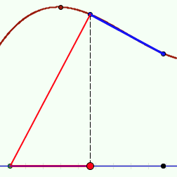
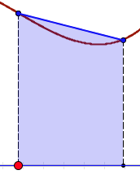
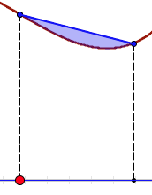
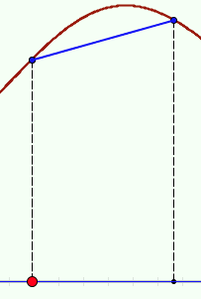
Some Chord Constructions
Rise
(gap)
angle
subtangent
area
between
subnormal
area below
length
What happens to the construct as the chord width goes to 0?
When it goes to zero, how fast does it go in relation to the interval width?

Slide 6
Types of Chords

Slide 7
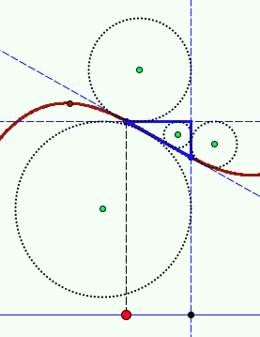
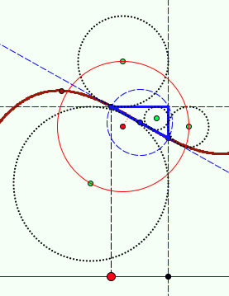
More Chordal Constructions
Incircle excircles
Bevan Circle
Circumcircle
What happens to the construct as the chord width goes to 0?
How fast does it go in relation to the interval width?

Slide 8
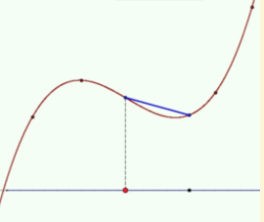
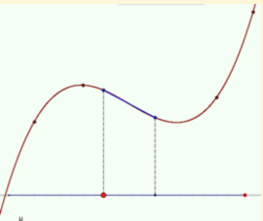
When Chord Width → 0
Part of the picture
Approach to limit is visual
Only relevant at a point
Applies to whole graph
What about the rest of the graph of the construct?
Same applies to any chordal construct

Slide 9
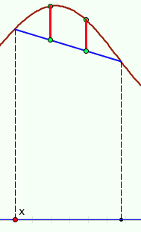
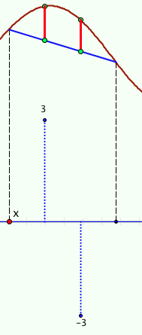
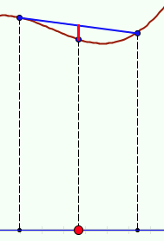
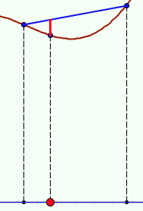
Chordal Gaps
Mid-point gap
µ-point gap
More divisions
Approaches
Approaches
Weighted gaps

Slide 10
Epistemological Obstacles
Induced by personal self-confidence & (dis)trust
Induced by past teaching
Induced by inappropriate or incomplete concept images
Psychologically challenging

Slide 11
Reacting, Responding, Remoting
Reacting:
acting without thought; automatically
Remoting:
Triggered emotion; fear of failure
Responding:
considering; choosing
Behaviour (enaction)
Emotion (affect)
Intellect (cognition)
When we test someone, we expect them to respond
But they are placed under duress;
Their attention might be elsewhere and occupied;
So what we see is only or mostly their reaction
(a+b)² → a² + b²
Babbling & Gargling
sin(a+b) → sin(a) + sin(b)

Slide 12
Chreods in a Landscape
Neural pathways may be chreodic
Epistemological Obstacles
Procepts
Didactic Contract
Students
Lecturers
Threshold Concepts

Slide 13
Homeorhesus
After an initial period of experiment and enthusiasm, returning to earlier habits
Notes:
Waddington

Slide 14
Flow
Still
Spate
Creative flow

Slide 15
Pedagogic Interventions
Listening to students carefully
For what they might be trying to express
Generating mental images (concept images)
Mental Imagery; Animated Diagrams; Physical Manifestations
Prompting students to construct their own narrative
Construct a mathematically meaningful sentence which uses the words … and … .
Attention to inner incantations with procedures
How are your actions supported by inner speech?

Slide 16
To Follow Up
www.PMTheta.com and mcs.open.ac.uk/jhm3
john.mason@open.ac.uk
Researching Your own practice Using The Discipline of Noticing (RoutledgeFalmer)
Questions and Prompts: (ATM)
Key ideas in Mathematics (OUP)
Designing & Using Mathematical Tasks (Tarquin)
Fundamental Constructs in Mathematics Education (RoutledgeFalmer)
Annual Institute for Mathematical Pedagogy (end of July) (see PMTheta.com)

