Slide 1


On the Nature and Structure of Attention in
Teaching and Learning Mathematics
Chile
via Zoom
Dec 7 2021

Slide 2
Outline
Some Introductory remarks
Some Methodological Remarks
Some Tasks for you through which to notice, and become aware of,
shifts of attention
  Classroom based
  Mathematics Education based
  Research based
All the slides are on my website
A written version of this talk may appear subsequently, and possibly be translated into Spanish

Slide 3
Methodological Remarks
I am interested in the lived experience of mathematical thinking and of supporting the mathematical thinking of others
Phenomenological Stance
  I am not going to quote lots of respected sources
  I am not going to smother you with data about other people
  What you get from this session will be largely what you notice happening to you, that is, to your attention

Slide 4
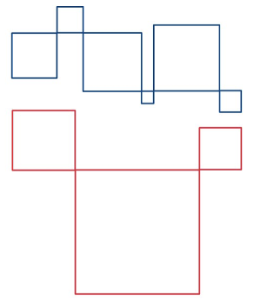
Recently Twittered Task (Prof Smudge)
The closed figures are all squares
Which set of squares has the largest total perimeter … the red or the grey?
Conjectures
At first you simply gazed
Then you discerned squares
At some point you recognised something about the horizontal edges of the squares
At some point you recognised a relationship between the grey and the red figures
At some point you made use of a property of squares

Slide 5
Suggestion
Holding Wholes (gazing)
Discerning Details
Recognising Relationships
Perceiving Properties
Reasoning on the basis of properties
These are really different ways of attending
Conjecture
If people are attending to different things,
Or if despite attending to the same thing they attend differently,
Communication will be at best partial
Conjecture
Teaching is largely about directing learners’ attention
So every act of a teacher is an intervention in learner attention
Teaching takes place IN time; learning takes place OVER time

Slide 6
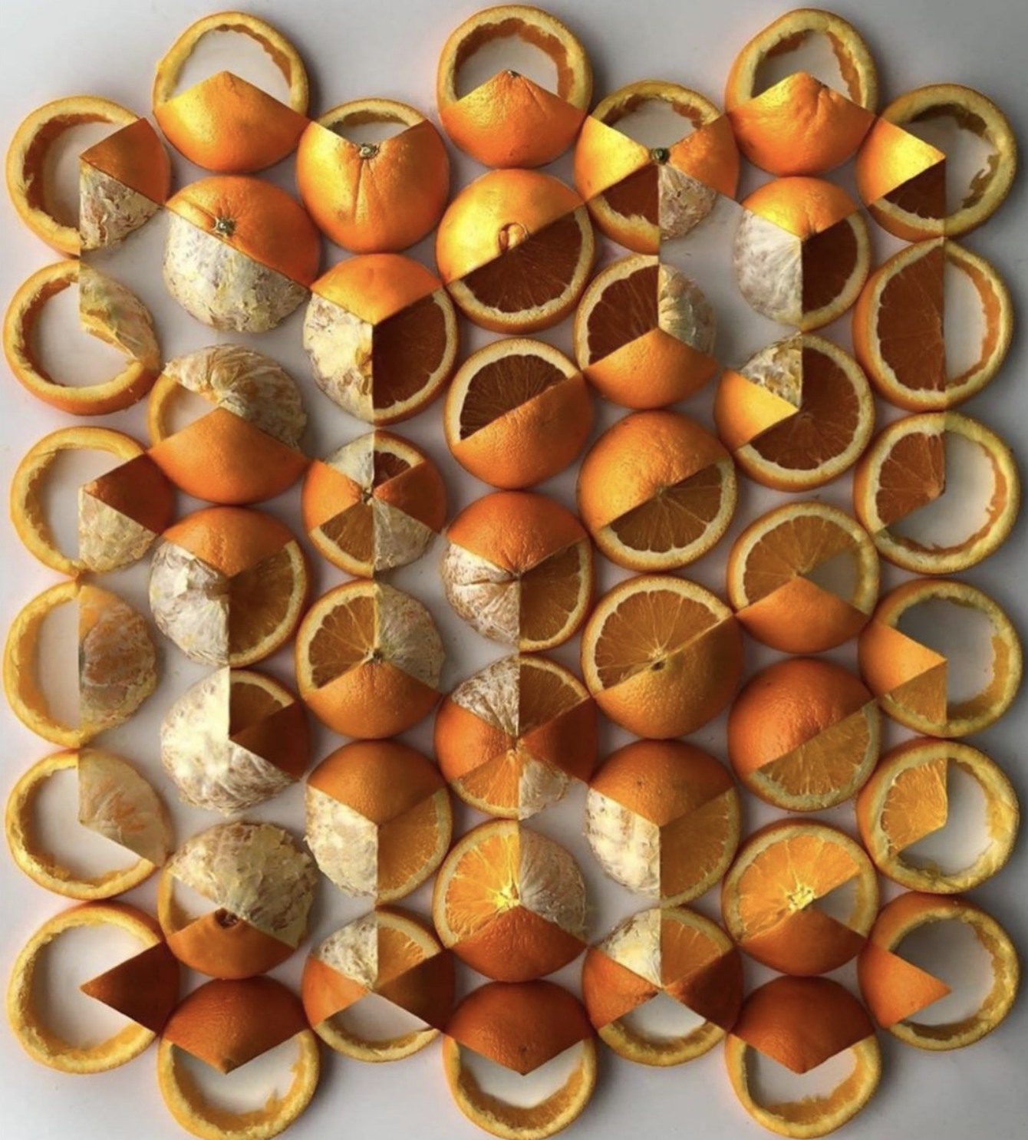
Say What You See
https://twitter.com/Dandoesmaths
Oranges?
Cut differently?
Gestalt

Slide 7
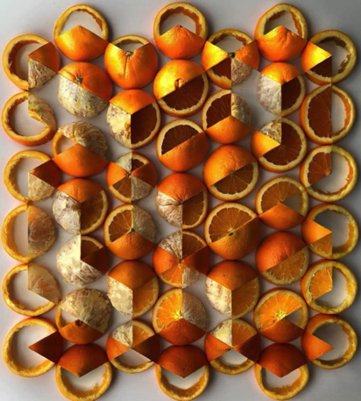
Attention
At first, you probably saw oranges
At some point you recognised that the oranges had been cut in different ways
At some point your attention shifted to ‘seeing’ parts of, even whole cuboids and other similar structures
You may have looked at the details of how the cutting of the oranges ‘created’ the illusion of faces of a cuboid.
Think back and see whether you recognise periods when you were
Holding a whole (gazing)
Discerning Details
Recognising Relationships
Perceiving Properties (as being instantiated)
Reasoning on the basis of agreed properties

Slide 8
Here are the first three patterns in a sequence:
Note difference between
‘seeing how to extend’
And
‘seeing structural relationships’
How many white tiles are needed to make the next pattern?
How many white tiles are needed to make pattern 10?
Suggest a method to calculate the number of white tiles needed in any pattern in the sequence
Suggest a method to calculate the number of white tiles needed for the nth pattern in the sequence
Amit M., Neria D. (2010) Assessing a Modeling Process of a Linear Pattern Task. In: Lesh R., Galbraith P., Haines C., Hurford A. (eds) Modeling Students' Mathematical Modeling Competencies. Springer, Boston, MA.

Slide 9
Connections
Note alignment with van Hiele ‘levels’
Note that forms of attention are NOT levels
  People move back and forth between them spontaneously and rapidly
Holding Wholes (gazing)
Discerning Details
Recognising Relationships
Perceiving Properties
Reasoning on the basis of properties
Visualisation
Analysis
Abstraction
Deduction
Rigour
Conjecture
Gazing is not simply an introductory form of attention
Gazing is a gateway between
An analytic mode
and
A wholistic sense of form and structure (gestalt?)
Gazing involves not just ‘whole wholes’
but any discerned part of some whole,
seen as a whole in itself
Aristotle: ”There is more to the whole than simply the parts”.

Slide 10
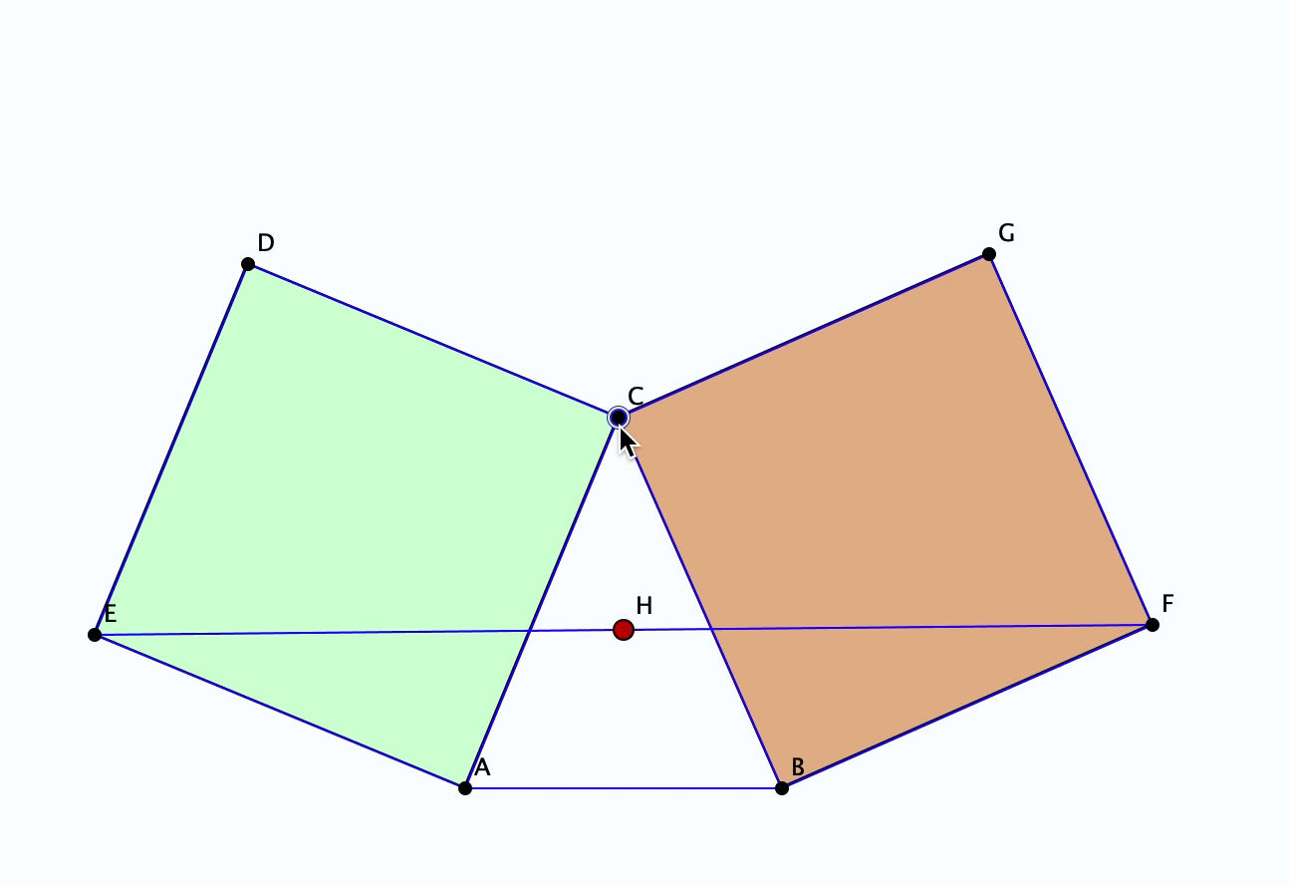
Bottema’s Theorem
When did you become aware of the invariance of H?
How did your attention shift?
How might you justify the conjecture that H must be invariant as C moves?
Reconstruction of the relationships (geometrical construction)
Seeking relationships which hold as C varies (thus becoming properties)

Slide 11
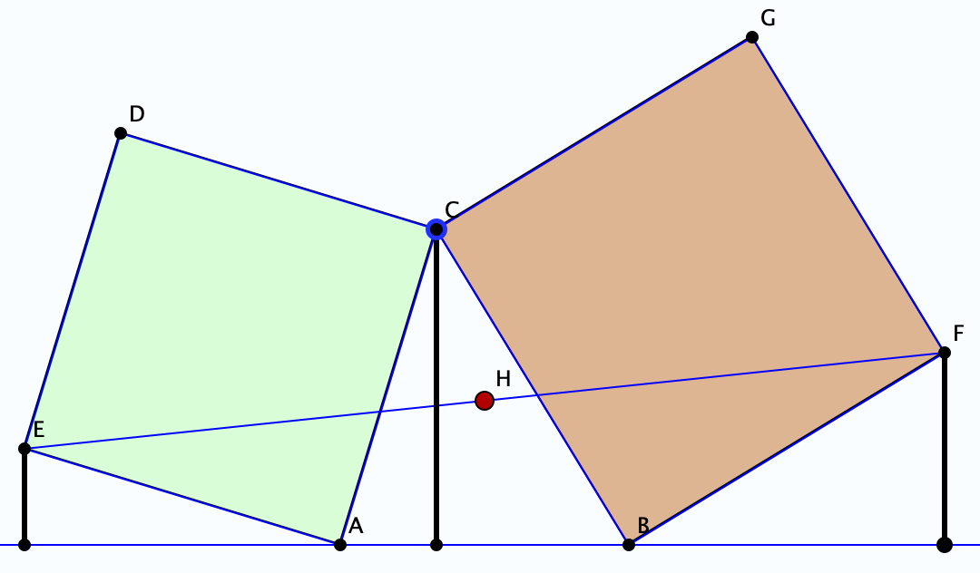
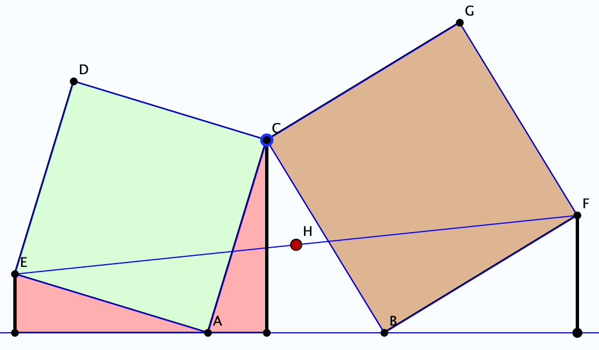
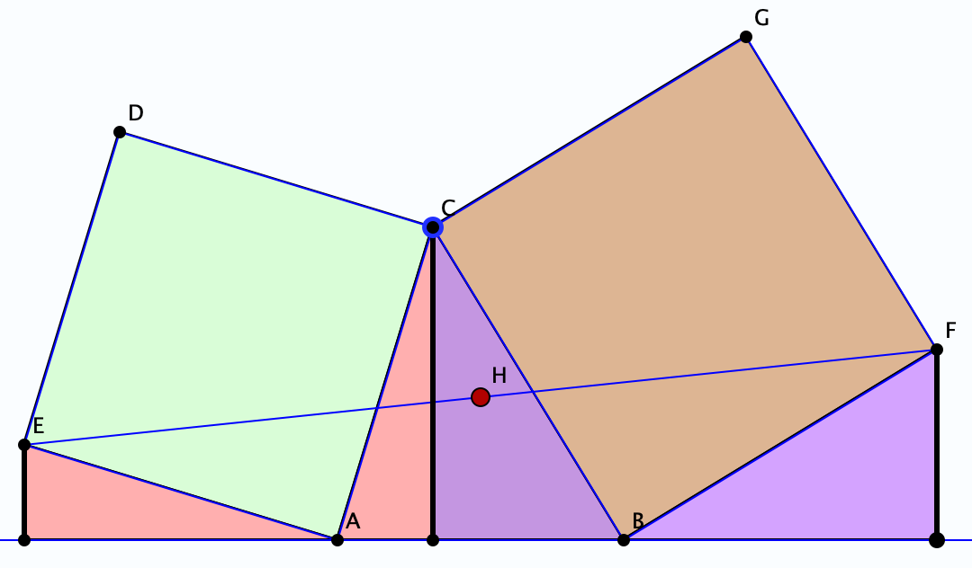
Reasoning
Your task is to construct a narrative for my pictures
I could narrate the reasoning, but that would involve you in using your attention differently
Again, re-constructing the reasoning involves
Shifting what is attended to
And how it is attended to
But reasoning is NOT enough!
What can be varied and still preserve the phenomenon?
Note the role of
‘invariance in the midst of change’

Slide 12
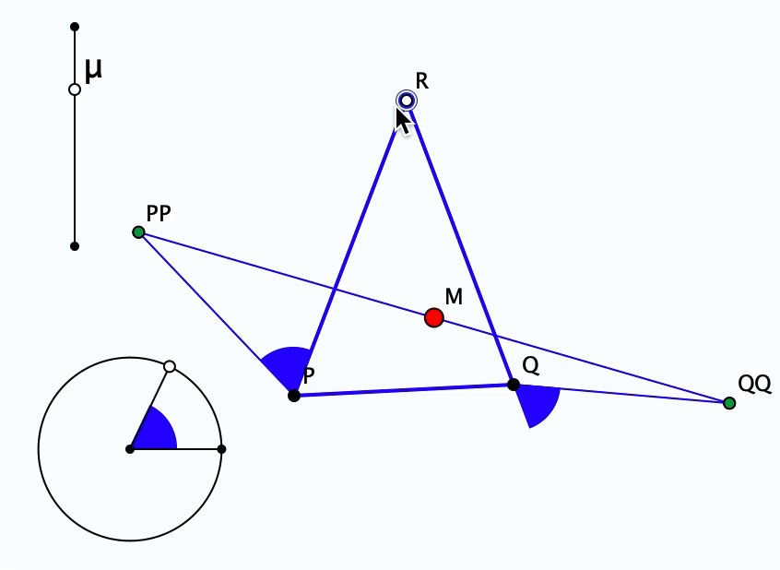
What can be Varied, Retaining Invariance?
Notice the ways in which your attention shifted as you tried to make sense of discerned details through recognising relationships

Slide 13
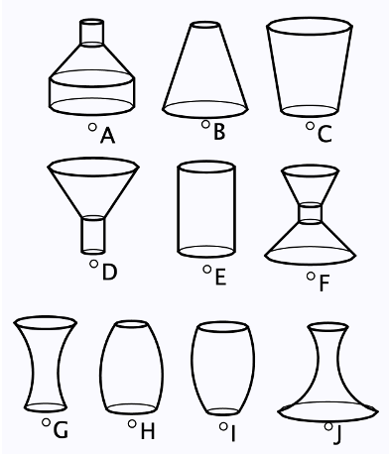
Flask Graphs
Here are pictures of ten flasks, all with circular cross-section

Slide 14
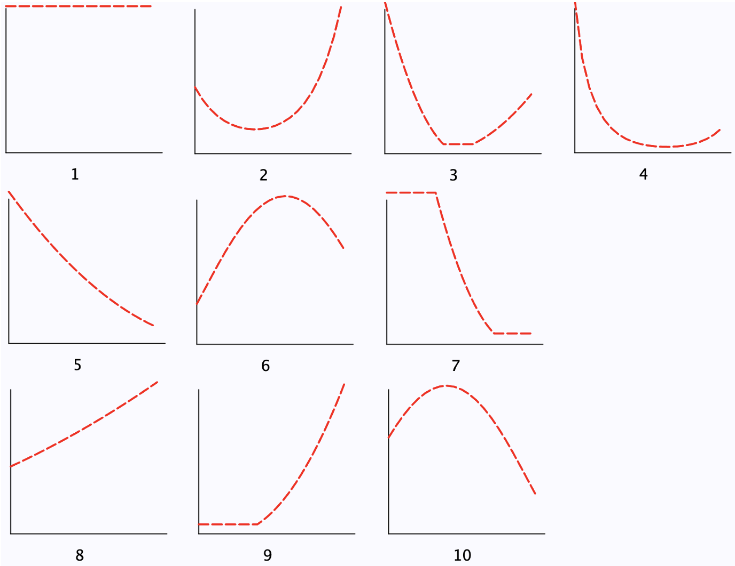
Graphs of surface area against height of liquid
Which graph corresponds to which flask?

Slide 15
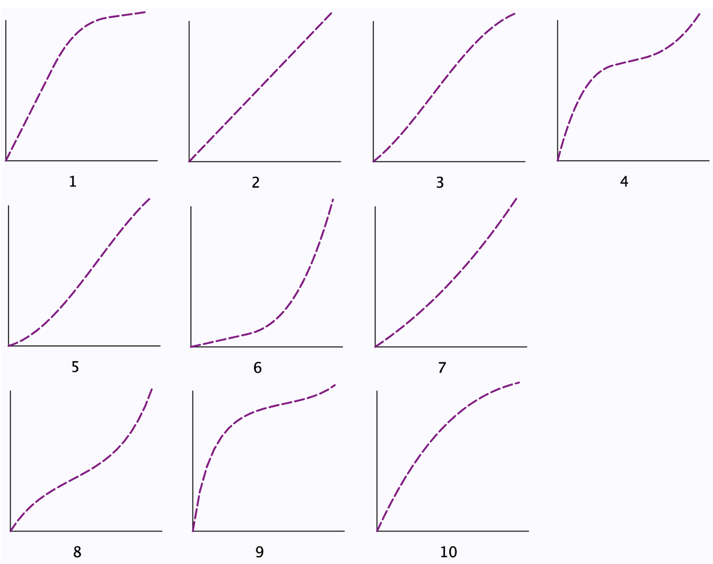
Graphs of Volume against height
Which graph corresponds to which flask?

Slide 16
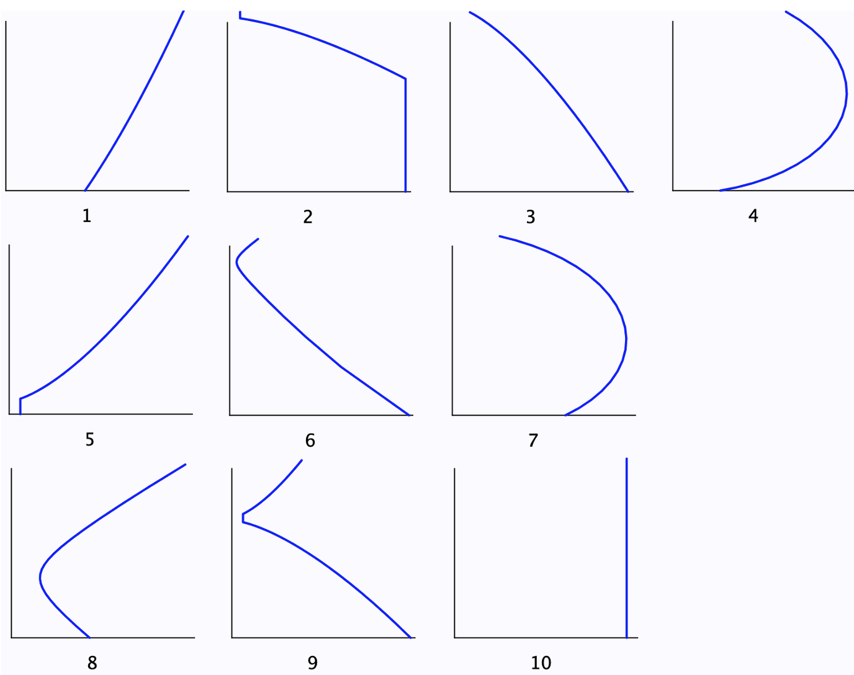
Graphs of Volume against Surface Area
Which graph corresponds to which flask?

Slide 17
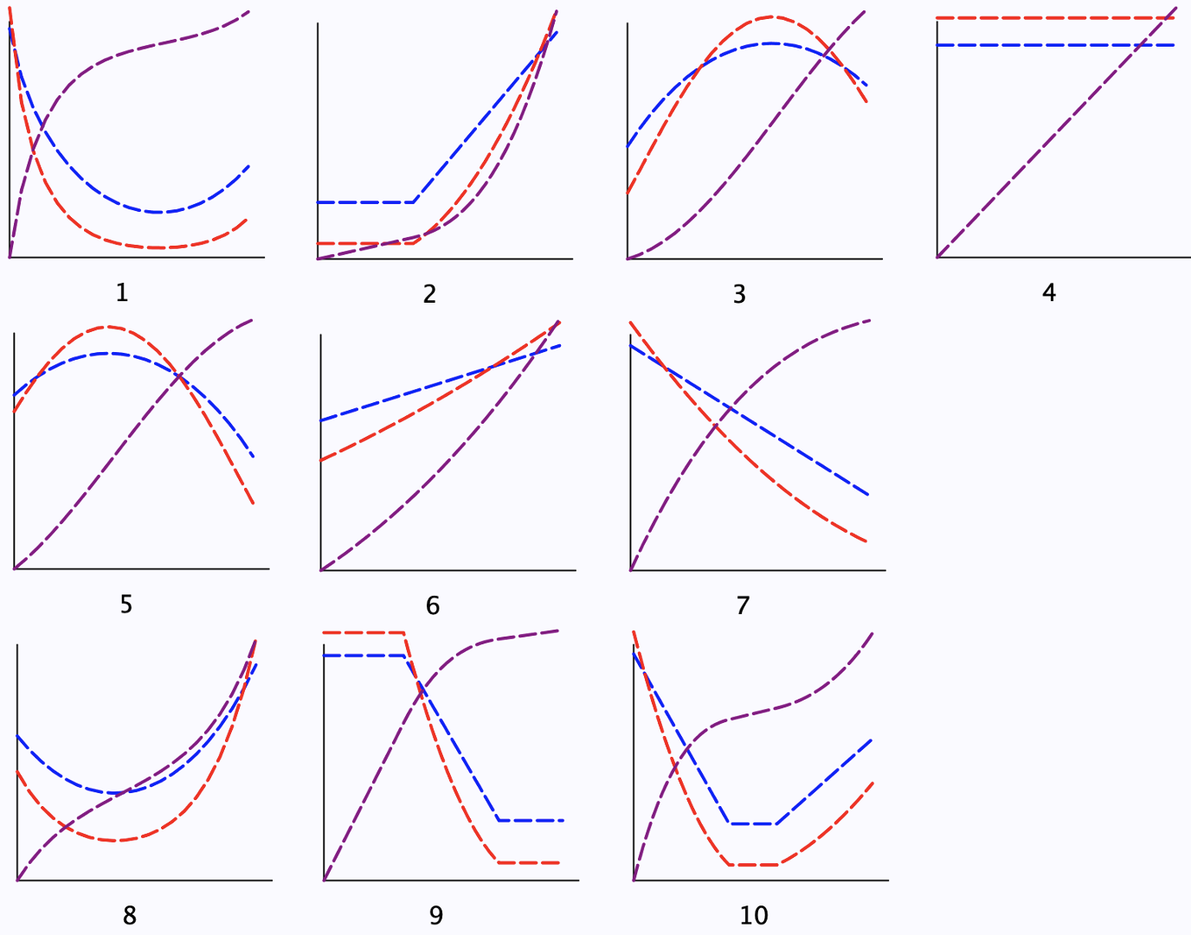
Radius, surface area and volume, all with respect to height
Which graph corresponds to which flask?

Slide 18
Attention & Mathematics Education Research
Theoretical Terms
Didactic Contract
What might you need to attend to, and how, in order to make these statements?
The distance (or proximity) between what students know about a specific topic versus what the teacher knows about this same topic. [igi-global.com/dictionary/didactic-contract/54293]
A “didactical contract” is an interpretation of the commitments, the expectations, the beliefs, the means, the results, and the penalties envisaged by one of the protagonists of a didactical situation (student, teacher, parents, society) for him - or herself and for each of the others, à propos of the mathematical knowledge being taught. [Brousseau, quoted in Encyclopaedia of Mathematics Education]

Slide 19
Attention & Mathematics Education Research
Theoretical Terms
Didactic Transposition
The process of didactic transposition refers to the transformations an object or a body of knowledge undergoes from the moment it is produced, put into use, selected, and designed to be taught until it is actually taught in a given educational institution. [Chevellard (1985), quoted in Encyclopaedia of Mathematics Education]
Transformation of expert awareness into learner behaviour (via a task) [Mason]
Think back to the Perimeters task:
What didactic transposition took place?
Think back to the Flask task:
What didactic transposition took place?

Slide 20
Attention and Mathematics Education Research
Theoretical Terms
Didactic Tension
… a didactic tension (Mason, 1988) arises in practice, with teachers then stuck in a position of having certain knowledge to inculcate or elicit, while recognizing that such knowledge is individual and can only be shared through listening and negotiation. [Jaworski (1994), quoted by Pratt (2003))]
The more explicitly the teacher indicates the behaviour sought, the easier it is for the students to display that behaviour, without generating it through understanding. [Open University 1988]

Slide 21
Say What You See
Notes:
Can you see boy reading?, boy copying or checking? Girl thinking?

Slide 22
Is 51 + 51 = 50 + 52?
How do you know?
What is Fran attending to?
Fran: Like fifty-one plus fifty-one are one hundred and two, but fifty-one, if you subtract fifty, you can add to fifty-one, one from the other, one more, and you get fifty-two.
Teacher-Researcher: Ah, that is interesting. You said that you can take one from here [pointing to the first fifty-one] and add it to this one [pointing to the second fifty-one]. Isn’t it? Is that what you said?
Fran: And you get there, one hundred… fifty plus fifty-two.
How is her attention shifting?
Babbling or Gargling?
What is being attended to?
Listening-to or
listening-for?
Teaching Action:
selecting/editing
What is Fran attending to?
Notes:
Mason, J. (2012). You Can Lead a Horse to Water…: Issues in Deepening Learning Through Deepening Teaching. In S. Hegedus & J. Roschelle (Eds.) Democratizing Access to Important Mathematics through Dynamic Representations: Contributions and Visions from the SimCalc Research Program. Berlin: Springer-Verlag.
Nicolina Malara; Brent Davis

Slide 23
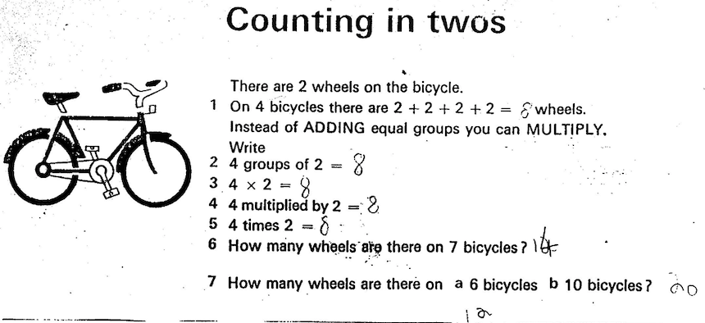
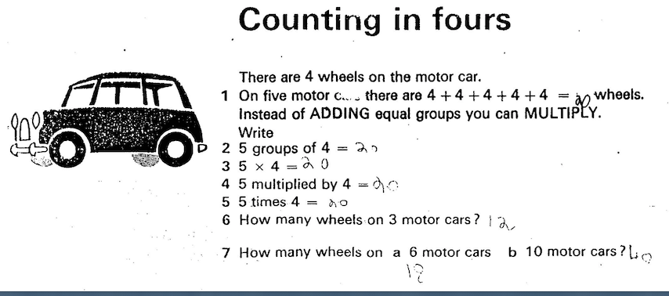
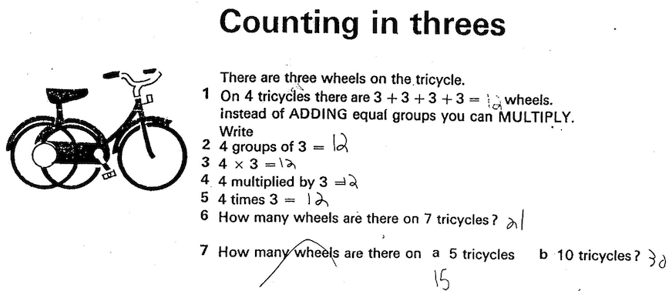
Sample Data
The top part of a page that came home with my daughter aged 7
“I don’t know what to do.”
I asked her to start reading to me. She got to 2 + 2 + 2 + 2 and said “is it eight?”. I replied with “What do you think?”. She said in a tentative voice “eight”. She skipped over “Instead of …” and went on to “4 groups of 2” ”What does that mean?” she asked. ”What does 4 groups of 2 mean?” I asked her. “Eight?”
I pointed to the bicycle and asked “What is that doing there?”. She didn’t know. She went on to 4 x 2 and asked “What is multiplied?”
I watched her carry on, using her fingers to do 7 bicycles, and in response to my raised eyebrows, did it again. The last bicycle question she did quickly. “Is that all there is?”.
She set to, head down, pencil gripped tightly. Each question (tricycle, car) was tackled in turn, perfectly correctly.
When I asked her what the page was about, she looked at me in amazement, as if to say
“its just a bunch of questions, Dad (you fool!)”

Slide 24
What is Lucy attending to?
Lucy: I need a sum to be something divisible by 9. So we can choose 18. OK, 8 and 2 give 10, and now I break the 8 [the units of 18] into 4, 3 and 1. So 82431 should be divisible by 9.
Interviewer: Can you think of another strategy to find such a number? Lucy: I could make the sum something else, like 27 or something...
Before analysing using a framework
ask yourself
“What might I be attending to, and how,
if I were to have said this?
Hazzan, O. & Zazkis, R. (1999). A Perspective on "Give an Example" Tasks as Opportunities To Construct Links among Mathematical Concepts. Focus on Learning Problems in Mathematics. 21 (4) p1-14.

Slide 25
Conjecture
A sensible place to begin analysis of qualitative data is to ask yourself:
  What would I have to be attending to in order to say or do what I hear being said or see being done?
  How would I be attending to it?
  What would I be overlooking?

Slide 26
Reflection
Forms and Shifts of Attention
Relevant to learning,
hence to teaching
Relevant to researching
Every act of teaching is an intervention in the attention of learners
If teacher and learners are attending to different things
Or
If they are attending to the same thing but in different ways
Then communication may be at best impoverished

Slide 27
Precision Conjecture
The more precisely data is specified and analysed,
the more we learn about
the researcher’s sensitivities to notice and attend
The universe is a mirror
in which we can contemplate
only
what we have learned
to know about ourselves
(Italo Calvino)

Slide 28
Follow-Up
PMTheta.com
John.mason @ open.ac.uk

