Slide 1


Problem Posing
&
Problem Solving
(focusing on the role of mental imagery)
Bogota
by Zoom
Sept 2021
in the time of Corona

Slide 2
Throat Clearing
My focus is on the lived experience of learners
It requires a Conjecturing Atmosphere
  Everything said is a conjecture …
  uttered with the intention of modifying it as seems necessary
  You must not believe anything I say … you must test it in your experience
I am going to offer you a collection of tasks
chosen to illustrate different ways in which mental imagery contributes
  If you don’t engage with them, I can promise you will get nothing from this session!
By Mental Imagery I mean any sensory-like experience, including
‘having a sense of’ without having pictures, words, kinaesthetic or olfactory components

Slide 3
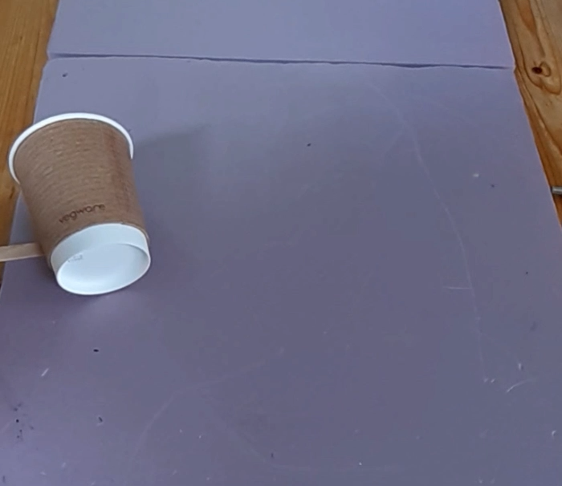
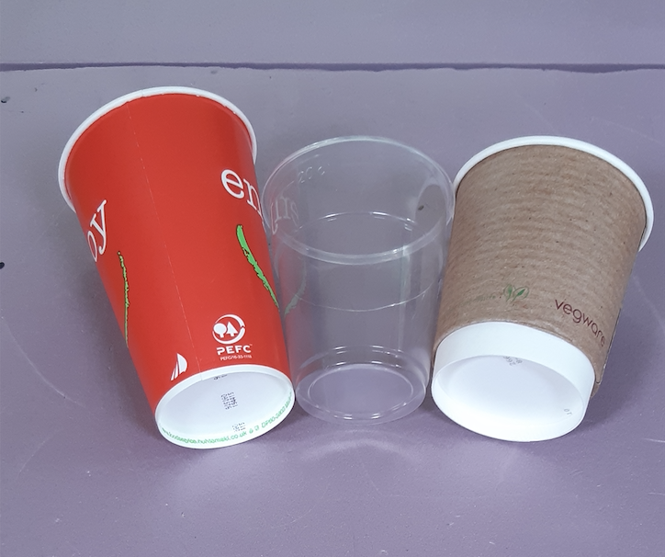
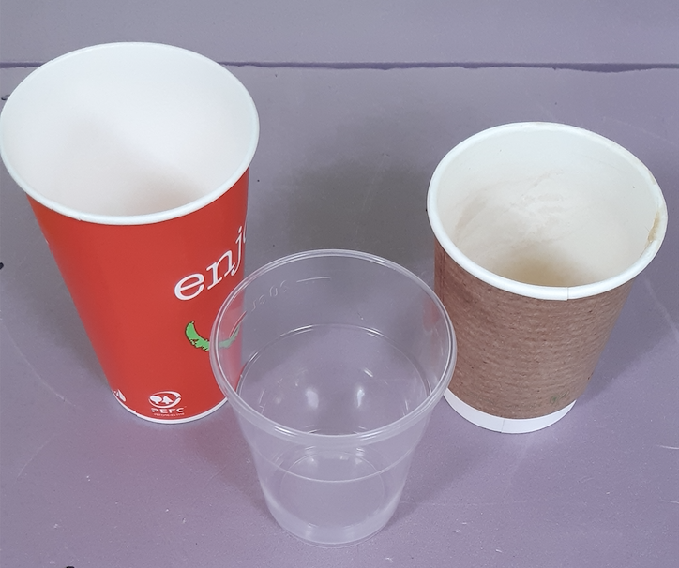
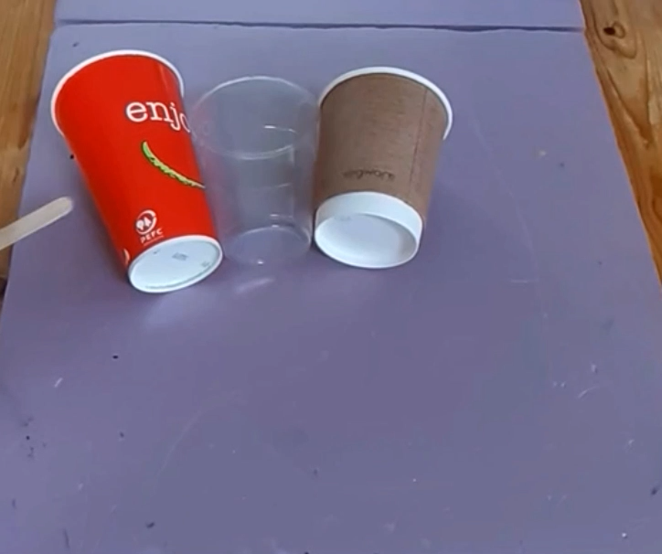
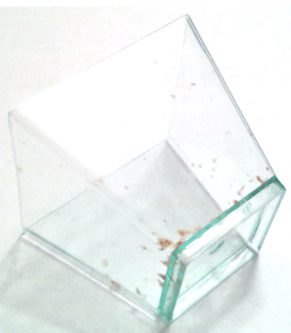
In My Cups
Imagine a paper coffee cup
Any questions arising?
Tempting to pose questions to others!
Shift from objects to phenomena
(rolling)
Will the path of the rolling cups close up?
Will they really roll along the same path?
What measurements would you need to make in order to predict the size of the path a cup follows?
What about a square-based vessel?

Slide 4
Did You Notice:
Some work needed to be clear about the situation?
One or more questions arising?
A conjecture arising?
An action become available?
(Pólya: make a plan)
Use of natural powers?
  Imagining & Expressing
  Specialising & Generalising
  Conjecturing & Convincing
  Organising & Characterising
  Others?
Shifts of Attention?
  Gazing (Holding Wholes)
  Discerning Details
  Recognising Relationships
  Perceiving Properties as being instantiated
  Reasoning on the basis of agreed properties
√
√
√
√
How might the problem or the method be extended or generalised?
√
√
√
√

Slide 5
Questions:
What is a problem?
  Something is a problem only when it is perceived to be problematic, uncertain, unfamiliar.
  So the appropriate question is ‘When is a problem?’ or in other words,
  ‘When is something problematic for me or for learners?’
What constitutes a solution?
  A sequence of actions that achieve a resolution
  Reflection on what worked and what didn’t work (Pólya: looking back)
Why invite learners to ‘solve mathematical problems’?
  To experience mathematical thinking
  To experience choosing a mathematical action to enact
  To experience the use of mathematical powers
  To experience instances of mathematical themes
  NOT … to get answers except insofar as it motivates or develops mathematically
Where do ‘problems’ come from?
  A sense of wonder or surprise, arising from a shift of attention
  Imagining something changing (Brown & Walter 1983)
  Recognising pedagogic potential

Slide 6
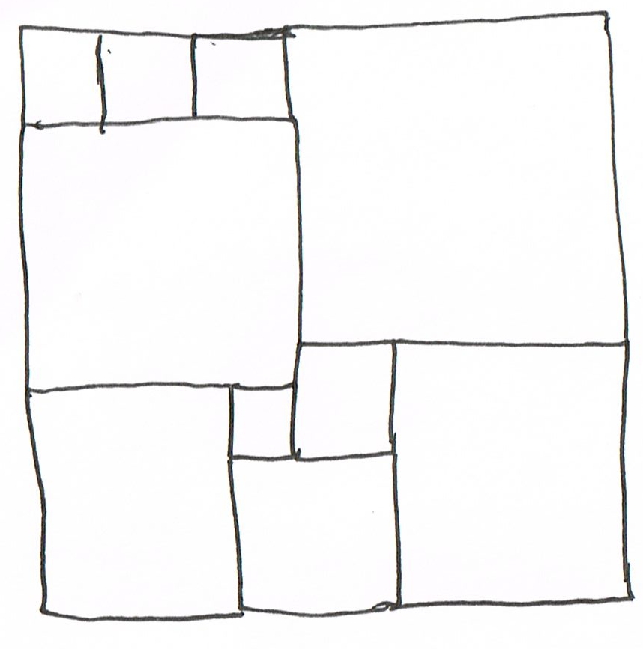
Square Deduction
Could these all be squares?
Stuck?
Acknowledge your ignorance!
(Mary Boole)
Use a symbol to denote
something you do not know
Use it to express relationships

Slide 7
Square Deduction: acknowledging ignorance
(3a+b)/3
3a+b = 3(3b-3a)
12a = 8b
So 3a = 2b
3b-3a
Shift of attention
a+3b
3a+b
Recognising relationships
a
b
For an overall square
4a + 4b = 2a + 5b
So 2a = b
2a+b
a+b
a+2b
3
11
For n squares upper left
n(3b - 3a) = 3a + b
So 3a(n + 1) = b(3n - 1)
But not also 2a = b
9
3
2
8
7
5

Slide 8
Did You Notice:
Being Stuck?
Feeling of release when getting unstuck through use of letters?
Sudden recognition of relationships?
Use of natural powers?
  Imagining & Expressing
  Specialising & Generalising
  Conjecturing & Convincing
  Organising & Characterising
  Others?
Encountering Mathematical Themes?
  Doing & Undoing
  Invariance in the midst of change
  Freedom & Constraint
  Making the implicit explicit
  Others?
Shifts of Attention?
  Gazing (Holding Wholes)
  Discerning Details
  Recognising Relationships
  Perceiving Properties as being instantiated
  Reasoning on the basis of agreed properties
How might the problem or the method be extended or generalised?

Slide 9
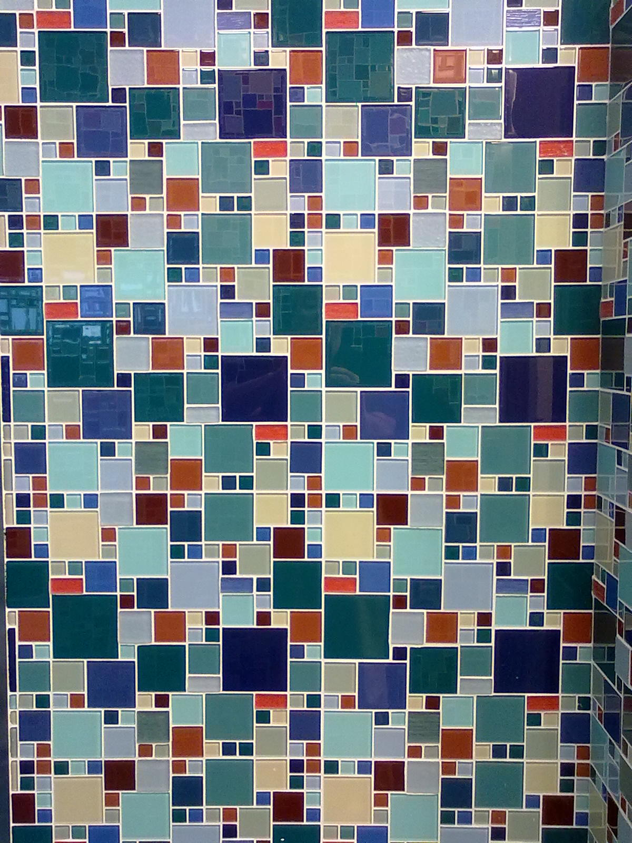
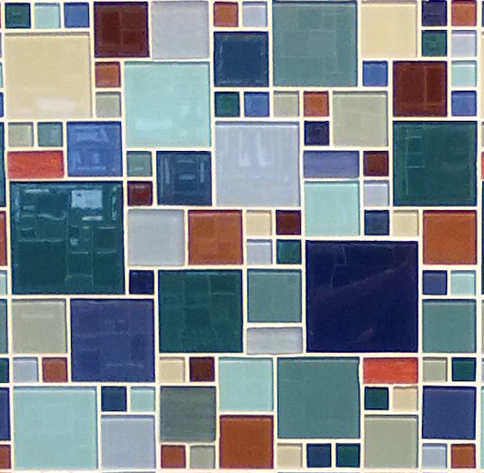
Vancouver Tiling
What questions arise for you?
What must be the (relative)
sizes of squares?

Slide 10
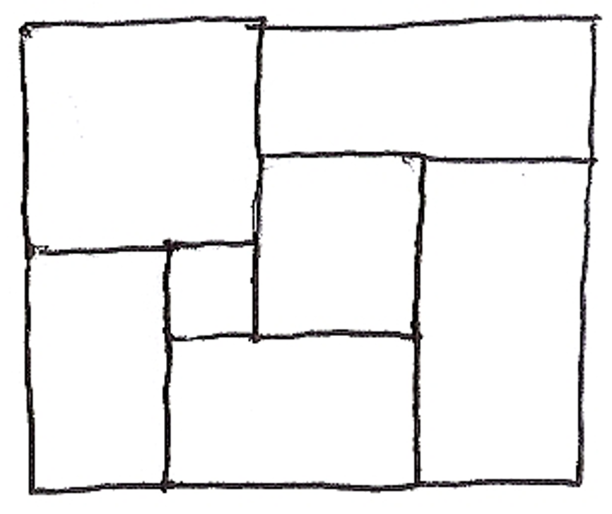
Rectangular extension
What if the rectangles were to be 2 : 1
or 3 : 2?
Is there a rectangle ratio so the whole is
also in the same ratio? A square?
Do you feel an urge
to draw your own configuration and play about?

Slide 11
One More Than
What numbers can arise as one more than the product of four consecutive numbers?
Diving in
n(n+1)(n+2)(n+3) + 1 =
n⁴ + 6n³ + 11n² + 6n + 1
Specialising
Stuck?
0x1x2x3 + 1 = 1
= 1²
1x2x3x4 + 1 = 25
= 5²
Recognise squares?
2x3x4x5 + 1 = 121
= 11²
Conjecture?
3x4x5x6 + 1 = 361
= 19²
Re-Specialise in order to express generality
In order to
‘see the general through the particular’
(generalising)

Slide 12
Did You Notice:
An immediate action arising …
algebra!
When stuck, resort to specialising (using examples to get-a-sense of underlying relationships) so as to generalise.
Asking what other similar relationships there might be?
Use of natural powers?
  Imagining & Expressing
  Specialising & Generalising
  Conjecturing & Convincing
  Organising & Characterising
  Others?
Encountering Mathematical Themes?
  Doing & Undoing
  Invariance in the midst of change
  Freedom & Constraint
  Making the implicit explicit
  Others?
Shifts of Attention?
  Gazing (Holding Wholes)
  Discerning Details
  Recognising Relationships
  Perceiving Properties as being instantiated
  Reasoning on the basis of agreed properties
How might the problem or the method be extended or generalised?

Slide 13
Likelihood
The results of a medical test show that 10% of the population exhibit a particular characteristic but 40% of the people who develop a particular syndrome also exhibit that characteristic. This means that people with that characteristic are 6 times as likely to develop the syndrome as people not exhibiting that characteristic.
Surpise?
Imagine how you will start
What action becomes available?
Would that be available
to your students??

Slide 14
Likelihood
What do
I Know?
10% of the population exhibit C
40% of the people who develop S also exhibit C
Likelihood of people with C developing S compared to people without C developing S
Ratio of fraction of people with C developing S to fraction of people without C developing S.
What do
I Want?
Syndrome
Let P be the total population
Depict those exhibiting C
Let S be the number of people
developing the syndrome
10%
with C
40%
40/100 x S
60%
10/100 x P
40 x 90
6
90%
without C
=
=
60 x 10
1
60/100 x S
90/100 x P

Slide 15
Did You Notice:
Some work to be clear about the situation?
Need to depict so as to imagine and express relationships?
An action become available?
Use of natural powers?
  Imagining & Expressing
  Specialising & Generalising
  Conjecturing & Convincing
  Organising & Characterising
  Others?
Encountering Mathematical Themes?
  Doing & Undoing
  Invariance in the midst of change
  Freedom & Constraint
  Making the implicit explicit
  Others?
Shifts of Attention?
  Gazing (Holding Wholes)
  Discerning Details
  Recognising Relationships
  Perceiving Properties as being instantiated
  Reasoning on the basis of agreed properties
How might the problem or the method be extended or generalised?

Slide 16
Decoding
Gazing (holding wholes)
Discerning Details
Recognising Relationships
Perceiving Properties
(as being instantiated)
Try n = 4
Reasoning on the basis of agreed properties
Specialising
In order to generalise

Slide 17
Did You Notice:
Some work to be clear about the situation?
Desire for an example?
Sense of ‘form’ so as to generalise?
What other similar relationships might be found?
Use of natural powers?
  Imagining & Expressing
  Specialising & Generalising
  Conjecturing & Convincing
  Organising & Characterising
  Others?
Encountering Mathematical Themes?
  Doing & Undoing
  Invariance in the midst of change
  Freedom & Constraint
  Making the implicit explicit
  Others?
Shifts of Attention?
  Gazing (Holding Wholes)
  Discerning Details
  Recognising Relationships
  Perceiving Properties as being instantiated
  Reasoning on the basis of agreed properties
How might the problem or the method be extended or generalised?

Slide 18
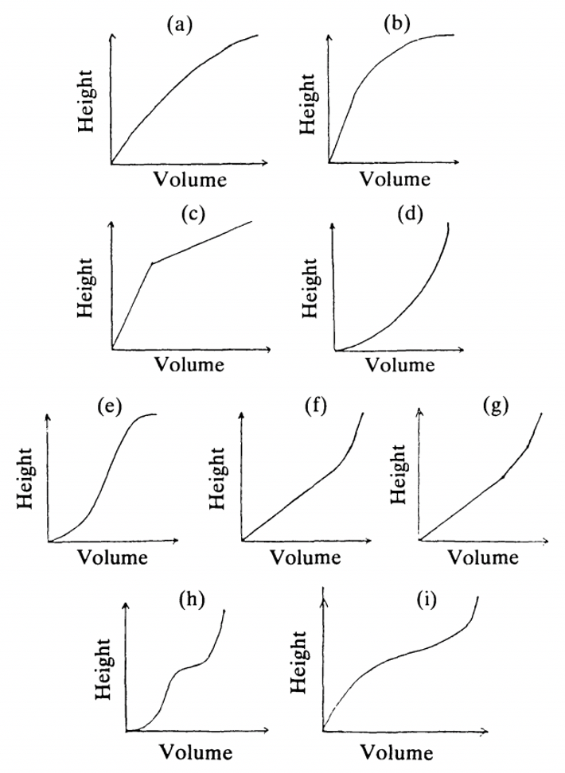
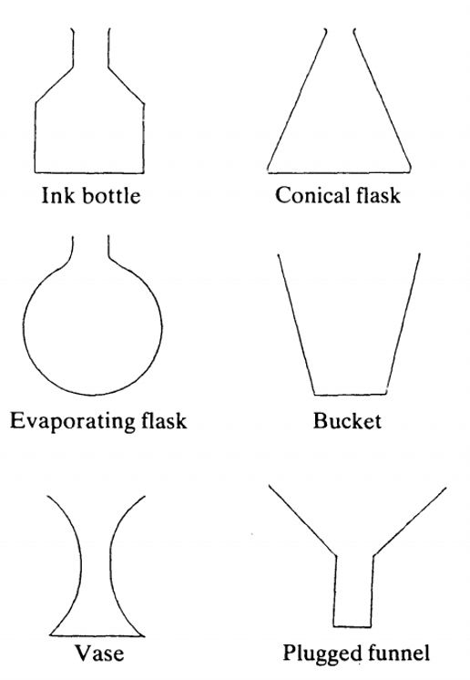
Match the Graphs
Here are 8 graphs
Here you see 6 vessels
Notes:
https://demonstrations.wolfram.com/FillingAContainerDefinedByACurve/

Slide 19
Did You Notice:
Some work to be clear about the situation?
What about graphing volume against surface area?
Use of natural powers?
  Imagining & Expressing
  Specialising & Generalising
  Conjecturing & Convincing
  Organising & Characterising
  Others?
Encountering Mathematical Themes?
  Doing & Undoing
  Invariance in the midst of change
  Freedom & Constraint
  Making the implicit explicit
  Others?
Shifts of Attention?
  Gazing (Holding Wholes)
  Discerning Details
  Recognising Relationships
  Perceiving Properties as being instantiated
  Reasoning on the basis of agreed properties
How might the problem or the method be extended or generalised?

Slide 20
Reflection
What struck you during this session that you might want to follow up?
  Particular ‘problem’?
  Particular task structure?
  Use of natural powers and mathematical themes?
Role of mental imagery
  Imagining (‘entering into’) a situation
  Imagining an action (planning) and its possible effects
Imagine yourself where you prepare your teaching, working on that idea.
  Imagining yourself in the future
Effective Professional Development
  Consists of being able to imagine yourself in the future acting freshly

Slide 21
Follow Up
john.mason @ open.ac.uk
PMTheta.com for presentations, applets, …
Thinking Mathematically (Pearson)
Designing & Using Mathematical Tasks (Tarquin)
Liljedahl & Cai (2021). Empirical research on problem solving and problem posing: a look at the state of the art. ZDM p53:723–735
Brown, S. & Walter, M. (1983). The Art of Problem Posing. Philadelphia: Franklin Press.

