Slide 1




Being Mathematically Professional about
Teaching Mathematics
Promoting Mathematical Thinking
John Mason
Oxford PGCE
April 2015
The Open University
Maths Dept
University of Oxford
Dept of Education

Slide 2
Pundits from the Past
A teacher who is not always thinking about solving problems – ones he does not know the answer to – is psychologically simply not prepared to teach problem solving to his students. [Halmos 1985 p322]
"A mathematical theory is not to be considered complete until you have made it so clear that you can explain it to the first [person] whom you meet on the street. [Hilbert 1900]
“Moreover a mathematical problem should be difficult in order to entice us, yet not completely inaccessible, lest it mock at our efforts. It should be to us a guide post on the mazy paths to hidden truths, and ultimately a reminder of our pleasure in the successful solution. [Hilbert 1900]

Slide 3
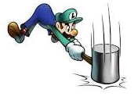
Throat Clearing
Everything said here is a conjecture …
  … to be tested in your experience
My approach is fundamentally phenomenological …
I am interested in lived experience.
Radical version: my task is to evoke awareness (noticing)
So, what you get from this session will be mostly …
  … what you notice happening inside you!
Avoid the teaching of
speculators,
whose judgements are
not confirmed
by experience.
(Leonardo Da Vinci)
Central role of attention:
… What is being attended to?
… How it is being attended to,
especially when reflecting?
Awareness
as consciousness
as that which enables action

Slide 4
Sequence
What powers do you use?
What themes do you encounter?
…
10
5
11
2
6
12
1
3
7
13
21
31
43
57
73
91
111
133
157
183
211
241
273
4
8
14
9
15
16
First differences = 2n

Slide 5
Sequence
What powers do you use?
What themes do you encounter?
10
21
22
23
24
25
…
5
11
20
7
8
9
10
2
6
12
19
6
1
2
11
1
3
7
13
21
…
18
5
4
3
12
4
8
14
17
16
15
14
13
9
15
16
Why?

Slide 6
Term Divisibility
…
10
5
11
2
6
12
1
3
7
13
21
31
43
57
73
91
111
133
157
183
211
241
273
4
8
14
9
15
16
307
343
381
421
463
507
553
601
651
703
757
813
871
Express your conjecture in symbols
Characterise all sequences that satisfy your conjecture

Slide 7
Difference Divisibility
…
10
5
11
2
6
12
1
3
7
13
21
31
43
57
73
91
111
133
157
183
211
241
273
4
8
14
9
15
16
307
343
381
421
463
507
553
601
651
703
757
813
871
Express your conjecture in symbols
Characterise all sequences that satisfy your conjecture

Slide 8
Powers & Themes
Powers
Themes
Imagining & Expressing
Specialising & Generalising
Conjecturing & Convincing
Stressing & Ignoring
Organising & Characterising
Doing & Undoing
Invariance in the midst of change
Freedom & Constraint
Extending & Restricting

Slide 9
Constructing Numbers
Write down a pair of numbers that differ by 2
  And another pair
  And another pair
Write down a number than no-one else in the room will write down
Now for a competition!
  The winner is the person who writes down the smallest positive whole number that no-one else writes down!
What did you find yourself thinking about (attending to)?
Example Space!

Slide 10

Differing Sums of Products
Write down four numbers in a 2 by 2 grid
4
7
5
3
Add together the products along the rows
28 + 15 = 43
Add together the products down the columns
20 + 21 = 41
Subtract second result from first
43 – 41 = 2
Now add a number to both of the main diagonal numbers
and
subtract a number from both of the off-diagonal numbers:
6
4
Repeat the calculation
2
5
Notes:
Mathematical context
What probaby matters most is not the context, but whether students ‘think’ they can solve the problem (follow instructions)
Notice movements of attention: discerning details; recognsiing relationships
Invariance in the midst of change; Conjecturing

Slide 11
Differing products
4
7
45
x
37
Take your two grids
Form the four two-digit numbers as indicated
5
3
47
35
–
x
= 20
Perfom the calculations
indicated
6
4
62
x
54
Compare your answers
2
5
64
x
52
–
= 20
Notes:
Relationship to previous calculations
Invariance in the midst of change

Slide 12
Undoing Differing Sums of Products
Construct a 2 by 2 grid of numbers so that
  Adding together the products along the rows
  And adding together the products down the columns gives a difference of 7
?
?
?
?
Notes:
Note the proceptual move: a sequence of actions becomes a compound action and is on the edge of becoming a noun
Undoing is often creative

Slide 13
Tracking Arithmetic
4
7
45 x 37
4x7 + 5x3
5
3
47 x 35
4x5 + 7x3
(40+5)x(30+7) – (40+7)x(30+5)
= 40x30 + 5x7 + 40x7 + 5x30
–(40x30 + 5x7 + 40x5 + 7x30)
4x(7–5) + (5–7)x3
= 40x(7-5) + (5-7)x30
= 4x(7–5) – (7–5)x3
= 40x(7-5) – (7–5)x30
= (4-3) x (7–5)
= (40–30)x(7–5) = 10(4–3)(7–5)
So in how many essentially different ways can 6 be the difference?
Why does adding a constant to both diagonal entries make no difference?
So in how many essentially different ways can n be the difference?
Notes:
Revealing Structure by attending to relationships not calculations
Dimensions of possible variation; range of permissible change

Slide 14
ThOANs: Think Of A Number

Slide 15
Using Tracking Arithmetic
?
3
7
4
1
8
Notes:
Applies to Pascal’s triangle; Leibniz’s triangle, multiplication and other tables

Slide 16
Imagine a Number-Line
-12
-11
-10
-9
-8
-7
-6
-5
-4
-3
-2
-1
0
1
2
3
4
5
6
7
8
9
10
11
12
Imagine a copy on acetate, sitting on top
Imagine rotating the acetate number-line through 180° about the point 5:
  Where does 3 end up?
  Where does -2 end up?
  Generalise
Notation:
R₅ rotates about 5
R₅ (x) =
Notation:
R_{a} rotates about a
R_{a} (x) =
5 – (x – 5)
a – (x – a)
Expressing relationships in general
Tracking Arithmetic
Notes:
Two readings of 5 – (5 – x)
Extracts from a sequence of tasks

Slide 17
Imagine a Number-Line
-12
-11
-10
-9
-8
-7
-6
-5
-4
-3
-2
-1
0
1
2
3
4
5
6
7
8
9
10
11
12
Imagine a copy on acetate, sitting on top
Imagine rotating the acetate number-line through 180° about the point 5;
Now rotate that about the point where 2 was originally
  Where does 3 end up?
  Where does -2 end up?
  How are these results related?
  Generalise!
Given a succession of rotations about various points, when is there a single point that can act as the centre for all of them?
R_{a}(x) = 2a – x
R_{b}(R_{a}(x)) =
R_{b}(2a – x)
= 2b – (2a – x)
= 2(b–a) + x
= T_{2(b–a)}(x)

Slide 18
Imagine a Number-Line
-12
-11
-10
-9
-8
-7
-6
-5
-4
-3
-2
-1
0
1
2
3
4
5
6
7
8
9
10
11
12
Imagine a copy on acetate, sitting on top
Imagine rotating the acetate number-line through 180° about the point 5;
Now rotate that about the point where 2 now is.
  Where does 3 end up?
  Where does -2 end up?
  Generalise
Q₅ rotates about where
5 currently is
Q_{b}(Q_{a}(x)) =
R_{R (b)}(R_{a}(x))
Q_{a}(x) = R_{a}(x) = 2a – x
a
= R_{2a–b}(R_{a}(x))
= 2(2a–b) - (2a – x)
Any resonances?
= 2(a – b) + x
= T_{2(a–b)}(x)
Notes:
Notice the use of absolute-reference-based actions in order to work with relative-reference-based actions

Slide 19
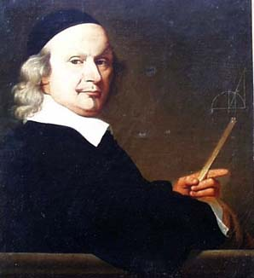
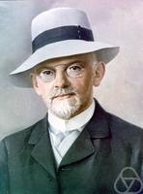
Reflexive Stance
How have you been working?
  Lots of examples?
  Recognising a Relationship in the Particular?
  Perceiving a Property in its Generality?
Working from examples
Many examples?
One generic example?
John Wallis 1616 - 1703
David Hilbert 1862-1943
Notes:
“My method of investigation”

Slide 20
Doing & Undoing
What operation undoes ‘adding 3’?
What operation undoes ‘subtracting 4’?
What operation undoes
‘subtracting from 7’?
What are the analogues for multiplication?
  What undoes multiplying by 3?
  What undoes dividing by 2?
  What undoes multiplying by 3/2?
  What undoes dividing by 3/2?
Notes:
Dave Hewitt’s THOAN sequences

Slide 21
Magic Square Reasoning
What other
configurations
like this
give one sum
equal to another?
6
7
2
2
1
5
9
Try to describe
them in words
2
8
3
4
Any colour-symmetric
arrangement?
)
Sum(
–
Sum ( )
= 0
Notes:
Think of all the patterns obtained like this one but with different choices of the red line and the blue line.
Sketch a few
Here is another reasoning
What about this pattern: is it true?
did you have difficulty recognising the components? This may be why learners find it hard to remember what they were taught recently!

Slide 22
More Magic Square Reasoning
Sum(
)
–
Sum( )
= 0

Slide 23
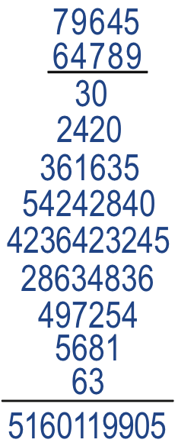
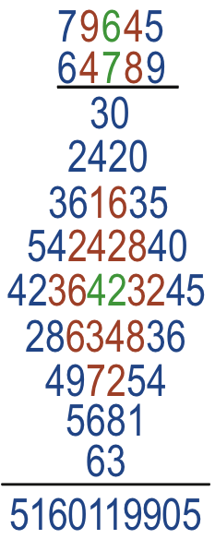
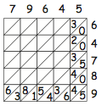
Diamond Multiplication
Find the mistake!

Slide 24
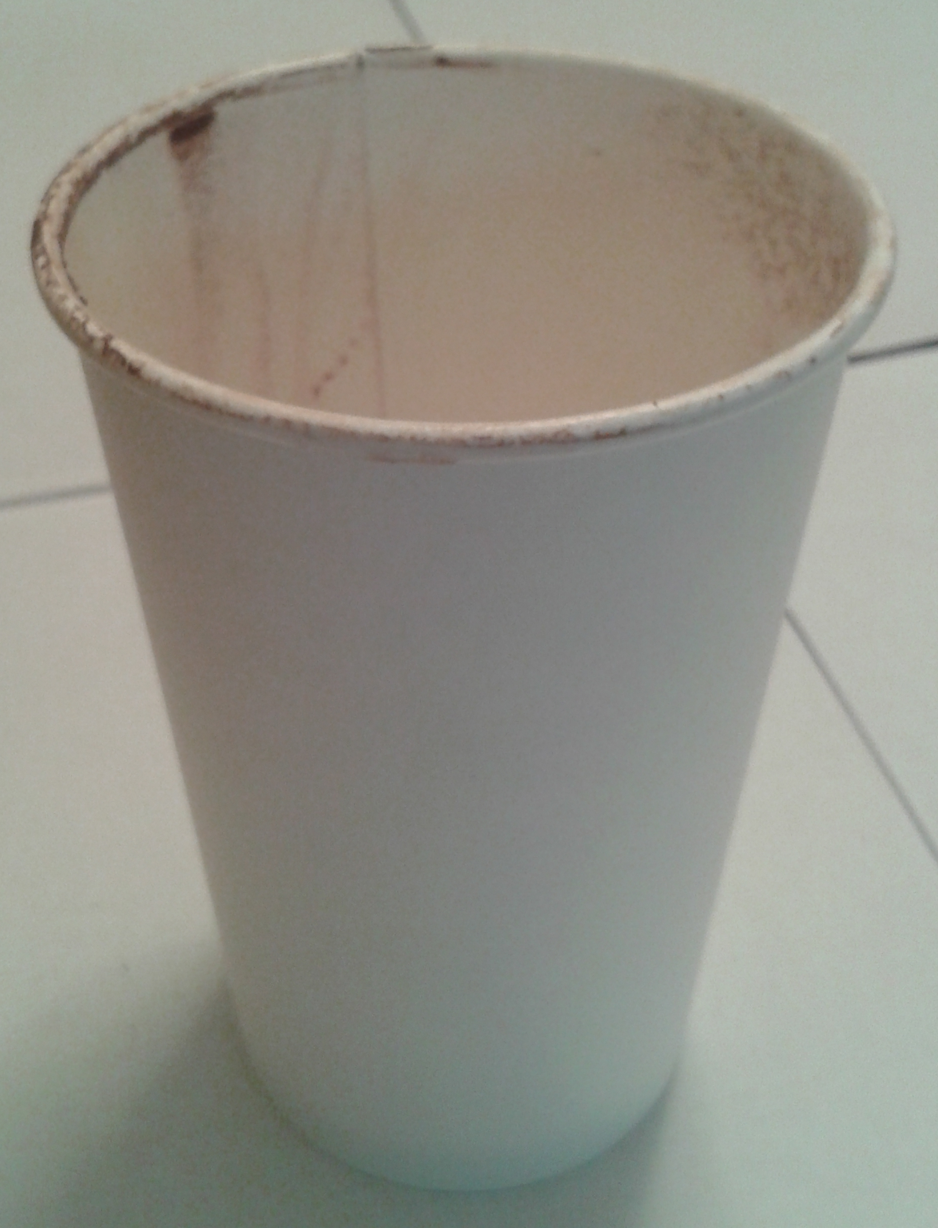
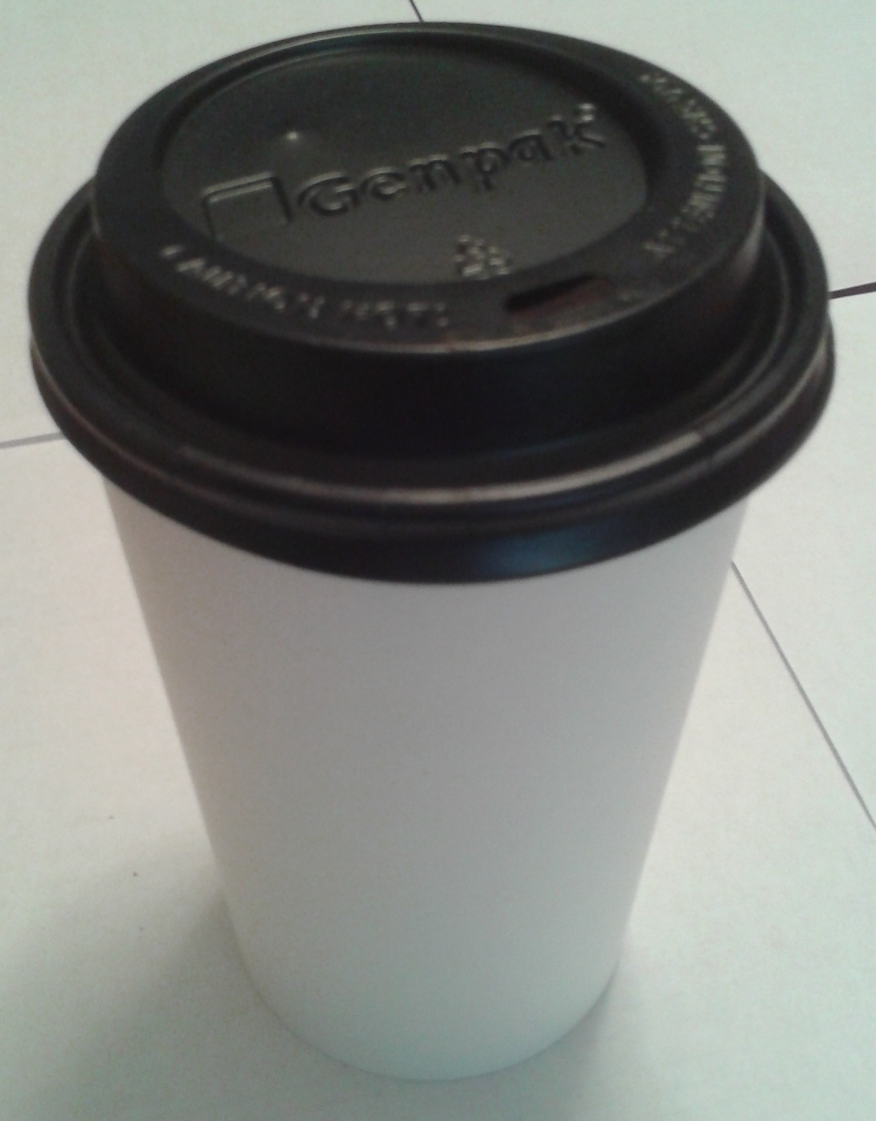
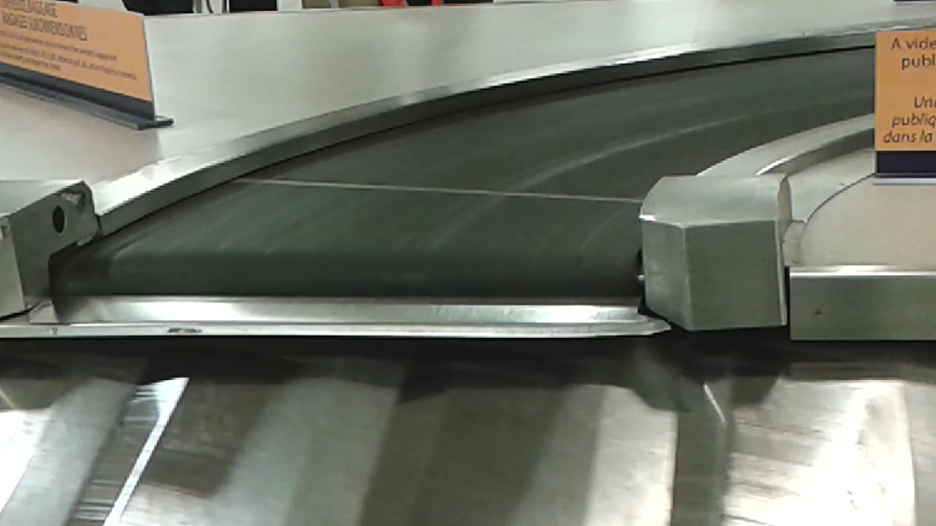
Rolling Cups & Luggage Belts
A cup rolls about. What path does it follow?
What difference would a lid make?
What would happen if the cup was oval?
What variations come to mind?
What shape is the upper belt?
Are these two phenomena related in any way?

Slide 25
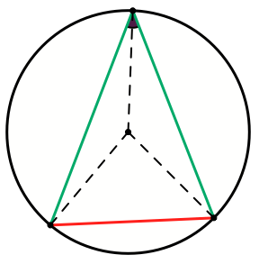
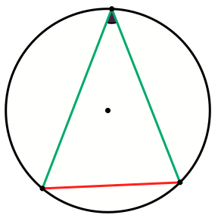
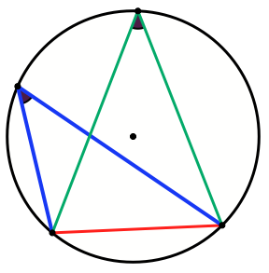
Invisible Embedded Elements

Slide 26
Classifying Quadrilaterals By Diagonals
If the diagonals of a quadrilateral are perpendicular then the alternating sum of squares of edge lengths is 0.
Converse?
Classify
  Squares
  Rectangles
  Trapezia
  Parallelograms
  Kites
by properties of their diagonals.

Slide 27
Reflection
Reflection in action (awareness –> actions enabled)
Reflection on action (awareness –> future actions)
Withdrawing from action (movement in higher dimension)
Reporting results;
Reporting actions;
Reporting effectiveness of actions
Self-explanation
Narrative construction
(inner incantations)
Object construction
Self-monitoring
Self-evaluation
Notes:
Anne’s notion of manifesting reflection by moving up one dimension

Slide 28
Aims & Desires
How would you like to see your students acting mathematically by the end of your time with them?
In what ways will you display that in your own behaviour?
In what ways will you use similar behaviour towards mathematical pedagogy and mathematics itself?

Slide 29
Sensitising Yourself to Notice
Hearing what is not said …
Seeing what is not shown …
  and becoming aware of it (so as to enable other actions)
Babbling & Gargling
  Trying to express oneself but not getting it quite right
  Pretending to understand by using big words strung together
Sensitising comes through recent personal parallel experience

Slide 30
Multi-Level Initiating of Tasks
In how many ways can a unit fraction be expressed as the difference of two unit fractions?
Notice that
Notice that
Notes:
Ways of initiating activity through presentation of a task

Slide 31
Mathematical Thinking
How describe the mathematical thinking you have done so far today?
How could you incorporate that into students’ learning?
What have you been attending to:
  Results?
  Actions?
  Effectiveness of actions?
  Where effective actions came from or how they arose?
  What you could make use of in the future?

Slide 32
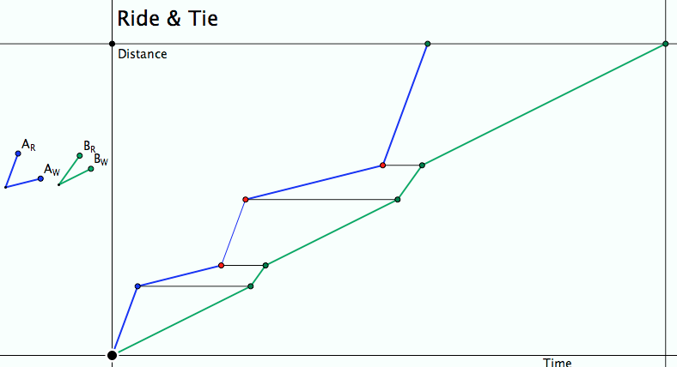
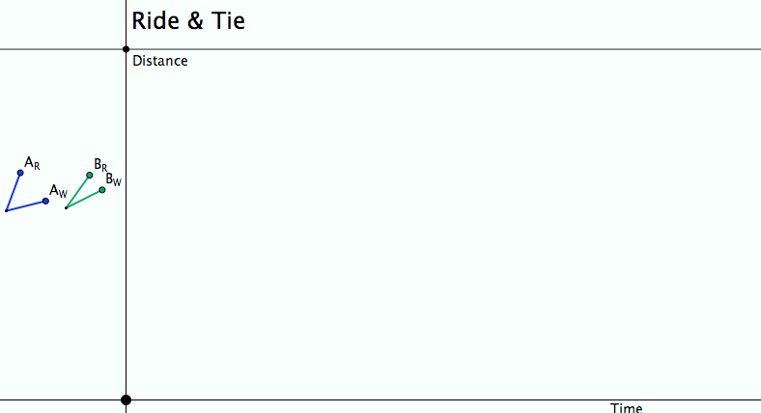
Ride & Tie
Two people and one horse make a journey. At various times the rider ties the horse and walks on. The aim is for all three to arrive together at the destination.
Imagine, then draw a graph!
Seeking Relationships
Does the diagram make sense
(meet the constraints)?
Notes:
Does the diagram meet the constraints?
What can be changed, what choices are there?
What relationships (does it really matter how many times the horse is swapped?)

Slide 33
Is 51 + 51 = 50 + 52?
How do you know?
What could Fran be attending to, that led her to say that?
Fran: Like fifty-one plus fifty-one are one hundred and two, but fifty-one, if you subtract fifty, you can add to fifty-one, one from the other, one more, and you get fifty-two.
Teacher-Researcher: Ah, that is interesting. You said that you can take one from here [pointing to the first fifty-one] and add it to this one [pointing to the second fifty-one]. Isn’t it? Is that what you said?
Fran: And you get there, one hundred… fifty plus fifty-two.
How would attention shift
so as to say that?
Babbling or Gargling?
What attended to so as to say that?
Listening-to or
listening-for?
Teaching Action:
selecting/editing
What might be being attended to so as to say that?
What shifts involved?
Notes:
Mason, J. (2012). You Can Lead a Horse to Water…: Issues in Deepening Learning Through Deepening Teaching. In S. Hegedus & J. Roschelle (Eds.) Democratizing Access to Important Mathematics through Dynamic Representations: Contributions and Visions from the SimCalc Research Program. Berlin: Springer-Verlag.
Nicolina Malara; Brent Davis

Slide 34
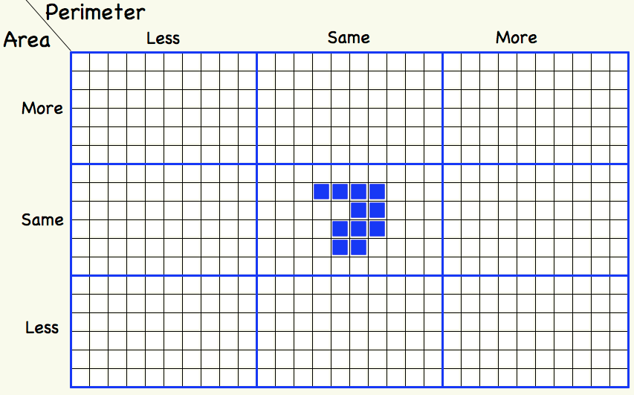
Tabled Variations

Slide 35
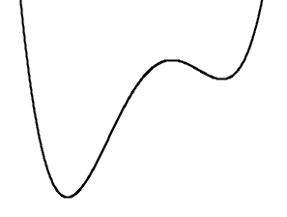
More or Less Variations
Number of factors
Frequency
Number of local maxima
LCM
Fewer
Smaller
More
Larger
Number of
prime factors
Period
Same
Number of
local minima
HCF
More
Larger
Same
300
84, 126
Fewer
Smaller

Slide 36
Tabled Constructions: functions
Range
Domain
(0, 1)
[0, 1)
(0, 1]
[0, 1]
(0, 1)
[0, 1]
(0, 1]
[0, 1]

Slide 37
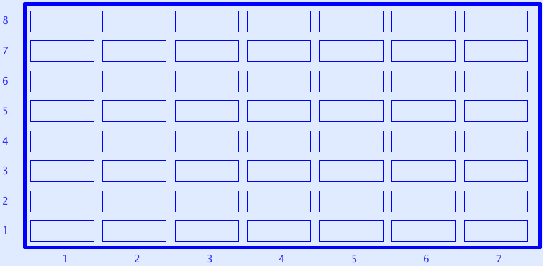
Sundaram Grids
All rows and columns are arithmetic progressions
How many entries do you need to fill out the grid?
Notes:
Drc=6, Dr=4 Dc=3 S=1 –> numbers that are the product of two numbers, one odd, the other congruent to 1 mod 3
Drc*rc+r(Dr-Drc)+c(Dc-Drc)+Drc-Dr-Dc+S
Disturbance; challenge + Trust that it is not excessive

Slide 38
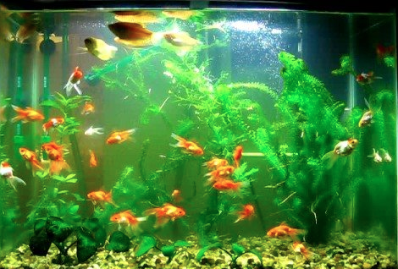
Goldfish
  I have a tank with 200 goldfish.
  98% of them are small, the rest are large.
  I want to remove some of the small ones so that the remainder form 96% of the fish left in the tank.
  How many small fish should I remove?
Immediate Thoughts:
a few; a middling number; a lot?
Now think about it!

Slide 39
Goldfish Resolved
I have a tank with 200 goldfish.
98% of them are small, the rest large.
I want to remove some of the small ones so
that the remainder from 96% of the fish in the tank.
How many small fish should I remove?
Which are the large and which are the small?
Focus on the invariants: the large fish.
98% of 200
= 196
200 – 196
There are 4 large fish.
These are to form 4% of the remainder.
96% of
100
4
4 = 4% of
100
?
There will be 100 fish remaining,
so 200 – 100 = 100 would have to be removed.
Are we done?
Reflecting?
Generalising?
Extending?

Slide 40
Goldfish: Tracking Arithmetic
I have a tank with 200 goldfish.
98% of them are small, the rest large.
I want to remove some of the small ones so
that the remainder from 96% of the fish in the tank.
How many small fish should I remove?
Focus on the invariants: the large fish.
98% of 200
= 196
200 – 196
large fish.
(100 – 98)% of 200
4
are to form (100 – 96)%
of the remainder.
96% of
100
(100 – 98)% of 200
4 = 4% of
100
(100 – 98)% of 200 = (100 – 96)% of
?
There will be 100 fish remaining,
so 200 – 100 = 100 would have to be removed.

Slide 41
Goldfish Reflections
What was effective?
What was not?
Anticipation allows surprise
Don’t believe first thought: treat it as a conjecture
Responding after Reacting
(Inner Outer & Meta aspects)
Reflecting
Extending
How many of the large fish do I need
to add to get the same percentages?
  What values will give sensible answers?
Suppose I can take some small fish away and add some large fish? What is the relationship between these numbers so as to achieve the final percentage?
  What values will give sensible answers?
Multiple answers
All correct
Relationships!

Slide 42
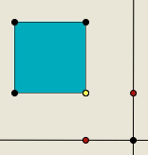
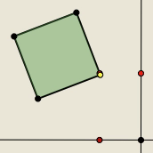
Perimeter Projections
Imagine a square
Imaging a point traversing the perimeter of the square
Let your right hand track the vertical movement of the point
Let your left hand track the horizontal movement of the point
Now imagine your square tilts a bit, say about 30°. What happens?

Slide 43
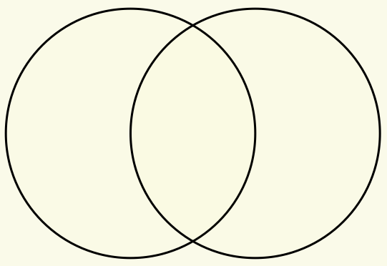
Set Ratios
In how many different ways can you put 17 objects into the two sets (the circles) so that both sets have the same number of objects?
Notes:
Now apply what we have been doing, paying attention to powers and themes.
How else could the task be presented?

Slide 44
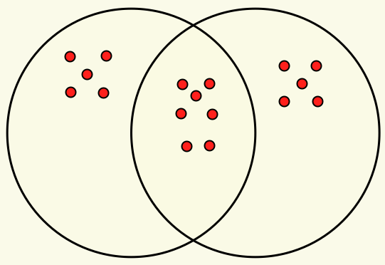
Example

Slide 45
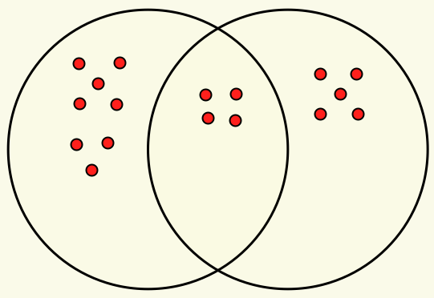
Extension
Here the sets are in the ratio of 4 : 3.
In how many ways can the 17 objects be placed so the sets are in the ratio 3 : 2?
4 : 3
What about 3 sets?

Slide 46
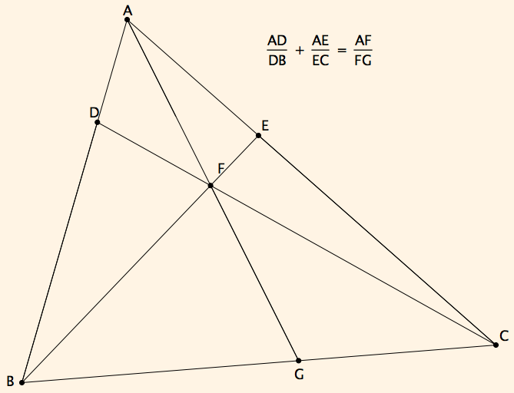
Ratio Addition

Slide 47
Reasoning
A
Movements of attention:
E
D
F
C
B
G

Slide 48
On Being Professional Mathematically
What do you actually value?
  Developing complex ways of thinking?
  Developing flexibility?
  Getting answers to routine questions?
  Having a go at problems?
Teaching Responsively
  Listening to students not for what you desire or expect but for variation so as to extend possibilities
  Distinguishing between babbling and gargling
Teaching Responsibly
  Becoming articulate about both what and why choices are made
  Being willing to justify criteria for choices
    Tasks (initiating, sustaining, intervening, concluding)
  Probing beneath the surface of like and dislike, of ‘went well’
  Negotiating technical vocabulary with colleagues

Slide 49
Outer, Inner & Meta Aspects of Tasks
Outer Task
  What students actually asked to do
  What students actually do
What author imagined
What teacher intends
What students construe
Inner Task
  What powers might be used or developed?
  What themes might be encountered and enriched?
  What connections might be made?
  What reasoning might be called upon?
  What sense students make of their activity
  What students are now prepared to be able to hear & see
  What students reconstruct later
Meta Task
  Personal propensities and dispositions to challenge or work on
  Working collaboratively and individually

Slide 50
Emergent Practice
Before observing, or prompting others,
try to generate a similar or analogous experience in and for myself
This may sensitise me to notice relevant features (discern details)
and alert me to recognising relationships

Slide 51
Powers & Themes
Powers
Themes
Imagining & Expressing
Specialising & Generalising
Conjecturing & Convincing
Stressing & Ignoring
Organising & Characterising
Doing & Undoing
Invariance in the midst of change
Freedom & Constraint
Extending & Restricting
Are students being encouraged
to use their own powers?
or
are their powers being usurped by textbook, worksheets and … ?

Slide 52
Attention
Holding Wholes (gazing)
Discerning Details
Recognising Relationships
Perceiving Properties as being instantiated
Reasoning on the basis of agreed properties

Slide 53
Being
Where confidence is situated:
  Not in knowing answers … but in having access to powers and themes
‘measure of being’ is what you can bear
  Frustrations
  Not-knowing
  Uncertainty
In self
Upholding
In students
Manifested as
  Access to mathematically oriented questions to ask:
What do I know?
What do I want?
What is the status of your statement?
How do you know?
  Attending to how students are attending
  Being aware of what you are attending to, and how

Slide 54
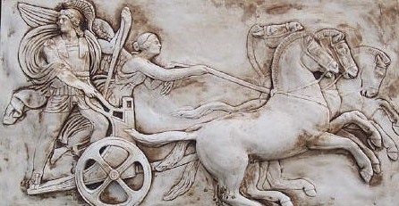
Human Psyche
Intellect (cognition)
Imagery
Attention/Will
Emotions
(affect)
Body (enaction)
Habits
Practices

Slide 55
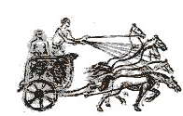
Structure of a Topic
Language Patterns
& prior Skills
Imagery/Sense-of/Awareness; Connections
Root Questions
predispositions
Different Contexts in which likely to arise;
dispositions
Standard Confusions
& Obstacles
Techniques & Incantations
Emotion
Awareness
Behaviour
Only Emotion is Harnessable
Only Awareness is Educable
Only Behaviour is Trainable
Only Attention can be Directed

Slide 56
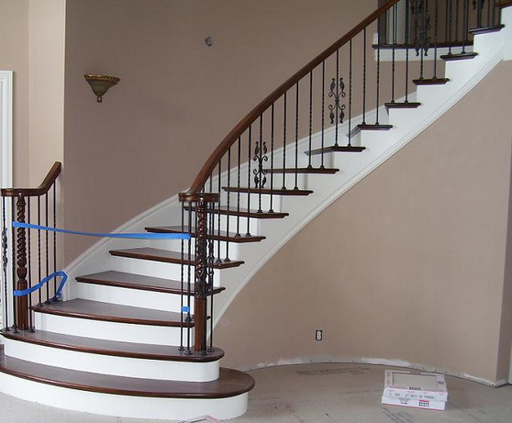
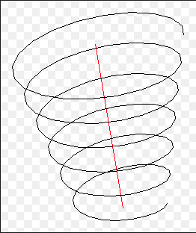
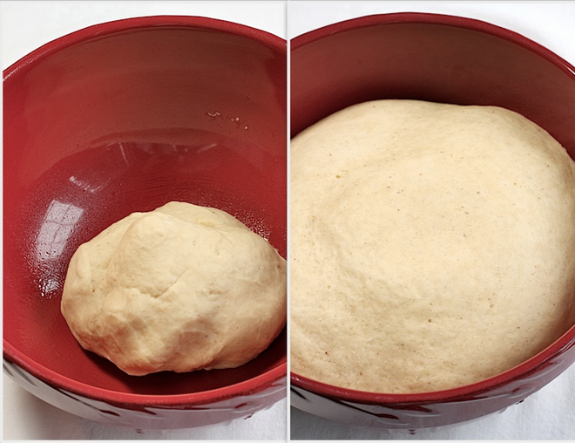
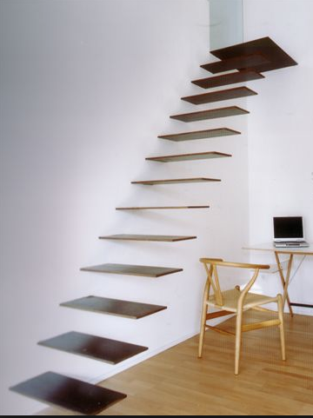

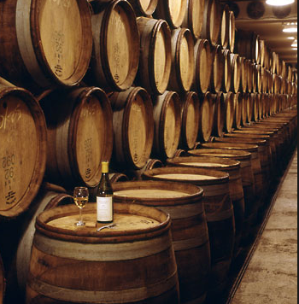
Conceptions of Learning
Staircase
Spiral
Maturation

Slide 57
MGA

Slide 58
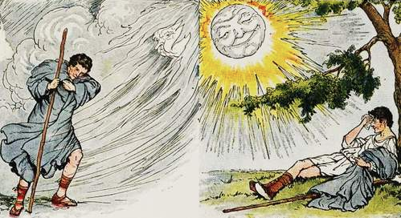
Aesop’s story of the Sun & the Wind
Direct instruction can be like the action of the wind;
Providing students with what is sufficient-necessary so they can use
their natural powers to work things out can be like the action of the sun

Slide 59
Learning & Assessment
What is available to be learned?
What is discernible?
What relationships are recognisable?
What properties are perceiveable as being instantiated?
What reasoning is called upon?
What behaviour is accessible to assessment?
What is done?
What discernments, relationships and properties need to be present in order to perform?
What justifications are sought and given?
What learning is accessible to assessment?
What is discerned?
What relationships are recognised?
What properties are perceived as being instantiated?
What reasoning is displayed?

Slide 60
Actively Enquiring (Research)
Developing a ‘researching’ or enquiring ‘being’ (self)
Observation
  ExtraSpectivity: from the outside;
  Introspectivity: speculative narrative
  Interspectivity: negotiating with others
  Intraspectivity: inner witnessing
  Spectivity: noticing in the moment

Slide 61
Reflection as Self-Explanation
What struck you during this session?
What for you were the main points (cognition)?
What were the dominant emotions evoked? (affect)?
What actions might you want to pursue further? (Awareness)
Notes:
Chi et al

Slide 62
Professional Associations
Mathematical Association (MA)
Association of Teachers of Mathematics (ATM)
London Mathematics Society (LMS)
Institute of Mathematics and its Applications (IMA)
National Centre for Excellence in Teaching Mathematics (NCETM)
  Mathemapedia
  Personal pages
  Forums and blogs
  Resources
National Stem Centre (York): resources

Slide 63
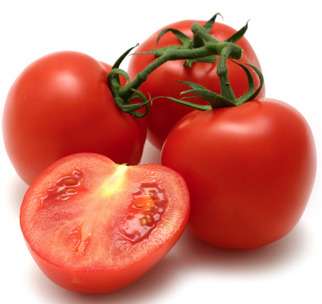
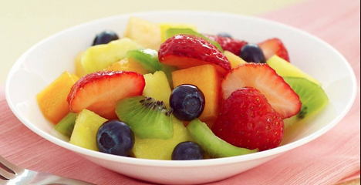
Knowledge & Wisdom
Knowledge is knowing a tomato is a fruit;
Wisdom is not putting it in a fruit salad! (Miles Kington)
Being (professional) is sustaining the complexity of both

Slide 64
To Follow Up
www.PMTheta.com and mcs.open.ac.uk/jhm3
john.mason@open.ac.uk
Researching Your own practice Using The Discipline of Noticing (RoutledgeFalmer)
Questions and Prompts: (ATM)
Key ideas in Mathematics (OUP)
Designing & Using Mathematical Tasks (Tarquin)
Fundamental Constructs in Mathematics Education (RoutledgeFalmer)
Annual Institute for Mathematical Pedagogy (end of July) (see PMTheta.com)

