Slide 1


Remembering
Maxim Bruckheimer
John Mason
Weizmann Institute
Sept
2023

Slide 2
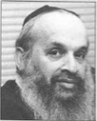
First encounter
As Dean
Designing Summer School
Pedagogy

Slide 3
From Martin Cundy review
One must be careful not to be too categorical. There are principles in mathematical education but they must be thought of within the general framework of the structure of mathematics. It may well distort the picture if one example is seized with too much violence.
This is an inherent danger in the present revolution. Many so-called new topics are being included in progressive syllabuses without integration into the general structure. They are presented in a very fragmentary fashion in much the same way that the traditional topics were.
It would seem to the authors that beside the thought needed for the new topics themselves, much more thought must be given to this point of structure in mathematics. It is apparent from conversations with teachers from many schools that they have as yet very little idea of what mathematics lies behind the new syllabuses and topics, and for this reason, many are convinced that the new topics are just new gimmicks for a new generation. This is, perhaps, not entirely wrong but surely there is much more to be gained or lost than gimmickry.

Slide 4
From Background to Set Theory
"If possible, one should not begin with the result and then provide the investigation. If one wishes one's students to react then one should present them with a reasonable problem suitably motivated, depending on their level, and not with the answer.”
[Their approach is] to explore a topic at the outset of each chapter, to develop it by means of Examples, many of which are left to the reader to work, to systematize what has thus been discovered, and then to suggest numerous Exercises which show the applications of the topic to familiar techniques.
Speaking of Examples …
I have learned a lot over the years about
the role of examples
effective actions in relation to examples.
For me it all boils down to attention …

Slide 5
Where is Your Attention when discussing examples with learners?
Weizmann Institute
Sept
2023

Slide 6

Throat Clearing
Everything said here is a conjecture …
  … to be tested in your experience
My approach is fundamentally phenomenological …
I am interested in lived experience.
Radical version: my task is to evoke awareness (noticing)
So, what you get from this session will be mostly …
  … what you notice happening inside you!
Avoid the teaching of
speculators,
whose judgements
are not confirmed
by experience.
(Leonardo Da Vinci)
Central role of attention:
… What is being attended to?
… How it is being attended to,
especially when reflecting?
Awareness
as consciousness
as that which enables action

Slide 7
Conjectures
Each act of teaching, each initiated pedagogic action
is an intervention in learner attention
  Asking a question
  Making a suggestion
  Making a statement
If the teacher and learners are attending to different things
then communication between them is likely to be impoverished
Even if they are attending to the same thing, they may be attending differently, rendering communication impoverished.

Slide 8
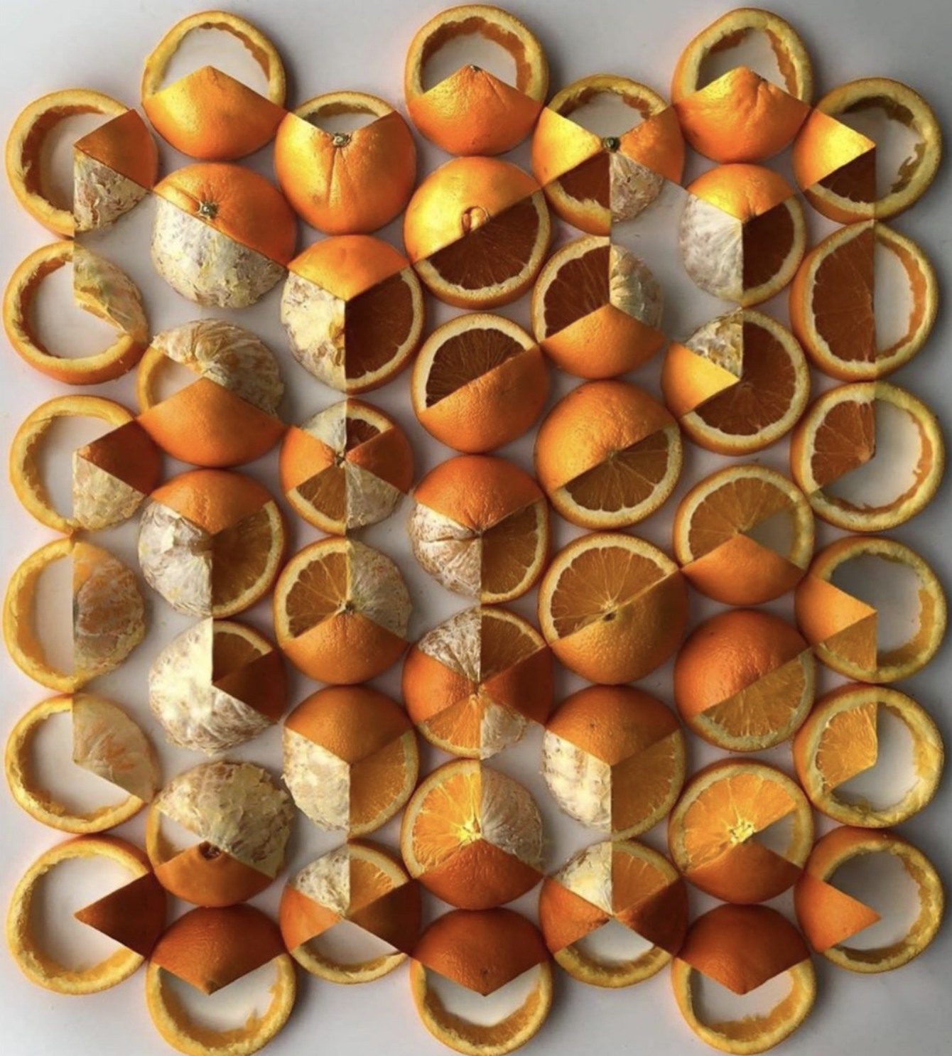
Say What You See
https://twitter.com/Dandoesmaths

Slide 9
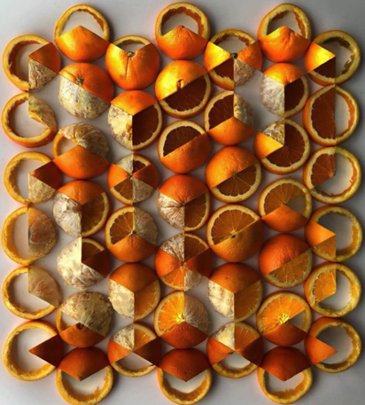
Attention
At first, you probably saw oranges
At some point you recognised that the oranges had been cut in different ways
At some point your attention shifted to ‘seeing’ parts of, even whole cuboids and other similar structures
You may have looked at the details of how the cutting of the oranges ‘created’ the illusion of faces of cuboids.
Think back and see whether you recognise periods when you were
Holding a Whole (gazing)
Discerning Details
Recognising Relationships
Perceiving Properties (as being instantiated)
Reasoning on the basis of agreed properties

Slide 10
Say What You See
What you see is influenced by what you expect to see,
which is based on what you have recently seen
Notes:
Seeing what could be there

Slide 11
Can You See …?

Slide 12
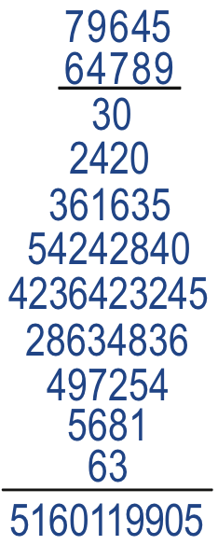
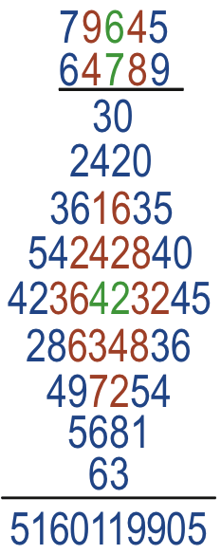
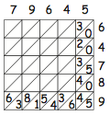
Diamond Multiplication
What is going on?

Slide 13
Kites
Are you sure this must be a kite?
Are you sure this must be a kite?
Notes:
First: Use lengths to deduce Kite
Second: Use angles to deduce Kite
Useful to know that second fold is at 22.5°

Slide 14
Where Were You?
Where was your attention?
  In or on the paper?
  In or on the folding?
  In or on fold lines?
  In or on relationships?
  In or on Properties being instantiated?
  Reasoning with those properties?
Notes:
Really in the paper, or on some idealised version of the paper as if exactly folded?

Slide 15
Verity’s Kite counton.org/explorer/origami/veritys-kite/

Slide 16
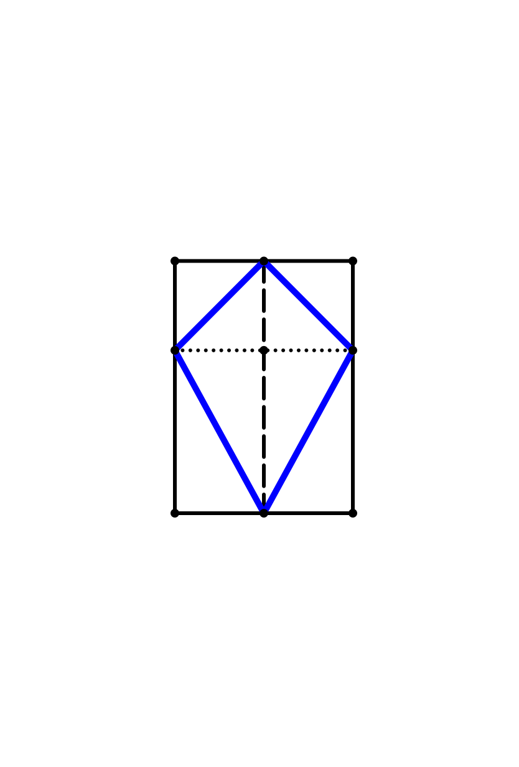
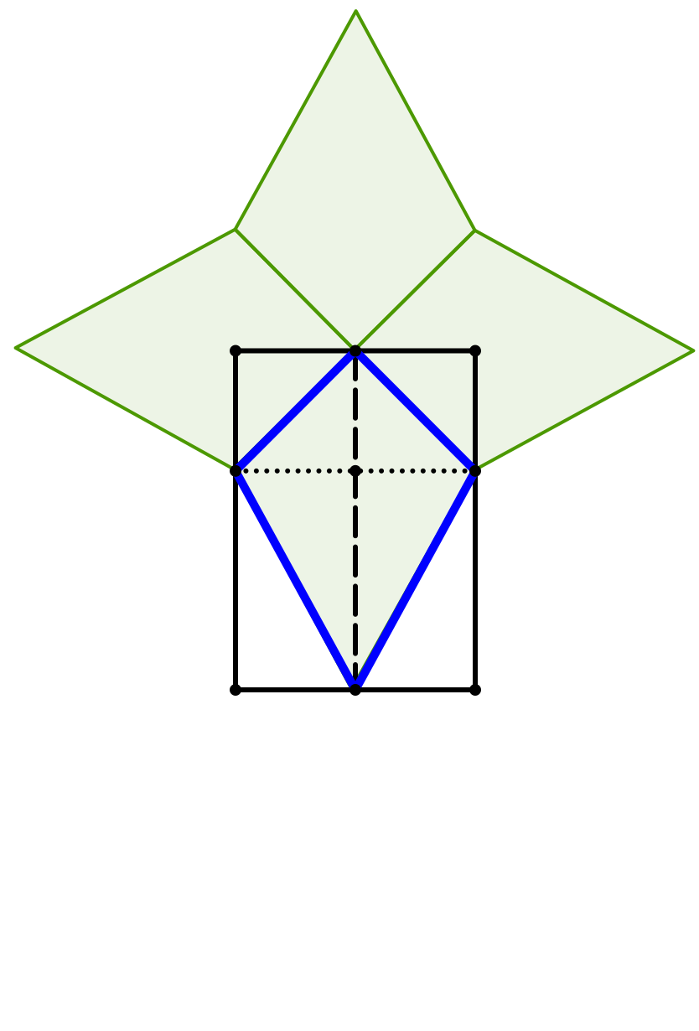
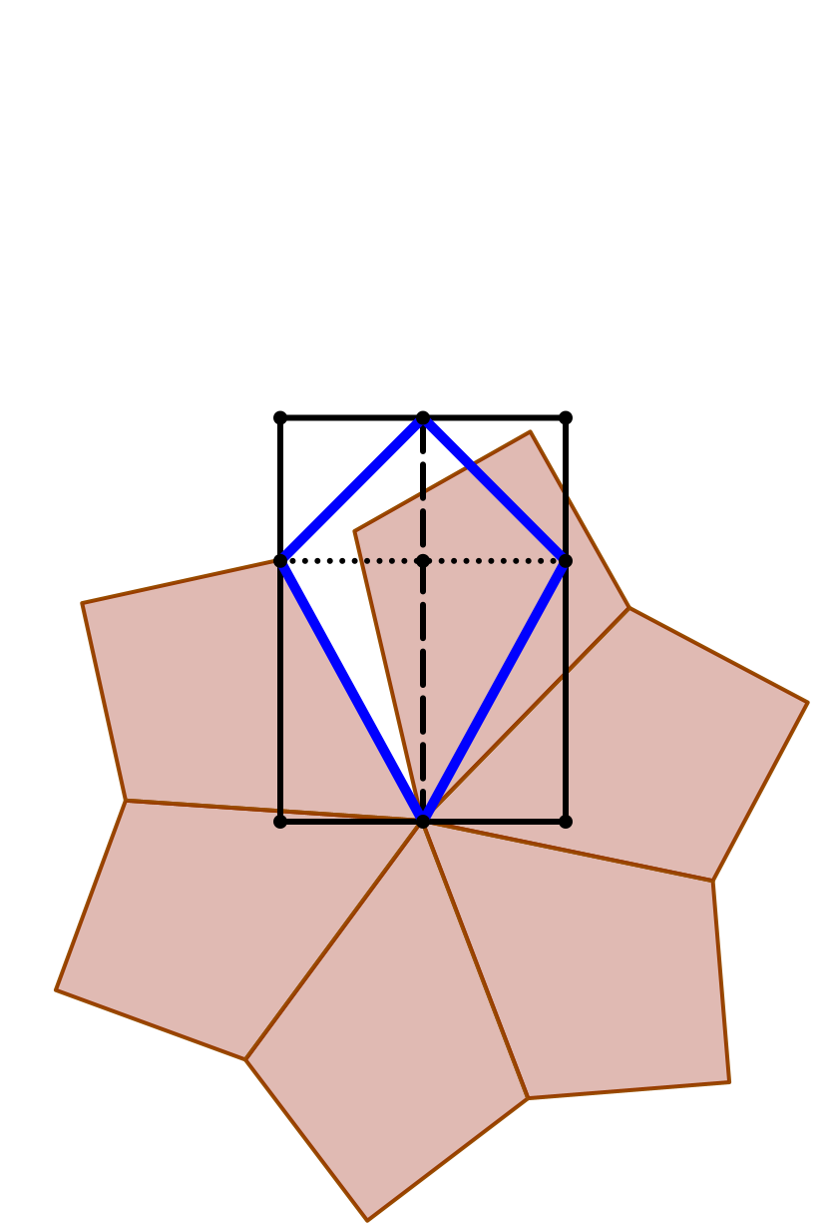
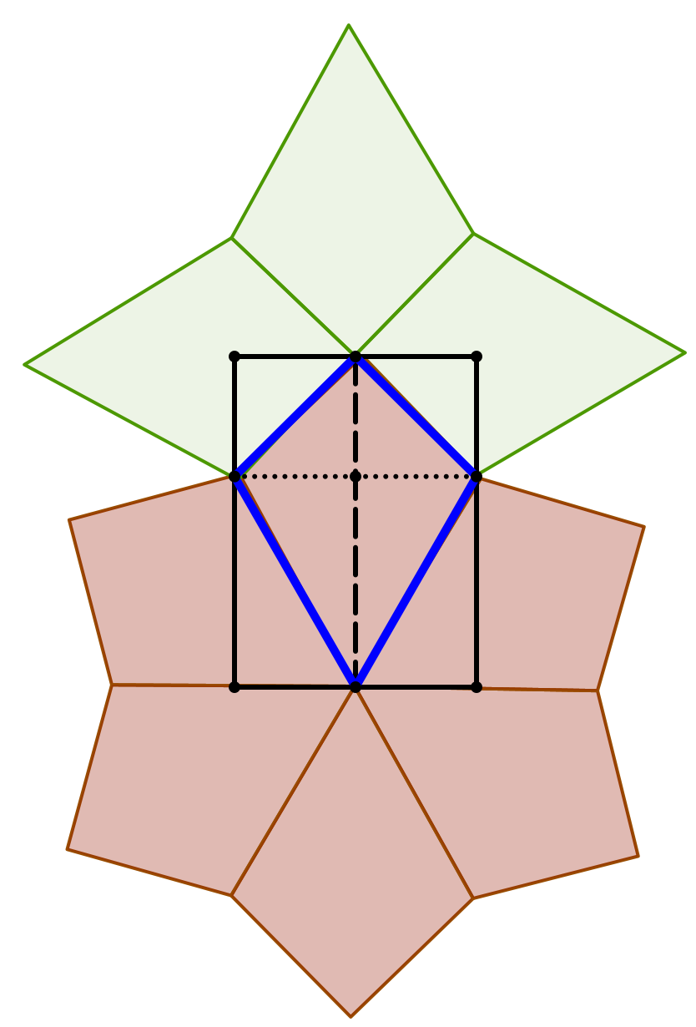

Slide 17
Conjectures
Each act of teaching, each initiated pedagogic action
is an intervention in learner attention
  Asking a question
  Making a suggestion
  Making a statement
If the teacher and learners are attending to different things
then communication between them is likely to be impoverished
Even if they are attending to the same thing, they may be attending differently, rendering communication impoverished.
When research involves other people’s experience:
  Begin analysis by asking yourself
  “what would I have to be attending to, and how,
  in order to say what they say and do what they do?”

Slide 18
Follow-Up
PMTheta.com
john.mason @ open.ac.uk

