Slide 1
Sums of Cubes and Squares of Sums
ATM April 2023

Slide 2
Divisors of Divisors (Liouville)
Pick a number
Write down all its divisors
For each of these, write down how many divisors it has.
That is your bag (includes repetitions)
Square the sum of the numbers in your bag; add the cubes of the numbers in your bag; smile!

Slide 3
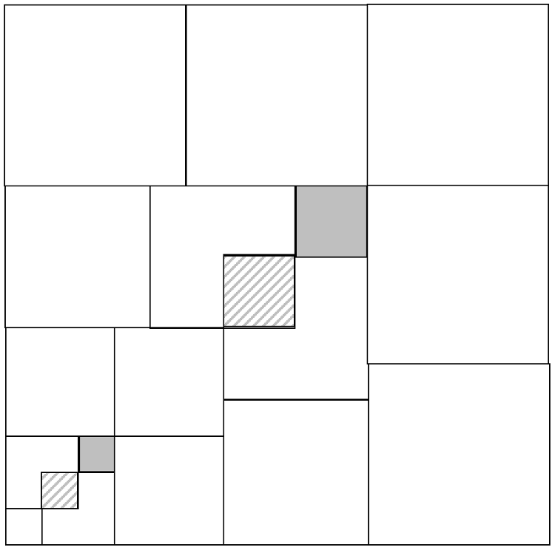
Reading a Diagram
Convince yourself, then convince a neighbour that the diagram illustrates the fact that (1 + 2 + 3 + 4)² = 1³ + 2³ + 3³ + 4³
Convince yourself that
the diagram and hence
the relationship
can be generalised

Slide 4
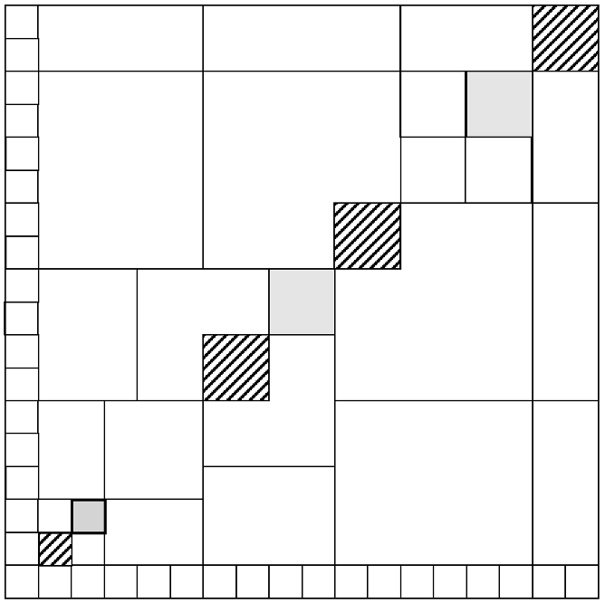
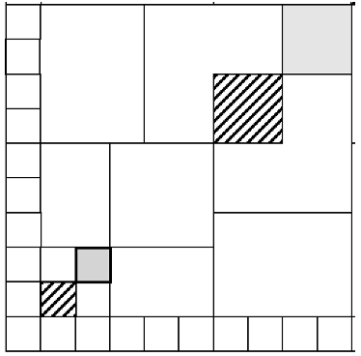
More Diagram Reading
Convince yourself that the diagram illustrates the fact that (1 + 2 + 3 + 4 + 6 + 2)² = 1³ + 2³ + 3³ + 4³ + 6³ + 2³
See the first diagram as an extension of the second
Now generalise!

Slide 5
Symbols

Slide 6
What then?
Are there any other bags of numbers whose sum of cubes is the square of their sum?
Are there infinitely many such bags?
Are there infinitely many of given length n?
Notice that
[1, 1, 4, 5, 5, 5] and [1, 2, 3, 4, 5, 6]
have the same sum (21) which is triangular
Wherever
[1, 5, 5] appears,
it can be replaced by [2, 3, 6]

Slide 7
Combining Bags
Given bags A and B
Form a new bag AxB =[ab: a in A, b in B]
[1, 2] x [1, 3] = [1, 2, 3, 6]
Can bags be factored?
Uniquely into ‘primes’?
If bags A and B both have the square of their sum equal to the sum of their cubes, what about the product bag AxB?

Slide 8
Factoring Bags
Factoring Bags
For each number n, replace each prime by a copy of the symbol p_{n} . The number 1 by is left alone
Now replace the bag by the sum of all the polynomials
The new bag can be factored uniquely as a product of irreducible polynomials
Factoring bags has only to do with the prime-structure of the component numbers!
These can then be converted back to bags!!

Slide 9
Examples
 | sum² | cubes |  | sum² | cubes
A1 = [2] | 16 | 8 | B1 = [4, 4] | 64 | 128
A2 = [1⁽⁴⁾, 2⁽³⁾, 3⁽³⁾, 5, 6] | 900 | 450 | B2 = [1⁽⁵⁾, 3] | 64 | 32
A1 x A2 = [2⁽⁴⁾, 4⁽³⁾, 6⁽³⁾, 10, 12] | 3600 | 3600 | B1 x B2 = [4⁽¹⁰⁾, 12⁽²⁾] | 4096 | 4096
A2xB1 = [4⁽⁸⁾, 8⁽⁶⁾, 12⁽⁶⁾, 20⁽²⁾, 24⁽²⁾] | 57600 | 57600 | A1xB2 = [2⁽⁵⁾, 6] | 256 | 256
So A1 x A2 x B1 x B2 factors in two different ways into ‘prime factors’
[8⁽⁴⁰⁾, 16⁽³⁰⁾, 24⁽³⁸⁾, 40⁽¹⁰⁾ 48⁽¹⁶⁾, 72⁽⁶⁾, 120⁽²⁾, 144⁽²⁾]

Slide 10
Special cases
Under what conditions on n can the bag [1^{(n)}] be factored, and when not?
For what values of n and m is the bag [n^{(m)}] a CubesSq bag?

Slide 11
Deductions
[1, 2, 3, …, n] are the only Cube-Sq bags without repetitions
Every bag is a factor of some Cube-Sq bag
Every bag can be extended to a Cube-Sq bag

Slide 12
Factoring CubeSumSq bags
In general, restricting yourself to subsets often turns unique factorisation into non-unique factorisation
For example
Consider all and only numbers leaving a remainder of 1 on dividing by 3.
Then 4, 25, and 10 are all ‘prime’.
However 4 x 100 = 10 x 10, so unique factoring of integers is lost.

