Slide 1
Whose Curriculum is it Anyway? Promoting Learner Ownership of What is Learned
John Mason Ark via Zoom March 2022

Slide 2
Outline
Some Experiences
Some Observations
Some Thoughts
Some Reflections
Some Conjectures
At any time, choose to intervene verbally or in the chat … everyone else will be pleased you did!

Slide 3
Where Would you Look For …
Imagine a number-line, stretching from left to right.
Where would you look for the number which is 1/6 to the right of negative 2?
Were you tempted to say “negative two and one-sixth”?
Did you pause to check?
–(2+ 1/6)
–2 + 1/6 = –(1+5/6)
Task as ‘check’ of comprehension?
Task as domain of challenges for learners to explore, construct?
Task as ‘control’:
Teacher ownership
Task as opportunity: Learner ownership

Slide 4
Dictated Example Construction
Please write down a decimal number between –2 and –3.
Please write down a decimal number between –2 and –3, which does not use the digit 5.
Please write down a decimal number between –2 and –3, which does not use the digit 5, and which does use the digit 7.
Please write down a decimal number between –2 and –3, which does not use the digit 5, and which does use the digit 7, and which is as close to –5/2 as possible.
Appreciation of place value/decimal digits
-2.47999…
-2.4999…7
What is now available to you?
Sense of discovery/creativity
-2.499…9799…

Slide 5
Ruminations on Experience
Simplistic Didactic Contract
Learners assume that if they undertake the tasks they are set, then the required learning will take place.
Learners & parents expect teachers to set tasks whose completion will ‘cause’ the learning to take place.
Phenomenon
Learners appear to remember, or to have access to, little of what they have been taught recently, or last term, or last year.
Partial Explanation
If asked whether they recall a fact, definition or procedure from the past, it is in their best interest to deny recall, either
because you might then test them,
or because you might have in mind some aspect that they don’t have access to, and it takes least energy to get you to remind them.
A worthy topic for discussion: what is the didactic contract in your school?
So the experienced curriculum is not the tasks, not even simply the experiences, but what is internalised from these experiences

Slide 6
Knowledge & Knowing
Conjectures
Distinctions such as between factual knowledge, procedural knowledge, and conditional knowledge fail to take into account human experience.
A much more useful discourse is knowing-to act in the moment, as distinct from (being able to write essays about) knowing-how, knowing-that, knowing-when, knowing-why etc.
The gerund knowing
reflects the influence of the context and situation on what is accessible;
admits the possibility of change, and the possibility of ongoing incompleteness
Knowing-about is superficial; Knowing-to-act in-the-moment is deep
In constructing the decimal …
How did -2.4 come to mind?
How did the use of 9’s come to mind?

Slide 7
Knowledge & Knowing
Learning from Experience
One thing we don’t seem to learn from experience, is that we rarely learn from experience alone.
Something more is required.
Being told something, or having an experience of something, is not always sufficient to mean than something has been internalised.
Doing something does not guarantee access to the same doing in ‘similar’ situations later.
Something more is required: a personal narrative which encompasses both an action and a trigger to that action.
As a teacher, owning the curriculum means:
a feeling that the next pedagogic action, the next mathematical idea, is entirely natural, both pedagogically and mathematically
a feeling of another experience in a coherent and cogent ‘trajectory’
As a learner, owning the curriculum means:
a growing sense of control over mathematical objects (example spaces), ways to construct more examples,
a growing sense of a landscape of gardens of ‘delight’ rather than dark and frightening ‘thickets’

Slide 8
Reacting & Responding
37 + 23 - 36 = 24 True/False?
Do you have learners who dive in, carrying out the first action that occurs to them?
Do you have learners who sit and wait until someone (you, an assistant, another learner) confirms what action to enact?
What did you do?
Started calculating from the left as you read it?
Read the whole, then used relationships that you recognised?
How might cautious yet intentional action be reinforced?
Providing experiences in which an action happens naturally, then prompting reflection and personal narrative construction around what was effective and what was not

Slide 9
Subtraction
Is subtraction commutative?
Let S_{a}(n) represent the action of subtracting a from n.
Let S_{b}(n) represent subtracting b from n.
What is S_{b}(S_{a}(n))?
What is S_{a}(S_{b}(n))?
The statement
“Subtraction is not commutative” is not helpful as something memorised if it is neither appreciated or comprehended

Slide 10
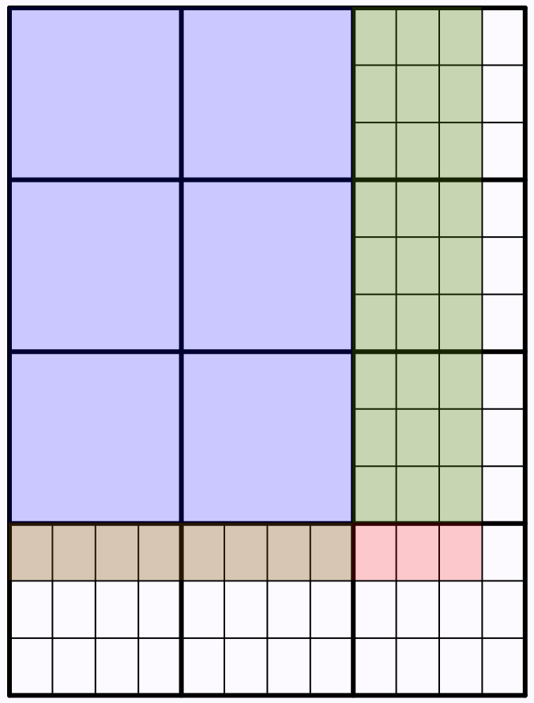
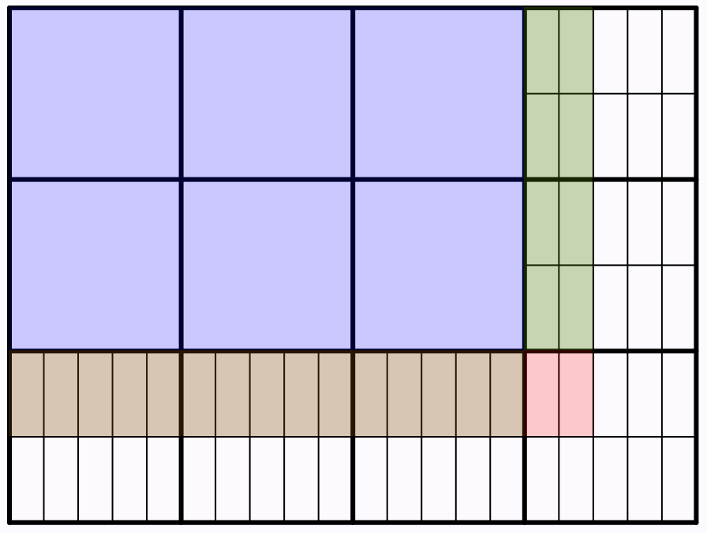
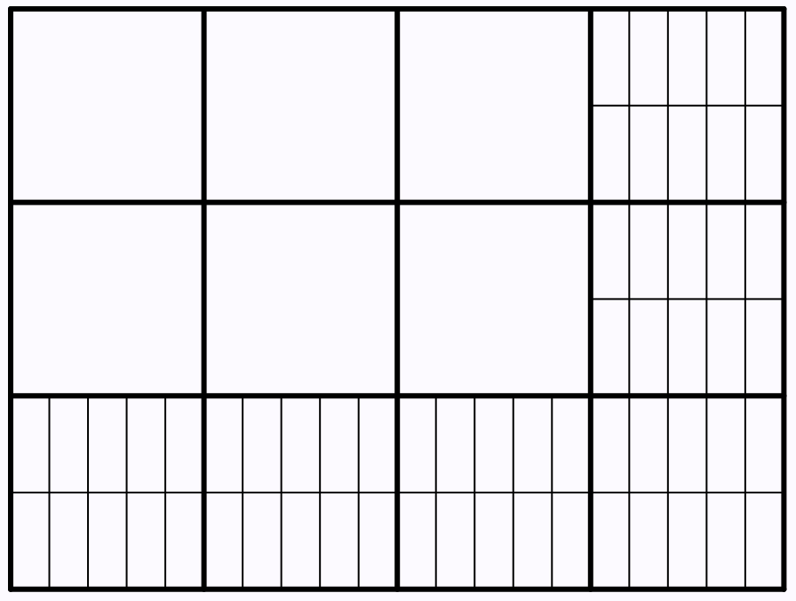
Mixed Fraction Multiplication
Model of?
Model for?
What fraction of each shaded row is shaded in?
What fraction of each shaded column is shaded in?
What fraction of the whole rectangle is shaded in?
Reading & Writing
Presenting & Interpreting
Shade in parts so as to display (3+2/5) x (2+1/2)
(2+3/4) x (3+1/3) = 6 + 9/4 + 2/3 + 1/4 = 9+1/6

Slide 11
Your Own Construction
Consider a topic you will be teaching very soon.
What is potentially confusing or unclear about one of the technical terms?
Construct a sequence of example-construction tasks which might bring to learner attention that aspect of the concept.
Is there an opportunity for surprise (hence for a sense of accomplishment or enriched meaning)?

Slide 12
Myths
Practice makes perfect
but only if you are training behaviour so that it becomes automatic; to use what has been practiced requires a suitable trigger (educated awareness)
Doing means Construing
Give a person a fish, you feed them for a day; teach them how to fish and you feed them for a lifetime; teach them how to teach others how to fish and you feed a whole community.
Successful ‘fishing’ requires more than the actions of using a rod or net; it requires knowing about the life of fish, the influence of environmental conditions.

Slide 13
Ownership
Policy makers construct curricula in order to control the actions of others, through lack of trust
Lack of trust filters down the system
Specialists and Heads of Dept feel forced to take ownership so as to control outcomes as required by the hierarchy
The whole point of education is that learners encounter and experience aspects of human culture that they might not encounter if they were earning a pittance to support their families
To say that “something has been learned” means that the learner has taken ownership of something (which may not be what the policy maker or teacher intended!). (didactic transposition)
How can teachers encourage learners to take initiative, to engage, and to take ownership?

Slide 14
Developing the Habit of Learner Ownership
Encouraging learners to make choices (and to take responsibility for those choices) whenever possible
Promoting personal and collective example construction whenever possible
Another one like this … in what way is it like, and in what way different?
Promoting personal narrative construction
Get learners to make a list of technical terms in a topic;
Get them to construct meaningful sentences using those words;
Get them to critique each others’ sentences

