Slide 1
Maths and Science education for imagined futures
Anne Watson
University of Oxford
Emeritus Professor of Mathematics Education

Slide 2
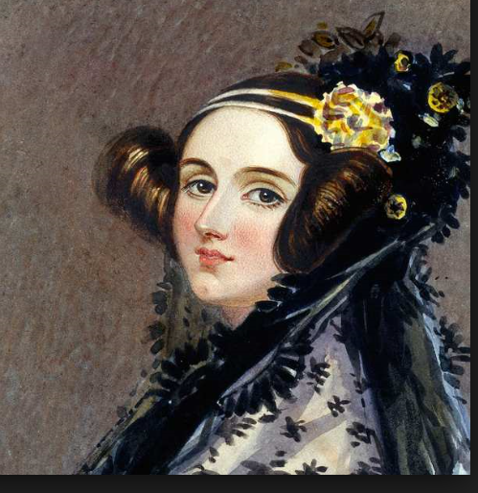
… [analytical engine is] likely to exert an indirect and reciprocal influence on science itself …
… devising for mathematical truths a new form in which to record and … use
views are likely to be induced, which should again react on the more theoretical phase of the subject.
Ada Lovelace (19th century)

Slide 3
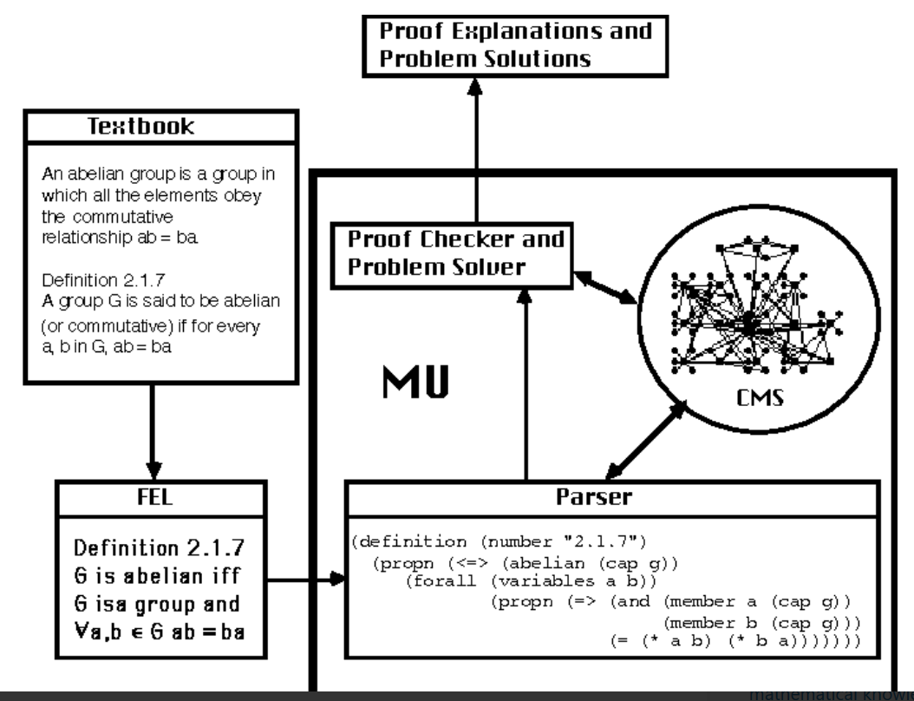

Edmund Furse (1990s)

Slide 4
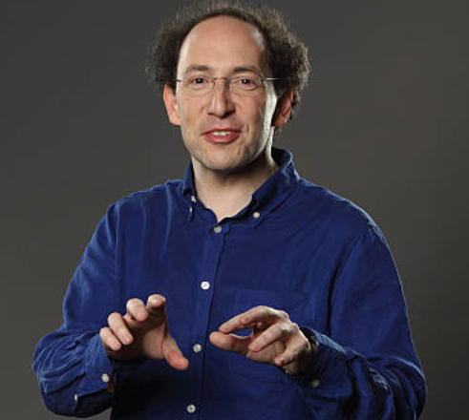
Computer-based mathematics
“… redefining maths as the anchor subject for computational thinking across all subjects, centred on real-life problem solving, not historical hand-calculating techniques” (Conrad Wolfram)

Slide 5
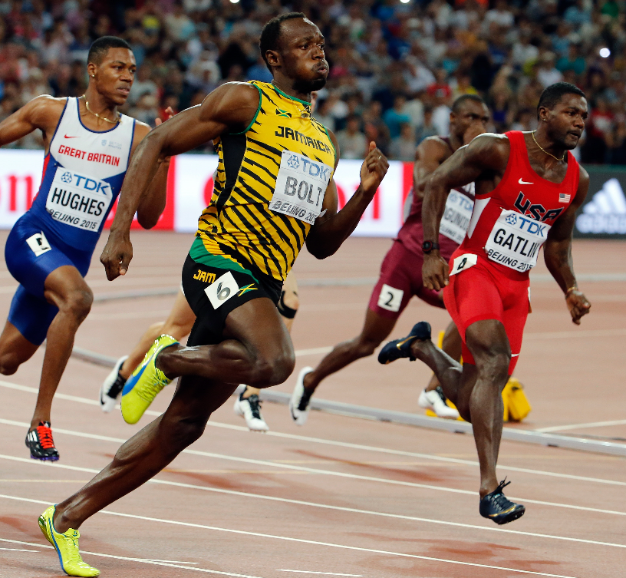
Usain Bolt

Slide 6
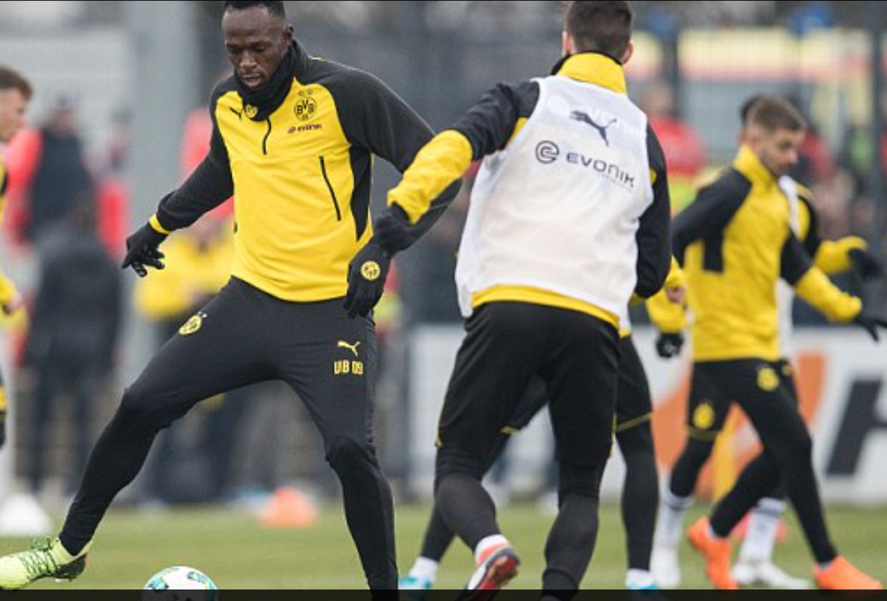
Usain Bolt

Slide 7
PISA (OECD)
Programme for International Student Assessment
Organisation for Economic Cooperation and Development

Slide 8
PISA (2015)
Mathematical literacy: capacity to formulate, employ and interpret mathematics … reasoning … describe, explain and predict … make well-founded judgements.
Scientific literacy: reasoned discourse … scientific explanation; evaluate and design scientific enquiry; interpret data and evidence scientifically.

Slide 9
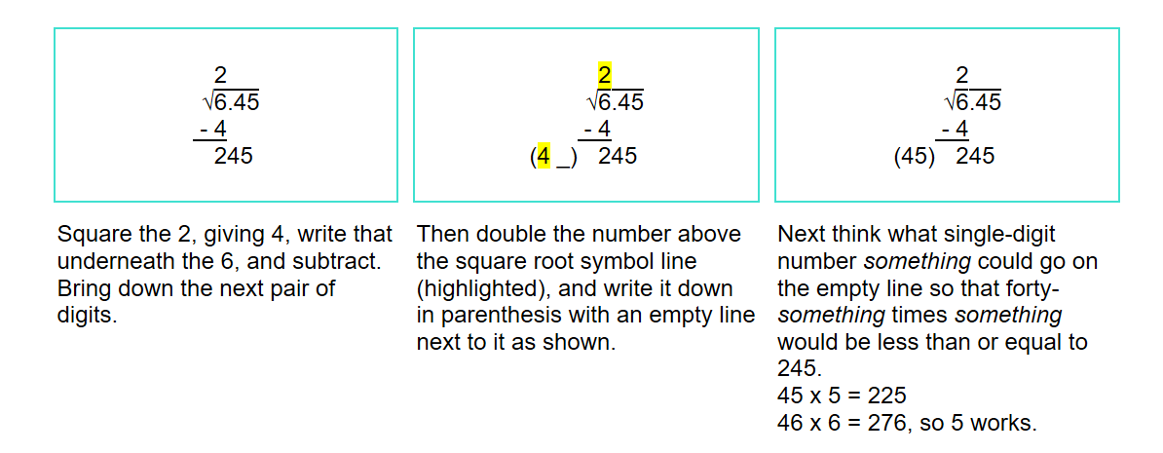

Slide 11
  personal development
  cultural inclusion
  economic inclusion
  advancement of knowledge
  vision

Slide 12


Slide 13
Shadow ecology’ of knowledge

Slide 14


Slide 15
Social justice
The ‘shadow ecology of knowledge’ undermines the knowledge-having and knowledge-buying status of those in power.
Separates power from knowledge
All need hardware, access, skills and critical intelligence to use the shadow ecology of knowledge
Education in disciplinary structures
Preserve the structured knowledge needed to advance science, technology and mathematics

Slide 16
Maths and Science education for imagined futures
NOW

Slide 17
Anne Watson
pmtheta.com

