Slide 1




Algebraic Thinking in the
Upper Years
Promoting Mathematical Thinking
John Mason
Roedean School
April 2017
The Open University
Maths Dept
University of Oxford
Dept of Education

Slide 2
Conjectures
Everything said here today is a conjecture … to be tested in your experience
The best way to sensitise yourself to learners
  is to experience parallel phenomena yourself
So, what you get from this session is mostly what you notice happening inside you!

Slide 3
Outline
Expressing Generality
  ThOANs &
  Tracking Arithmetic
  One Sum
Functions & Graphs
  Rational functions
  Compound Functions
  Lagrange Polynomials
Calculus
  Cubic Chords
  Tangent Power
Number Theory
  Doubly Factored
  Divisor’s Divisors
Trigonometry
  Perimeter projections
  Sin(A+B)

Slide 4
Characterising Numbers
What numbers arise as one more than the product of four consecutive integers?
1 + 1x2x3x4 = 25
1 + 2x3x4x5 = 121
1 + 3x4x5x6 = 361
1 + 0x1x2x3 = 1

Slide 5

Think Of A Number (ThOAN)
Think of a number
Add 2
Multiply by 3
Subtract 4
Multiply by 2
Add 2
Divide by 6
Subtract the number you first thought of
Your answer is 1
7
7
+ 2
3x + 6
7
7
3x + 2
6x + 4
7
6x + 6
7
+ 1
7
1
Notes:
Tracking Arithmetic
Idea comes from Mary Boole, wife of George Boole

Slide 6
Using Tracking Arithmetic
67
?
3+4x7
+6x4+
4x1+8
37
30
3+3x7
+3x4+1
7+3x4
+3x1+8
21
16
14
10
11
5
9
3+2x7
+4
7+2x4
+1
4+2x1
+8
3
7
4
1
8
3+7
7+4
4+1
1+8
3
7
4
1
8
What could be varied?
Notes:
Applies to Pascal’s triangle; Leibniz’s triangle, multiplication and other tables
Example of Chinese Pudian … foretaste of Pascal’s triangle

Slide 7
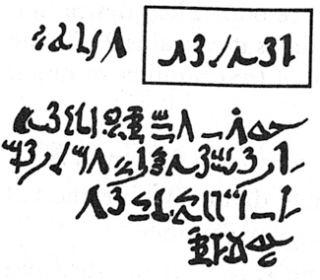
Rhind Mathematical Papyrus problem 28
Two-thirds is to be added.
One-third is to be subtracted.
There remains 10.
Make 1/10 of this,
there becomes 1.
The remainder is 9.
/10
– /10
2/3 of this is to be added.
The total is 15.
1/3 of this is 5.
Lo! 5 is that which goes out,
And the remainder is 10.
9x /10
+2/3x
9x /10
5/3 x9x /10
=3x /2
/2
The doing as it occurs!
Notes:
Problem 28 of the Rhind Mathematical Papyrus Gillings p182

Slide 8
Worked Examples
A 4000 year old practice
“Thus is it done”; “Do it like this”; …
What is the student supposed to do?
  Follow the sequence of acts
  Distinguish structural relations and values from parameters
Templating
What does the student need from a worked example?
  What to do ‘next’
  How to know what to do next
Chi & Bassok
Renkl & Sweller
Watson & Mason
Notes:
Atkinson, R. Derry, S. Renkl, A. & Wortham, D. (2000). Learning from examples: Instructional principles from the worked examples research Review of Educational Research; 70(2), 181-214.
Renkl, A. (1997). Learning from worked-out examples: A study on individual differences. Cognitive Science, 21, 1-29.
Renkl, A. (2002) Worked-out examples: Instructional explanations support learning by self-explanations. Learning and Instruction, 12, 529–556.
Chi, M. & Bassok, M. (1989). Learning from examples via self-explanation. In L. Resnick (Ed.) Knowing, learning and instruction: essays in honour of Robert Glaser. Hillsdale, NJ: Erlbaum.
Chi, M. Bassok, M. Lewis, P. Reiman, P. & Glasser, R. (1989). Self-explanations: How Students Study and Use Examples in Learning to Solve Problems. Cognitive Science. 13 p145-182.
Watson, A. & Mason, J. (2006) Seeing an Exercise as a Single Mathematical Object: Using Variation to Structure Sense-Making. Mathematical Thinking and Learning. 8(2) p91-111.

Slide 9
Exercises
for developing facility
Varying
type
Varying
structure
Doing & Undoing
for deepening comprehension
for extending appreciation
Varying context
Complexifying
& Embedding
for enriching accessible example spaces
Extending, & Restricting
Learners
generating own examples
subject to constraints
Generalising & Abstracting

Slide 10
Some Sums
1 + 2 =
3
4 + 5 + 6 =
7 + 8
9 + 10 + 11 + 12 =
13 + 14 + 15
16
+
17 + 18 + 19 + 20 =
21 + 22 + 23 + 24
2
+
2
2
( + 1)
+ … +
( + )
=
2
+ … +
2
( + ( + 1))
( + ( + ))

Slide 11
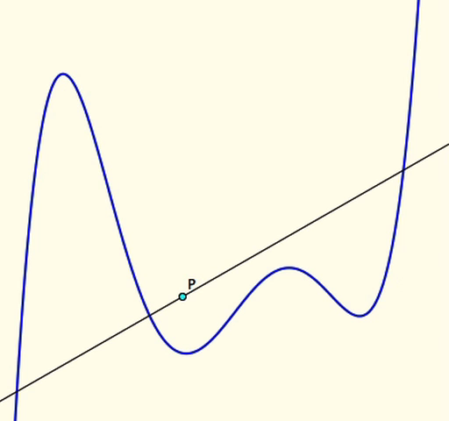
Tangent Power
The tangent power of a point P with respect to a smooth function f is the number of tangents to f through P
Notes:
Taylor Power: stright line as tangent is Taylor polynomial of degree 1 at the point on the curve.
What about considering the taylor-Power of various poj=ints … where are their regions?

Slide 12
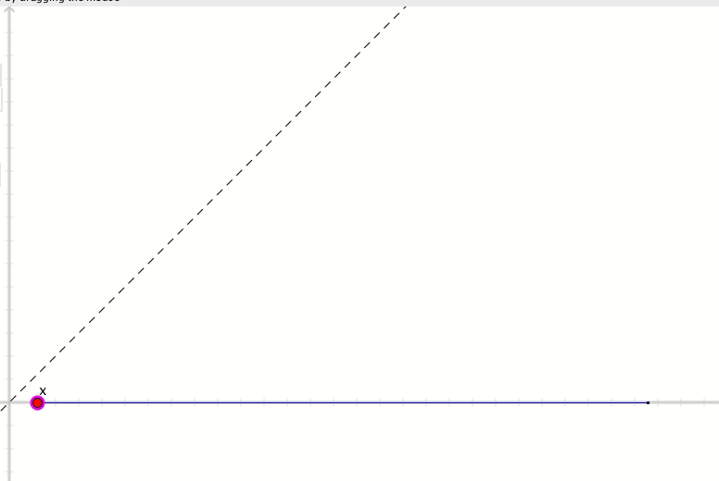
Cobwebs

Slide 13
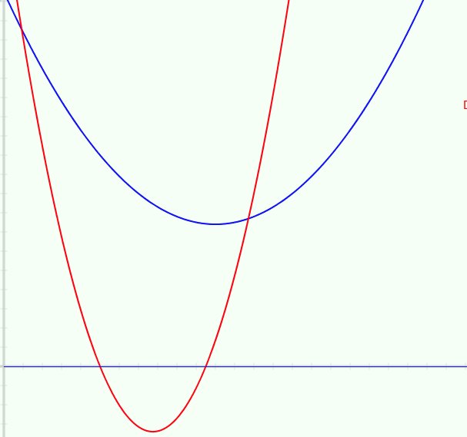
Rational Polynomials
The blue function is to be the numerator;
The red function is to be the denominator
What can be said about the graph of the quotient?

Slide 14
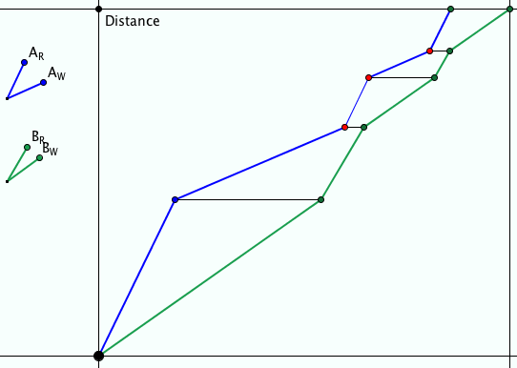
Ride & Tie
Two people have but one horse for a journey. One rides while the other walks. The first then ties the horse and walks on. The second takes over riding the horse …
They want to arrive together at their destination.
Imagine and sketch
Notes:
What is wrong with this graph?
Applet to adjust until a solution achieved

Slide 15
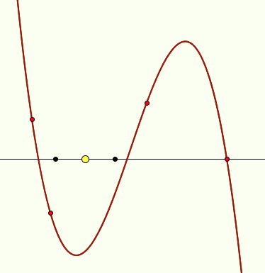
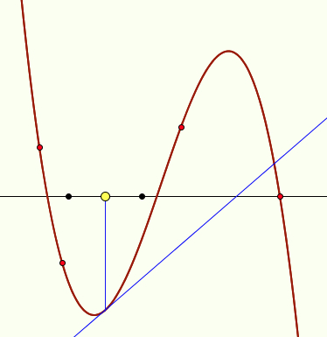
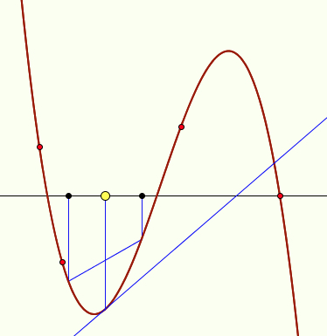
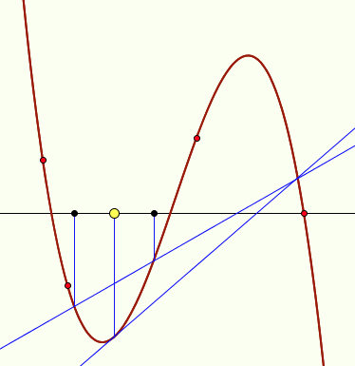
Cubic Chords
Imagine a cubic
Pick a point P on the x-axis and draw a tangent at the corresponding point on the cubic.
Draw points Q₁ and Q₂ equally spaced either side of P.
Draw the chord through the corresponding points on the cubic.
Extend the chord.
Where does it meet your tangent?

Slide 16
Variation
Theorems
Invariance in the midst of change
What can change and yet something remains invariant
Existence theorems
Gothenburg Variation
Something is available to be learned only when critical aspects have been varied in local time and space
“Nettle of a Concept”
Shanghai
(Confucian) Variation
Same problem different methods
Same method different problems
Same concept different contexts
Notes:
Nettle of a concept is from EM235 (1984)

Slide 17
Attention
What am I attending to?
What are students attending to?
What do they need to attend to?
How are they attending to it?
How am I attending to it?
Conjecture:
if students and tutor are attending to different things
OR
if attending to the same thing but differently
THEN
communication is likely to be impoverished

Slide 18
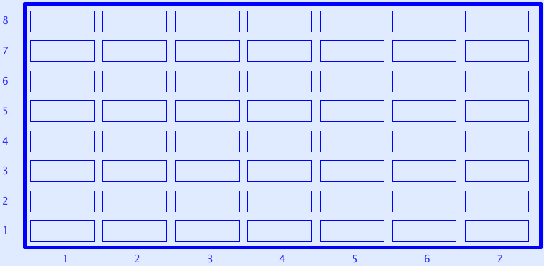
Sundaram Grids
7
12
4
7
If a number appears in this grid (extended to the right and up) then
doubling it and adding 1
gives a composite number.
All rows and columns are arithmetic progressions
How many entries do you need to fill out the grid?
Notes:
Drc=6, Dr=4 Dc=3 S=1 –> numbers that are the product of two numbers, one odd, the other congruent to 1 mod 3
Drc*rc+r(Dr-Drc)+c(Dc-Drc)+Drc-Dr-Dc+S
Disturbance; challenge + Trust that it is not excessive

Slide 19
Double Factorings
What is the smallest whole number with the property that there are two ways to factor it as the product of two numbers, and the sum of all four of those factors is a prime number?
Notes:
Modified from Moscow Mathematical Olympiad 1995 grade 9; question 58.9.4 on page 150

Slide 20

Divisor’s Divisors
Write down any whole number
12
List all of its factors
{1, 2, 3, 4, 6, 12}
For each number in your list, write down the number of factors it has
{1, 2, 2, 3, 4, 6}
Add up all those numbers and square the sum
(1 + 2 + 2 + 3 + 4 + 6)²
= 18² = 324
Add up the cubes of each of those numbers
1 + 8 + 8 + 27 + 64 + 216
= 324
(1 + 2)²(1 + 2 + 3)² = (1³ + 2³) (1³ + 2³ + 3³)

Slide 21
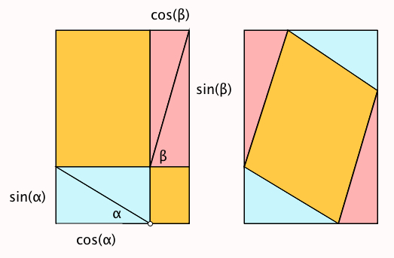
Sin(A+B)

Slide 22
Say What You See

Slide 23
Crossed Ladders
In an alleyway there is a ladder from the base of one wall to the opposite wall, and another the other way, reaching to heights 3m and 4m respectively on the opposite walls. Find the height of the crossing point.

Slide 24
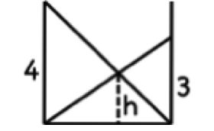
Crossed Ladders Solution
Dimensions of possible variation
Harmonic or
Parallel Sum

Slide 25
Journeys
Couriers
  A courier sets out from one town to go to another at a certain pace; a few hours later the message is countermanded so a second courier is sent out at a faster pace … will the second overtake the first in time?
Meeting Point
  Some people leave town A headed for town B and at the same time some people leave town B headed for town A. They all meet at noon, eating lunch together for an hour. They continue their journeys. One group reaches their destination at 7:15 pm, while the other group gets to their destination at 5pm. When did they all start? [Arnold]

Slide 26
Meeting Point Resolution
Draw a graph!
B
Distance
from
A
Dimensions of possible variation?
A
time

Slide 27
Cistern Filling
A cistern is filled by two spouts, which can fill the cistern in a and b hours respectively working alone. How long does it take with both working together?
a
Dimensions of possible variation?
b
time

Slide 28
Crossed Planes
Imagine three towers not on a straight line.
Imagine a plane through the base of two towers and the top of the third; and the other two similar planes.
  They meet in a point.
Imagine a plane through the tops of two towers and the base of the third; and the other two similar planes
  They meet in a point
The first is the mid-point between the ground and the second.
Notes:
And it generalises to higher dimensions

Slide 29
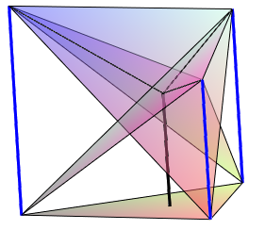
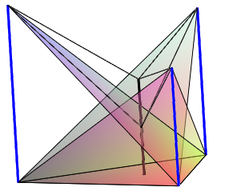
Tower Diagrams

Slide 30
Powers & Themes
Are students being encouraged
to use their own powers?
Powers
or
are their powers being usurped by textbook, worksheets and … ?
Imagining & Expressing
Specialising & Generalising
Conjecturing & Convincing
(Re)-Presenting in different modes
Organising & Characterising
Themes
Doing & Undoing
Invariance in the midst of change
Freedom & Constraint
Restricting & Extending
Exchanging

Slide 31
Forms of Attention
Holding a Whole (gazing)
Discerning Details
Recognising Relationships in the particular situation
Perceiving Properties as being instantiated
Reasoning on the basis of agreed properties

Slide 32
Inner & Outer Aspects
Outer
  What task actually initiates explicitly
Inner
  What mathematical concepts underpinned
  What mathematical themes encountered
  What mathematical powers invoked
  What personal propensities brought to awareness

Slide 33
Reflection as Self-Explanation
What struck you during this session?
What for you were the main points (cognition)?
What were the dominant emotions evoked? (affect)?
What actions might you want to pursue further? (Awareness)
Notes:
Chi et al

Slide 34
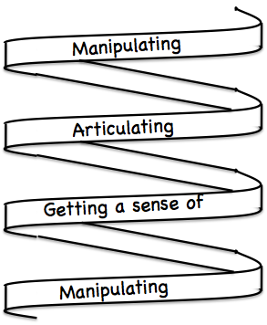
Frameworks
Enactive – Iconic – Symbolic
Doing – Talking – Recording
See – Experience – Master
Concrete – Pictorial– Symbolic

Slide 35
Reflection
It is not the task that is rich
  but the way the task is used
Teachers can guide and direct learner attention
What are teachers attending to?
  Powers
  themes
  Heuristics
  the focus and form of their own attention

Slide 36
To Follow Up
pmtheta.com
john.mason@open.ac.uk
Thinking Mathematically (new edition 2010)
Developing Thinking in Algebra (Sage)
Designing & Using Mathematical Tasks (Tarquin)
Questions and Prompts (ATM)

