Slide 1
What really matters for adolescents in mathematics lessons?
Anne Watson
University of Sussex CIRCLETS May 2011
Notes:
Norma
Pleasure and honour
Why me? Wide focus .... Exemplification, variation theory, situated cognition, classroom practice, raising achievement for low attaining students – how does it all hang together? This plenary as a challenge to me to show how these various interests combine to form a coherent intellectual project.
A written paper – a live presentation that responds to conversations I had on the plane, and over coffee here, is another .....

Slide 2
Warrants
Intellectual background
Research – CMTP
Research – children’s learning
Practice – teaching, mathematics and teacher education
Doing and learning mathematics

Slide 3
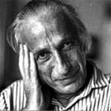
Ivan Illich
the fact that a great deal of learning […] seems to happen casually and as a by-product of some other activity defined as work or leisure does not mean that planned learning does not benefit from planned instruction and that both do not stand in need of improvement
Notes:
What I did read – deschooling society – what is it about? Lots about the damage schools do, and the violence that is done to us by authoritarian approaches to knowledge, but he also said ...
Planned learning and planned instruction

Slide 4
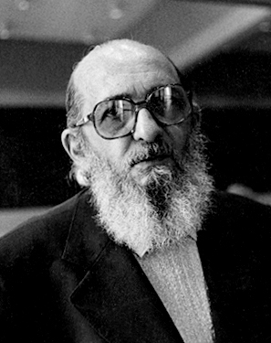
Paolo Freire
The teacher confuses the authority of knowledge with his own professional authority ...
Perception of previous perception
Knowledge of previous knowledge
Notes:
Freire: learning to be critical, where is the authority in mathematics? Teacher and textbook or in coherence of taking a mathematical view of situations. Through p of pp and k of pk

Slide 5
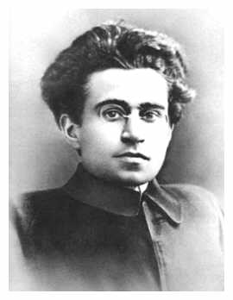
Antonio Gramsci
... forming (the child) as a person capable of thinking, studying and ruling - or controlling those who rule
Notes:
Went into teaching with these ideas from books I HAD read – to change society, to change the life chances of children, you have to help them have access to the knowledge of the elite – that means hard mathematics. What Gramsci understood was that to make change you have to understand the hegemonic perspective, and for me that means study the hard mathematics – not just what think you need here and now because you do not know what you will need tomorrow to influence society
I became a teacher and my head of department after a couple of years was ....

Slide 6
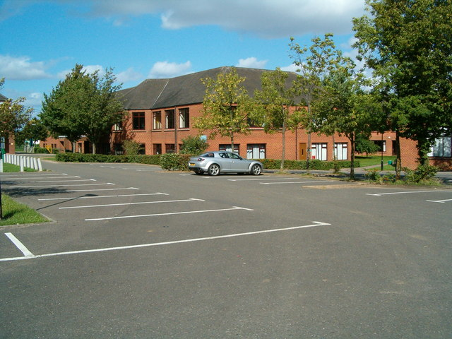
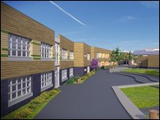
Mathematical coherence as the authority
Using learners’ ideas and insights
Groupwork & discussion
Solving complex problems- in maths and other contexts
Investigative tasks

Slide 7
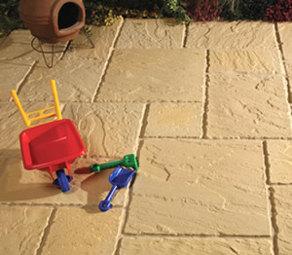
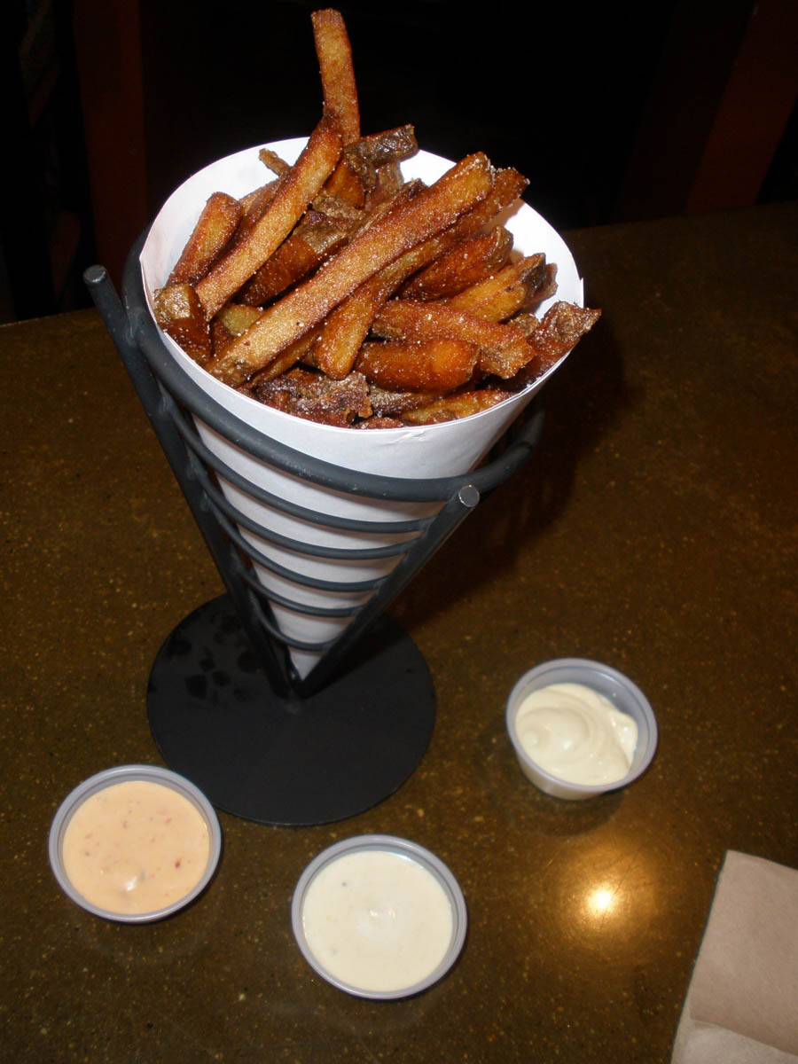
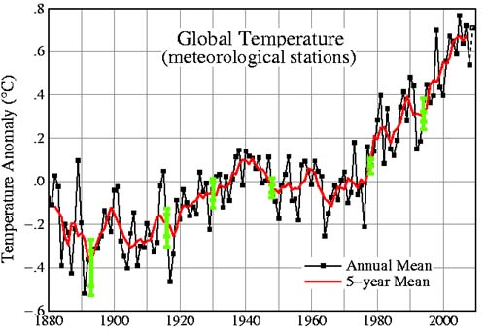
‘Real’ contexts: everyday or mathematical reasoning
Notes:
Yes, but the main event is more generating equivalent algebraic expressions, or more general packing problems, not counting and measuring. And cones, again the main focus is what can be generalised about the relation between surface area and volume, maybe – rather than merely designing one cone in an ad hoc fashion.

Slide 8
Stanislav Štech
How and when can the ‘scientific’ concepts of mathematics be learnt if teaching focuses on everyday reasoning and realistic contexts?
Notes:
The Vygotskian question
Scientific concepts – everyday reasoning

Slide 9
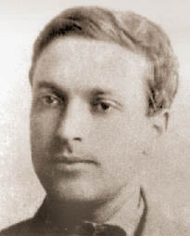
Lev Vygotsky
Spontaneous concepts ‘emerge from reflections on everyday experience’ Scientific concepts ‘originate in the highly structured and specialized activity of classroom instruction’ (Kozulin)
Notes:
For my students, and those of my colleagues, everyday experience in the classroom included talk and tasks and tools that supported moves towards scientific knowledge, away from empirical and outside forms of reasoning. We were not very good at that and my work since has been to understand how we could have been better.
Secondary mathematics – formal special ways of understanding the world

Slide 10
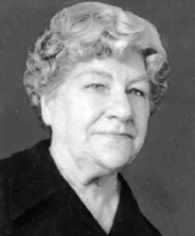
Anna Krygowska
The aim of the teacher is to consciously organise the pupil’s activity, the substantive activities of imagining and conceiving
1957 in ESM 1992 23(2)
Notes:
I have been influenced indirectly by the work of Anna Krygowska – her view of mathematics teaching was .....
The teacher has to draw on her own imagination and her own conceptualisation . But how do teachers do this in lessons?
It seems sensible to look at teachers who, within their own context, are doing a particularly successful job, and going back to my original drive to make a difference, therefore I look at teachers who are making a difference for the lowest achieving students.
I had been looking at lessons that are similar, within some current orthodoxy of what a good lesson ‘should’ look like, to search for differences; now I turn to looking at lessons that are different to search for similarities.

Slide 11
Illich, Freire, Gramsci, Vygotsky, Krygowska ...
Relate spontaneous concepts to the formal concepts of mathematics
Be aware of previous perceptions and previous knowledge
Use formalisations that do not arise in everyday activity
Learn to use the intellectual tools of the elite, which afford access to powerful forms of reasoning
Notes:
And how did what we were seeing relate to my original, strucytural,m deep, spinal knowledge? How did out teachers help students? ... Click

Slide 12
Issues for social justice
Social justice in mathematics education is about all students making shifts of conception in mathematics
What are the intellectual levers that enable students to understand new mathematical ideas?
What conceptual shifts are afforded in the public domain as lessons unfold?
Notes:
MQAG
Rationale
Coherence
Complexity

Slide 13
The sites, context and data www.cmtp.co.uk
3 comprehensive schools
autonomous decisions
ethnographic approach and data
40 lesson videos and records

Slide 14
KS3 Results
SCHOOL | 2007 | 2008
SP | 47 | 61
LS | 53 | 62
FH | 79 | 80
 | (Eng 76 | 69)
 | (Sci 77 | 69)

Slide 15
2010 GCSE results
SCHOOL | INCREASE
SP | 10%
LS | 5%
FH | 10%

Slide 16
Common features of their lessons
expressing meaning and reasoning
providing multiple visual, physical, verbal experiences
using students’ views to direct the discussion
comparing methods & representations
generating collections of examples
constructing examples & conjectures
directing attention to new ways of seeing
promoting new classifications
discussing implications & justifications
Notes:
We find common features – the lessons of the teachers that made a difference all involved:
The mathematical spine
The mathematical thread
The mathematical story
My approach to analysing lessons and talking about good teaching now:
Incorporates what we know about talk, about the need for new classifications, naming and representing, perception, social and intellectual need for inclusion, and for students’ own ideas to be taken account of .....
More than the common features, it shows the complexity of good mathematics teaching, the role for the teacher’s own knowledge, the complexity of bringing students to understand mathematical ideas, and the impossibility of legislating for certain models of teaching, or measuring teachers and teaching

Slide 17
Access to new ideas
Teacher points public attention towards new idea
Tasks draw personal attention towards new idea
Examples of the need for attention towards new ideas ...

Slide 18
35 + 49 – 35
a + b - a

Slide 20
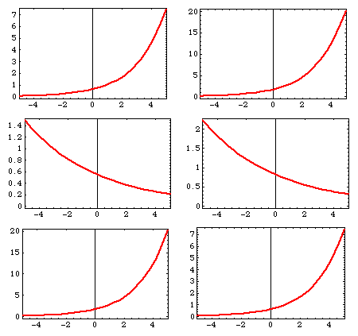

Slide 21
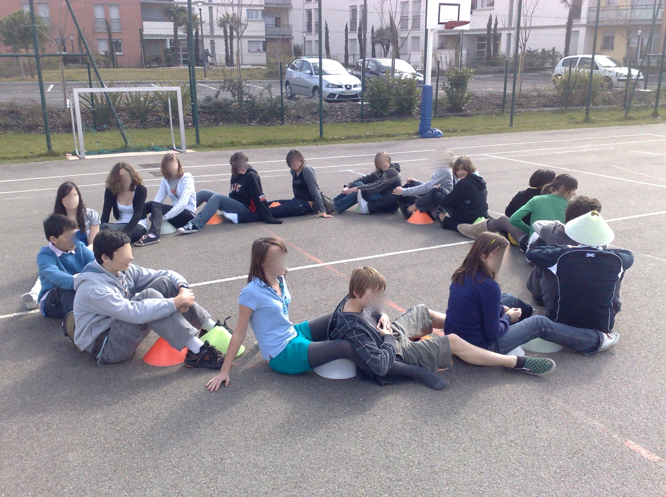

Slide 22
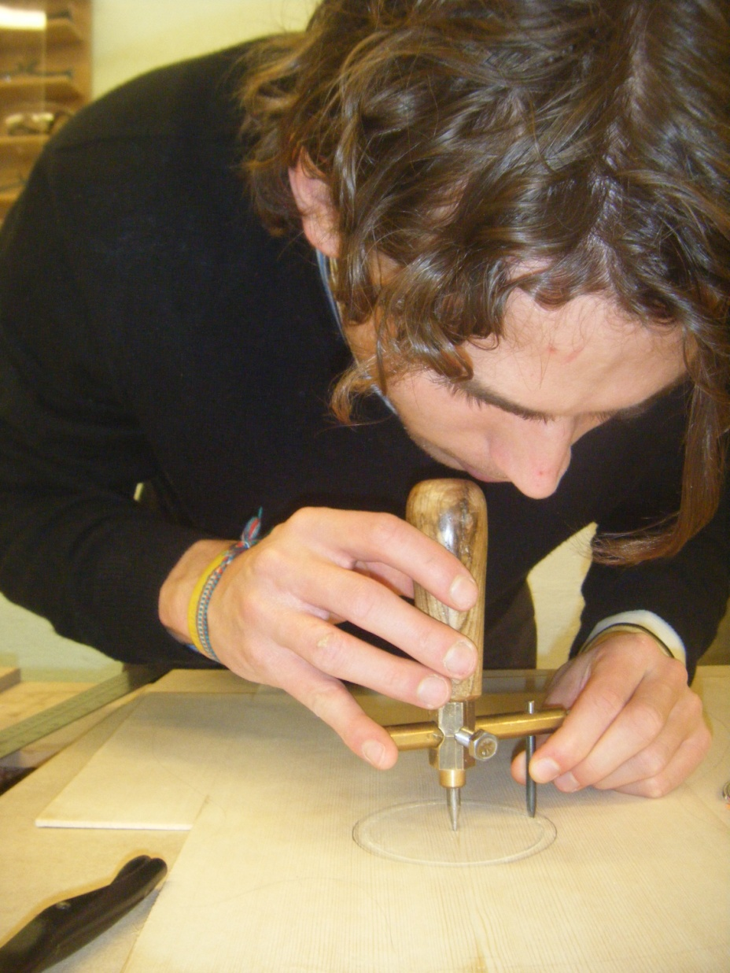
Notes:
So I looked at videos of some of these five lessons with Helen Doerr, and we noticed a subtle difference:
One teacher ‘same distance’ – relation to centre point is isomorphic
Another teacher – ‘all the points for which ...’ points and lines mean the same thing –joined up and two-way relations. You can see this in the two enactments of the circle. In one the points are important, in another they have tried to show continuity.
The surface features, even the pedagogic design, were very similar, but in the end what made the difference was the teacher’s own conceptualisation of locus –
This sense of ‘what is available to be learnt’ has exercised me for quite a few years now - at secondary level the teacher’s own conceptualisations are very important.

Slide 23
Desirable shifts of focus
physical - models
symbols - images
answering questions - seeking similarities
number – structure
discrete – continuous
additive - multiplicative
calculation - relation
visual response - thinking about properties
.....

Slide 24
Shifts of potential power
generalities - examples
making change - thinking about mechanisms
making change - undoing change
making change - reflecting on effects of change
following rules - using tools
‘it looks like…’ - ‘it must be…’
different points of view - representations
representing - transforming
induction - deduction
using safe domains - using extreme values and beyond

Slide 25
Work in progress – seeking overarching shifts
Methods: between proximal, ad hoc, and sensory and procedural methods of solution and reasoning based on abstract concepts
Reasoning: between inductive learning by generalising and understanding and reasoning about abstract relations
Representations: between ideas that can be modelled iconically and those that can only be represented symbolically
Responses: between verbal and kinaesthetic responses to sensory stimuli focusing on visual characteristics and symbolic responses focusing on properties

Slide 26
Adolescence
identity
belonging
being heard
being in charge
being supported
feeling powerful
understanding the world
negotiating authority
arguing in ways which make adults listen

Slide 27
What nearly all learners can do naturally
Describe
Draw on prior experience and repertoire
Informal induction
Visualise
Seek pattern
Compare, classify
Explore variation
Informal deduction
Create objects with one or more features
Exemplify
Express in ‘own words’
- how to use these powers?

Slide 28
Shifts observed in maths lessons
Remembering something familiar
Seeing something new
Public orientation towards concept, method and properties
Personal orientation towards concept, method or properties
Analysis, focus on outcomes and relationships, generalising
Indicate synthesis, connection, and associated language
Rigorous restatement (note reflection takes place over several experiences over time, not in one lesson)
Being familiar with a new idea/object/class
Becoming fluent with procedures and repertoire (meanings, examples, objects..)

Slide 29
Subject-specific implications
Variables; adaptations of procedures; relationships; justifications; generalisations; conjectures; deductions

Slide 30
Subject-specific integrations and connections
Associations of ideas; generalisations; abstractions; objectifications; formalisations; definitions

Slide 31
Subject-specific affirmation
Adaptations/ transformations of ideas; applications to more complex maths and to other contexts; proving; reviewing the process

Slide 32
Example of a lesson structure
T introduces 'learning about equivalent equations'
T introduces one example and then asks students for examples with certain characteristics
T summarises so far, identifies variables in their examples, and compares selected examples, choosing so that the comparisons become more and more complex
Students solve some equations made by other students and compare methods
T leads public deduction of how methods relate to each other, with explanation and adaptation.
T summarises ideas, and shows application to equations with more variables
Students work in groups to express in own words how sets of equivalent equations indicate the value of the variables
Notes:
Sorry this is so small – but this is in the paper
Where is the place where the teacher scaffolds new ways of thinking?
Read the lesson structure out loud
Comparison of methods, application in an extended field of action, focusing away from simplistic assumptions, making complexity available in the classroom.
The notion of LCMP is relevant here if the ways in which she does this can become habitual for the community of learners – but the mathematical conceptualisations of the teacher is central in choosing the content and sequence of these moves.

Slide 33
Another lesson structure
T says what the lesson is about and how it relates to previous lesson - recap definitions, facts, and other observations
T introduces new aspect and asks what it might mean
T offers example, gets students to identify its properties
T gives more examples; students identify properties of them.
Students have to produce examples of objects
Three concurrent tasks for individual and small group work:
describe properties in simple cases;
describe properties in complex cases;
create own objects.
T shows how to vary some variables deliberately
They then do a classification task in groups & identify relationships
T circulates asking questions about concepts and properties.
Notes:
Another small one – also in the paper.
Where does the teacher offer an experience which might change the way they are thinking?

Slide 34
Adolescent self-actualisation in mathematics
identity as active thinker
belonging to the class
being heard by the teacher
understanding the world
negotiating the authority of the teacher through the authority of mathematics
being able to argue mathematically in ways which make adults listen
having personal example space
being supported by the inherent structures of mathematics
feeling powerful by being able to generate mathematics
thinking in new ways

Slide 35
Anne Watson
anne.watson@education.ox.ac.uk
www.education.ox.ac.uk
Watson & Mason: Mathematics as a Constructive Activity (Erlbaum)
Watson: Raising Achievement in Secondary Mathematics (McGraw – Open University Press)
Watson & Winbourne: New Directions for Situated Cognition in Mathematics Education (Springer)

