Slide 1
A variety of variation
Laurie Jacques, John Mason and Anne Watson
Shape Up
Session D1 1100-1230
@smartjacques
#jointconf24

Slide 2
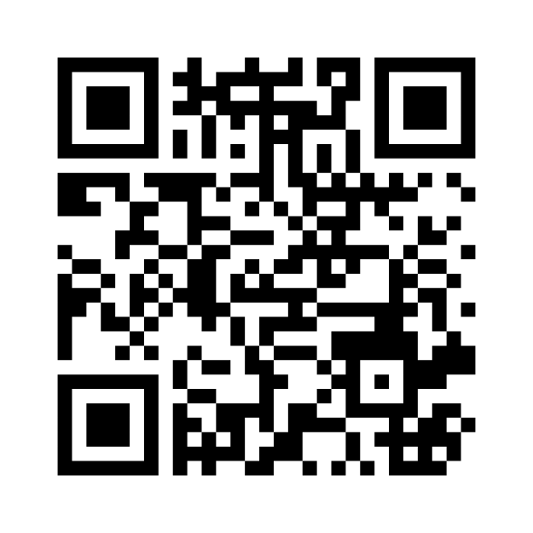
What terms/ language comes to mind when you talk about tasks designed with variation?
1.
Join at menti.com
7150 4319
2.
L
Notes:
LJ switch to mentimeter screen

Slide 4
Explore a variety of variation
How would you describe how variation is used in the design of this task?
What is varied? What is kept invariant?
What is the purpose of the variation/ invariance?
To what does the variation/ invariance point attention?
What is done with the variation? … By the pupils? By the teachers?
J
Notes:
LJ add example by Thursday lunchtime
JM to upload slides to PMtheta
25 Mins
We go round engaging and identifying interesting examples. Laurie takes photos of interesting ones for display. We could each find two and get into a huddle to decide which to present for discussion.
LJ to take photos and email to LJ
Not everyone will have brought examples in shareable form. Reconstruct something you have done if necessary or choose one of Laurie’s examples.
Student constructed?
Laurie – proc/conc variation
Anne – Dependency relationship
John – Dimensions and range
Who is it that presents the variation?
Last 2 minutes – what has struck you in that discussion?

Slide 5
What did we notice?
Mason, J. (2019). Evolution of a Task Domain. Digital Experiences in Mathematics Education. p1-21. http://link.springer.com/article/10.1007/s40751-018-0046-3
Mason J. (2008). Making Use of Children’s Powers to Produce Algebraic Thinking. In J. Kaput, D. Carraher & M. Blanton (Eds.) Algebra in the Early Grades. Lawrence Erlbaum. New York. p57-94.
J
Notes:
Refs

Slide 6
What did we notice?
Jacques, L. (2023). Primary Teachers’ Design Principles and Pedagogical Practices for Promoting Mathematical Learning from Procedural Variation Tasks. Unpublished doctoral thesis, UCL.
Watson, A. (2017). Pedagogy of Variations: Synthesis of Various Notions of Variation. In R. Huang & Y. Li (Eds.), Teaching and Learning Mathematics through Variation. Mathematics Teaching and Learning (pp. 85-103). Rotterdam: Sense Publishers.
contact annewatson1089@gmail.com if you need a copy.
Watson, A. (2014) Enacting variation theory in the design of task sequences, ppt presented at EARLi SIG9. see pmtheta.com home page.
A
Notes:
Refs

Slide 7
What did we notice?
Ekdahl, A.-L., Venkat, H., Runesson, U., & Askew, M. (2018). Weaving in connections: Studying changes in early grades additive relations teaching. South African Journal of Childhood Education (SAJCE), 8(1). doi:10.4102/sajce.v8i1.540
Gu, F., Huang, R., & Gu, L. (2017). Theory and development of teaching through variation in mathematics in China. In R. Huang & Y. Li (Eds.), Teaching and learning mathematics through variation: Confucian heritage meets western theories (pp. 13-41). Rotterdam: Sense Publishers.
Jacques, L. (2023). Same structure, different values - designing one-problem-multiple-changes procedural variation tasks. Mathematics Teaching, (289), 43-45.
Pang, M. F., Bao, J., & Ki, W. W. (2017). ‘Bianshi’ and the Variation Theory of Learning. In R. Huang & Y. Li (Eds.), Teaching and Learning Mathematics through Variation: Confucian Heritage Meets Western Theories (pp. 43-67). Rotterdam: Sense Publishers.
Sun, X. H. (2013). The fundamental idea of mathematical tasks design in China: the origin and development. Paper presented at the The International Commission on Mathematical Instruction Study 22: Task design in mathematics education, Oxford, UK
Yang, Y., & Ricks, T. (2012b). How crucial incidents analysis support Chinese lesson study. International Journal for Lesson and Learning Studies, 1(1), 41-48.
L
Notes:
Procedural variation, conceptual variation (Gu)
OPMC, OPMS, MPOS (Sun)
Anchoring point of knowledge, potential distance, pudian (Gu)
Bringing convergence from the variation and invariance (Pang)
Bringing convergence on a dependency relationship (Jacques)
Attending to simultaneity and making connections within and between equations (Ekdahl et al)
Working horizontally, working vertically [dependent on layout] (Jacques)
Key point, critical point, difficult point (Yang & Ricks)

Slide 8
Types of Variation in a Ravel
Thanks to:
Brent Davis and Martina Metz
University of Calgary
A

Slide 9
Types of Variation in a Ravel
Varied Contexts
Varied Interpretations
Varied Relationships
Varied Values
Varied Examples

Slide 10
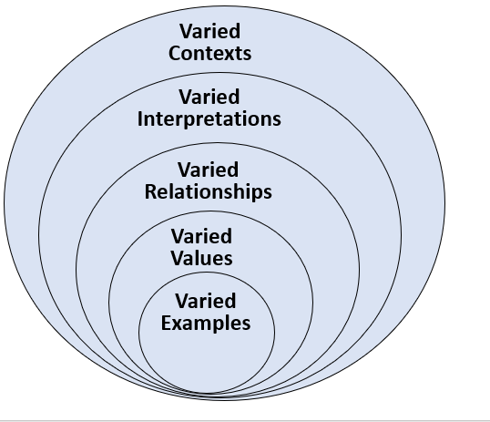
Types of Variation in a Ravel
A

Slide 11
Exponents
“Repeated addition” (e.g., 3 + 3 + 3) is one way to think about “multiplication.”
“Repeated addition” and “repeated multiplication” (e.g., 3 × 3 × 3) are not the same thing.
“Repeated multiplication” is one way to think about “exponentiation.”
The expression x^{y} if known as a “power.” In that power, the “x” is called the “base” and the “y” is called the “exponent.”
Critical
Discernments
in this part of the Ravel
A

Slide 12
3
3 + 3 = 6
3 + 3 + 3 = 9
3 + 3 + 3 + 3 = 12
3 × 1 = 3
3 × 2 = 6
3 × 3 = 9
3 × 4 = 12
The OPERATION
The SHORTHAND
“What changed?”, “What stayed the same?”, & “What might happen next?”
A

Slide 13
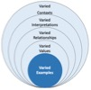
What are “exponents”? ... Our strategy here is to compare and an initial meaning, “exponentiation is repeated multiplication,” to the idea that “multiplication is repeated addition.”
3
3 × 3 = 9
3 × 3 × 3 = 27
3 × 3 × 3 × 3 = 81
3¹ = 3
3² = 9
3³ = 27
3⁴ = 81
The OPERATION
The SHORTHAND
“What changed?”, “What stayed the same?”, & “What might happen next?”
Level 1:
Varied Examples afford the noticing of relevant features.
A

Slide 14
3
3 × 3 = 9
3 × 3 × 3 = 27
3 × 3 × 3 × 3 = 81
3¹ = 3
3² = 9
3³ = 27
3⁴ = 81
3²
← exponent
base →
}
The OPERATION
power
The SHORTHAND
A

Slide 15
3 × 1 = 3
3 × 2 = 6
3 × 3 = 9
3 × 4 = 12
3¹ = 3
3² = 9
3³ = 27
3⁴ = 81
“What changed?”, “What stayed the same?”, & “What might happen next?”
A
Notes:
Brent
And, of course, returning to our major contrast at this level, we might place repeated addition beside repeated multiplication and pose our orienting questions: how are these alike and different?
Here’s one detail that some learners will notice … for repeated addition, there’s a steady increase at each stage
But with repeated multiplication, with each stage, the increase increases. Something different is happening … and that difference moves us to a level 2 type of variation

Slide 16
A
Notes:
MartinaSo, we want to be clear about an important detail. We’re not claiming to have invented anything new here.] There are literally dozens of similar “levels of learning” and “stages of understanding” models.
1.One is Norman Webb’s “Depth of knowledge model,” which …
2.Starts with a focus on facts and familiar procedures,
3.And then moves to activities involving comparing, organizing, and predicting as means to get to know a new idea
4.And then moves to more non-routine, explorative variations,
5.And finally takes the idea to the bigger world.
6.Another model that covers similar topics, but that’s specific to mathematics learning is the PK dynamical model of mathematical understanding … and that model certainly figures into our thinking.
7.And, also well fitted to what we’re talking about, “Chinese Variation Pedagogy” distinguishes between “conceptual” and “procedural” variation – where we see multiple levels nested inside “procedural variation.”
We have found it highly productive, however, to juxtapose levels of learning and CATEGORIES of variation. Nesting the levels of variation allows the differences at one level to become the objects of variation at the next.

Slide 17
Changing the “base” changes what you are multiplying (multiplicand).
Changing the “exponent” changes the number of times you multiply.
An exponent of 1 means you’re working with an unmultiplied base.
Sometimes x^{y} = y^{x} ; sometimes x^{y} > y^{x} ; sometimes x^{y} < y^{x} – that is, exponentiation is not commutative.
Critical
Discernments
in this part of the Ravel
A

Slide 18
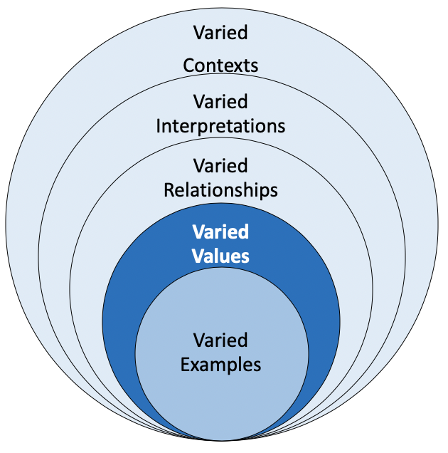
What happens when “bases” and “exponents” vary? ... Here we systematically
vary the values of bases and exponents to study how they behave.
2¹
4¹
4⁰
2⁰
3¹
4²
2²
3⁰
2³
3²
4³
2⁴
3³
4⁴
3⁴
Level 2:
Varied Values afford the noticing of patterned relationships.
A

Slide 19
What happens when “bases” and “exponents” vary? ... Here we systematically
vary the values of bases and exponents to study how they behave.
y
+5
+4
+3
+2
+1
0 1 32 243 1024 3125
0 1 16 81 256 625
y
x
0 1 8 27 64 125
0 1 4 9 16 25
0 1 2 3 4 5
1 1 1 1 1
x
0 +1 +2 +3 +4 +5
A

Slide 20
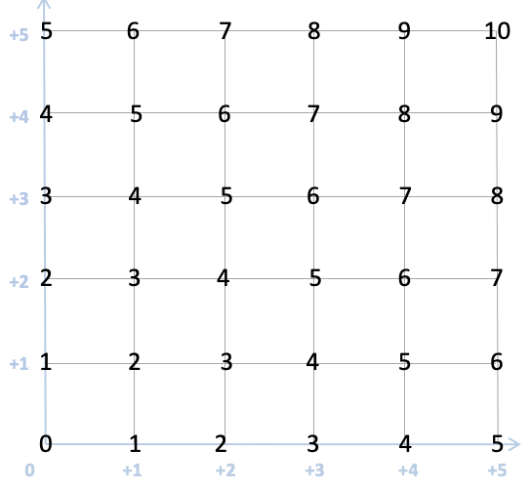
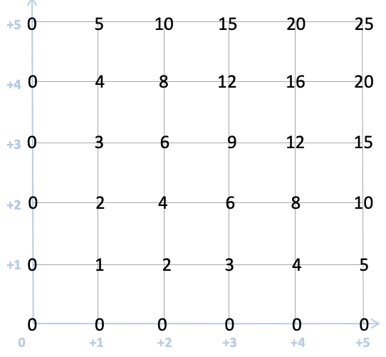
What happens when “bases” and “exponents” vary? ... Here we systematically
vary the values of bases and exponents to study how they behave.
ADDITION
y
EXPONENTIATION
MULTIPLICATION
+5
+4
+3
+2
+1
0 1 32 243 1024 3125
0 1 16 81 256 625
0 1 8 27 64 125
0 1 4 9 16 25
0 1 2 3 4 5
(x + y)
= (y + x)
(x × y)
= (y × x)
1 1 1 1 1
x
0 +1 +2 +3 +4 +5
y
x
x
≠ y
A

Slide 21
A

Slide 22
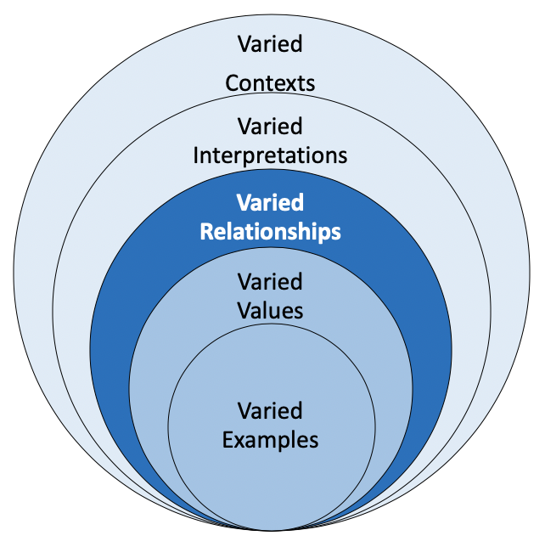
Under what conditions do the patterns we just examined hold true? ... Here we look for features that can be generalized and used to extend the concept.
Equivalent expressions involving exponents can be written in different ways.
2³ × 2⁵ = 2⁸
2⁵ ÷ 2² = 2³
(2³)⁴ = 2¹²
Critical
Discernments
in this part of the Ravel
… or, more generally, xª × x^{b} = x^{a+b}
… or, more generally, xª ÷ x^{b} = x^{a–b}
… or, more generally, (xª)^{b} = x^{a×b}
Level 3:
Varied Relationships afford the noticing of mathematical concepts.
A

Slide 23
Under what conditions do the patterns we just examined hold true? ... Here we look for features that can be generalized and used to extend the concept.
2⁵ =
2⁴ =
2³ =
2² =
2¹ =
2⁰ =
2^{–1} =
2^{–2} =
2^{–3} =
2^{–4} =
2^{–5} =
32
16
8
4
2
1
¹/₂
¹/₄
¹/₈
¹/₁₆
¹/₃₂
A

Slide 24
Under what conditions do the patterns we just examined hold true? ... Here we look for features that can be generalized and used to extend the concept.
Level 2: Varied Values
afford noticing of
patterned
relationships.
Level 3: Varied Relationships
afford noticing of
mathematical
concepts.
2⁵ =
2⁴ =
2³ =
2² =
2¹ =
2⁰ =
2^{–1} =
2^{–2} =
2^{–3} =
2^{–4} =
2^{–5} =
32
16
8
4
2
1
(–2)⁵ =
(–2)⁴ =
(–2)³ =
(–2)² =
(–2)¹ =
(–2)⁰ =
(–2)^{–1} =
(–2)^{–2} =
(–2)^{–3} =
(–2)^{–4} =
(–2)^{–5} =
–32
+16
–8
+4
–2
+1
¹/₂
+¹/₄
–¹/₈
+¹/₁₆
–¹/₃₂
2³ × 2² =
2⁴ × 2² =
2⁵ × 2² =
2⁵ × 2³ =
2⁵ × 2⁴ =
2⁵ × 2⁵ =
2⁵ × 2⁶ =
2⁵ × 2⁷ =
2⁶ × 2⁸ =
2⁷ × 2⁹ =
2³ ÷ 2² =
2⁴ ÷ 2² =
2⁵ ÷ 2² =
2⁵ ÷ 2³ =
2⁵ ÷ 2⁴ =
2⁵ ÷ 2⁵ =
2⁵ ÷ 2⁶ =
2⁵ ÷ 2⁷ =
2⁶ ÷ 2⁸ =
2⁷ ÷ 2⁹ =
¹/₂
¹/₄
¹/₈
¹/₁₆
¹/₃₂
.
A

Slide 25
Under what conditions do the patterns we just examined hold true? ... Here we look for features that can be generalized and used to extend the concept.
2¹⁶
2¹⁶ = 2 × 2 × 2 × 2 × 2 × 2 × 2 × 2 × 2 × 2 × 2 × 2 × 2 × 2 × 2 × 2
= (2²)⁸
= 4⁸
= 4 × 4 × 4 × 4 × 4 × 4 × 4 × 4
= 16⁴
= 16 × 16 × 16 × 16
= 256²
= 65 356
= ((2²)²)⁴
= (((2²)²)²)²
= (4²)⁴
= ((4²)²)²
= (16²)²
A

Slide 26
E.g. Relating Exponents, Logs, and Radicals
How might exponential relationships be used to interpret and link other mathematical ideas? ... How might the concept be used to elaborate one’s webs of mathematical understanding?
2⁶ = 64
$$\sqrt[6]{64}=2$$
log₆64 = 2
2⁶ = ? (missing total)
2? = 64 (missing exponent)
?⁶ = 64 (missing base)
A

Slide 27
A

Slide 28
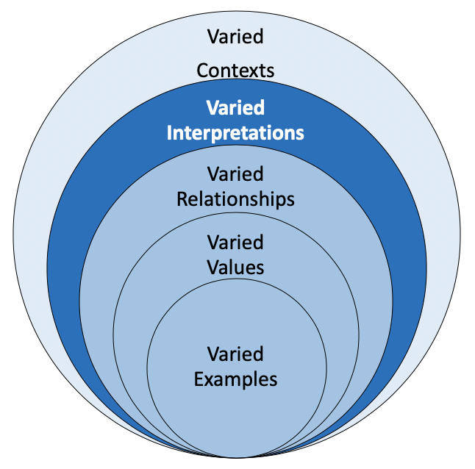
How might exponential relationships be used to interpret and link other mathematical ideas? ... How might the concept be used to elaborate one’s webs of mathematical understanding?
Learners have likely already encountered instances of exponentiation when dealing with …
place value (across difference bases)
making combinations of items
calculating areas and volumes
squares, cubes, and some other growth patterns
some recursive/compounding functions
Critical
Discernments
in this part of the Ravel
Level 4:
Varied Interpretations afford the noticing of mathematics’ ravel.
A

Slide 29
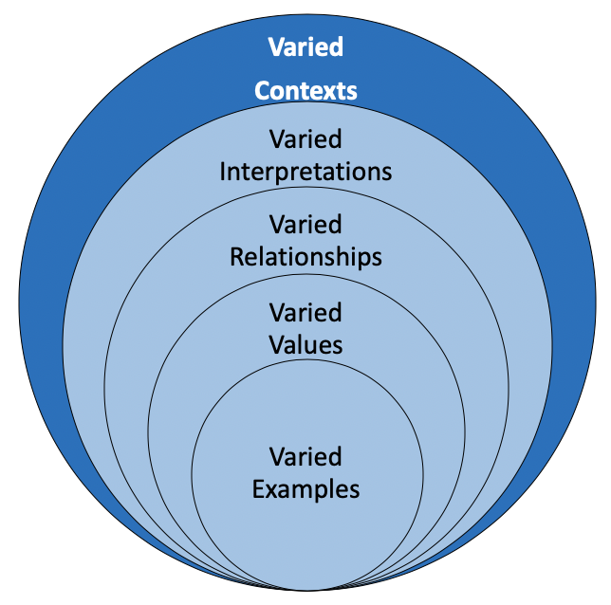
Where might we take this idea in the world? ... What might exponents help us interpret?
2 + 4
• combining of sets or lengths
• can be consistently represented as a linear event
• sets of sets or array/area generated by crossing dimensions
• can typically be represented an area-making event
2 × 4
• sets of sets of sets (etc.) or multidimensional form
• representable in a fractal-esque, recursively generated, nested and/or branching image
2⁴
Level 5:
Varied Contexts afford the noticing of applications & encounters.
A

Slide 30
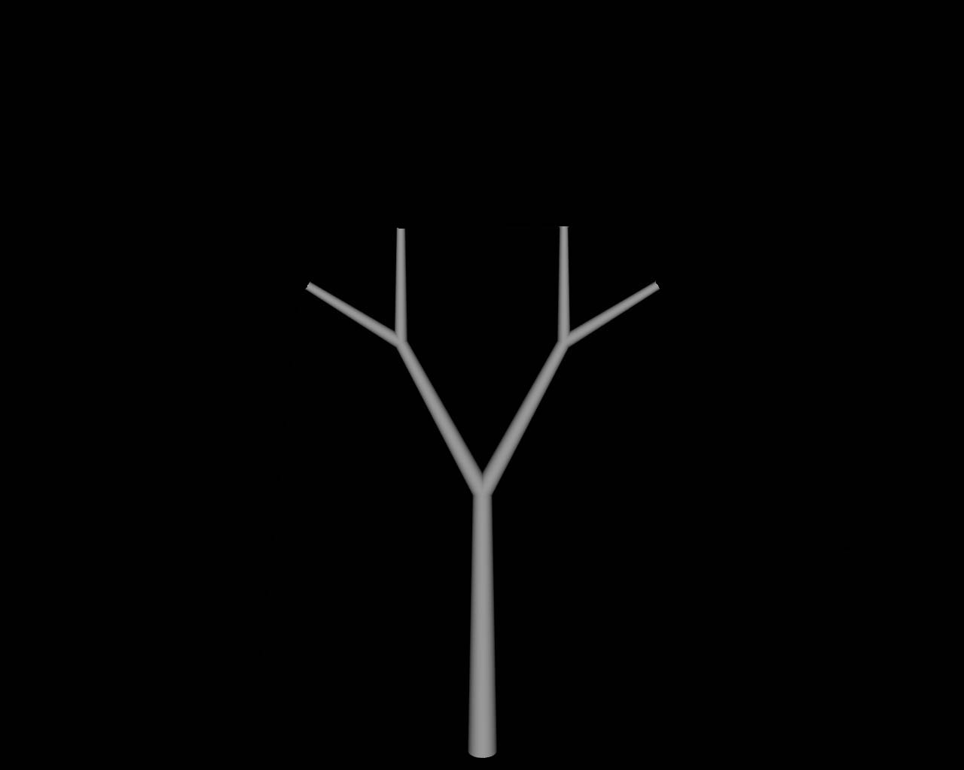
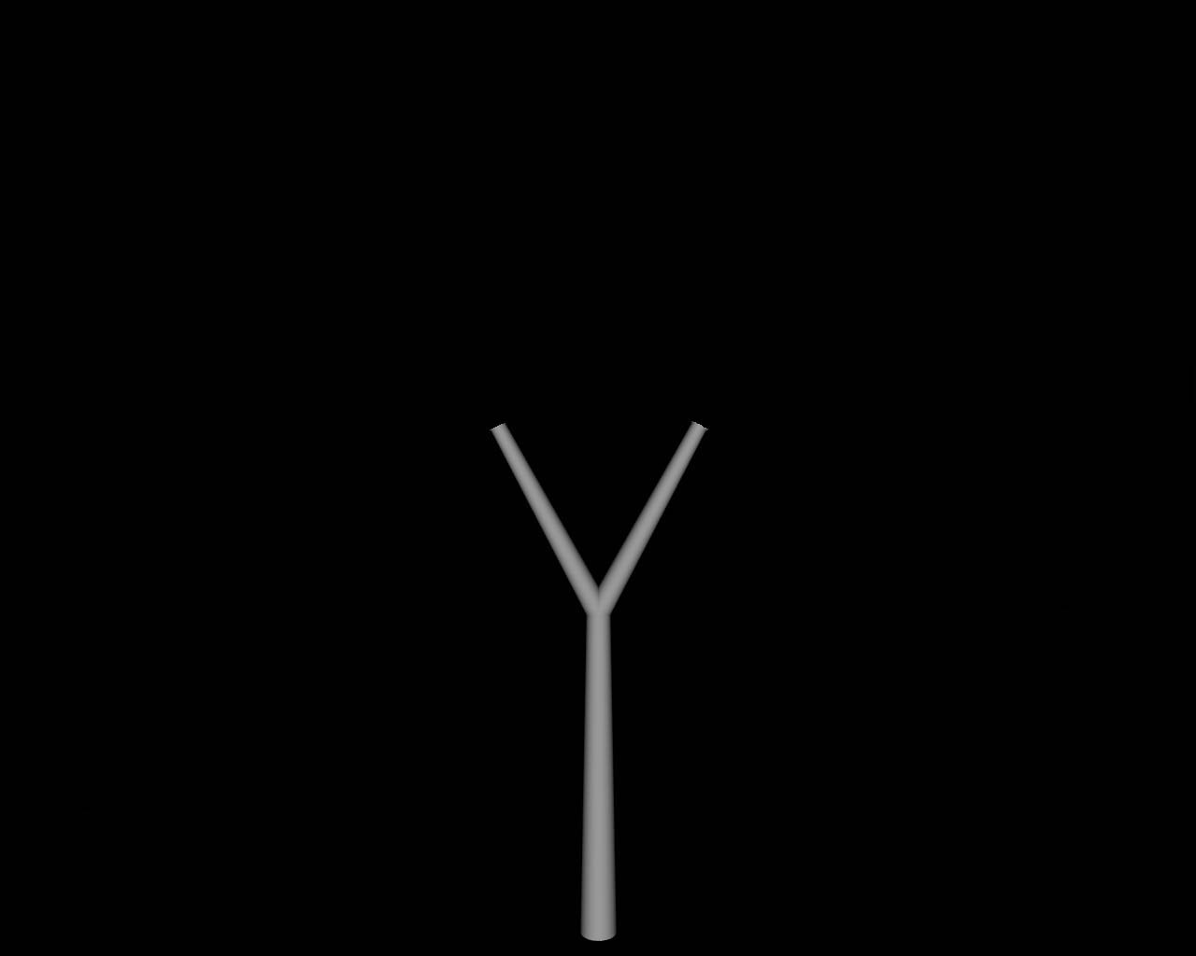
Where might we take this idea in the world? ... What might exponents help us interpret?
Virtually all of the crises currently faced by the planet – pandemics, population growth, species decline, climate change, catastrophic weather, etc. – involve exponential change.
A

Slide 31
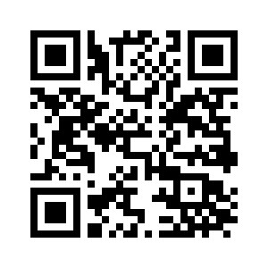
https://www.structuringinquiry.com/

Slide 32
Reflections on a variety of variation
How do your experiences during the session relate to your contribution to the Mentimeter at the beginning?
What struck you?
J

Slide 33
What next?
Slides on pmtheta
Continue conversation on X (Twitter)
@smartjacques #jointconf24
lauriejacques@smartpd.co.uk
john.mason@open.ac.uk
annewatson1089@gmail.com
L

