Slide 1


Thinkers
ATM
London
June 2019
John Mason

Slide 2
Aims
To sharpen and develop our personal powers to think mathematically
To work on ways of recognizing, invoking and developing learner’s powers to think mathematically

Slide 3
History
Questions & Prompts for Mathematical Thinking
  Was developed for ATM from a list of Questions used by Zigfryd Derzlag obtained by Anne Watson
  We have never been able to establish contact with him
  Core of Q&P are cells of a table formed from mathematical actions and mathematical statements
Thinkers
  Arose from use of Q&P by Chris Bills working with teachers
  It is essentially an expansion of one pair of facing pages of Q&P!

Slide 4
Throat Clearing
What you get from today will be largely what you notice about how you
  Draw upon your powers
  Exploit mathematical themes
Conjecturing Atmosphere
  Everything said today, particularly by me, is a conjecture to be tested in your experience
  Where you are certain, listen particularly to others, and ask non-leading questions
  Where you are uncertain, take the opportunity to express that uncertainty
  REMEMBER that you may be mistaken!

Slide 5
Outline
A small prize is available for anyone who can clearly distinguish between these!
A: Expressing Generality
B: Developing Concepts
C: Creating Methods & Developing Fluency
D: Enriching Example Spaces & Revealing Awarenesses
Questions are welcome at any time
Before lunch there will be opportunity to raise topics you might like to work on in the afternoon

Slide 6
A:
Expressing Generality

Slide 7

Say What You See!
Keith Richardson-Jones untitled 1974

Slide 8
Reflection
What could experience of the task contribute to mathematical thinking?
What could be varied?
What constrains variation?
What seems to be invariant?
Personal Narrative
Self-Explanation

Slide 9
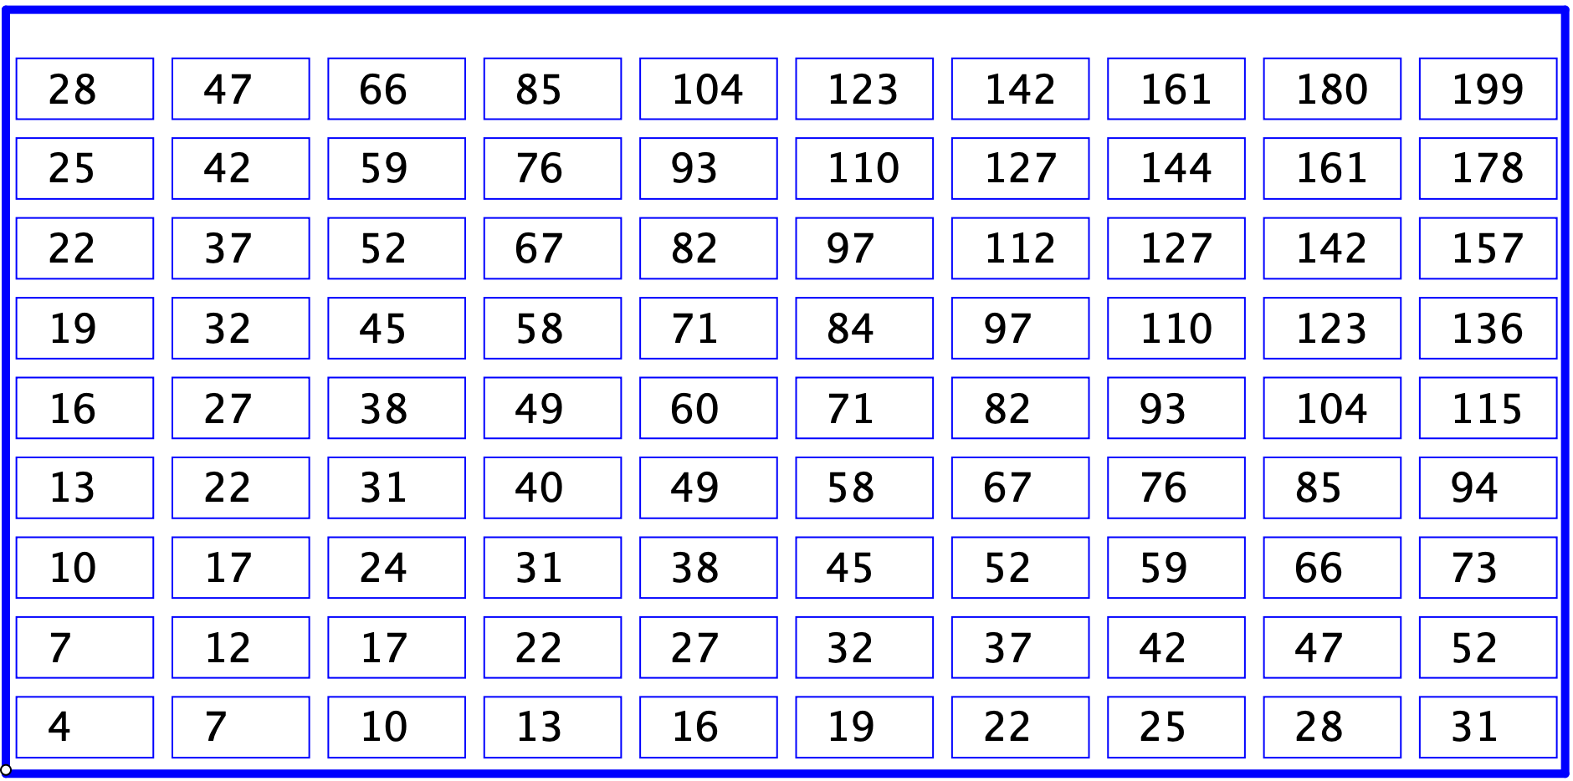
Skip Counting
Also
Parallelogram
Invariants
1 more than twice any entry
(to the right and-or up) is composite
Find a quick way to sum all the visible entries
Generalise to other skip counts
Notes:
Every odd number is one more than twice some number (to the right and-or up) in this grid

Slide 10
Remainders
Write down a number which leaves a remainder of
  3 when divided by 5
  and another
  and another
Tell someone else how to do this without doing any mental division
Write down a number which leaves a remainder of
  17 when divided by 37
Write down an expression for all numbers leaving a remainder of r when divided by m.
Write down a number which leaves a remainder of
  5 when divided by -7
  and another …
  -5 when divided by -7
  and another …

Slide 11

Repeating Frieze Patterns
…
What colour is the 37th cell?
Someone is thinking of a cell number . Tell them how to work out the colour of their cell.
That is the ‘Doing’
What might be an “Undoing?
Where is the 37th blue cell?
Someone is thinking of a number .. Tell them how to work out the position of the -th blue cell.
Notes:
Using various objects to create the repeating pattern

Slide 12
Patterns from Two

Slide 13
B:
Concept Development

Slide 14
Parentheses
Some mathematical dictation
  (2 + 2) x 2 and 2 + (2 x 2)
How many different answers can you get by inserting parentheses?
  2 + 3 – 4 – 1
  36 ÷ 3 ÷ 2 x 3
Make up your own sequence using four operations so as to have a maximal number of different parsings.
Notes:
(2 + 2) x 2 and (2 + 2x2);

Slide 15
Angles
What is an angle?
  Why is someone who fishes called an angler?
What can vary and still the measure of an angle stays the same?
Note: don’t immediately look for equality
How many angles can you discern?
Notes:
Ambiguity: angle and angle measure. Do angles have direction?
Isaac Walton “the Compleat Angler”

Slide 16
Moving Angles
Imagine a straight line. Move it around to get a sense of its freedom. Fix it in some non-horizontal direction.
Imagine a second straight line crossing the first.
Imagine an acetate copy of this second line being translated without rotation (remaining parallel).
  Bring it back to its original position and mark one of the angles it makes with the first line.
  Now follow that angle as the line is translated (remains parallel). What can you say about your marked angle?
Go back to two lines crossing
  Mark one of the angles
  Rotate one of your lines about the point of intersection
  What changes as your marked angle changes?

Slide 17
Constructing Angles
Construct a diagram using two sets, each consisting of three parallel lines. How many angles are there?
  Generalise!
How many different sizes of angle are there?
Construct a diagram using 6 lines
  label as few angles as possible so that the sizes of all the other angles can be determined
  so that there are as many different sizes of angle as possible

Slide 18
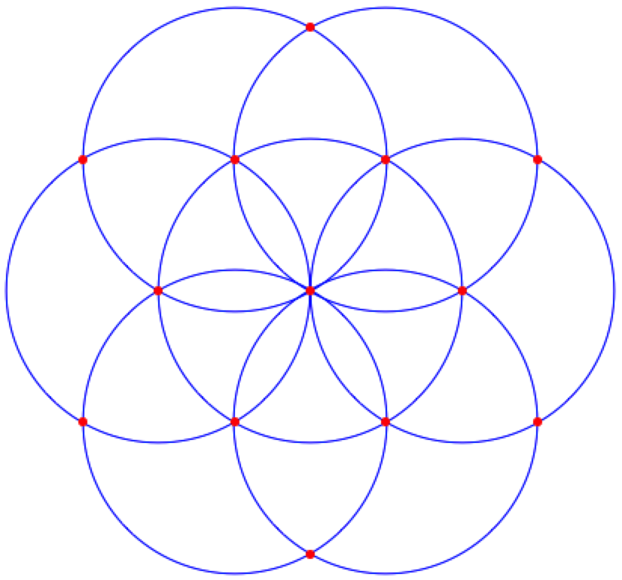
Seven Circles
Using ONLY the red intersection points,
how many differently shaped
  triangles?
  quadrilaterals?
  sized angles?
  … ?
Notes:
From Geoff Faux

Slide 19
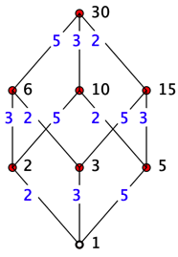
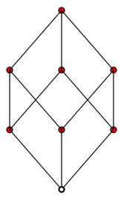

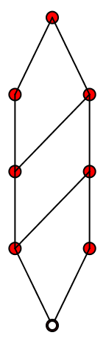
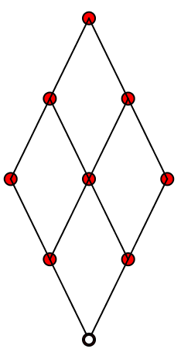
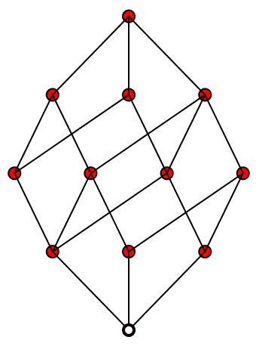

Factor Lattices
Say what You See
Look for relationships
What other numbers would have the same structure?
What numbers would have these structures?

Slide 20
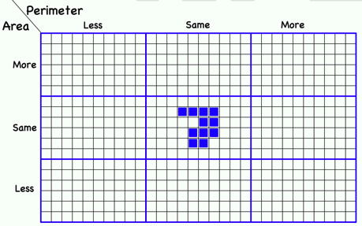
More or Less (Perimeter & Area)
Notes:
General Principles for retaining, decreasing or increasing area

Slide 21
More or Less: Factoring
Distinct prime divisors
Number of factors
More
Same
Fewer
More
Same
24
Fewer

Slide 22
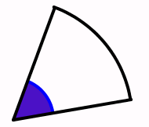
More or Less: Perimeter
Radius
Angle
More
Same
Less
More
Perimeter
6+π/3
Same
Less

Slide 23
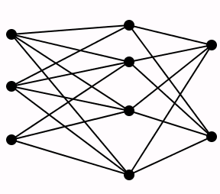
More or Less: Thread Count
Pins
More
Same
Fewer
Columns
More
24 links between pins
Same
Fewer

Slide 24
More or Less: Fractional Parts of … always 15
Whole
Fractional part
More
Same
Less
More
= 15
= 15
= 15
= 15
Same
= 15
3
4
of 20 = 15
= 15
= 15
= 15
= 15
Less

Slide 25
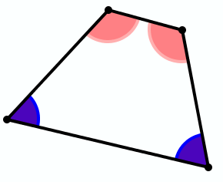
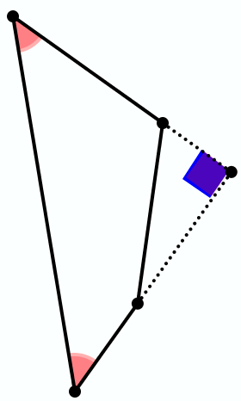
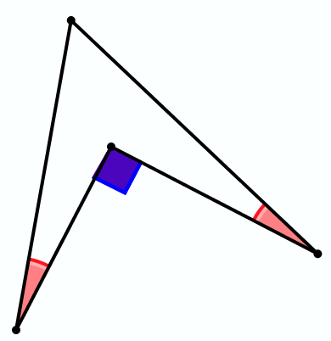
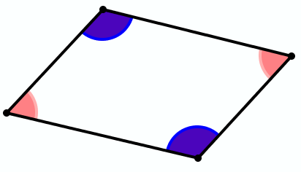
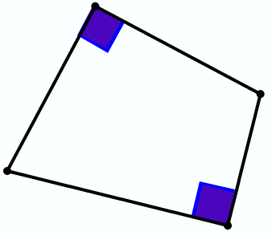
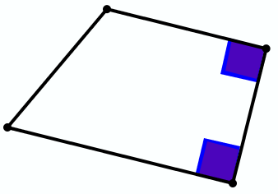
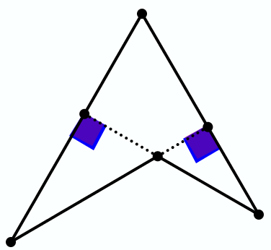
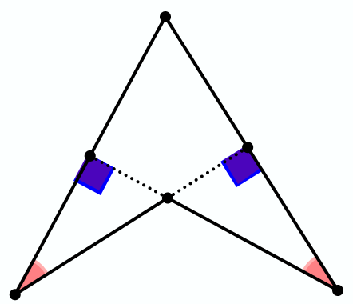
Quadrilaterals
(exactly)
One pair of
angles equal
Two pairs of
angles equal
One pair of
sides parallel
?
?
No perpendiculars!
One pair of
sides
perpendicular
?
No parallels!
Two pairs of
sides parallel
?
No perpendiculars!
Two pairs of
sides
perpendicular
No parallels!
?
Two pairs of
opposite sides
perpendicular

Slide 26
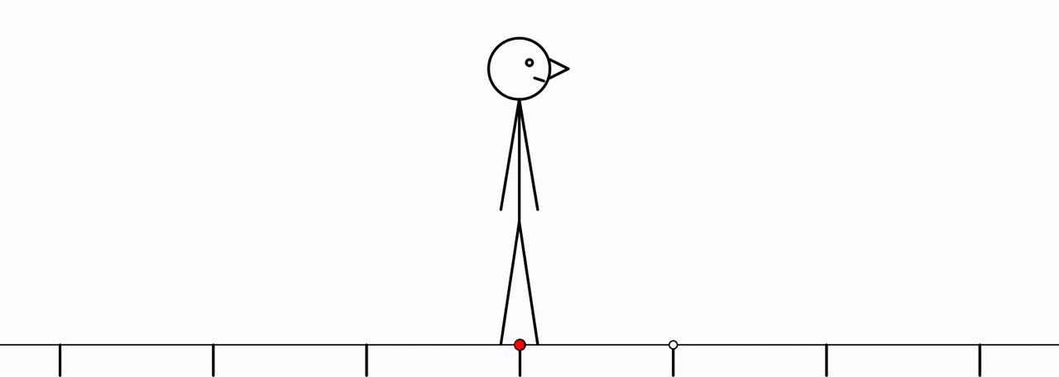

Number Line Movements
TFFBTFF
TF TFF
BFF
F

Slide 27
Imagine a Number-Line (T1)
Imagine a copy on acetate, sitting on top
Imagine translating the acetate number-line by 7 to the right:
  Where does 3 end up?
  Where does -2 end up?
  Generalise
Notation:
T₇ translates by 7 to the right
T₇(x) =
x + 7
Notation:
T_{t} translates by t
T_{t}(x) =
x + t
Notes:
No Diagrams! No Hands!
Is “to the right” needed for general a?

Slide 28
Imagine a Number-Line (T2)
Imagine a copy on acetate, sitting on top
Imagine translating the acetate number-line by 7 to the right;
Now translate the acetate number-line to the left by 4;
  Where does 3 end up?
  Where does -2 end up?
  Generalise
T₋₄ o T₇ translates by 7 and then by -4
Does order matter?
T_{s} T_{t} = T_{t} T_{s} = T_{s} _{+ t}
Notes:
No Diagrams!
No Hands!

Slide 29
Imagine a Number-Line (R1)
-12
-11
-10
-9
-8
-7
-6
-5
-4
-3
-2
-1
0
1
2
3
4
5
6
7
8
9
10
11
12
Imagine a copy on acetate, sitting on top
Imagine rotating the acetate number-line through 180° about the point 0:
  Where does 3 end up?
  Where does -2 end up?
  Generalise
Notation:
R₀ rotates about 0
R₀ (x) = –x
Notes:
No Diagrams!
No Hands!

Slide 30
Imagine a Number-Line (R2)
-12
-11
-10
-9
-8
-7
-6
-5
-4
-3
-2
-1
0
1
2
3
4
5
6
7
8
9
10
11
12
Imagine a copy on acetate, sitting on top
Imagine rotating the acetate number-line through 180° about the point 5:
  Where does 3 end up?
  Where does -2 end up?
  Generalise
Notation:
R₅ rotates about 5
R₅ (x) =
Notation:
R_{a} rotates about a
R_{a} (x) =
5 – (x – 5)
a – (x – a)
Expressing relationships in general
Tracking Arithmetic
Notes:
Two readings of 5 – (5 – x)

Slide 31
Imagine a Number-Line (R3a)
-12
-11
-10
-9
-8
-7
-6
-5
-4
-3
-2
-1
0
1
2
3
4
5
6
7
8
9
10
11
12
Imagine a copy on acetate, sitting on top
Imagine rotating the acetate number-line through 180° about the point 5;
Now rotate that about the point where 2 now is.
  Where does 3 end up?
  Where does -2 end up?
  Generalise
Q₅ rotates about where
5 currently is
Q_{b}(Q_{a}(x)) =
R_{R (b)}(R_{a}(x))
Q_{a}(x) = R_{a}(x) = 2a – x
a
= R_{2a–b}(R_{a}(x))
= 2(2a–b) - (2a – x)
Any resonances?
= 2(a – b) + x
= T_{2(a–b)}(x)
Notes:
Notice the use of absolute-reference-based actions in order to work with relative-reference-based actions

Slide 32

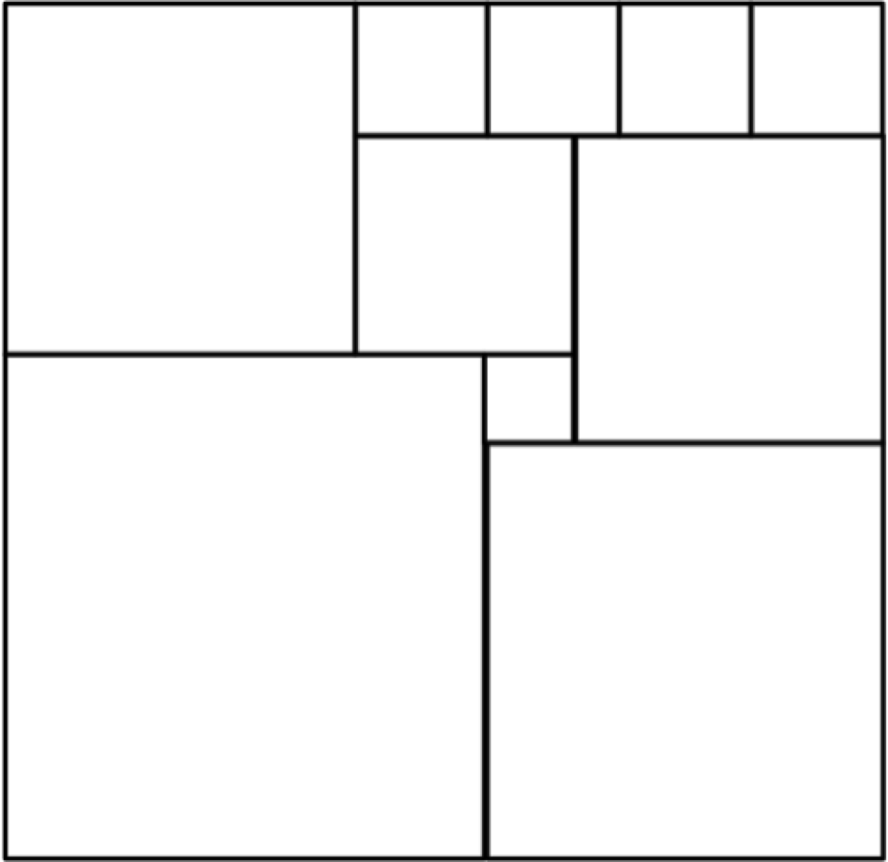
Square Deductions
Each of the inner quadrilaterals is a square.
Can the outer quadrilateral
be square?
15a = 6b
4(4a–b) = a+2b
4a–b
?
Acknowledge ignorance:
denote size of edge of
smallest square by a;
?
4a
b
?
a+b
Adjacent square edge by b
a
To be a square:
7a+b = 5a+2b
?
3a+b
?
So 2a = b
2a+b

Slide 33
C:
Methods & Facility

Slide 34
Multi-Level Initiating of Tasks
In how many different ways can a unit fraction be expressed as the difference of two unit fractions?
Notice that
Notice that
Purposeful Practise
(recent ATM publication)
Notes:
Ways of initiating activity through presentation of a task

Slide 35
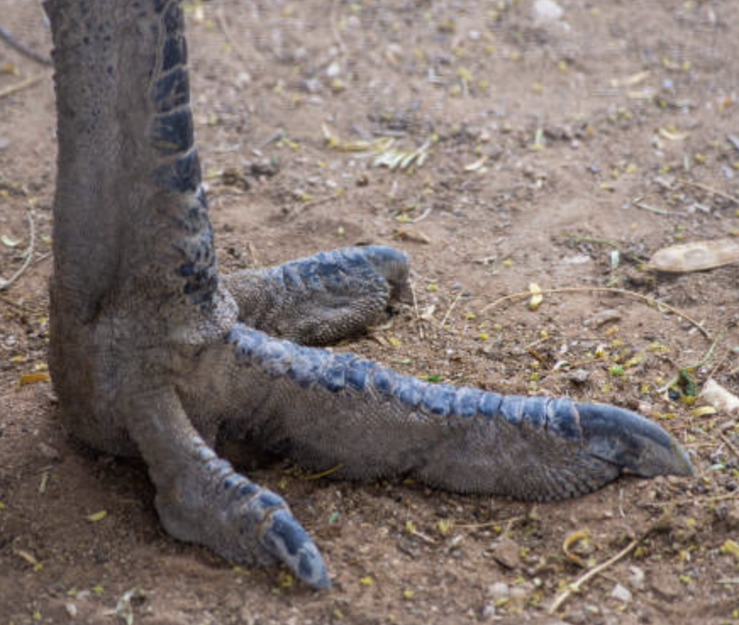
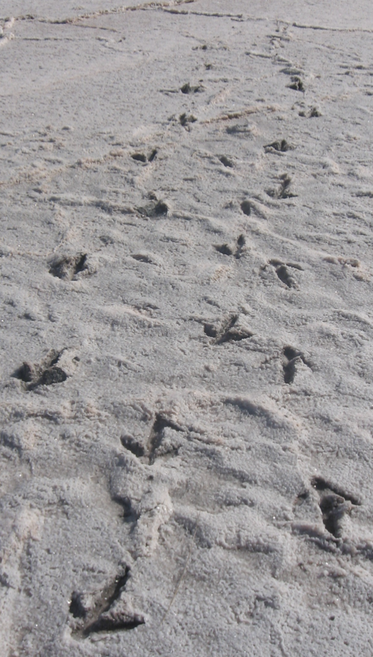
Tracking Arithmetic
Emu tracks
Construct a story for what happened

Slide 36
Clubbing
In a certain club there are 47 people altogether, of whom 31 are poets and 29 are painters.
How many are both? (Everyone is in at least one!)
How many painters are not poets?
How many poets are not painters?
47 total
poets
31
47–29
47–31
29
painters
31–(47–29)
29–(47–31)
Tracking Arithmetic
31 + 29 – 47
Tracking Arithmetic
Notes:
Tracking Arithmetic

Slide 37
In a certain club there are 28 people.
There are 14 poets, 11 painters and 15 musicians.
There are 22 who are either poets or painters or both.
There are 23 who are either painters or musicians or both.
There are 21 who are either musicians or poets or both.
How many people are all three: poet, painter and musician?
both painter & musician?
both poet & musician?
both poet & painter
15 musicians
only a painter?
only a poet?
28 total
only a musician?
21 musicians or poets
28–22
23 painters or musicians
14
poets
11
painters
28–23
28–21
22 poets or painters
11+15–23
14+15–21
14+11–22
(14+11–22) + (11 + 15 –23) + (14 + 15 –21)
– (28 – (28–22)–(28–23)–(28–21))
2
Notes:
Tracking Arithmetic

Slide 38

Differing Sums of Products
Write down four numbers in a 2 by 2 grid
4
7
5
3
Add together the products along the rows
28 + 15 = 43
Add together the products down the columns
20 + 21 = 41
43 – 41 = 2
Calculate the difference
That is the ‘doing’
What is an undoing?
Now choose positive numbers
so that the difference is 11
Notes:
Mathematical context
What probaby matters most is not eh context, but whether students ‘think’ they can solve the problem!

Slide 39
Differing Sums & Products
4
7
Tracking Arithmetic
5
3
4x7 + 5x3
4x5 + 7x3
4x(7–5) + (5–7)x3
= 4x(7–5) – (7–5)x3
= (4–3) x (7–5)
So in how many essentially different ways can 11 be the difference?
So in how many essentially different ways can n be the difference?
Notes:
Revealing Structure by attending to relationships not calculations

Slide 40
Extended Differing Sums & Products
4
7
Take your initial grid
Add some number to both of the main diagonal entries
Subtract some number from both of the off diagonal entries
Why is the ‘result’ the same for all three grids?
5
3
9
7
5
8
9
2
0
8
Reading around the grid in both directions:
45 x 37 – 47 x 35
95 x 87 – 97 x 85
90 x 82 – 92 x 80
= 20
= 20
= 20
Notes:
Revealing Structure by attending to relationships not calculations

Slide 41


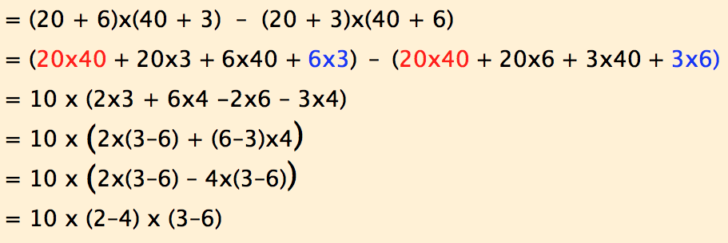
Varied Multiplication Differences
= 60
= 60
= 60
2
3
6
4

Slide 42

Think Of A Number (ThOANs)
Think of a number
Add 2
Multiply by 3
Subtract 4
Multiply by 2
Add 2
Divide by 6
Subtract the number you first thought of
Your answer is 1
and so is everyone else’s!
7
7
+ 2
3x + 6
7
7
3x + 2
6x + 4
7
6x + 6
7
+ 1
7
1

Slide 43
ThOANs
Think of a number between 0 and 10
Add six
Multiply by the number you first thought of
Add 4
Subtract twice the number you first thought of
Take the positive square root
subtract the number you first thought of
You (and everybody else) are left with 2!

Slide 44
Using Tracking Arithmetic
67
?
3+4x7
+6x4+
4x1+8
37
30
3+3x7
+3x4+1
7+3x4
+3x1+8
21
16
14
10
11
5
9
3+2x7
+4
7+2x4
+1
4+2x1
+8
3
7
4
1
8
3+7
7+4
4+1
1+8
3
7
4
1
8
What could be varied?
Notes:
Applies to Pascal’s triangle; Leibniz’s triangle, multiplication and other tables
Example of Chinese Pudian … foretaste of Pascal’s triangle

Slide 45
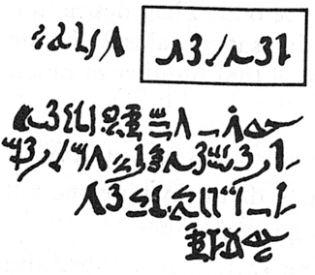
Rhind Mathematical Papyrus problem 28
Two-thirds is to be added.
One-third [of that] is to be subtracted.
There remains 10.
2/3 of this is to be added.
+2/3 x
= 5/3 x
1/3 of this is to be subtracted.
5/3 x – 1/3 x 5/3 x
=10/9 x
There remains 10.
10/9 x = 10
= 9
Notes:
Problem 28 of the Rhind Mathematical Papyrus Gillings p182

Slide 46
Rhind Mathematical Papyrus problem 28
Two-thirds is to be added.
One-third [of that] is to be subtracted.
There remains 10.
Make 1/10 of this,
there becomes 1.
The remainder is 9.
/10
– /10
Check
2/3 of this is to be added.
The total is 15.
1/3 of this is 5.
Lo! 5 is that which goes out,
And the remainder is 10.
+ 2/3 x
9x /10
9x /10
5/3 x 9x /10
= 3x /2
/2
The doing as it occurs!
Notes:
Problem 28 of the Rhind Mathematical Papyrus Gillings p182

Slide 47
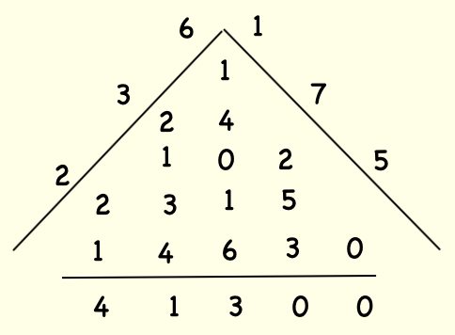
Medieval Multiplication
6
1
1
3
7
2
4
1
0
2
5
2
2
3
1
5
1
4
6
3
0
4 1 3 0 0

Slide 48
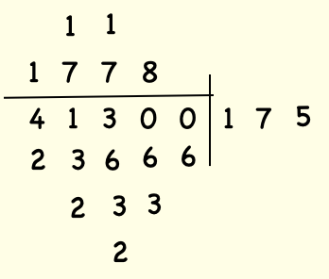
Galleon Division
1
1
1 7 7
8
4 1 3 0 0
1
7
5
2
3
6
6
6
2
3
3
2

Slide 49
Long Division
1
7
5
236
4 1 3 3 0
2 3 6
3
1 7 7
1 6 5 2
1 2 1
0
1 2 1 0

Slide 50
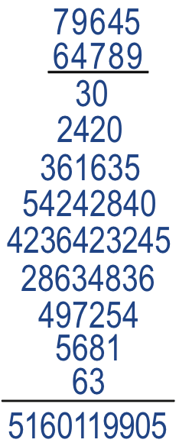
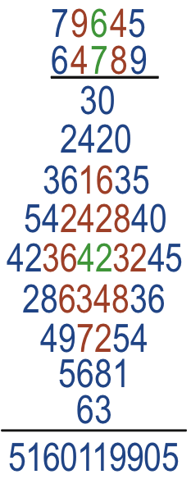
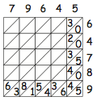
Diamond Multiplication

Slide 51
D:
Example Spaces
& Revealing Awareness
Notes:
Remember Remainders?

Slide 52
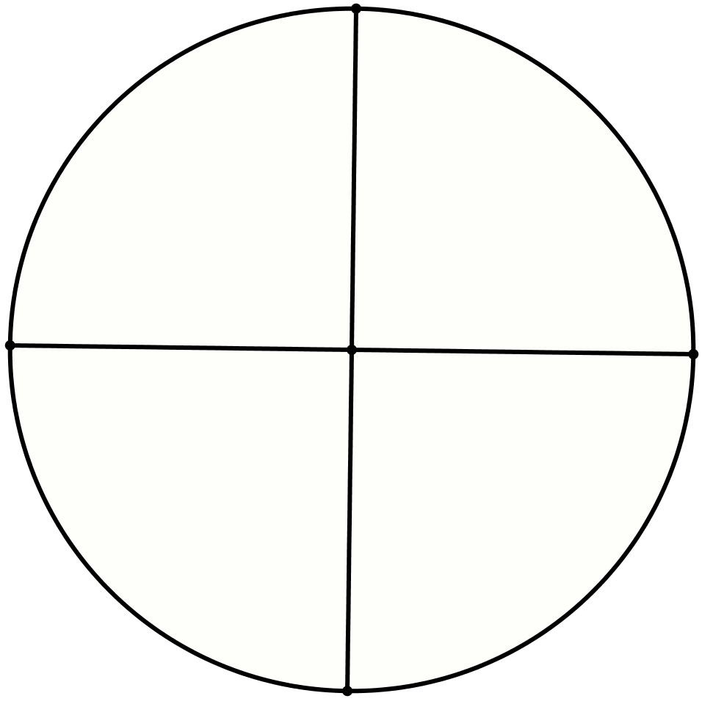
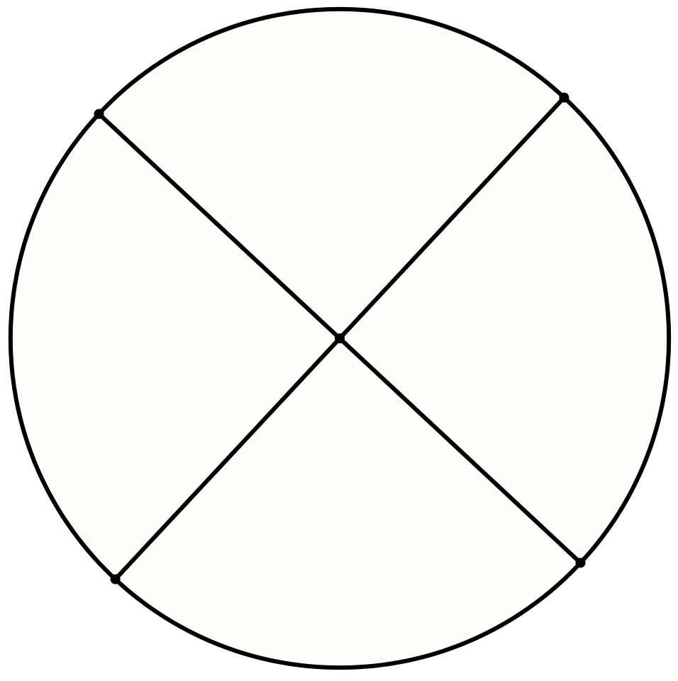
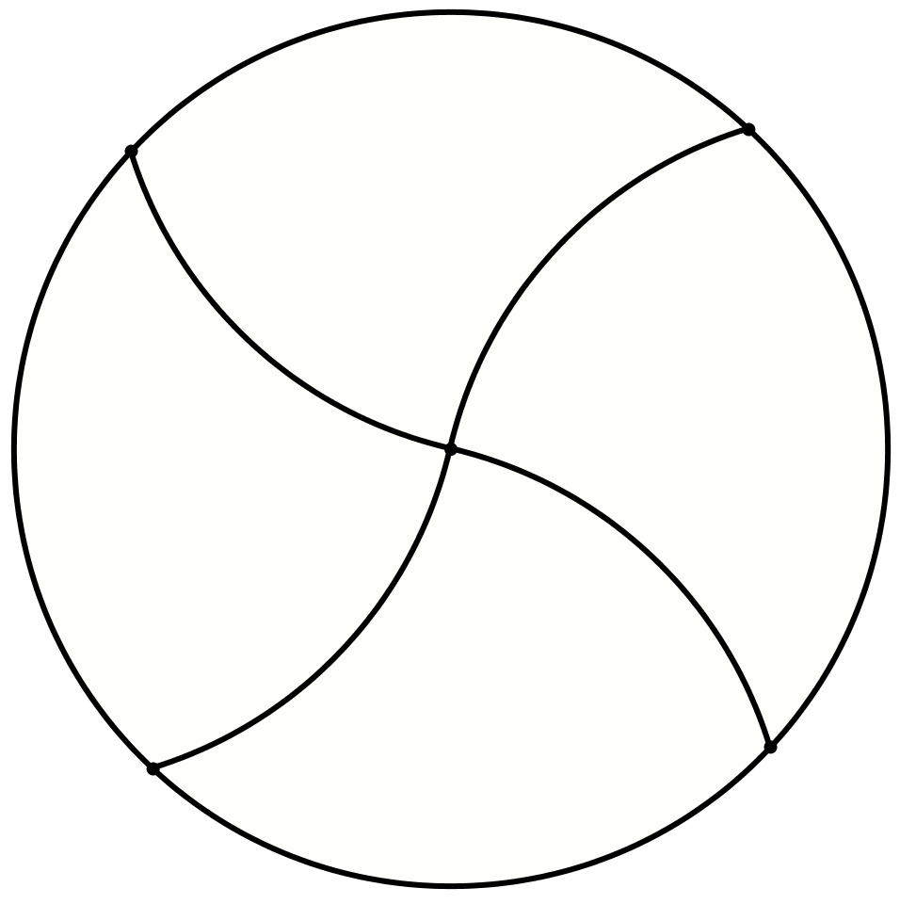
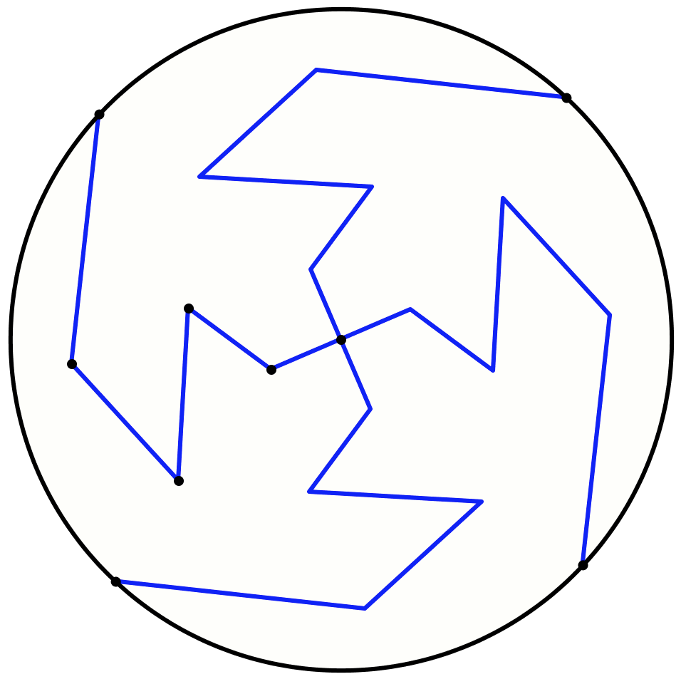
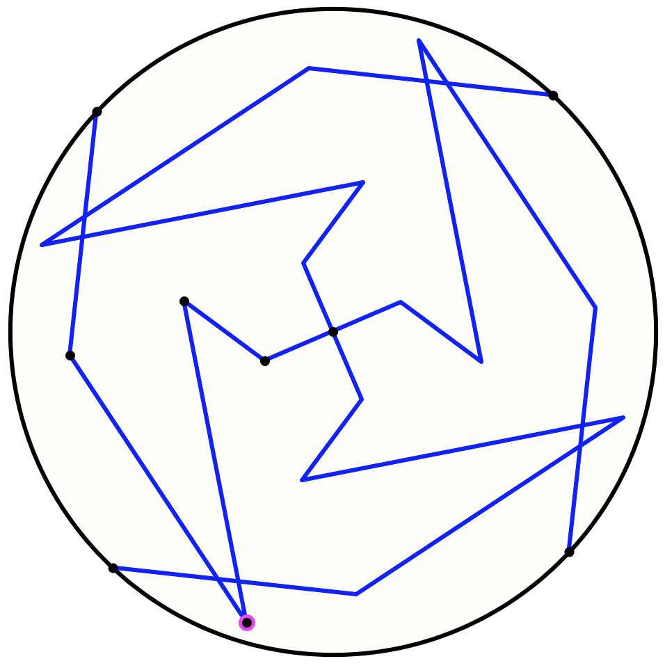
Another & Another
Draw a circle and divide it into four congruent pieces
Do it another way
Do it another way
What could experience of the task contribute to mathematical thinking?
Negotiating
‘same & different’
What could be varied?
What seems to be invariant?
What constrains variation?
Personal Narrative
Self-Explanation

Slide 53
Another & Another
Write down two numbers whose difference is 2
  And another
  And another
  And which make it difficult to see immediately that the difference is 2
Notes:
Remember Remainders?

Slide 54
Increasingly Constrained
Write down a decimal number that lies between 3 and 4
  and which does not use the digit 5
  and which does use the digit 7
  and which is as close to 3½ as possible

Slide 55
Bury the Bone
Construct a long multiplication
  which requires 12 products of single digits
  and which requires 8 column additions

Slide 56
Reflection
What could experience of the task contribute to mathematical thinking?
What could be varied?
What constrains variation?
What seems to be invariant?
Personal Narrative
Self-Explanation

Slide 57
Outer & Inner Tasks
Outer Task
  What author imagines
  What teacher intends
  What students construe
  What students actually do
Inner Task
  What powers might be used?
  What themes might be encountered?
  What discernments might be made?
  What connections might be made?
  What reasoning might be called upon?
  What personal dispositions might be challenged?

Slide 58
Personal PD
Choose a particular style of task
Imagine yourself, in a class, using it
Look for an opportunity to choose to use it
  Delicious moment of freedom!
Keep doing this until it becomes ‘second nature’
(until you have internalised it as an action)
(ie “your awareness has been educated”)
Choose a different style of task

Slide 59
Follow-Up
john.mason@open.ac.uk
PMTheta.com
Attend the ATM annual conference!
Consider IMP (see PMTheta.com)

