Slide 1



Variation not simply Variety
The Open University
Maths Dept
University of Oxford
Dept of Education
Promoting Mathematical Thinking
John Mason
MathsFest 17
GlowMath Hub
Cheltenham
June 2017

Slide 2
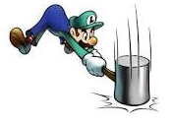
Throat Clearing
Everything said here is a conjecture …
  … to be tested in your experience
My approach is fundamentally phenomenological …
I am interested in lived experience.
Radical version: my task is to evoke awareness (noticing)
So, what you get from this session will be mostly …
  … what you notice happening inside you!
Avoid the teaching of
speculators,
whose judgements are
not confirmed
by experience.
(Leonardo Da Vinci)
Who takes initiative?
Who makes choices?
What is being attended to?

Slide 3
My Current Interests
The role and nature of attention in teaching and learning mathematics
Drawing on the full human psyche:
  Cognition, Affect, Enaction; Attention, Will, Witness; Conscience
Extending Dual Systems Theory to the whole psyche
  S1: automaticity
  S1.5: emotivity
  S2: consideration (particularly cognitively)
  S3: openness to creative energy
How tools and tasks mediate between student, teacher and mathematics

Slide 4
Skip Counting
Starting at 3, counting in 5s
  What will the 100th number be?
  I have a friend in Vancouver who wants to know what will be the th number
Starting at 4 counting in 7s
    What will the 100th number be?
    The th number?
Starting at 23, counting down in 5s
3 + 5 x 99
( – 1)
(3 – 5) + 5 x 100
4 + 7 x 99
( – 1)
Starting at counting in s
Starting at 101 counting down in ths

Slide 5
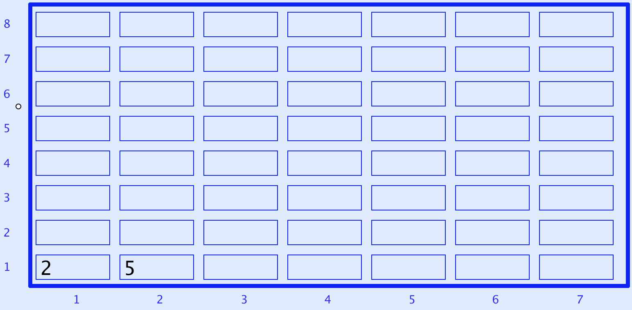
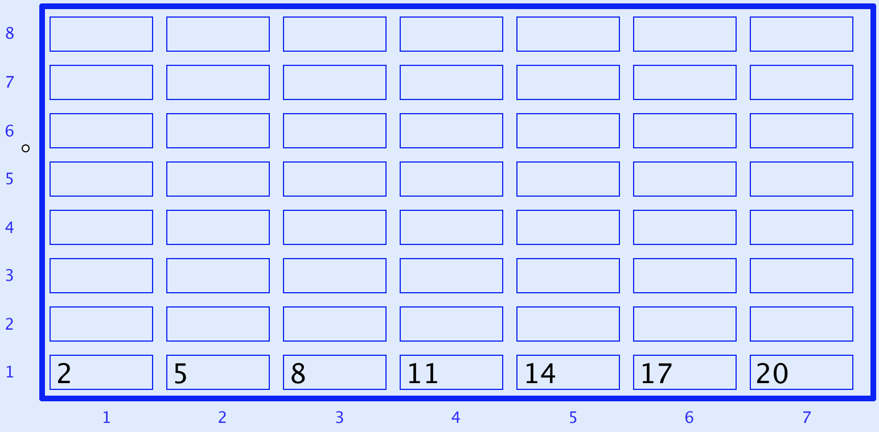
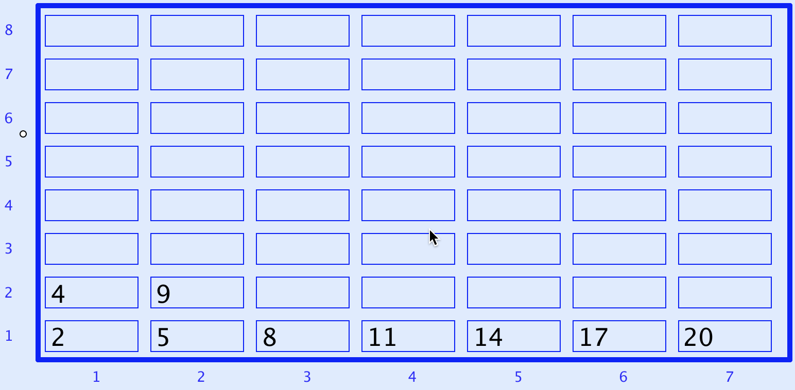
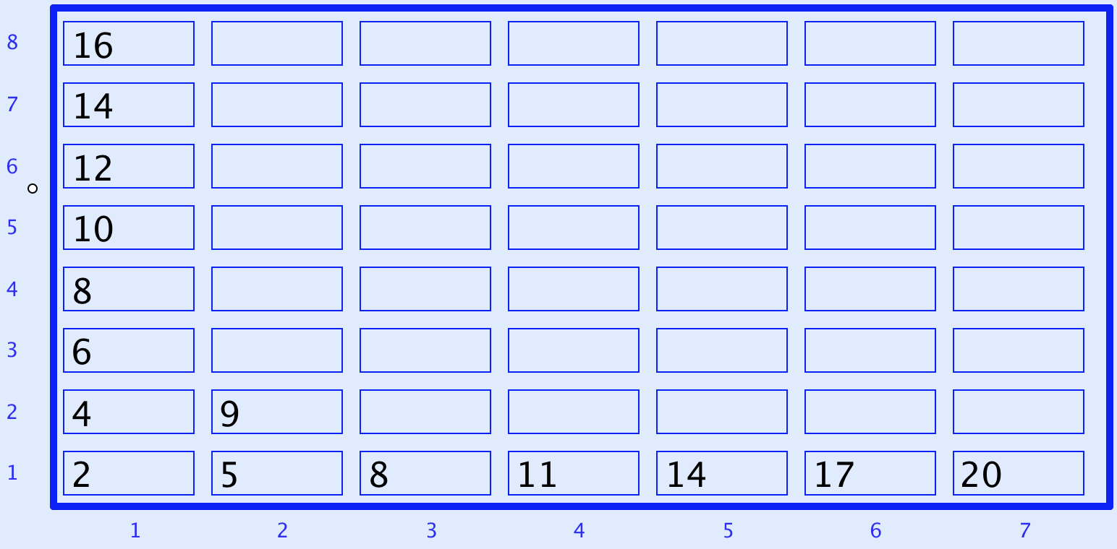
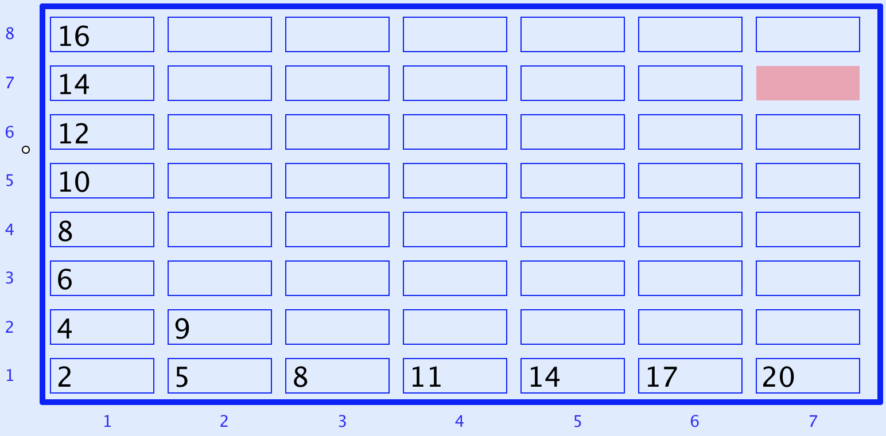
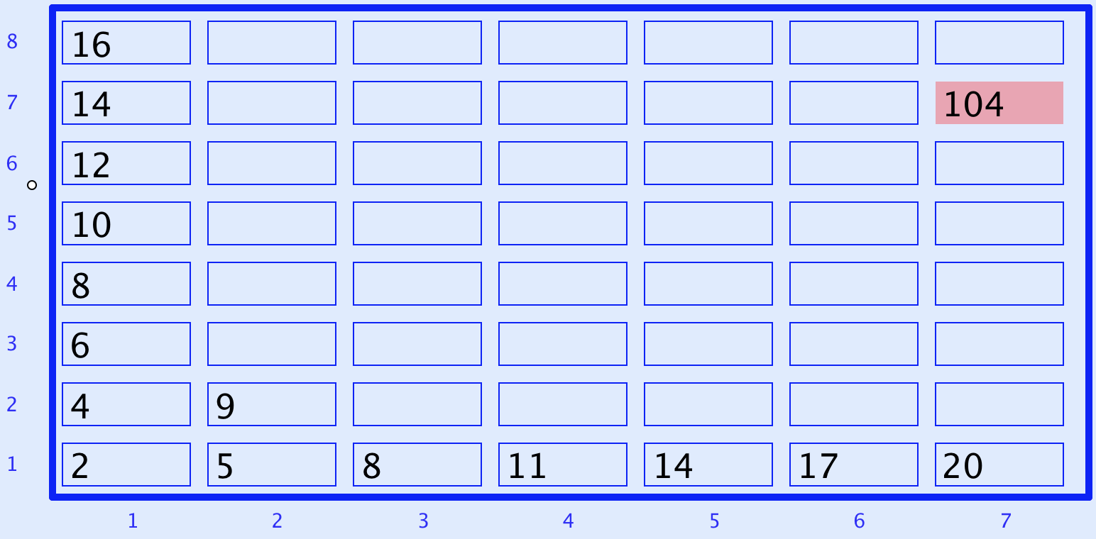
What Next?
Every row and column is an arithmetic progression
(constant difference)

Slide 6
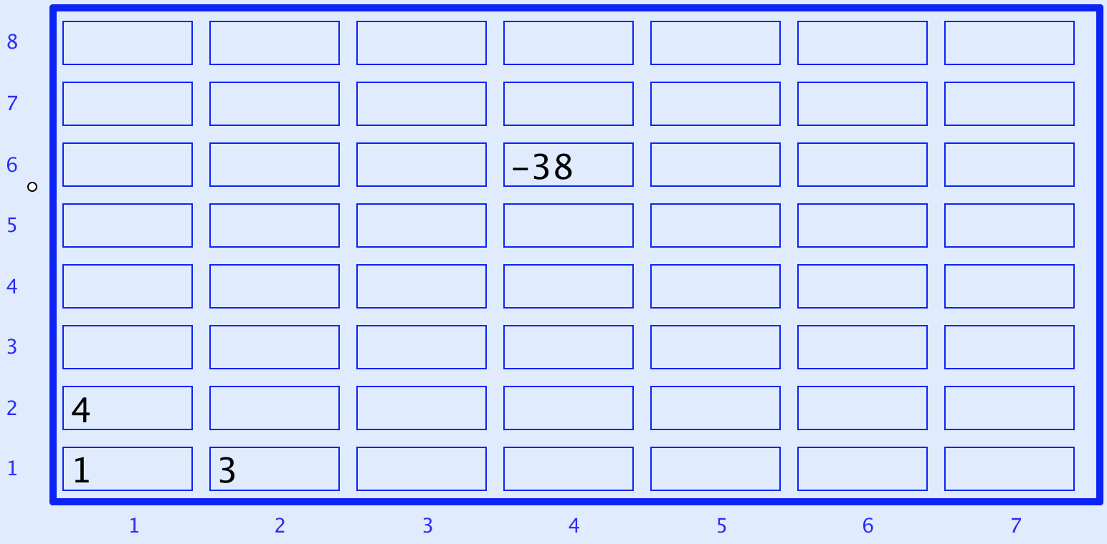
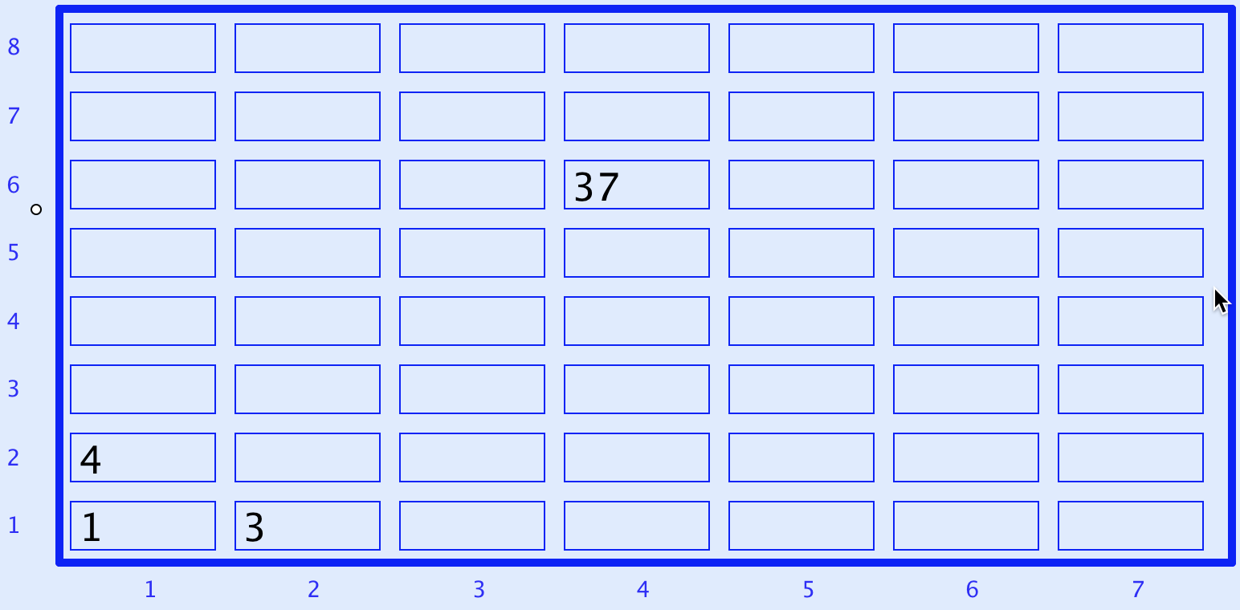
Now What Next?
A lesson without the opportunity to express generality
is not a mathematics lesson
Notes:
Expressing Generality

Slide 7
Appreciating & Comprehending Division
I tell you that 10101 is divisible by 37.
What is the remainder upon dividing
1010137 by 37?
What is the remainder upon dividing
1010123 by 37?
What is the remainder upon dividing
10124 by 37?
What is the remainder upon dividing
232323 by 37?
Make up your own similar question
  What is the same and what different about your task and mine?
How do you know?
0
Did you write it down for yourself?
How do you know?
1010100+37
23
How do you know?
23
0
How do you know?
It’s all about what you are attending to,
and how you are attending to it
Attention is directed
by what is being varied
Notes:
Student initiative

Slide 8
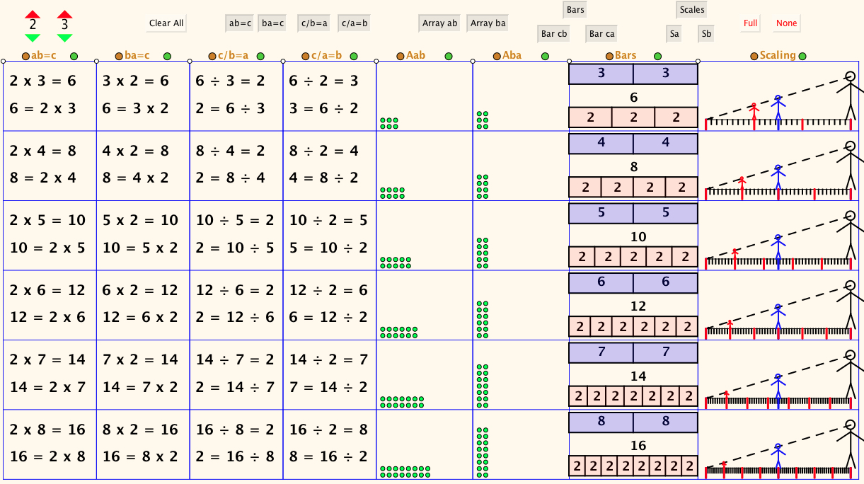
The Drakensberg Grid

Slide 9
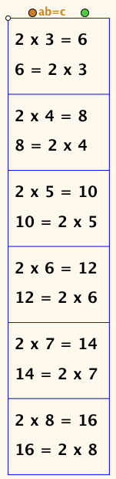
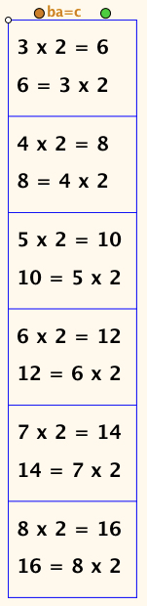
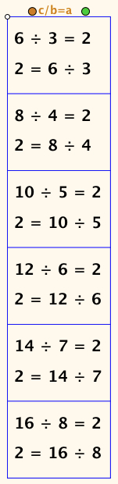
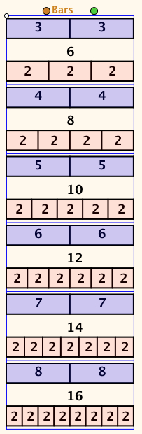
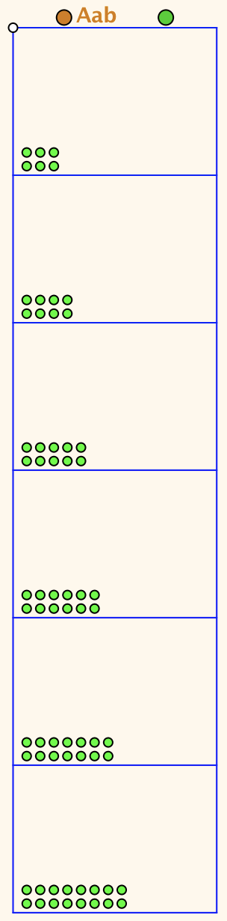
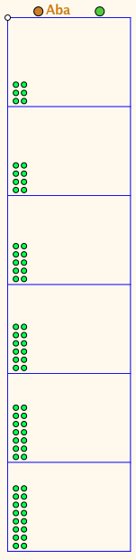
Selected Columns
Notes:
(I) full grid fully filled
(ii) first column fully filled
(iii) first two columns fully filled
(iv) first column, third column and bars fully filled
(v) first column, third column and bars first row only
(vi) all entries in, say, row 5 displayed together
(vii) full grid fully filled

Slide 10
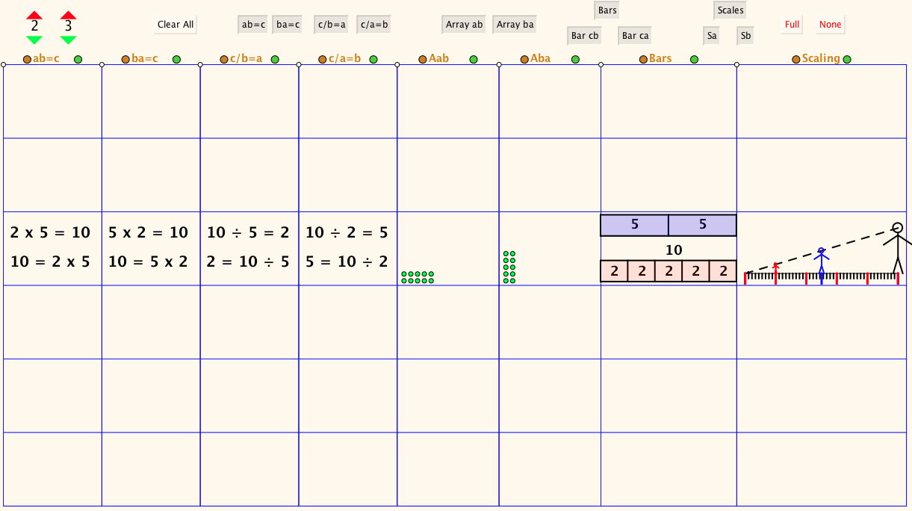
Selected Row

Slide 11
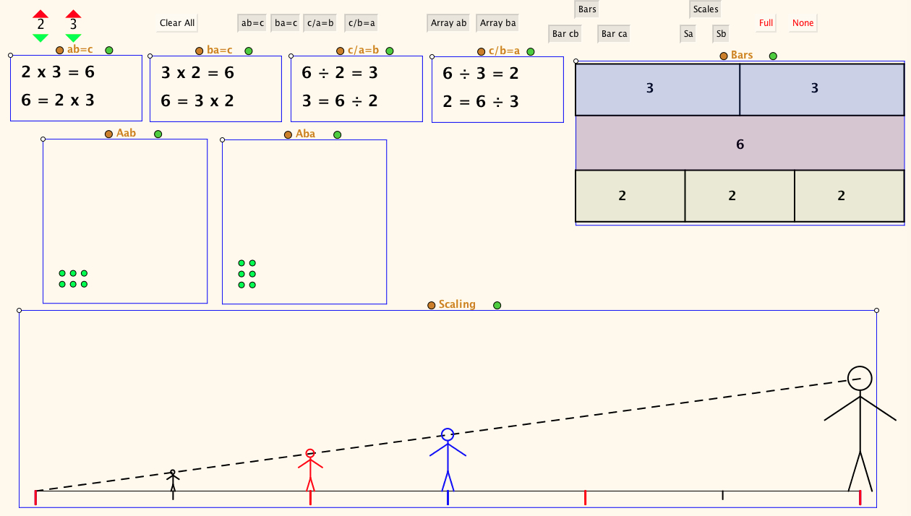
Single row expanded

Slide 12
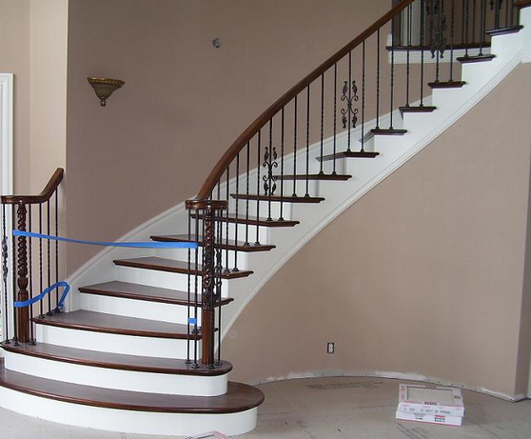
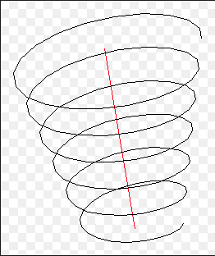
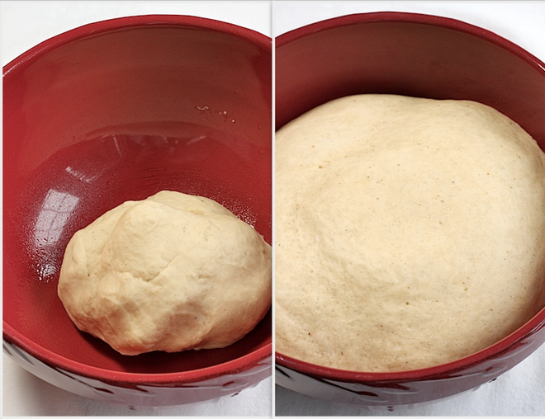
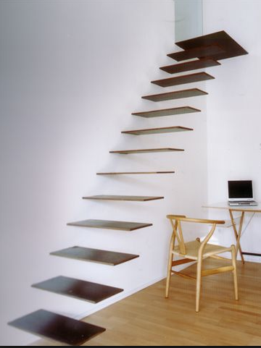

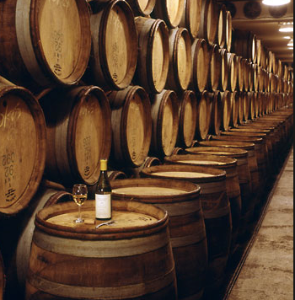
Conceptions of Learning
Consequences for Teaching
Staircase
Spiral
Maturation

Slide 13
Considerations
Intended / enacted / lived object of learning
  Author intentions
  Teacher intentions
  Learner experience
Didactic Transposition
Expert awareness
is transformed into
instruction in behaviour
Task
  Author intentions
  Teacher intentions
  As presented
  As interpreted by learners
  What learners actually attempt
  What learners actually do
  What learners experience and internalise

Slide 14
Imagining & Expressing
Imagine a pentagon;
Now draw it
Now draw a pentagon …
  with exactly one right angle
  with exactly two right angles
  with exactly three right angles
  How many right angles can a polygon have?

Slide 15
Problem Solving via Covering-Up
If Anne gives John 5 of her marbles, and then John gives Steve 2 of his marbles, Anne will have one more marble than Martina and the same number as John. How many more marbles has Steve than John at the start?
If Anne gives John 5 of her marbles, and then John gives Steve 2 of his marbles, Anne will have one more marbles than Steve and one less than John. How many more marbles has Steve than John at the start?
If Anne, John and Steve give each other some marbles of their marbles. …
Notes:
Janet Mock ATM 2017
Beginning Generally and Playfully before introducing constraints
Freedom & Constraint

Slide 16
Progression & Development
DTR (do, talk, record)
MGA (manipulating, getting-a-sense-of, articulting)
EIS (enactive, iconic, symbolic: Bruner)
  (weaning off material objects)
PES (enriching Personal Example Space)
LGE (Learner Generated Examples)
Re-construction when needed
Communicate effectively with others

Slide 17
Inner, Outer & Mediating Aspects of Tasks
Outer
  What task actually initiates explicitly
Inner
  What mathematical concepts underpinned
  What mathematical themes encountered
  What mathematical powers invoked
  What personal propensities brought to awareness
Mediating
  Between Teacher and Student
  Between Student and Mathematics (concepts; inner aspects)
Activity
  Enacted & lived objects of learning
Object of Learning
Resources
Tasks
Current State
Notes:
Tahta
Bennett

Slide 18
Concrete-Pictorial-Abstract
(re)-presentations
Enactive – Iconic – Symbolic
Manipulating – Getting-a-sense-of – Articulating
Doing – Talking – Recording

Slide 19
Powers & Themes
Are students being encouraged
to use their own powers?
Powers
or
are their powers being usurped by textbook, worksheets and … ?
Imagining & Expressing
Specialising & Generalising
Conjecturing & Convincing
(Re)-Presenting in different modes
Organising & Characterising
Themes
Doing & Undoing
Invariance in the midst of change
Freedom & Constraint
Restricting & Extending
Exchanging

Slide 20
Mathematical Thinking
Learner construction of mathematical objects
Learner construction of exercises and problems
Learner informed choice for ‘practicing’
Structured Variation to call upon natural powers

Slide 21
Reflection and the Human Psyche
What struck you during this session?
What for you were the main points (cognition)?
What were the dominant emotions evoked? (affect)?
What actions might you want to pursue further? (enaction)
What initiative might you take (will)?
What might you try to look out for in the near future (witness)
What might you pay special attention to in the near future (attention)?
What aspects of teaching need specific care (conscience)?
Notes:
Chi et al

Slide 22
Reflection
Withdrawing from action
Becoming aware of an action, or a relationship
NOT ‘telling them so they remember’
but rather
immersing them in a culture of mathematical practices

Slide 23
Stances
Deficiency
  What learners cannot (do not) do at different ages and stages
  What teachers do not know, do, or appreciate about different topics and pedagogical strategies
Proficiency
  What learners & teachers & policy makers do already
  Not doing for learners & teachers what they can already do for themselves
Efficiency & Effectiveness
  Seeking efficient and effective ways of enhancing, extending, and enriching
    Peoples’ sensitivities to notice what matters
    Peoples’ powers,
    Peoples’ appreciation of mathematical themes,
    Peoples’ experience of mathematical thinking
    Peoples’ internalisation of effective actions

Slide 24
To Follow Up
PMTheta.com
john.mason@open.ac.uk
Questions and Prompts: (secondary & primary) (ATM)
Thinkers (ATM)
Mathematics as a Constructive Enterprise (Erlbaum)
Designing & Using Mathematical Tasks (Tarquin)
Key Ideas in Mathematics (OUP)
Thinking Mathematically (Pearson)
Researching Your Own Practice Using The Discipline of Noticing (RoutledgeFalmer)
Annual Institute for Mathematical Pedagogy
(early August: see PMTheta.com)

