Slide 1


What is the Problem with (teaching)
Problem Solving?
John Mason
MEM Conference
Feb
2024

Slide 2
Throat Clearing
I am interested in the lived experience of
thinking, teaching and learning Mathematically
The essence of my way of working would be to offer you some experiences in the form of task-exercises, but time is too short
Today, the questions I shall address are about problem solving itself, as a pedagogy, an orientation, a perspective on teaching mathematics
As usual, everything said today, especially by me, is
A CONJECTURE
to be tested in and against your experience.
The core of the session will be some problems arising from wanting to, or trying to ‘Teach Problem Solving’.
But first, some pedagogical assumptions:

Slide 3
Pedagogical Assumptions
Tasks generate activity
  Effective activity requires a balance between
    Resources available
    Tasks proposed
    Current state of learner
    Intended goal
Activity generates experience
  One thing we don’t often learn from experience is that we don’t often learn from experience alone
  Something else is required …
Reflection, Reconstruction, Pro-flection
  Personal Narratives; Self-Explanations
  Imagining acting differently in the future
Intended goal
Resources
Tasks
Current state

Slide 4
Context
Some
Mathematical Themes
Invariance in the midst of change
Doing & Undoing
Freedom & Constraint
Restricting & Extending
Some Powers
used Mathematically
Imagining & Expressing
Specialising & Generalising
Conjecturing & Convincing
Organising & Characterising
4

Slide 5
Some Observations
‘Problem Solving’ comes into and out of fashion
(Policy-makers’ concern) regularly
  In the UK emphasis currently is on facts and procedures:
  ‘knowing that’ and ‘knowing how’ (not ‘knowing when’ or ‘knowing why’)
‘Problem Solving’ means different things to different folk
  It is not like teaching a concept, theorem, or procedure
It is a disposition, a mindset, a way of being
It involves ‘having potentially relevant mathematical actions become available to be enacted’
The task itself is not actually ‘the’ problem:
rather it is whether learners experience it
as a potentially doable task
  This means having one or more potential mathematical actions becoming available to enact
  Without it being merely routine
Core ‘problem’
with trying to teach problem solving:
trying to transform awareness of problem solving states
into an algorithm, a sequence of routines

Slide 6
Difficulties/Problems with ‘Teaching Problem Solving’
What ‘problem’ is ‘teaching problem solving’ supposed to (re)solve?
When given ‘problems to solve’, learners don’t know what to do
Time it takes to experience problem solving in a crowded curriculum
How might pertinent mathematical actions become available to enact when experiencing something as problematic?
What recent past experiences of learners have influenced them?
Developing a positive & trusting working relationship with teacher and text
Focus on STEM based tasks for motivation
is likely to dilute mathematics, often reducing it to arithmetic

Slide 7
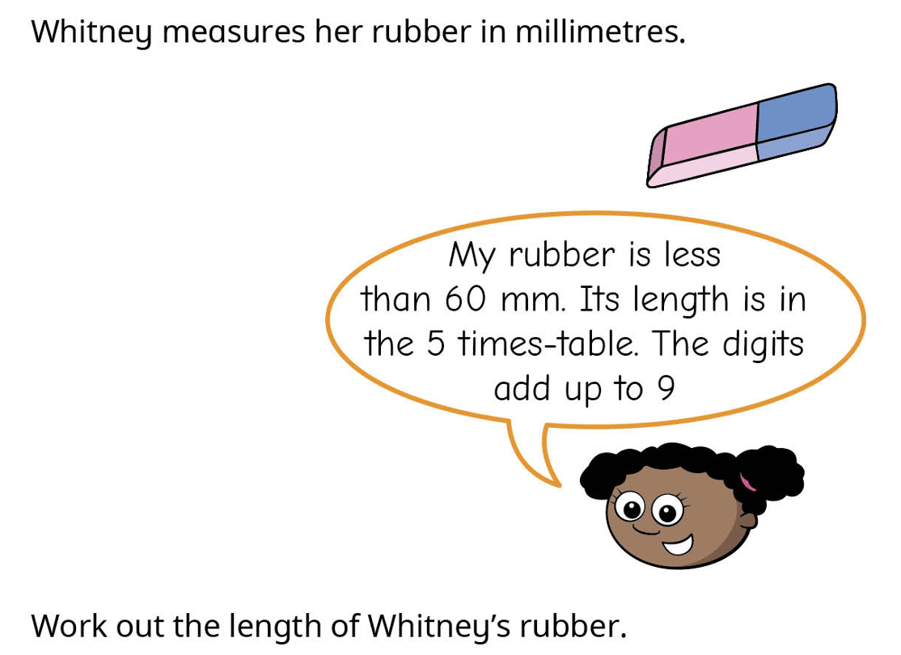
Problem?
What does this contribute to
Conceptual Image?
Awareness of
mathematical themes?
Development of
natural powers?
White Rose B2 length & Perimeter

Slide 8

Set Ratios
In how many different ways can 17 objects be placed in two (possibly overlapping) sets
  So that the two sets have the same number of objects
  So that set A has twice as many elements as set B?
Being Systematic
Opportunity to generalise
A
B
Unfamiliar context
Personal construction
Opportunity to pose own variation/generalisation
C
Intended for Primary
Extendible to Secondary
Three sets;
specified ratios

Slide 9
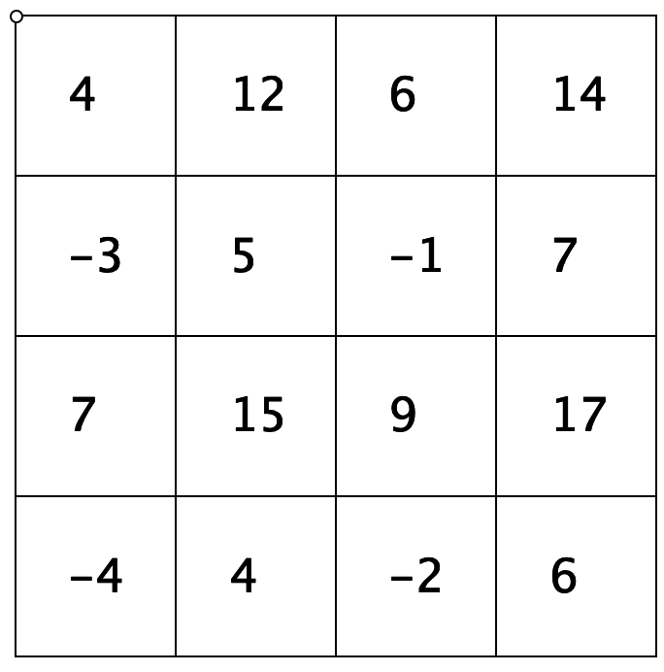
Selected Sums
Add up any four entries,
no two on the same row or column
504
512
506
514
How much freedom do you have to construct your own ‘like this’?
497
505
499
507
Place arbitrary entries in any
7 cells, no 4 forming a rectangle
then complete the grid
507
515
509
517
Following instructions
496
504
498
506
Gazing before acting
Recognising Relationships
Invariance in the midst of change
Perceiving Properties
Freedom & Constraint
Reasoning with Properties
Constructing your own
Articulating generality

Slide 10
Proizvlov
Choose 5 distinct numbers in the range 11 to 20 and write them down in a column in descending order.
In a column beside the first, write down the remaining numbers in the range 11 to 20 in ascending order.
Calculate the (absolute) differences in each row
Add these up.
Conjecture:
  Your answer is the same as mine!
20
18
15
14
11
12
13
16
17
19
8
5
1
3
8
| – | =
| – | =
| – | =
| – | =
| – | =
__
25
Unfamiliar context
confidence inspiring actions
Invariance in the midst of change
Useful action:
construct more examples
Freedom & Constraint
posed by Vyacheslav Proizvolov as a problem in the
1985 All-Union Soviet Student Olympiads (Savchev & Andreescu 2002, p. 66)

Slide 11
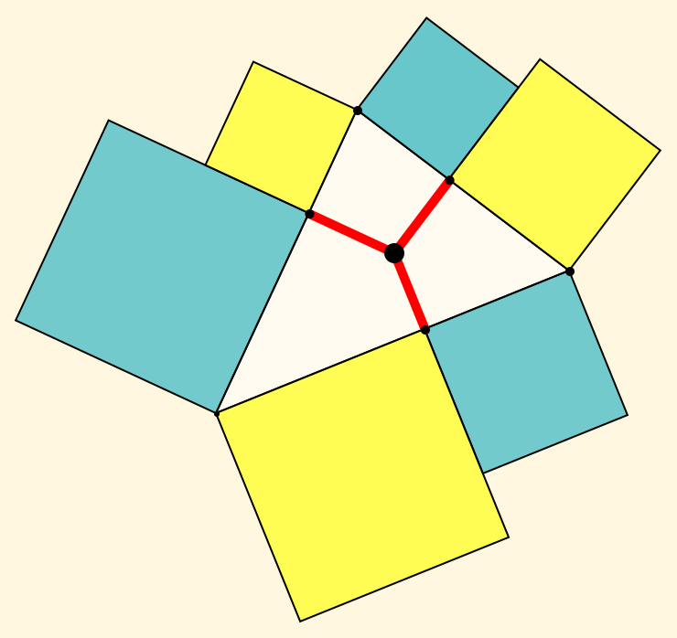
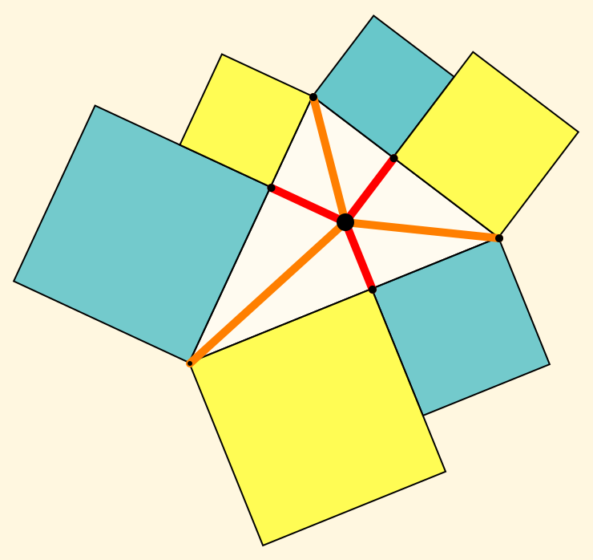
Alternating Squares
Choose any point P in the interior of a triangle.
Drop perpendiculars to the edges of the triangle.
On each of the six segments formed, erect external squares.
Why must the alternating sum
of the areas of the squares be 0?
Varying for self
(posing problems)
Familiar action;
(constructing squares)
Choose any point P in the interior of a triangle.
Drop perpendiculars to the edges of the triangle.
What is the locus of points P for which the alternating sum
of the lengths of the segments is 0?
Opportunity to specialise
(circumcentre; Incentre)
Introducing a new element
Recognising a
familiar relationship
Combinatorial principle:
Count in two different ways

Slide 12
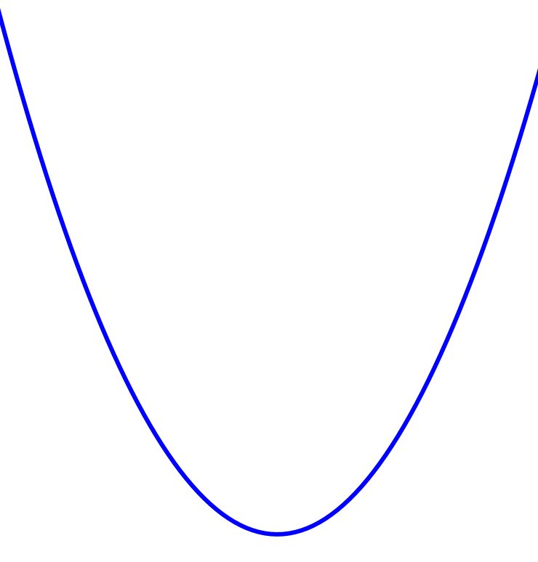
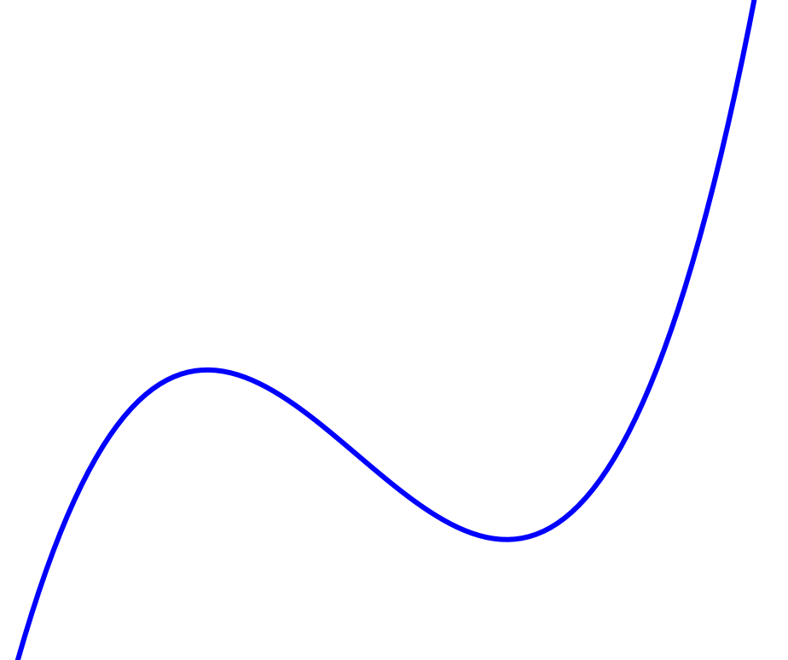
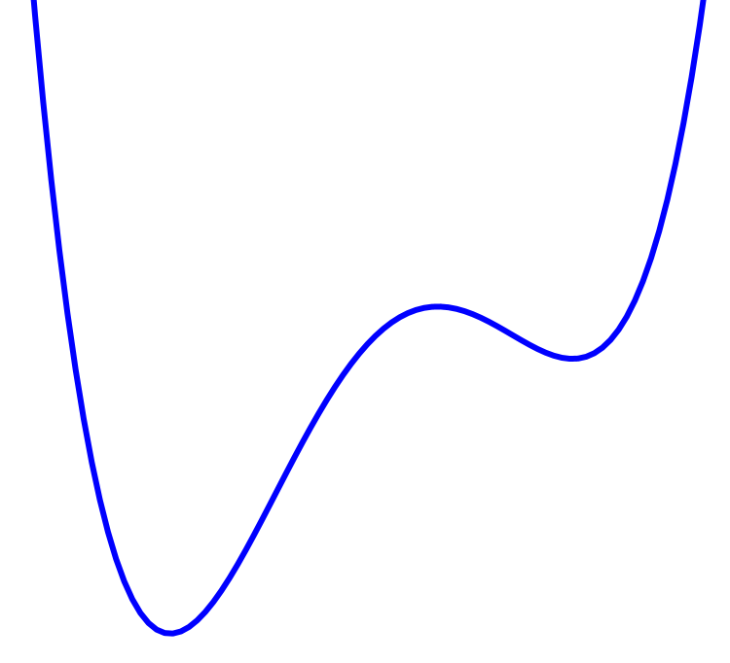
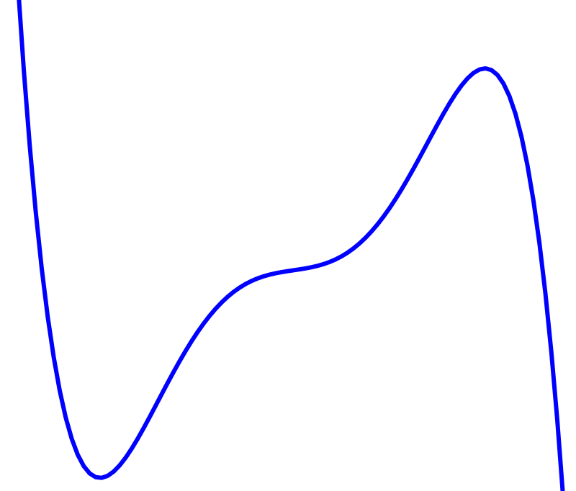
Graphs of Functions
Through what angles can the graph of a given polynomial be rotated and still be the graph of a function?
About what axes of reflection can the graph of a given polynomial be reflected and still be the graph of a function?
Using what axes and what shear factors can the graph of a given polynomial by sheared and still be the graph of a function?
Enriching concept image of the shape of graphs for large values of |x|
Personal construction of examples

Slide 13

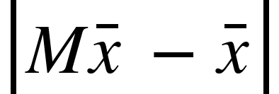
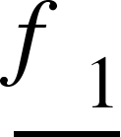
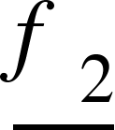
2 by 2 Matrices M
For what is a maximum or minimum?
For a given choice of new basis element
what is the locus of new basis elements
for which the matrix M of transition between bases has real eigenvalues?

Slide 14
Provocative ‘Problems’
Impossible questions
  Find the area of the right-angled triangle if its hypotenuse is 10 cm and the height dropped on the hypotenuse is 6 cm
Wrong Statements
  Show that the area of the triangle with the sides 20 cm, 10 cm and 8 cm is larger than 50 cm²
  Explain why the more decimal digits a number has, the larger is that number
6 cm
10 cm
Sangwin & Klymchuk (2020)
A new type of questions for teaching and
assessing critical thinking in mathematics

Slide 15
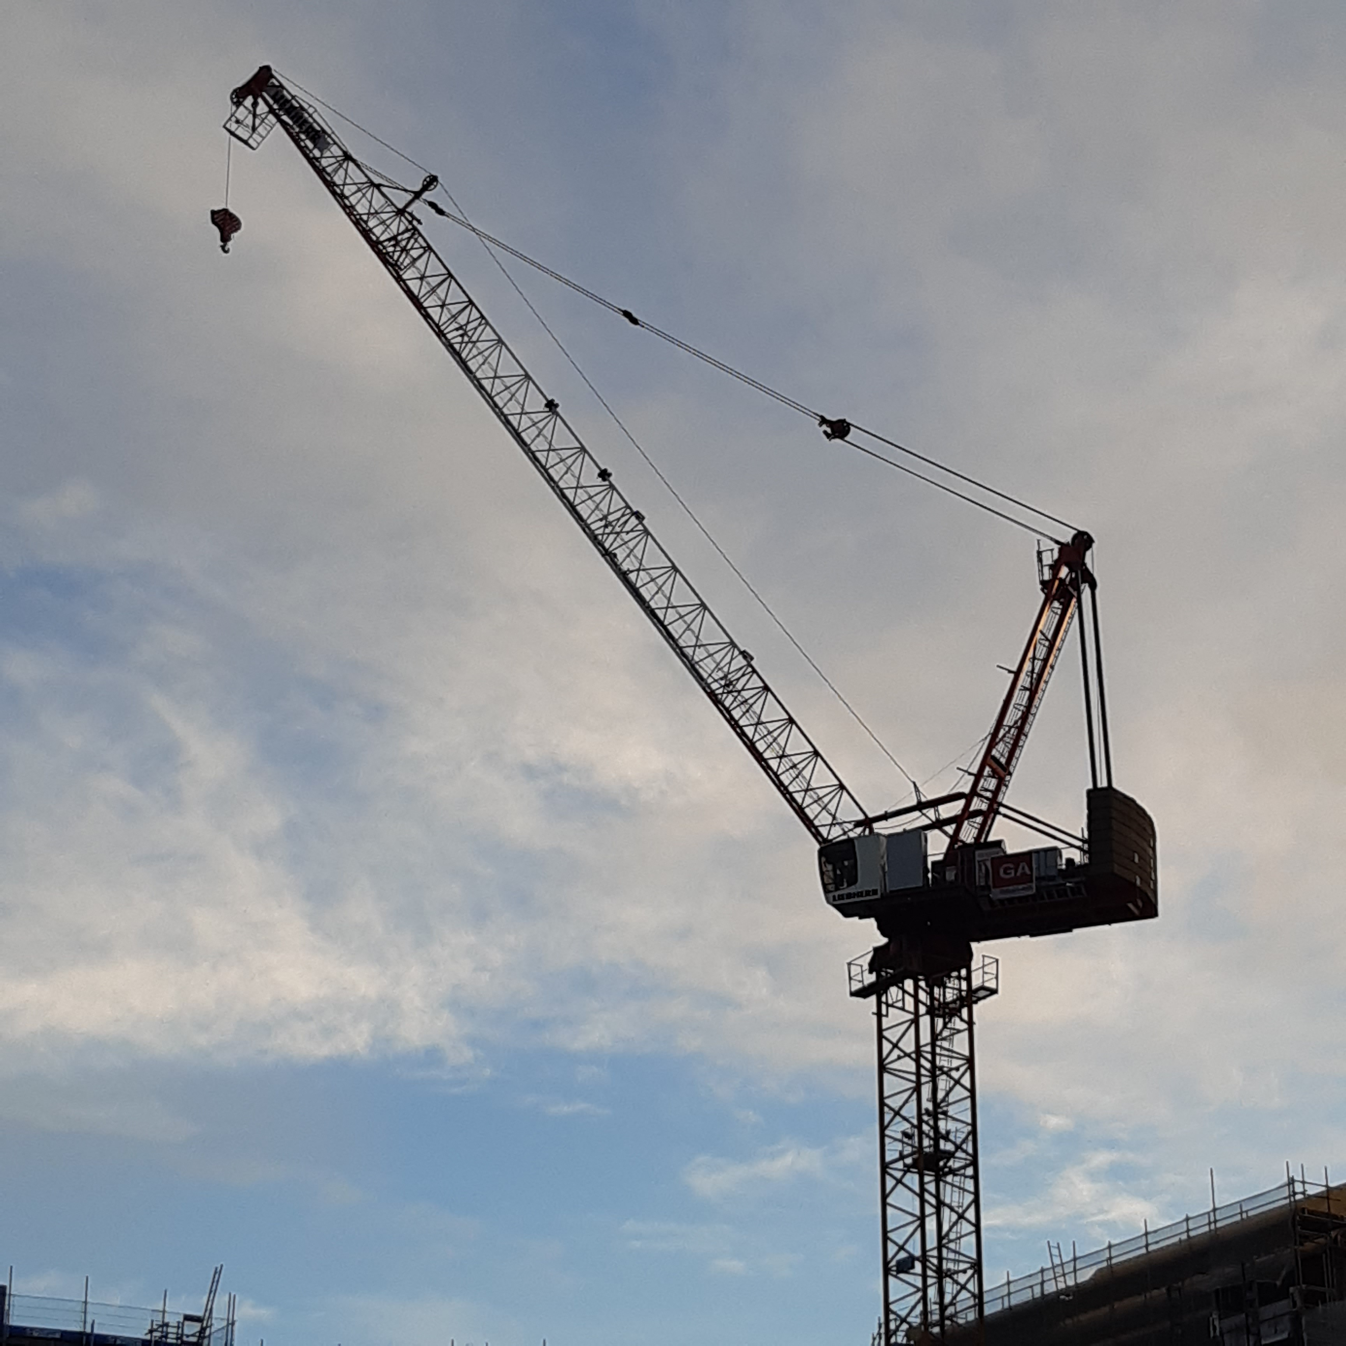
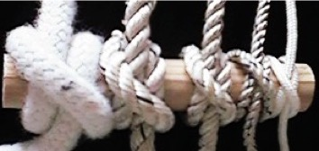
Some STEM-like Situations
Devise a measure of scrunchy-ness for a piece of paper scrunched into a ball (Malcolm Swan)
What range of weights can an overhead crane lift?
By how much is the length of a piece of rope shortened by tying a clove-hitch around a rod?
Notice the different definitenesses of the situation
USMES project
Madaleine Goutard
recommended problem posing from indefinite situations

Slide 16
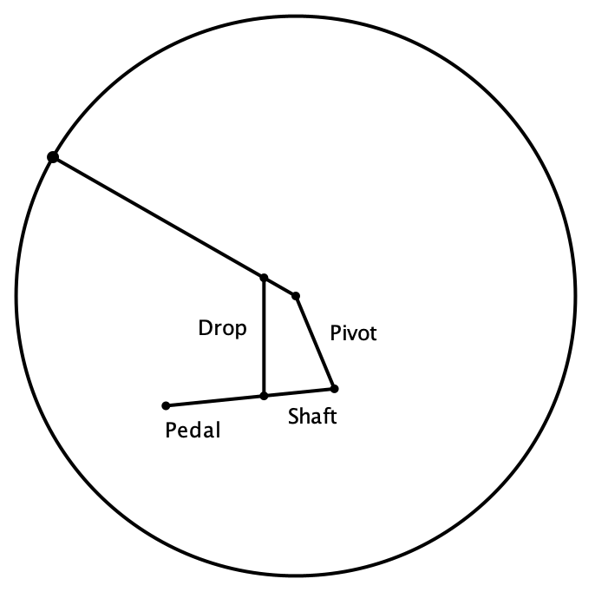
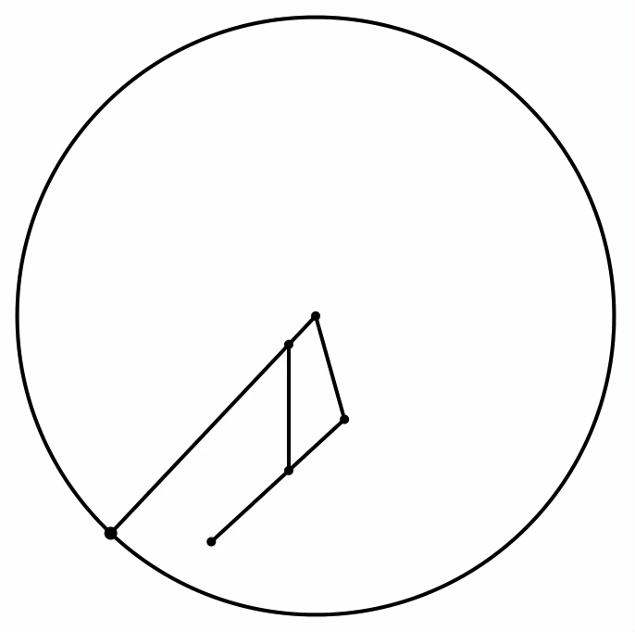
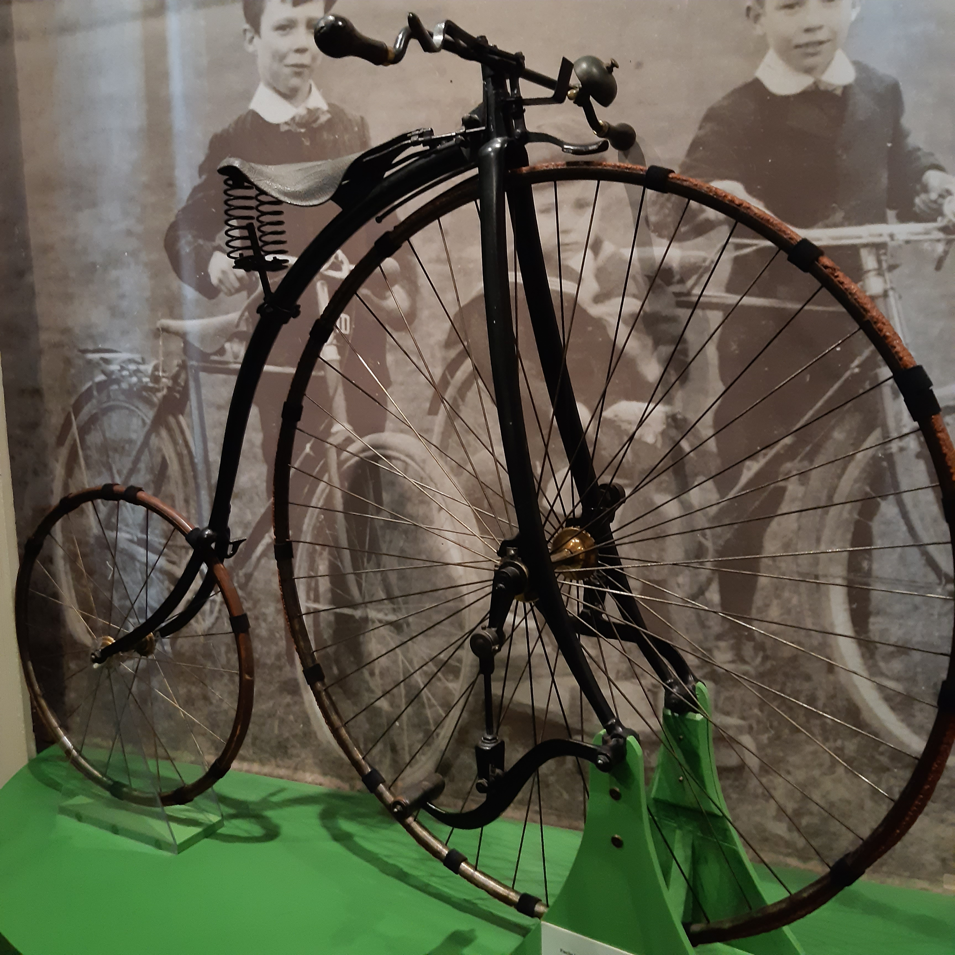
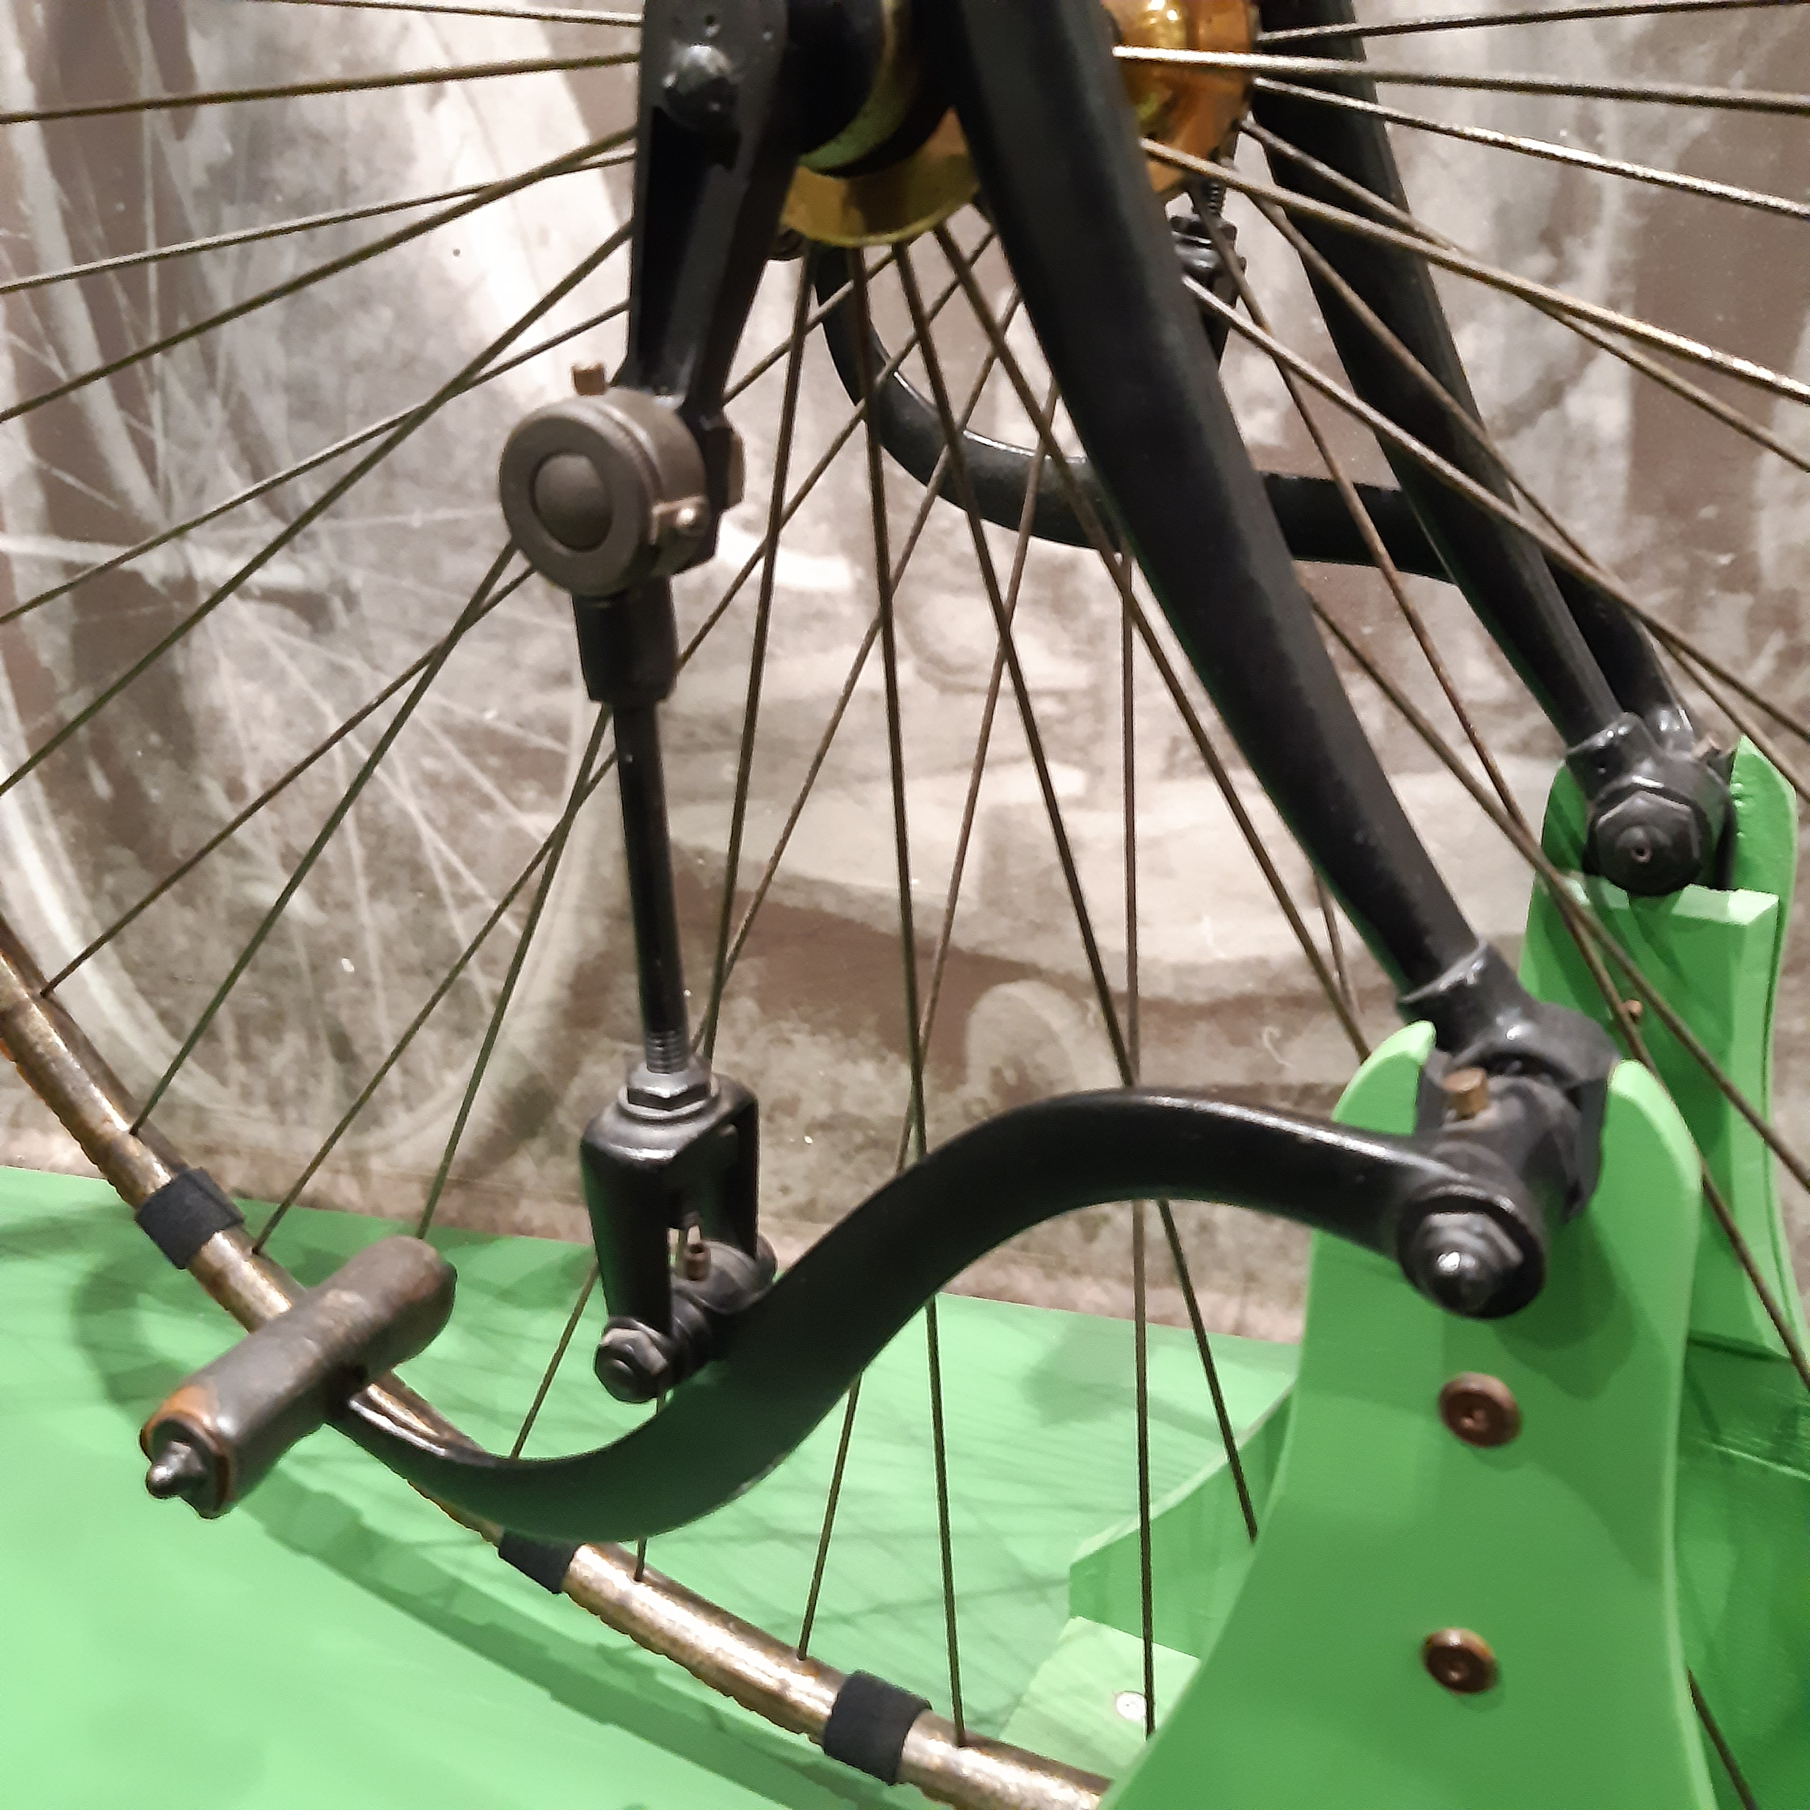
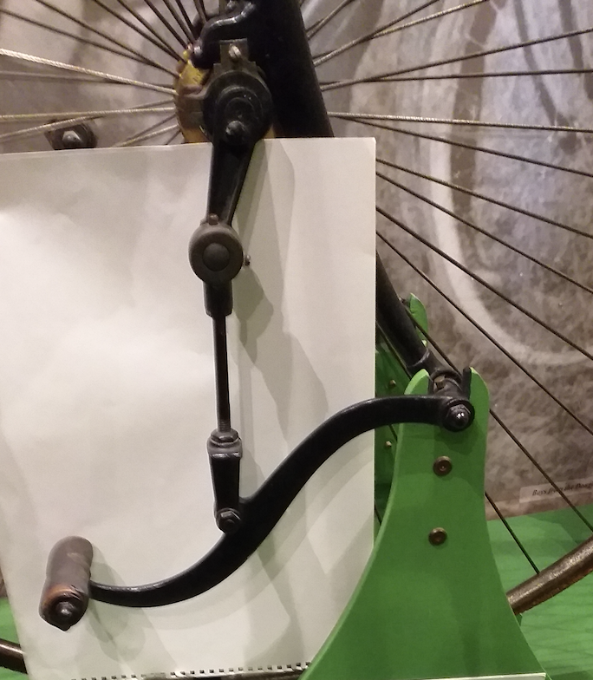
Facile Bike 1878
The 'Facile' was patented by John Beale and introduced in 1878.
Because the rider was positioned further back they were less likely to tip over the handlebars

Slide 17
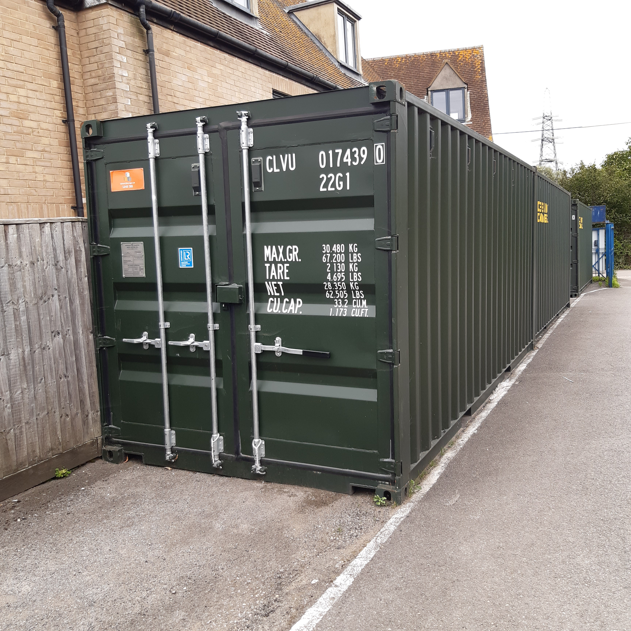
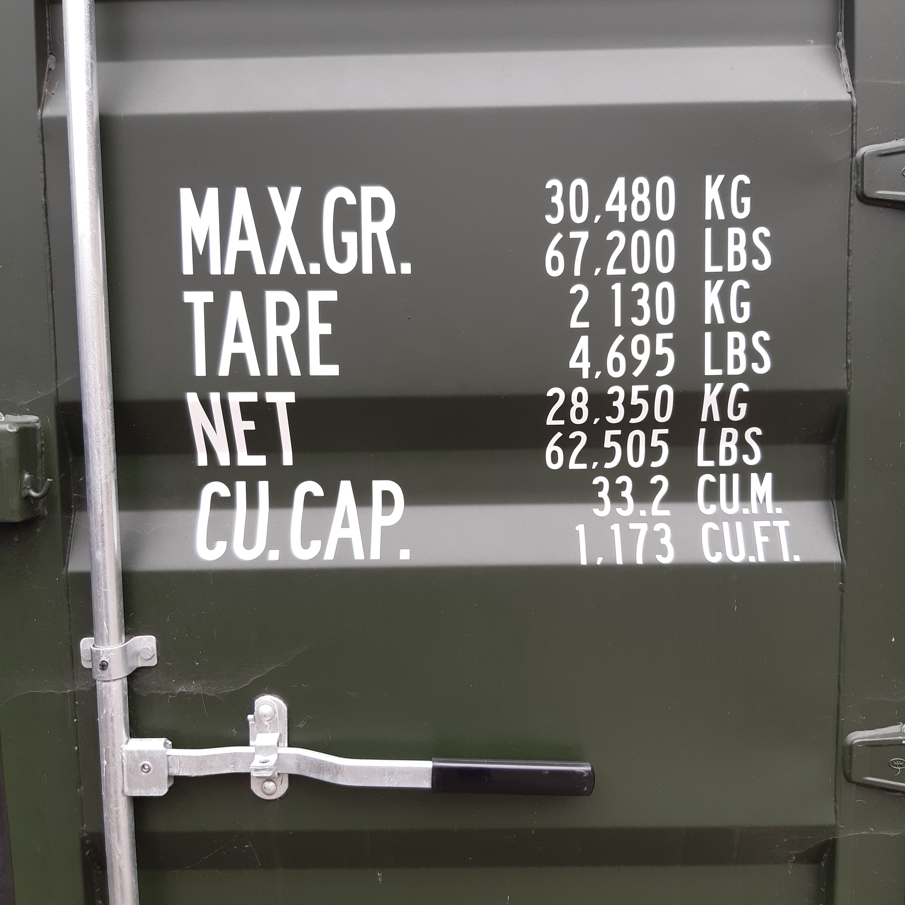
What do the numbers mean?

Slide 18
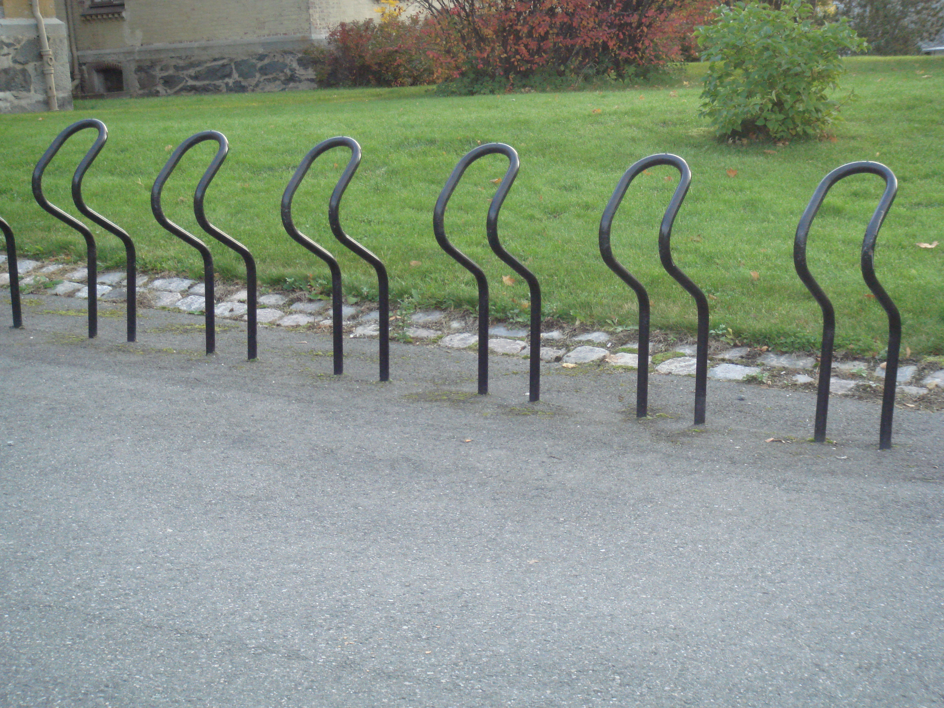

Bike Racks
Design an efficient bike rack
What mathematical concepts might be called upon?
What mathematical themes might be called upon?
What mathematical processes might be called upon?

Slide 19
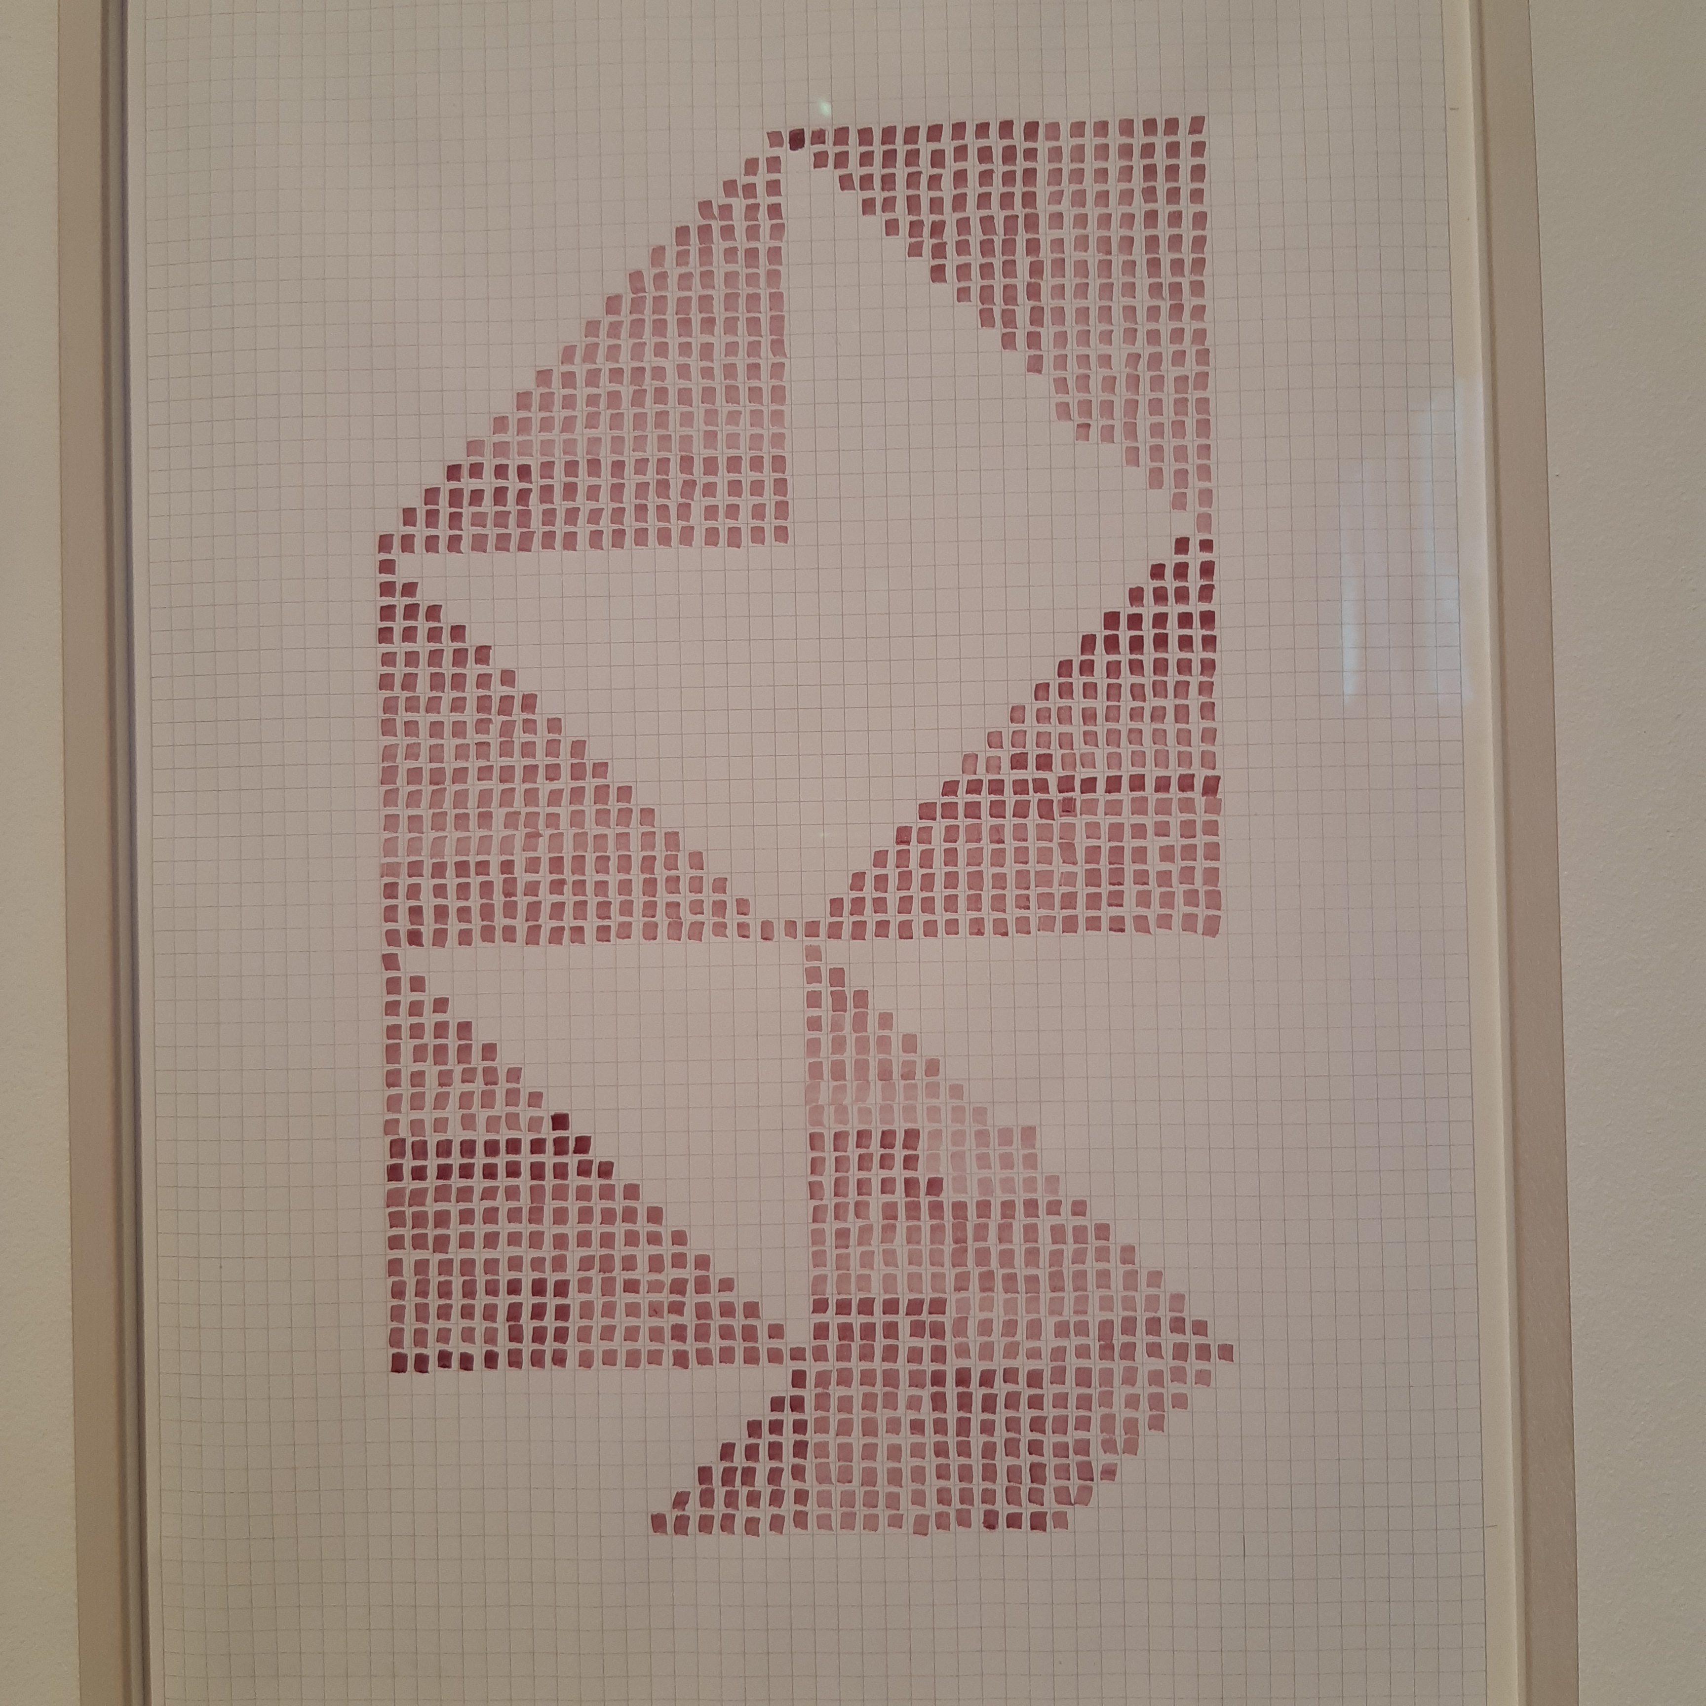
What is being attended to?
Art Gallery
Pythagoras?
Arithmetic Progressions?
Equality?

Slide 20
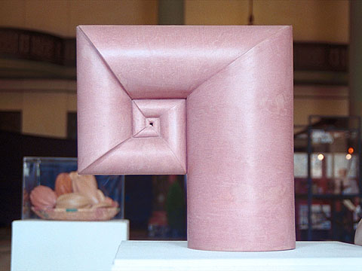
Artistic Construction
Are you asking yourself …
… what are the cross-sections of the ‘cylinders’?

Slide 21
Learning Mathematics Should Mean…
''finding one's way through problems of new sorts,
and taking responsibility for the results”
[Hassler Whitney 1907-1989]
Conjecture: every topic in school mathematics
and in university mathematics into, say, second year
can be introduced, deepened, revised and even assessed through making sense of some phenomenon
Initiating
Entry
These are NOT a programme to be followed
Exploring
Attack
They could be useful signposts as reminders of fruitful ways of attending & acting
Revising
Review
Assessing
Notes:
Rasmussen & Kwon (2002). An Enquiry-Oriented Approach to Mathematics Education. J of Math’l Behavior 26 p189-194.

Slide 22
Request from Prof Mayra Amaya
The resolution of problems from the phases that you and co-authors propose (approach, attack and review), has made it easier for us to understand many processes.
As a mathematics educator one tries to carry out these phases with some guiding questions. But I would believe that the biggest challenge that is presented to us as educators is to verify this learning for each phase in a qualitative way, that is, when analyzing the results, how can we organize them in order to demonstrate true mathematical learning, on especially when you want to teach from constructivism and working in teams.
If you could see a complete process from the theoretical that is guided by an example, it would be the best. That is, starting from how to select a problem, what questions are asked to the students in each phase and when they do not understand what is requested (what to do?). After applying the activity, how can we evaluate it from its objective and show true learning from problem solving, taking into account its achievements and difficulties.

Slide 23
Practicalities
Entry: Choosing a task
  Calls upon mathematical themes and the use of natural powers while encountering a mathematical concept (probably through example(s))
Entry: comprehending the situation
  Often by encountering, or constructing examples
  Periods of gazing, tinkering, and exploring
Attack:
  Wallis & Hilbert: comprehend example(s) thoroughly
  Use specialising to inform generalising
  Enacting mathematical actions that have become available
Review
  What worked? Why?
  Imagining using these actions in the future.
  What didn’t work?
  Posing further extensions or generalisations

Slide 24
How do You Know Learning is Taking Place?
Scaffolding (Directed – Prompted – Spontaneous)
Change of focus of Scaffolding because learners have internalised
More Efficient Learning
(Less complex topic introductions and development)
Increasingly sophisticated learner-generated questions/problems

Slide 25
Addressing Difficulties/Problems 1
What ‘problem’ is ‘teaching problem solving’ supposed to (re)solve?
  Something to do with creativity? Independence? Critical thinking?
  Engagement? Development of disposition? Decrease in dependence?
When given ‘problems to solve’, learners don’t know what to do.
  Are teachers being mathematical both with and in front of learners?
  Seeing & participating in mathematical thinking
Time it takes to experience problem solving
  Initially, perhaps …
  though scaffolded encounters with mathematical thinking can make a big difference
  Learning becomes more efficient as learners ‘Learn How To Learn’
Response determines what actions you enculturate learners into

Slide 26
Addressing Difficulties/Problems 2
The task itself is not a problem:
rather it is whether learners experience it as a
(potentially doable or interesting) problem
A person can be in a state in which something is problematic for them: when they experience surprise, consternation, or curiosity
Most likely to happen when people ask their own questions
  This requires an openness to uncertainty, to not-knowing immediately what to do
How might pertinent mathematical actions become available to enact when experiencing something as problematic?
Frequent review/reflection & pro-flection on successful actions;
and reflection on unsuccessful actions
What recent past experiences of learners have influenced them?
Classroom rubric, enculturation, habits, expectations, dispositions
Suddenly confronting learners with non-routine tasks
when all they are used to is routine exercises
is bound to be ‘problematic’
Inducting learners into mathematical thinking habits by
Being Mathematical with and in front of learners

Slide 27
Addressing Difficulties/Problems 3
Developing a positive & trusting working relationship with teacher and text
  MAA Focus Dec 2023-Jan 2024; DeVito 2006; Handa 2011
Focus on STEM based tasks for motivation
is likely to dilute mathematics, often reducing it to arithmetic
  Mathematical Modelling is a constituent of Mathematical Problem Solving
  Choosing tasks with the potential for exposing learners to
    Problem Posing for themselves
    Mathematical Themes
    Mathematical Powers
Invariance in the Midst of Change
Doing & Undoing
Freedom & Constraint
Restricting & Extending
Imagining & Expressing
Specialising & Generalising
Conjecturing & Convincing
Organising & CLassifying

Slide 28
Assent-Assert
Do your students sit there and nod, as if assenting to what they are told?
Do your students make conjectures (assert)?
Do they try to validate and justify conjectures?

Slide 29
Spondent Teaching
Re-sponding to students in real time or soon thereafter
  Listening-to not listening-for
  Entering-in as well as Dragging-in
  Experiencing parallel struggles as a re-minder for oneself
Re-sponsible as a teacher … able to justify choices
  of topics,
  of tasks,
  of modes of interaction with students

Slide 30
Engaging the whole Psyche
Problem posing (exercising curiosity)
Disposition to Think Mathematically
Asking why
Seeking connections

Slide 31
Thinking Mathematically (Mathematical Thinking)
Overly specific lists of actions (dos and don’ts)
Underly specific: general and abstract sentiments
Investigation by Skelton & Watson (2023):
  How would (could) you find the volume of a lump of plasticene?
  Notice what actions you considered or contemplated or undertook
  Consider how these might be encouraged and developed with learners
Parallel to process leading to
Mason et al
Thinking Mathematically
Novice teachers evinced
Importance of
Descriptions
NOT prescriptions
negative emotions
(unfamiliarity with ‘problem’)
Lived experience of
classroom culture
positive emotions
(‘something to manipulate’)

Slide 32
What If Not?
Stephen Brown & Marion Walter

Slide 33
Pressures
To ensure learners can perform procedures on tests
To equip learners to be flexible in a changing world
Especially in STEM subjects
To engage and enthuse learners concerning mathematical thinking
Ineffective Strategies
Training behaviour by frequent rehearsal of procedures
Watering down mathematical content to arithmetic and perhaps a few other basic procedures
Dropping learners into unexpected unfamiliar tasks

Slide 34
Main Points
Assent-Assert
Responsive Teaching & Responsible Teaching
Mathematics as a Creative Enterprise
Guided Re-Invention (Freudenthal)
Inside Mathematics Itself
  Testing conditions; seeking counter-examples
  Constructing examples (developing tools for tinkering)
Outside Mathematics Itself
  Modelling
  Questioning stance towards world (curiosity)

Slide 35
Research 1
Problem Posing
  4 Phases: orientation, connection, generation, and reflection
  Parallel to Pólya’s 4 phases: understand, plan, execute, look back
    Cai & Rott (2024)
  the most important thing was not the solution of a problem but the way of posing it. Instead of requiring that the child shall solve problems, mathematical education ought to stimulate them to ask themself questions (clearly more is envisaged than the writing out in their own words of little stories on a familiar theme: instead what is contemplated is a reversal of what is usually done).
  The need to give children a sense of problem arises because we need creative mathematicians and not only people who know mathematics and can express clearly what they know. Suppose that, instead of having them set for him, the child himself meets, invents and constructs his own problems!
  we must start with indefinite situations (for such is the reality in which they live). If in such a situation it is the size or number of objects that must be considered, the problem becomes mathematics.

Slide 36
Research 2
Inquiry Pedagogy: sufficient time required for exploration
  Radišić & Jošić (2015)
Importance of Questioning
  Menezes, Guerreiro, Martinho & Ferreira (2013)
Appropriating Practice
  Gruver & Hawthorne (2023). Classroom interactions that shape the nature of students’ appropriation of a complex mathematical practice. JMB

Slide 37
Follow-Up
PMTheta.com
John.mason@open.ac.uk

