Slide 1



What can vary and what stays the same?
Insights into mathematics teaching methods based on variation
University of Oxford
Dept of Education
The Open University
Maths Dept
Promoting Mathematical Thinking
Anne Watson & John Mason
MAST cohort 8
Edge Hill Ormskirk June 2017

Slide 2
Ways of Working
We work through lived experience:
ours and yours
We offer tasks for you,
to work on with colleagues

Slide 3
Plan for this workshop
Direct experience of the use of variation in thinking about measure
Variation principles and more examples
Planning variation and invariance
From pattern spotting to recognising relationships

Slide 4
Measuring Length
You have been given a paper strip
Please measure the length of the strip using various rods and record the measurement in the table provided

Slide 5
Colour of rod | Number of rods | L = length of (colour) rod x (number)

Slide 6
Colour of rod | Number of rods | L = length of (colour) rod x (number)
pink | 9 | L = length of pink x 9

Slide 7
Colour of rod | Number of rods | L = length of (colour) rod x (number)
white
red
light green
pink
yellow
dark green
black
brown
blue
orange
What relationships can be detected?
Notes:
Recognising relationships

Slide 8
Further Variation
What if
  the line was 72 units?
  the line was 18 units?
  the line was 144 units?
  the line was 12 units?
What if
  the white rod represents 1m?
  the yellow rod represents 1m?
  …
Notes:
Order
Format
Easy/hard
Most useful set of rods to measure the line?
Knowing more about the numbers if the line is 36 units long

Slide 9
Variation Principles
Swedish:
We notice a feature that varies against a background of invariance
What is available to be learned (about)
is what has been varied
Our variation:
We may notice what is constant within a varying context

Slide 10
Notes:
Also the role of diagram, visual effects, (e.g. the simultaneous graphs) interplay of variation with invariance

Slide 11
Find a number half way between:
28 and 34
2.8 and 3.4
38 and 44
-34 and -28
9028 and 9034
.0058 and .0064

Slide 12
Variation theories
Chinese:
One problem multiple methods of solution (OPMS)
One problem multiple changes (OPMC)
Multiple problems one solution method (MPOS)
(Procedural and conceptual)
(Static and dynamic)

Slide 13
Analysing variation and invariance in the task
Variation
Invariance
measuring unit
exact or not exact length of line given in units < cms.
- length of line given in units > cms.
actual length of line
measuring method, repeated units
format for results
format for number sentence

Slide 14
Considerations
Intended / enacted / lived object of learning
  Author intentions
  Teacher intentions
  Learner experience
Didactic Transposition
Expert awareness
is transformed into
instruction in behaviour
Task
  Author intentions
  Teacher intentions
  As presented
  As interpreted by learners
  What learners actually attempt
  What learners actually do
  What learners experience and internalise

Slide 15
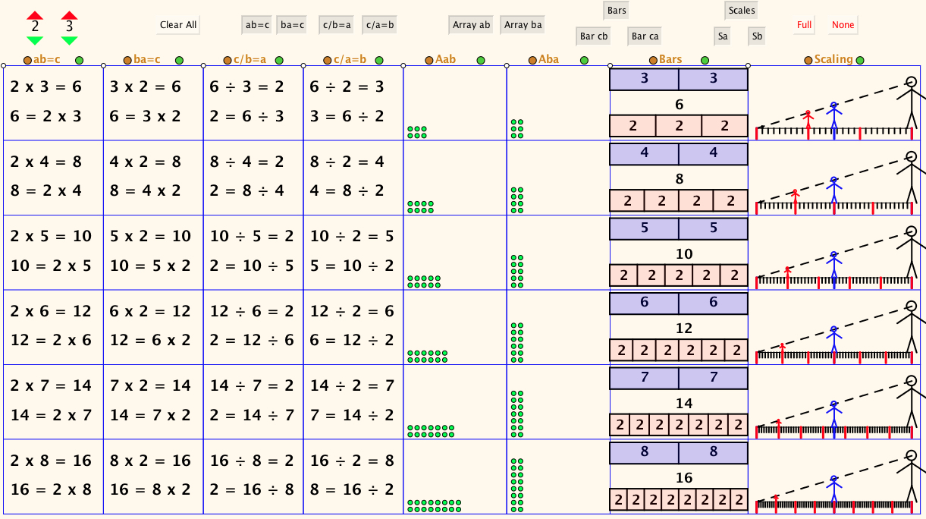
The Drakensberg Grid

Slide 16
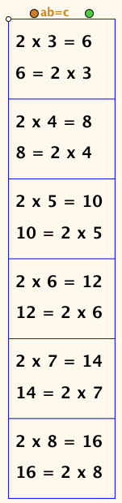
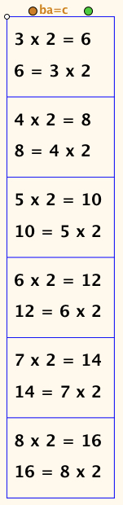
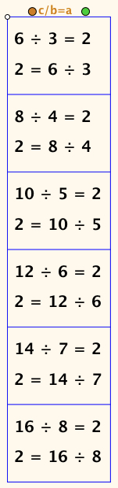
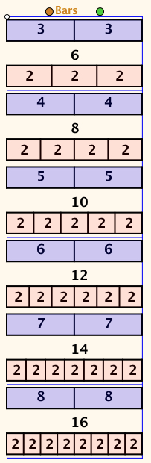
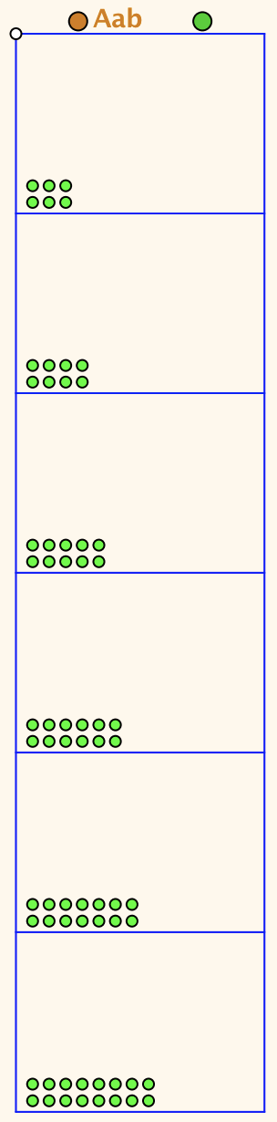
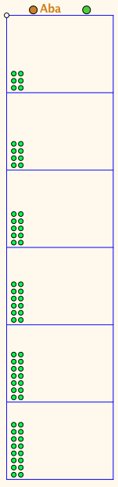
Selected Columns
Notes:
(I) full grid fully filled
(ii) first column fully filled
(iii) first two columns fully filled
(iv) first column, third column and bars fully filled
(v) first column, third column and bars first row only
(vi) all entries in, say, row 5 displayed together
(vii) full grid fully filled

Slide 17
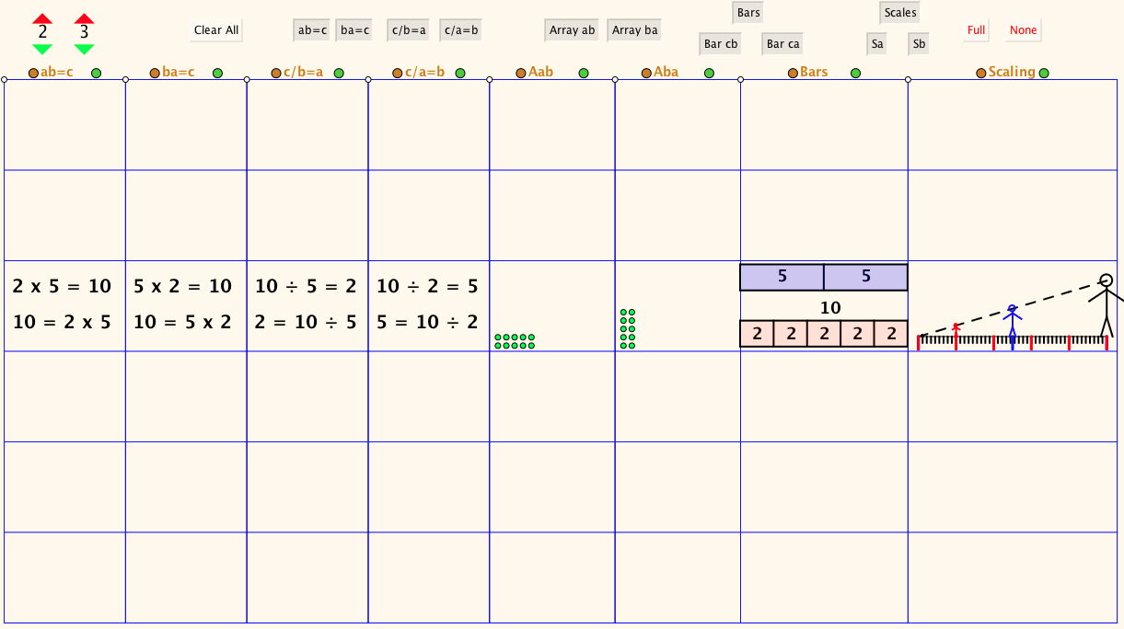
Selected Row

Slide 18
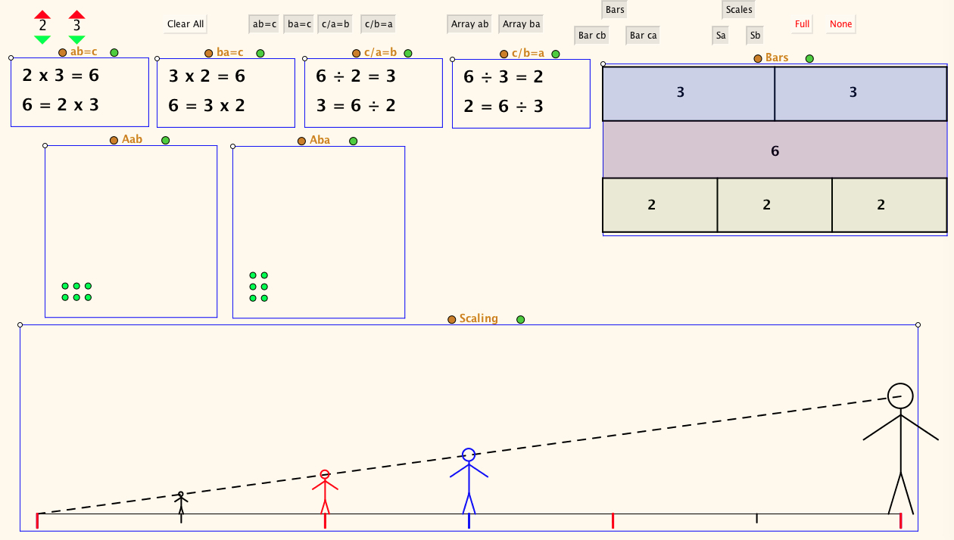
Single row expanded

Slide 19
Giant

Slide 20
Role of formatting to draw attention to variation and invariance
object | g | ÷ | h | = | r |  | g | ÷ | r | = | h |  | h | x | r | = | g
shoelace
bus pass width
footprint

Slide 21
Reflection
Intended enacted lived object of learning
Use of variation to bring lived object of learning and intended object of learning together

Slide 22
Reflection on the effects of variation on you
What struck you during this session?
What for you were the main points to think about (cognition)?
What upset you or got you going (affect)?
What actions might you want to use in your teaching and talk about with others (awareness) ?
Notes:
Chi et al

Slide 23
Availability of variation/invariant relation
Visual, available without teacher direction
Visual, available with teacher direction
Visual or non-visual and independent of prior knowledge
Visual or non-visual but dependent on prior knowledge
Dependent on prior knowledge and teacher direction and choice

Slide 24
Does Variation Principle (VP) bring something to maths that cannot be seen already?
Maths is about variation/invariance
VP gives focus, language, structure
VP commits you to analysing and constructing variation as a professional tool
Experiential, no need for ‘black box’ e.g neuroscience; laboratory studies

Slide 25
Role in English policy and practice
Shanghai
NCETM training and videos
Textbook design
Professional training and development
The next big thing…......? ☹

Slide 26
Variation used in teaching
Be clear about the intended concept to be learned, and work out how it can be experienced through varied examples
Matching up varied representations of the same example helps learning
The intended object of learning is often an abstract relationship that can only be experienced through examples
When a change in one variable causes a change in another, learners need several well-organised examples and reflection to ‘see’ relation and structure
Variation of appropriate dimensions can sometimes be directly visible, such as through geometry or through page layout
Draw attention to connections, similarities and differences
Use deep understanding of the underlying mathematical principles

Slide 27
Follow-Up
PMTheta.com
Thinkers (ATM)
Questions & Prompts for Mathematical Thinking (Primary) (ATM)

