Slide 1
Nature of Mathematics as a Human Endeavour
The Open University
Maths Dept
University of Oxford
Dept of Education
Promoting Mathematical Thinking
Oxford N1A
§2 2019

Slide 2
Outline
Phenomena provoking mathematical thinking
Material world; Imagined & Virtual world; Symbolic world
Ways of Working on Mathematics
Use of Powers/Processes
Mathematical Themes
Shifts of Attention

Slide 3
Conjecturing Atmosphere
Everything said in this room is a conjecture …
To be tested out in your experience
To be tested mathematically
To be modified as necessary
If you KNOW immediately, take the opportunity to focus on what you know, or ask questions that might assist others to see what you see
If you are uncertain or stuck, take the opportunity to try to express what you do comprehend, or to ask about what you do not!

Slide 4
Pundits from the Past
A teacher who is not always thinking about solving problems – ones (s)he does not know the answer to – is psychologically simply not prepared to teach problem solving to students. [Halmos 1985 p322]
Moreover a mathematical problem should be difficult in order to entice us, yet not completely inaccessible, lest it mock at our efforts. It should be to us a guide post on the mazy paths to hidden truths, and ultimately a reminder of our pleasure in the successful solution. [Hilbert 1900]
Moreover, I wish to observe learning processes to improve my understanding of mathematics. (Freudenthal, 1978).

Slide 5
One More Than …
What numbers can be expressed as one more than the product of four consecutive integers?
What did you do …
… that was successful?
Notes:
Paying attention to the actions that become available to you (relevant to assignment)
Use of powers; mathematical themes

Slide 6
Use of Powers
Imagining & Expressing
Specialising & Generalising
Conjecturing & Convincing
Gazing (holding wholes)
Discerning Details
Recognising Relationships
Perceiving Powers (being instantiated)
Recognising Invariants
Doing & Undoing
Freedom & Constraint

Slide 7
Reminder
Being Stuck is an honourable and valuable state
It is then possible to learn something of advantage for the future
What matters is not so much ‘being stuck’ as what you do to get unstuck
You get the most from working on a problem/task when you stop, withdraw from the action, and think back over …
what were the key ideas
what actions you undertook
what actions were effective
what actions you might use in the future.
Tell yourself a mathematical ‘story’ of the result

Slide 8
Good Advice …
"The best way of overcoming a difficult Probleme is to solve it in some particular easy cases. This gives much light into the general solution. By this way Sir Isaac Newton says he overcame the most difficult things.” (David Gregory 1705 correspondence)
“The art of doing mathematics consists in finding that special case which contains all the germs of generality.” (David Hilbert quoted by Courant)
Specialising & Generalising

Slide 9
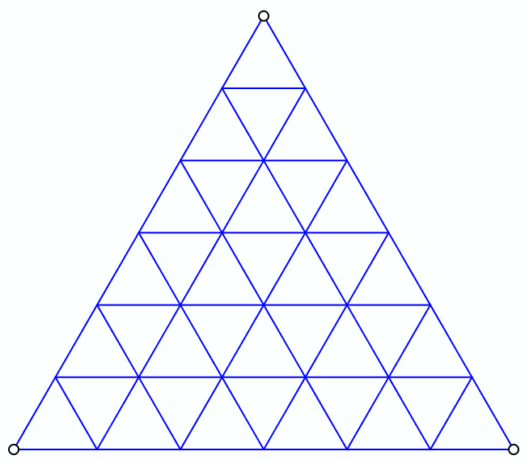
Triangular Division
How many triangles?

Slide 10
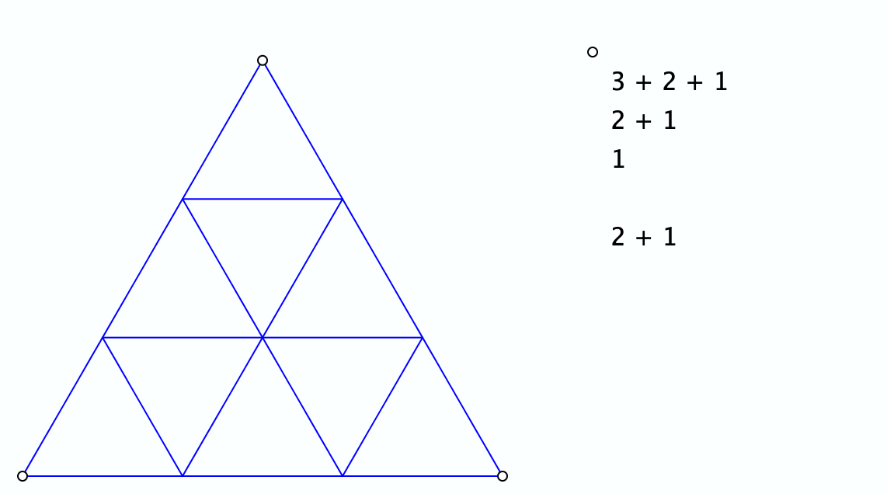
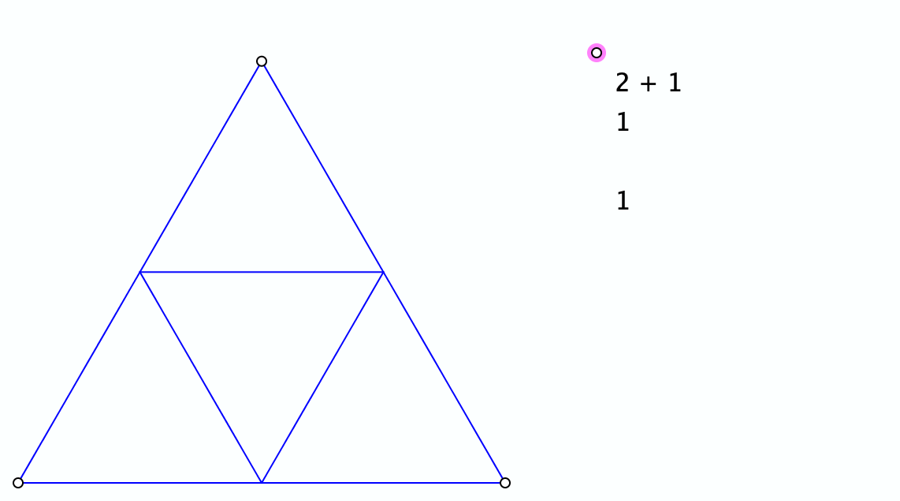
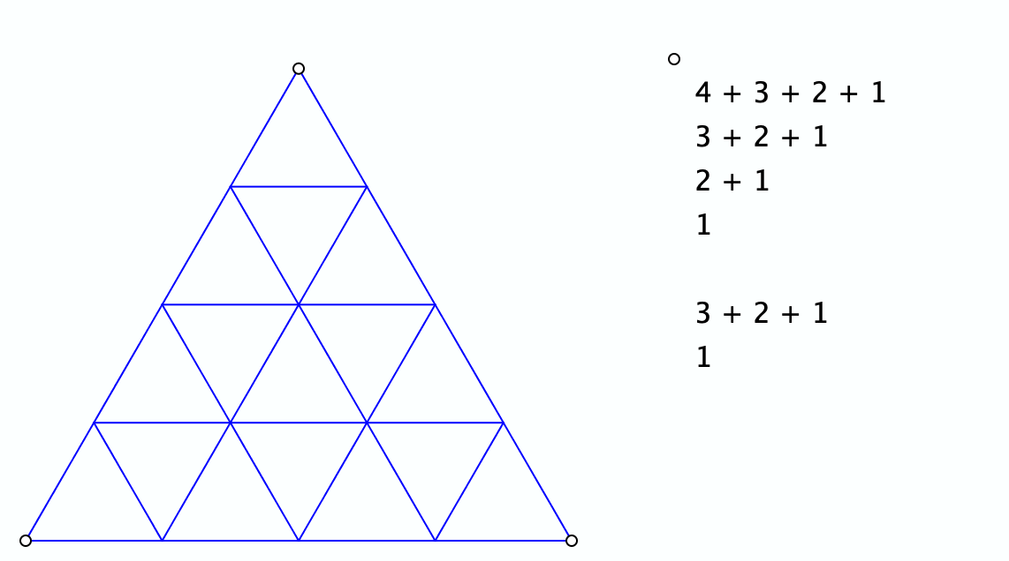
Triangular Divisions
Specialising

Slide 11
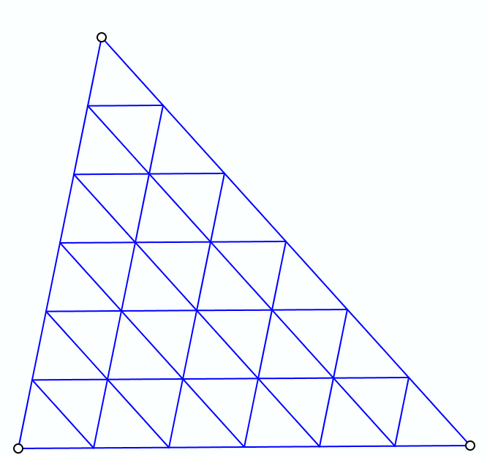
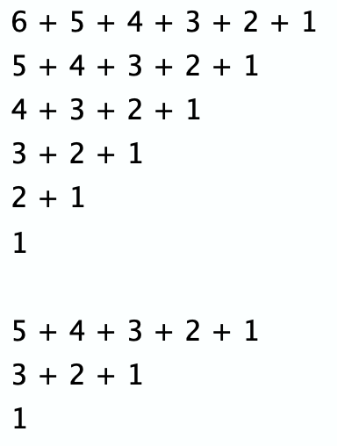
Triangular Division
Generalising & Extending
Three dimensions ?
Or more ?

Slide 12
Divisible Differences
17
18
19
20
21
22
23
24
25
10
11
12
13
14
15
16
What is the nth term of the central sequence?
5
6
7
8
9
2
3
4
1
…
n² – n + 1
1, 3, 7, 13, 21, 31, 43, 57, 73, 91, 111, 133, 157, 183, 211, 241, 273, 307, 343, …
2, 4, 6, 8, 10, 12, 14, 16, 18, 20, 22, 24, 26, 28, 30, 32, 34, 36, …
2, 2, 2, 2, 2, 2, 2, 2, 2, 2, 2, 2, 2, 2, 2, 2, 2,
Perceiving Potential Generality
Expressing Generality
Generalise further

Slide 13
Count Down
We are going to count together,
starting at 101
counting down in steps of 1 & 1/10.
Are you ready?
It occurs to me that someone else might be counting up, starting at say 2, in steps of say 7/10.
What is going to happen if we all chant together?
Both counters will at some point cross over.
But will we ever all say the same number at the same time?
What numbers will we both say but at different times?

Slide 14
Generalised Count Down
Some people start at S and count down in steps of s
Others start at T and count up in steps of t.
Under what conditions will they say the same number at the same time?
What numbers will they both say (not necessarily at the same time)?
S - ns = T + nt
n = (S – T)/(s+t)
So for what starting values must the up-counters with steps of 7/10 use so as to coincide at some point with the down counters starting at 101 with steps of 1 & 1/10?
101 – T has to be divisible by 9
Notes:
S-ns = T+mt so m = ((S-T)-ns)/t
S-Ns =T + Mt so (N-n)s = (m-M)t so common numbers differ by a multiple of t/(s,t)

Slide 15
What will happen?
1x9 + 2 = 11
12x9 + 3 = 111
123x9 + 4 = 1 111
1234x9 + 5 = 11 111
12345x9 + 6 = 111 111
123456x9 + 7 = 1 111 111
1234567x9 + 8 = 11 111 111
12345678x9 + 9 = 111 111 111
123456789x9 + 10 = 1 111 111 111
1234567900x9 + 11 = 11 111 111 111
123456789(10)x9 + 11 = 11 111 111 111
Notes:
Conjecturing & extending

Slide 16
Rational or Irrational?
0.1234567891011121314151617…
0.123456789
10
11
12
13
14
…
0.123456790123456790…

Slide 17
Fibonacci Decimal
0, 1, 1, 2, 3, 5, 8, 13, 21, 34, 55, 89, 144, …
.0112358
13
21
34
55
…
.01123595505617977528089887640449438202247191
= 1/89

Slide 18
Belted

Slide 19
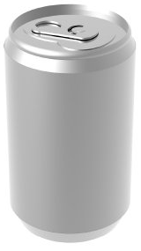
Canned Phenomenon
Imagine a drinks can
Where is the centre of gravity before it is opened?
Where is the centre of gravity when it is empty?
Where is the centre of gravity lowest?

Slide 20
Tennis Ball
Imagine a tennis ball. It has a seam
What is the shape of the seam, and why?
If you roll a tennis ball along its seam, where will it end up?
What is the family of curves on the plane such that
If you roll a ball along the curve, the ‘north pole’ ends up pointing north?
If you roll a ball along the curve then a flag at the ‘north pole’ ends up pointing the same way at the north pole?

Slide 21
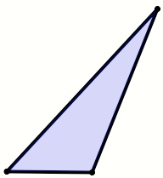
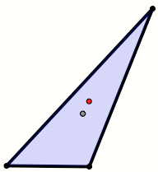
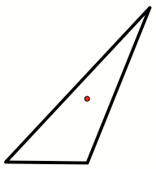
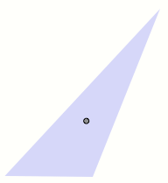
Centres of Gravity
Imagine a triangle
Where is the centre of gravity?
Vertices
Edges
Lamina
Notes:
For any N is there a polygon such that the polygon falls over when placed on any but two of its edges?

Slide 22
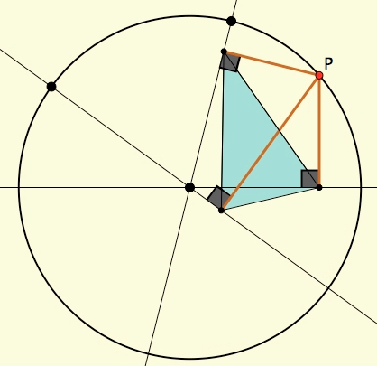
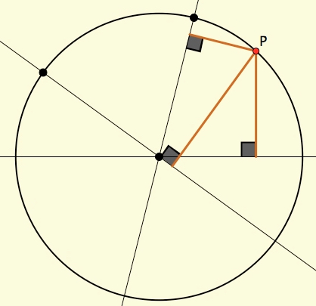
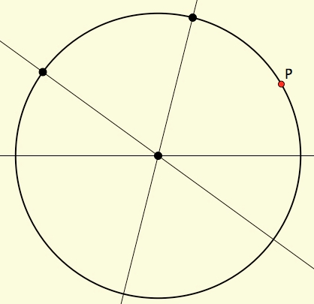
Rolling Polygons
Imagine a circle
Imagine a point P on the circle, moving around it
Imagine three lines each through the centre
From P, drop perpendiculars onto your three lines
As P moves, track the triangle formed by the feet of the perpendiculars

Slide 23
Rolling Polygons

Slide 24
Added Triangles

Slide 25
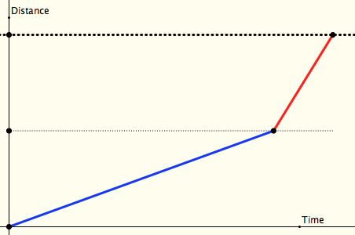
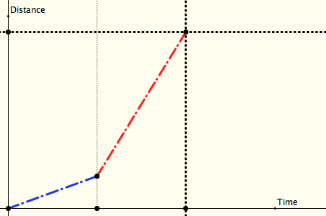
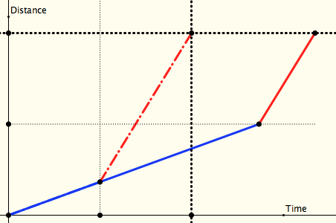
Half-Way, Half-Time
Peter Liljedahl
On two different occasions I make the same journey, each time travelling at two different speeds for two parts:
I travel half the distance at one speed, and half at the other
I travel half the time at one speed and half the time at the other
Which journey is shortest, or does it depend on the relative speeds?
distance
time
Notes:
Now recast in terms of other situations in which one thing varies directly and another inversely

Slide 26
Ride & Tie
Two scouts with heavy rucksacks have to complete 1 24km route along a moorland trail in less than 3½ hours
One scout can manage 6 km/hr; the other only 4 km/hr. However, they also have a single off-road bike which either of them can ride at 12 km/hr. They calculate that if one of them rides the bike for twice as long as the other (leaving the bike beside the path) they can arrive at the same acceptable time.
How long do they take?
Notes:
Mathematical Pie 2019 no 208 p1657

Slide 27
Ride & Tie
Imagine that you and a friend have a single horse (bicycle) and that you both want to get to a town some distance away.
In common with folks in the 17th century, one of you sets off on the horse while the other walks. At some point the first dismounts, ties the horse and walks on. When you get to the horse you mount and ride on past your friend. Then you too tie the horse and walk on…
Supposing you both ride faster than you walk but at different speeds, how do you decide when and where to tie the horse so that you both arrive at your destination at the same time?

Slide 28
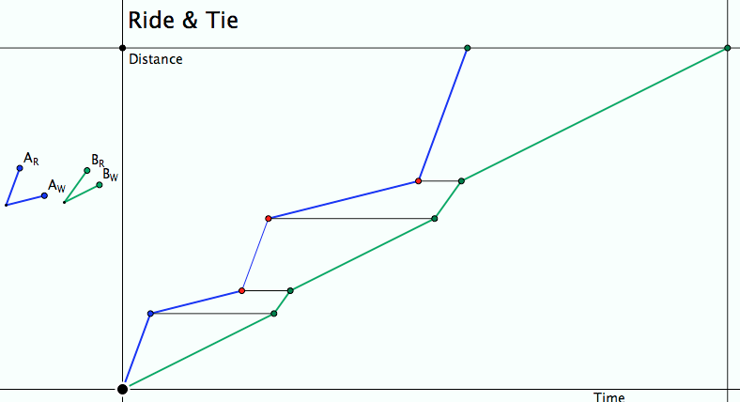
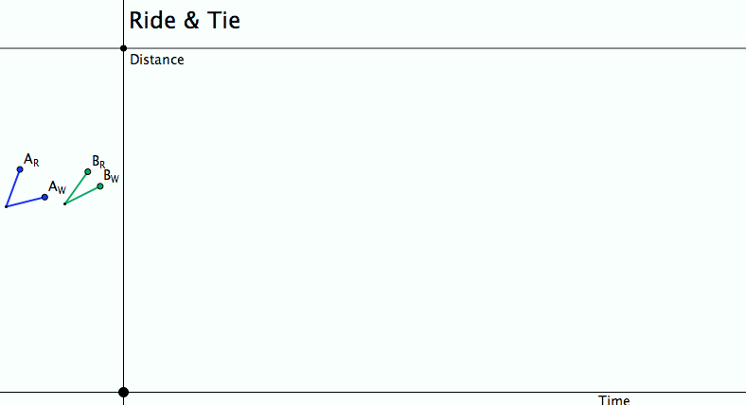
Ride & Tie
Imagine, then draw a diagram!
Seeking Relationships
Does the diagram make sense (meet the constraints)?
Notes:
Does the diagram meet the constraints?
What can be changed, what choices are there?
What relationships (does it really matter how many times the horse is swapped?)

Slide 29
Sundaram’s Sieve
16 | 27 | 38 | 49 | 60 | 71 | 82
13 | 22 | 31 | 40 | 49 | 58 | 67
10 | 17 | 24 | 31 | 38 | 45 | 52
7 | 12 | 17 | 22 | 27 | 32 | 37
4 | 7 | 10 | 13 | 16 | 19 | 22
Claim: N will appear in the table extended to the right and up
iff 2N + 1 is composite
What number will appear in the R^{th} row and the Cth column?

Slide 30
Reflection
Mathematics as a human endeavour
A way of making sense of phenomena often brought to attention via some sort of disturbance or fractured expectation in a world of experience: material, mental-virtual, symbolic
Modelling the material world in a manipulably expressive language;
Locating underlying structural relationships
Use of natural powers:
Imagining & Expressing Specialising & Generalising
Conjecturing & Convincing Organising & Classifying
Stressing & Ignoring Extending & Restricting
Ubiquitous Mathematical Themes
Invariance in the midst of change. Doing & Undoing Freedom & Constraint

Slide 31
Where is Mathematics?
Do we discover/uncover pre-existant relationships (invariances in the midst of change)?
Do we construct mathematical relationships as part of our sense-making of our experience of material and mental worlds?
Does it ever make sense to ask for a location for mathematics?

Slide 32
Follow-Up
PMTheta.com
(goto John Mason Presentations)
john.mason@open.ac.uk
Thinking Mathematically (2010 edition)
Cuoco, A. Goldenberg, P. & Mark, J. (1996). Habits of Mind: an organizing principle for mathematics curricula. Journal of Mathematical Behavior, 15, 375-402.

