Slide 1


School Arithmetic is to Mathematics, as
Making Sounds is to Music: some pedagogically supported transitions from arithmetic to mathematics
Fields Institute
Mathematics Education Forum
Jan 2023

Slide 2
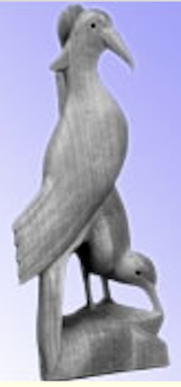
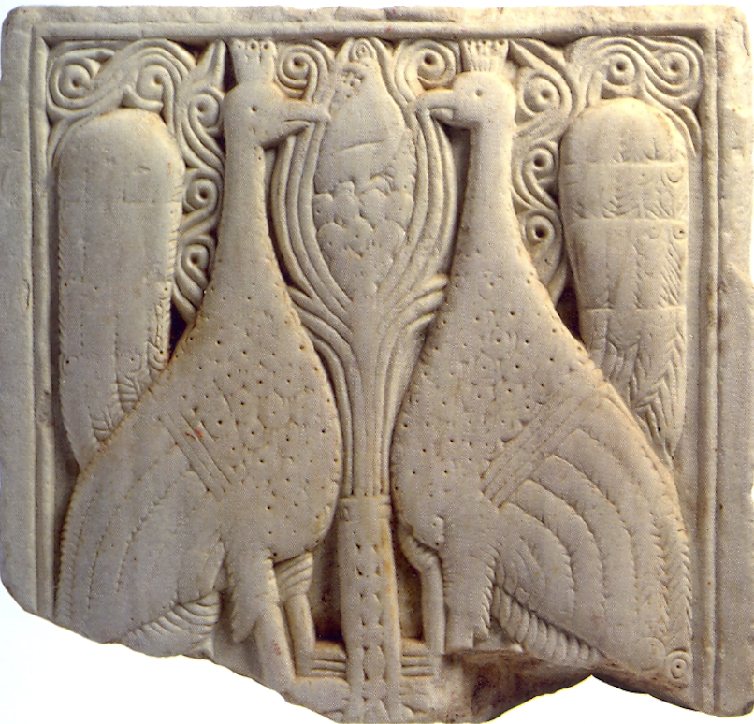
Throat Clearing
Two birds, close-yoked companions,
both clasp the self-same tree;
One eats of the sweet fruit,
the other looks on without eating
Rg Veda
Research Method
  Fundamentally Phenomenological
  I am interested in the lived experience of Thinking, Doing & Teaching Maths
  I invite you to focus on how your attention shifts its focus, and alters its form, awakening your second bird, your personal witness.
  I advocate working on mathematical problems yourself which challenge you, in order to experience what it might be like for the learners with whom you work
  Everything said today is a conjecture … to be tested in your experience

Slide 3
Outline
Analogy
  School Arithmetic is to Mathematics,
  as Making Sounds is to Music
Tracking Arithmetic
  Re-attracting algebra-refusers
Expressing Generality
  A lesson without opportunity for learners to generalise
  is NOT a mathematics lesson
  Doesn’t include generalisations such as “algebra is not for me”
Multiple Expressions of the same thing
  Manipulating Symbols for a Reason
Reflection
Trying out distinct ways of attending mathematically

Slide 4
Analogy
School Arithmetic is to Mathematics,
as Making Sounds is to Music
  I identify arithmetic with numerical computation (the four/five operations)
  Analogy is quintessentially a mathematical notion (equality of two ratios)
  Music uses sounds in sequence (tune; relationships), and in parallel (harmony; relationships between relationships). Music is the expression of relationships
Mathematics (of number and beyond) studies relationships between numbers and numerical calculations (in sequence),
and relationships between relationships (in parallel) between calculations
To study mathematics is to study
  relationships;
  relationships between relationships;
  relationships between relationships between relationships …

Slide 5
Tunes
Some Pedagogical Actions
Say What You See
Subvocal Reading
Pausing (holding silence/attention)
Parking the first action that becomes available in case a more fruitful one arises
(evident tension … how long to wait?)
Variation
Construct your own
Another & Another
Did you start calculating?
48 + 69 – 49 – 68 = ?
748 + 369 – 769 – 348 = ?
748 + 369 + 251 –761 –358 – 249 = ?
Did you read it to yourself?
Did you invoke an action not invoked in the first question?
Did you pause and look for relationships?
Articulate a generality of which these are instances.
Make up your own like it;
and another;
and another’
Holding Wholes (gazing)
Discerning Details
Recognising Relationships
Perceiving Properties as instantiated
Reasoning on the basis of agreed properties
Knowing what to attend to
Knowing how to attend to it
Marta Molina et al
Max Stephens

Slide 6
Attention Conjecture
Holding Wholes (Gazing)
Discerning Details
Recognising Relationships
Perceiving Properties as being instantiated
Reasoning on the basis of (agreed) properties
If teacher and learners are attending to different things
Or if they are attending differently
Then communication is likely to be impoverished at best

Slide 7

Think Of A Number (ThOANs)
Think of a number
Add 2
Multiply by 3
Subtract 4
Multiply by 2
Add 2
Divide by 6
Subtract the number you first thought of
Your answer is 1
and so is everyone else’s!
7
Tracking Arithmetic
based on an idea of Mary Everst Boole
(1832-1916)
7
+ 2
3 x + 6
7
7
3 x + 2
6 x + 4
7
Tracking (not absorbed)
Semiotic sign:
Personal creativity
Flexibility of symbols
Variation Principle
6 x + 6
7
7
+ 1
1
What can be varied?

Slide 8

Differing Sums of Products
Write down four numbers in a 2 by 2 grid
4
7
28 + 15 = 43
5
3
Add together the products along the rows
20 + 21 = 41
Add together the products down the columns
Calculate the difference
43 – 41 = 2
That is the ‘doing’
What is an undoing?
Now find other positive numbers
for a grid for which the result is also 2
Notes:
Mathematical context
What probaby matters most is not eh context, but whether students ‘think’ they can solve the problem!

Slide 9
Differing Sums & Products
4
7
Tracking Arithmetic
5
3
4x7 + 5x3
4x5 + 7x3
4x(7–5) + (5–7)x3
= 4x(7–5) – (7–5)x3
= (4–3) x (7–5)
So how can you choose numbers so that 2 will be the difference?
What about 6? Or any other number?
Importance of personal narrative:
bringing to articulation
Notes:
Revealing Structure by attending to relationships not calculations

Slide 10
Extended Differing Sums & Products
4
7
Take your initial grid
Add some number to both of the main diagonal entries
Subtract some number from both of the off diagonal entries
Why is the ‘result’ the same for all three grids?
5
3
9
7
5
8
9
3
1
8
Reading around the grid in both directions:
45 x 37 – 47 x 35
95 x 87 – 97 x 85
91 x 83 – 93 x 81
= 20
= 20
= 20
Notes:
Revealing Structure by attending to relationships not calculations

Slide 11
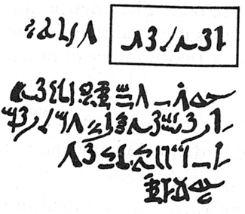
Rhind Mathematical Papyrus problem 28
Two-thirds is to be added.
One-third [of that] is to be subtracted.
There remains 10.
Solution
Make 1/10 of this,
there becomes 1.
The remainder is 9.
/10
– /10
Check
2/3 of this is to be added.
The total is 15.
1/3 of this is 5.
Lo! 5 is that which goes out,
And the remainder is 10.
+ 2/3 x
9x /10
9x /10
5/3 x 9x /10
= 3x /2
/2
The doing as it occurs!
Notes:
Problem 28 of the Rhind Mathematical Papyrus Gillings p182

Slide 12
Rhind Mathematical Papyrus problem 28
Two-thirds is to be added.
One-third [of that] is to be subtracted.
There remains 10.
Solution
Make 1/10 of this,
there becomes 1.
The remainder is 9.
/10
– /10
= 9x /10
Check
2/3 of this is to be added.
The total is 15.
1/3 of this is 5.
Lo! 5 is that which goes out,
And the remainder is 10.
+ 2/3 x
9x /10
9x /10
5/3 x 9x /10
= 3x /2
/2
The doing as it occurs!
Notes:
Problem 28 of the Rhind Mathematical Papyrus Gillings p182

Slide 13
Tracking Arithmetic as
an aid to generalisation
  Shifting from particular answer to general method
An introduction to algebra
  Gradual shift from ‘cloud’ to letter as symbol for the as-yet-unknown
Opportunity to shift from ‘doing’
(expressing generality)
To ‘undoing’: using algebra to resolve problems

Slide 14
Hexagon Surrounds
Any shifts of attention?
Any different
shifts of attention?
2 by 5 array
with hexagonal surround
3 by 4 array
with hexagonal surround
How many hexagons needed to surround an
r by c array
with hexagonal surround?

Slide 15
Hexagon Surrounds
X
??
2(c+2) + 2
2(r+1) + 2c
Multiple ways to express the same thing … leads to manipulation
2(r+c) + 2
2(c+2) + 2(r-1)
Narrative needed
to support
conjecture
2r + 2c + 2

Slide 16
Motivating Algebraic Manipulation
2(r+1) + c = 2(r+c) + 2 = 2r + 2c + 2 = 2(c+2) + 2(r-1)
NOT because of ‘rules’
But BECAUSE they express the same thing
So what must the ‘rules’ of manipulation be?
Pedagogical Actions;
Providing opportunities for
Harmony:
Relationships between relationships
individual creativity (ways of seeing)
which MUST be giving the same answers
Motivating algebraic manipulation
Manipulating – Getting-a-sense-of – Articulating
Constructing Personal Narratives

Slide 17
Some Pedagogical Actions
Say What You See and Watch What You Do
Learning to direct attention in expressing oneself
Following the shifts of attention of other speakers
Providing multiple opportunities for creativity and personal variety (Learner Constructed Examples)
Contributing to a common enterprise (expressing generality)

Slide 18
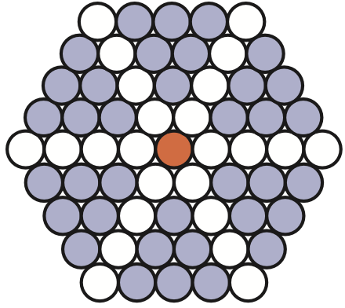
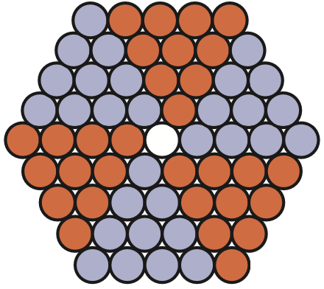
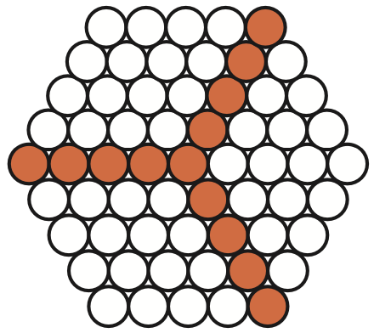
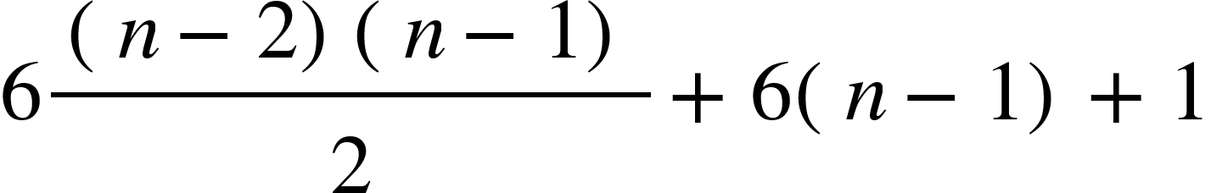
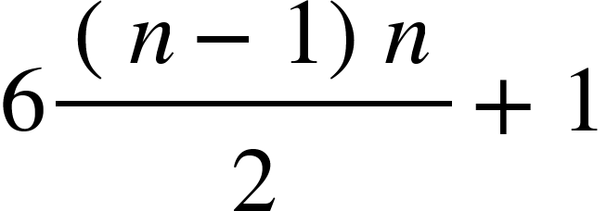
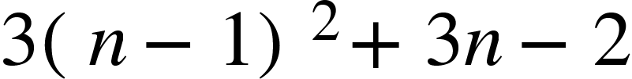
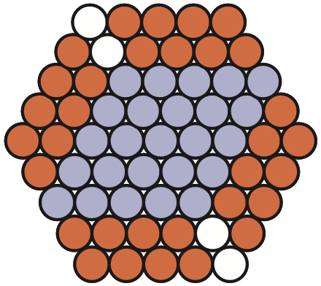
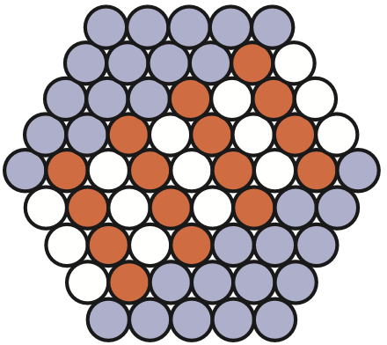
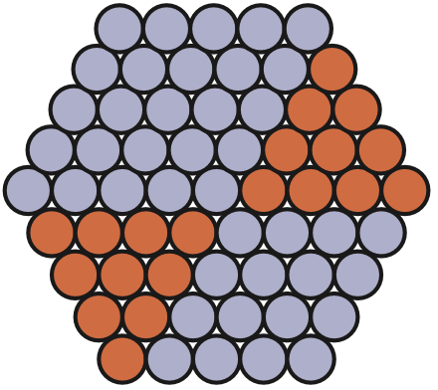
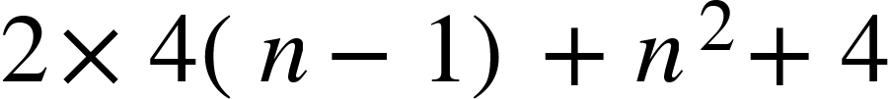
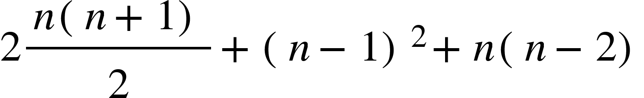
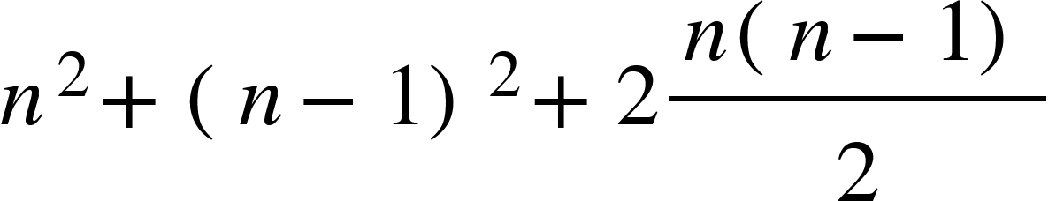
General Hexagon Count
Use each of the following to suggest formulae for the number of cells
in a regular hexagon with n cells on the edge. Do they all ‘work’?
Need to check same colouring on other sized examples,
then provide a narrative

Slide 19
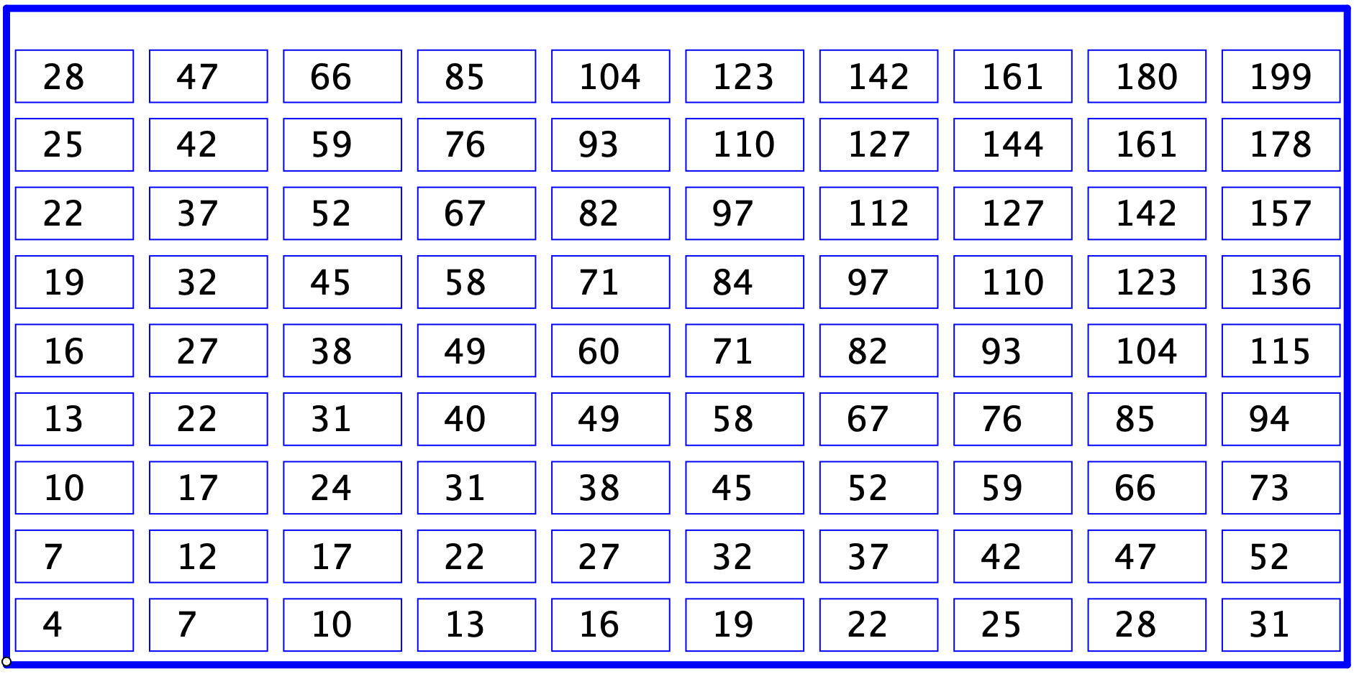
Sundaram’s Grid
Double any entry and add 1
What can be varied?
Your answer is composite (not prime)
Need to express general entry in row r and column c;
Need to manipulate that to see why doubling and adding 1 makes it composite
THEN explore what variations in conclusion are forced by changes in the grid

Slide 20
Recall: School Arithmetic is to Mathematics, as Making Sounds is to Music:
Tunes as series of sounds
Harmony as parallel sets of sounds
Byway to consider: series and parallel arithmetic (Ellerman)

Slide 21
Rate (Rational) Reasoning
distance = speed x time
(number of objects) = (objects per person) x (number of persons)
Voltage = current x resistance
Volume = flow x time
Suppose p = r x a
“it takes a amounts at rate r to produce p”
series
If r₁ and r₂ are working together for the same amount a,
then p = (r₁ + r₂)a is the combined effect achieved
If r₁ and r₂ are working jointly to achieve a fixed p,
then p/r₁ and p/r₂ are the corresponding amounts to produce p individually
so working together, p = r x (p/r₁ + p/r₂)
which makes the joint (parallel) rate r = 1/(1/r₁ + 1/r₂).
Parallel
If a₁ and a₂ are each required to achieve p separately,
then they operate at rates of p/a₁ and p/a₂ respectively.
Working together to achieve p, p = (p/a₁ + p/a₂)a so
together they need an amount a = 1/(1/a₁ + 1/a₂) to achieve p
Parallel

Slide 22
Summary
Analogy
  School Arithmetic is to Mathematics,
  as Making Sounds is to Music
Tracking Arithmetic
  Re-attracting algebra-refusers
Structure of Attention
  Mathematical; giving and receiving
Expressing Generality
  A lesson without opportunity for learners to generalise
  is NOT a mathematics lesson
  Doesn’t include generalisations such as “algebra is not for me”
Multiple Expressions for the same thing
  Manipulating Symbols for a Reason
Reflection
  Vital role of personal narrative construction

Slide 23
Attention Conjecture
Holding Wholes (Gazing)
Discerning Details
Recognising Relationships
Perceiving Properties as being instantiated
Reasoning on the basis of (agreed) properties
If teacher and learners are attending to different things
Or if they are attending differently
Then communication is likely to be impoverished at best
Attending Mathematically
Attending to learners
Being attended to by learners

Slide 24
Fundamental Steps To Algebra
Expressing Generality
  At any age, whenever
  often as possible
Multiple Expressions for the same thing
  Motivating and informing algebraic manipulation
Constructing Variations
  Enriching personal example space
Personal Narratives
  More substantial and reliable than memorised procedures

Slide 25
Remarks on Maths Education Research
What is it for?
  Academic careers?
  Path of personal development?
  Improving the experience of learners?
  Making predictions?
  Informing choices?
Theories are sets of labels for distinctions
  Does making the distinction make a difference?
  Seeking differences that make a difference (Bateson)
Recasting insights in the current vernacular

Slide 26
Useful Constructs?
‘Theories’
Actions
Reification
Objectification
Procepts
Semiotics
Responsive Teaching
Activity theory
Cognitive Load
Working Memory Limitations
Variation Principle
(beyond ‘same & different’)
Tracking Arithmetic
Personal Narrative
(own explanation)
Expressing Generality
Co-variation principle
Manipulating–Getting-a-sense-of–Articulating
Doing–Talking–Recording
Shifting Attention
Activating learner’s powers

Slide 27
Taking Things Further
www.PMTheta.com
Mason, J. with Johnston-Wilder, S. & Graham, A. (2005). Developing Thinking in Algebra. London: Sage (Paul Chapman).
Mason, J. (2018). How Early is Too Early for Thinking Algebraically?. In C. Kieran (ed.) Teaching and Learning Algebraic Thinking with 5- to 12-Year Olds: the global evolution of an emerging field of research and practice. ICME13 Springer
Mason, J. (2017). Overcoming the Algebra Barrier: being particular about the general, and generally looking beyond the particular, in homage to Mary Boole. In S. Stewart (Ed.) And the Rest is Just Algebra. Springer p97-117.
Mason, J. (2011). Envisioning What Is Possible in the Teaching and Learning of Algebra. In Jinfa Cai & Eric Knuth (Eds). Early Algebraization: a global dialogue from multiple perspectives. Advances in Mathematics Education, Springer p557-578.
Mason, J. (2008). Making Use of Children’s Powers to Produce Algebraic Thinking. In J. Kaput, D. Carraher & M. Blanton (Eds.) Algebra in the Early Grades. Lawrence Erlbaum. New York. p57-94.
Mason, J. (2005). Exploiting Mathematical Opportunities Afforded by Mathematical Tasks: a case study of shifting from arithmetical to algebraic thinking. In C. Bergsten & B. Grevholm (Eds.). Conceptions of mathematics: proceedings of NORMA 01, Third Nordic Conference on Mathematics Education. Linköping: SMDF. p20-32.
Mason, J. 2002, Generalisation and Algebra: exploiting children's powers. In L. Haggerty (Ed.) Aspects of Teaching Secondary Mathematics: perspectives on practice, RoutledgeFalmer, London, p105-120. ISBN 0-415-26081-7
Mason, J. 2001, On The Use and Abuse of Word Problems For Moving from Arithmetic to Algebra, in H. Chick, K. Stacey, J. Vincent & J. Vincent (Eds.) The Future Of The Teaching And Learning Of Algebra, Proceedings of the 12th ICMI Study Conference, University of Melbourne, Melbourne, p430-437.

Slide 28
Series & Parallel Arithmetics
www.ellerman.org/series-parallel-duality-part-i-combating-series-chauvinism/
www.ellerman.org/sp-duality/

